Slide 1
Grocery Bridge™
Diya
Sihan
Zhongjie

Slide 2
What is Grocery Bridge™ ?
A powerful solution: brings online customer to offline grocery stores
An easy to use add-on: increase profit and competitiveness for website
An accurate market and user data provider

Slide 3




Why do they need Grocery Bridge™ ?
For our customer: Grocery Stores
Today’s grocery store are lacking customer channel
(Hard to push ads)
Heavy competition with other stores (Price war)
Absence of market data (who is buying what in where?)

Slide 4



Why do they need Grocery Bridge™ ?
For our partner: (Recipe) Website owner
No effective income channel.
Traditional ads has limited Pay-per-Click. (Due to poor accuracy)
Lack of diversity

Slide 5
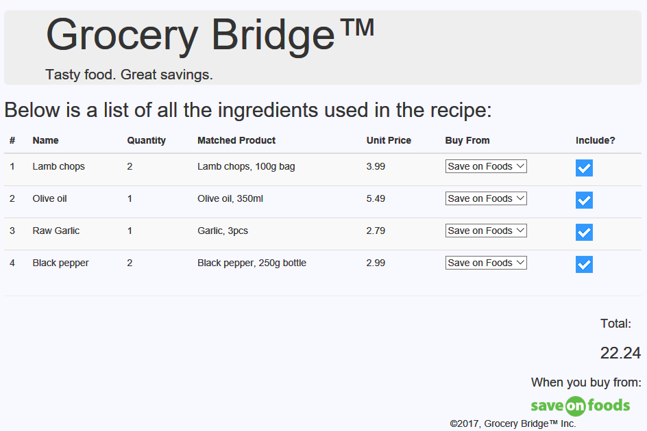
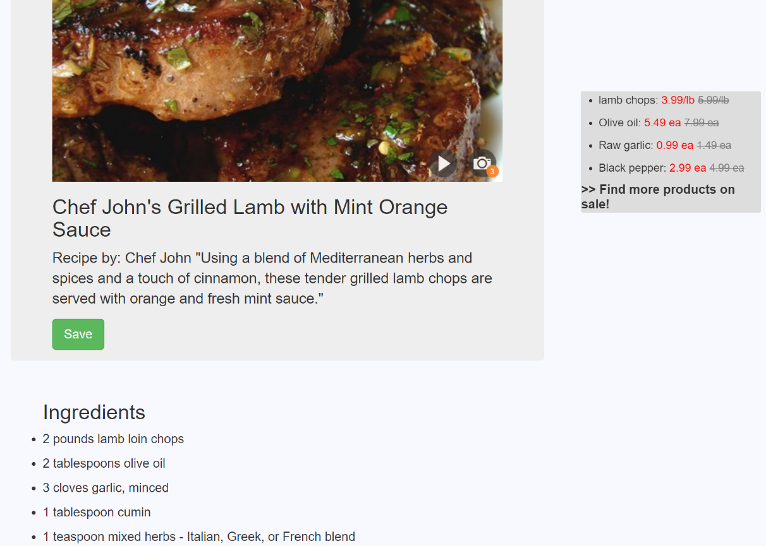
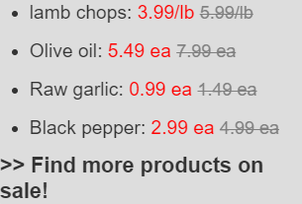
How does Grocery Bridge™ work?

Slide 6
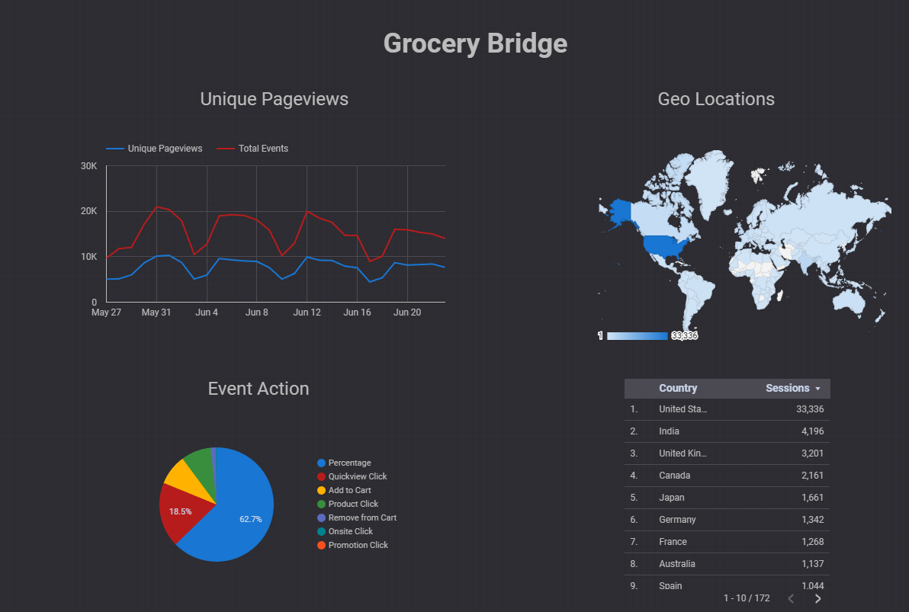
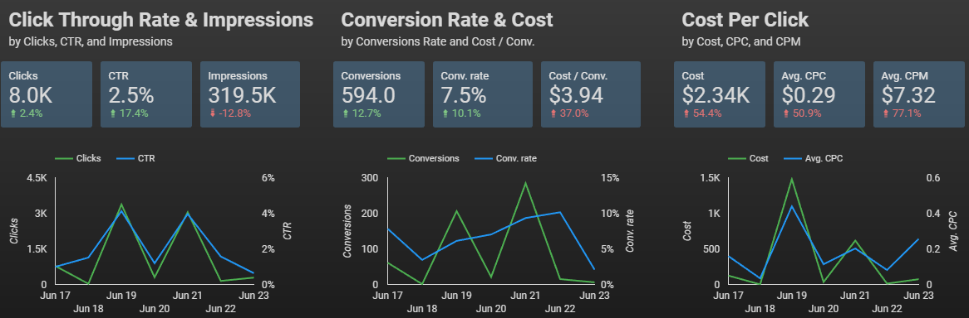
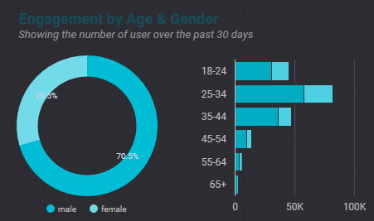
How does Grocery Bridge™ work?

Slide 7
How does Grocery Bridge™ make profit ?
Profit
Program development
PPC to Website
Misc. cost
Cost
Sell anonymous data to third party
CPC from Grocery Stores
Revenue

Slide 8
Thank you
Diya
Sihan
Zhongjie

