Slide 1
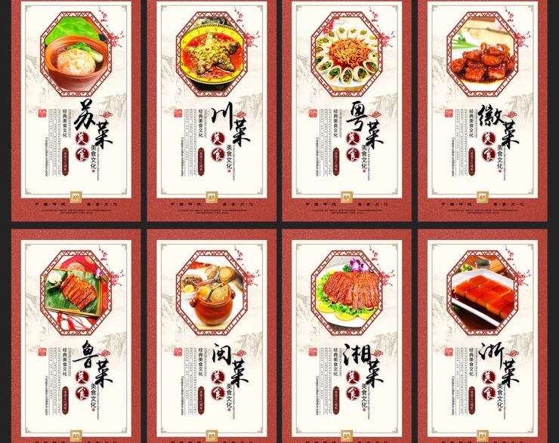
Meals 一日三餐
Diya Ren
Sihan Bo
Zhongjie Shen

Slide 2
What to have ?
How to make ?
Where to buy ?

Slide 3
Market Demand
People need to know where to buy ingredients
New immigrants have language barrier
Lack of Asian recipes on the Internet

Slide 4
Target Users
New immigrants
Students
Everyone…

Slide 5

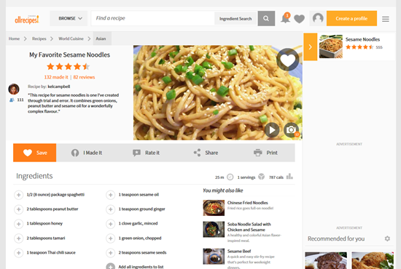
Channels
App
Sidebar on website
Meals
一日三餐

Slide 6
Workflow
Choose Recipe
List Ingredients
Detailed quantity and nutrition info
Show price in stores
Integrate coupon and discount information
Popular recipes
User rated
Display prices across stores

Slide 7
Profit Analytics
Store commission
Push Ads
User data

Slide 8
Future plan
Expand service to national wide
Expand service categories
One-click order

Slide 9
Thank you

