Slide 1

Walmart Sales Analysis
Understanding Sales Performance from 2010–2012
Diya Sarah James · Data Analyst Portfolio Project

Slide 2

BUSINESS PROBLEM
What Are We Trying to Understand?
Walmart operates across multiple stores, generating large volumes of weekly sales data. This project analyzes sales performance across 2010, 2011, and 2012 to identify meaningful trends and patterns.
Year-over-Year
Store-Level
Annual sales performance comparison
Performance across 45 stores
Seasonal Trends
External Factors
Monthly and holiday patterns
Temperature, fuel, CPI, unemployment
Key Question: "How did Walmart's sales performance change between 2010 and 2012, and what key patterns can be identified across stores, months, holidays, and external factors?"

Slide 3
DATASET & SCOPE
Project Data at a Glance
6,435
45
Weekly Sales Records
Walmart Stores
3
8
Years Analyzed
Original Variables
2010, 2011 & 2012
Original Variables
Engineered Features
Store
Date
Weekly Sales
Holiday Flag
Temperature
Fuel Price
CPI
Unemployment
Additional date-based features were created during data preparation to support time-series analysis:
Year — Annual grouping
Month — Seasonal analysis
Day — Granular breakdown
Month Name — Readable labels

Slide 4

METHODOLOGY
Data Preparation & Analysis Workflow
A structured, end-to-end pipeline transformed raw Walmart sales data into actionable business insights.
Raw Data
Python
SQL
Power BI
Insights
Each stage builds on the last — from cleaning and structuring raw data in Python, to querying with SQL, and finally visualizing results in an interactive Power BI dashboard for stakeholder-ready reporting.

Slide 5
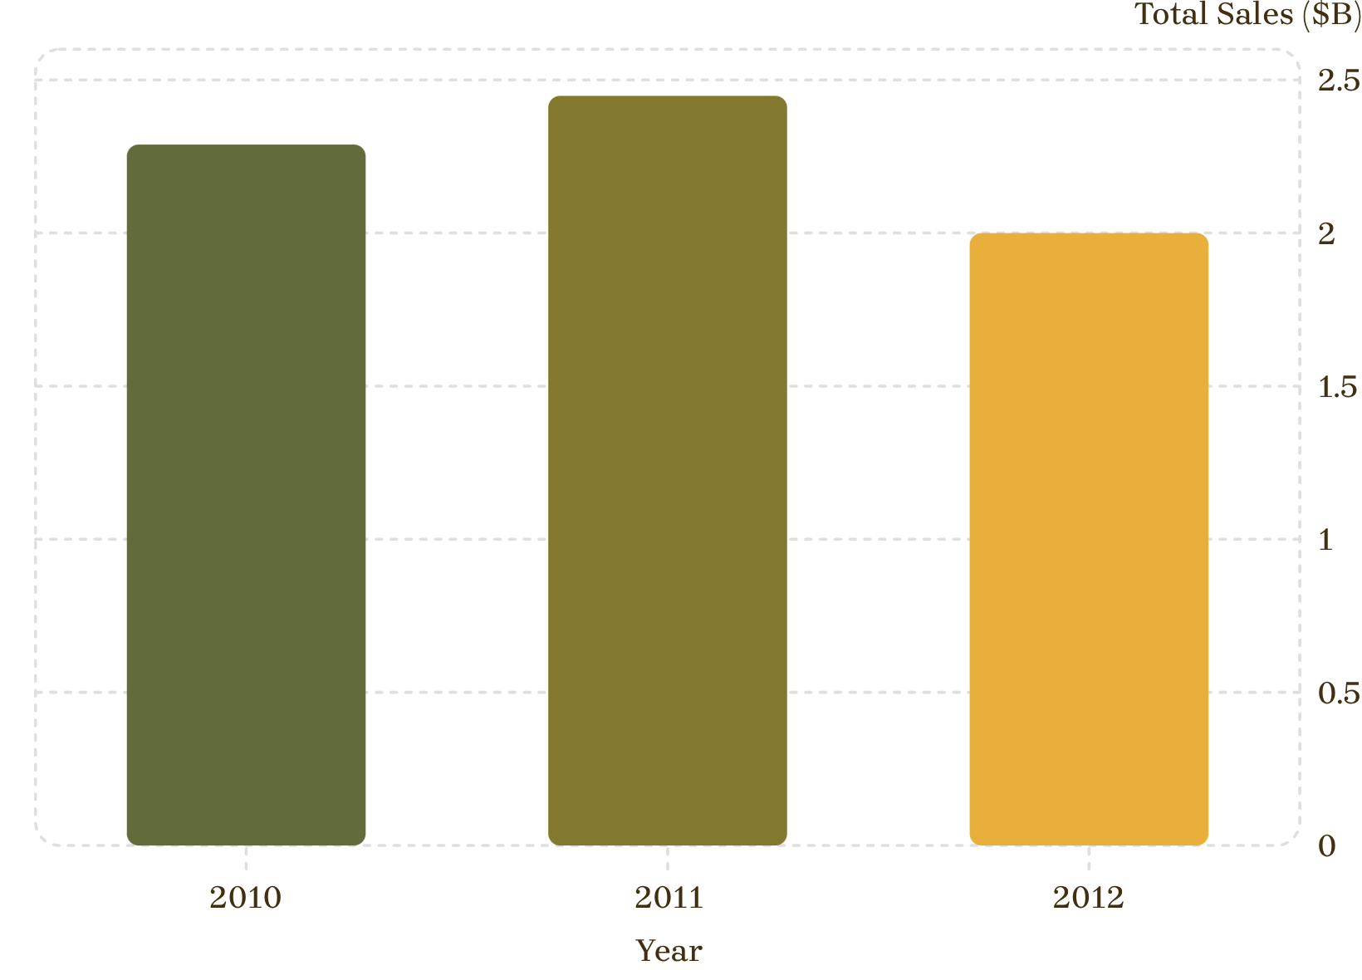
YEAR-OVER-YEAR PERFORMANCE
Total Sales by Year: 2010–2012
Key Observation
2011 recorded the highest total sales among the three years at $2.448B, while 2012 recorded the lowest at $2.000B.
Sales rose from 2010 to 2011, then declined in 2012. This pattern suggests shifting market conditions or operational changes worth further investigation.

Slide 6
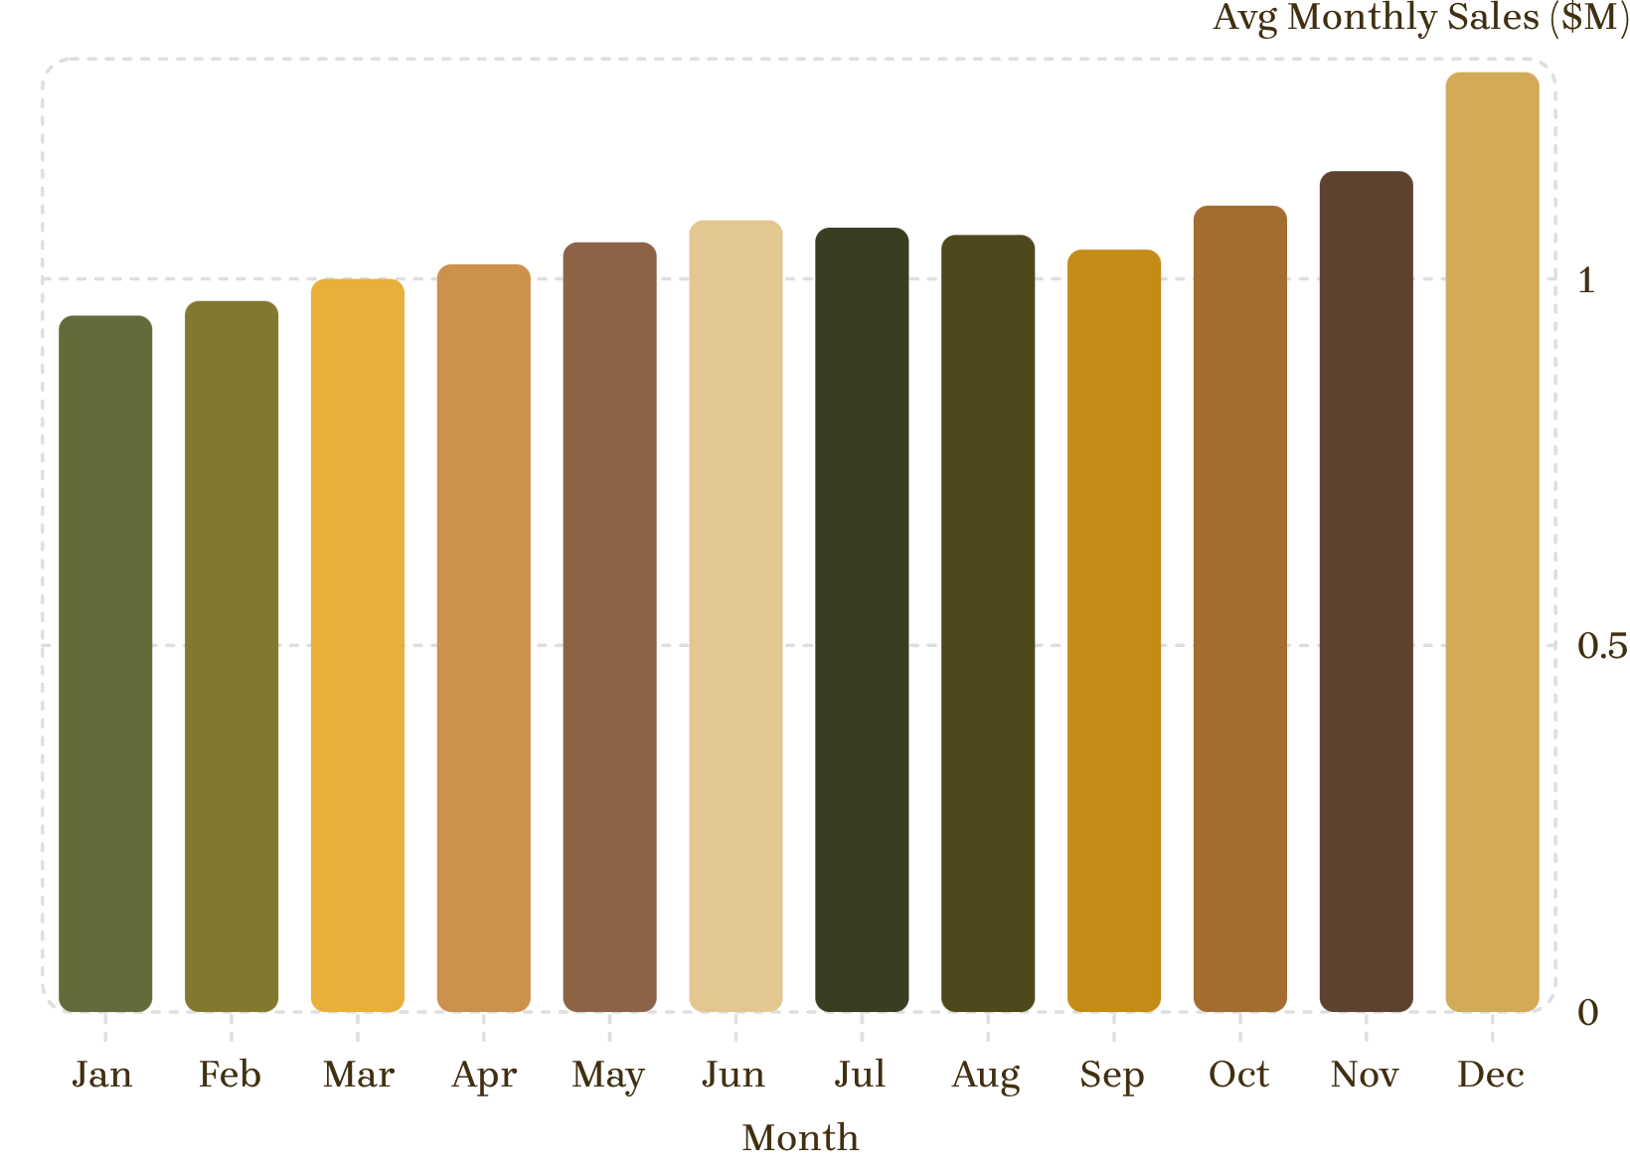
SEASONAL TRENDS
Monthly Average Sales: Identifying Peak Seasons
Seasonal Insight
December had the highest average monthly sales at $1.282M, followed by November at $1.147M.
The year-end surge reflects strong holiday shopping behavior. Identifying these seasonal peaks supports better planning around inventory, staffing, and promotional campaigns.
Note: Monthly values for Jan–Oct are illustrative placeholders. Replace with actual computed values from your analysis.

Slide 7
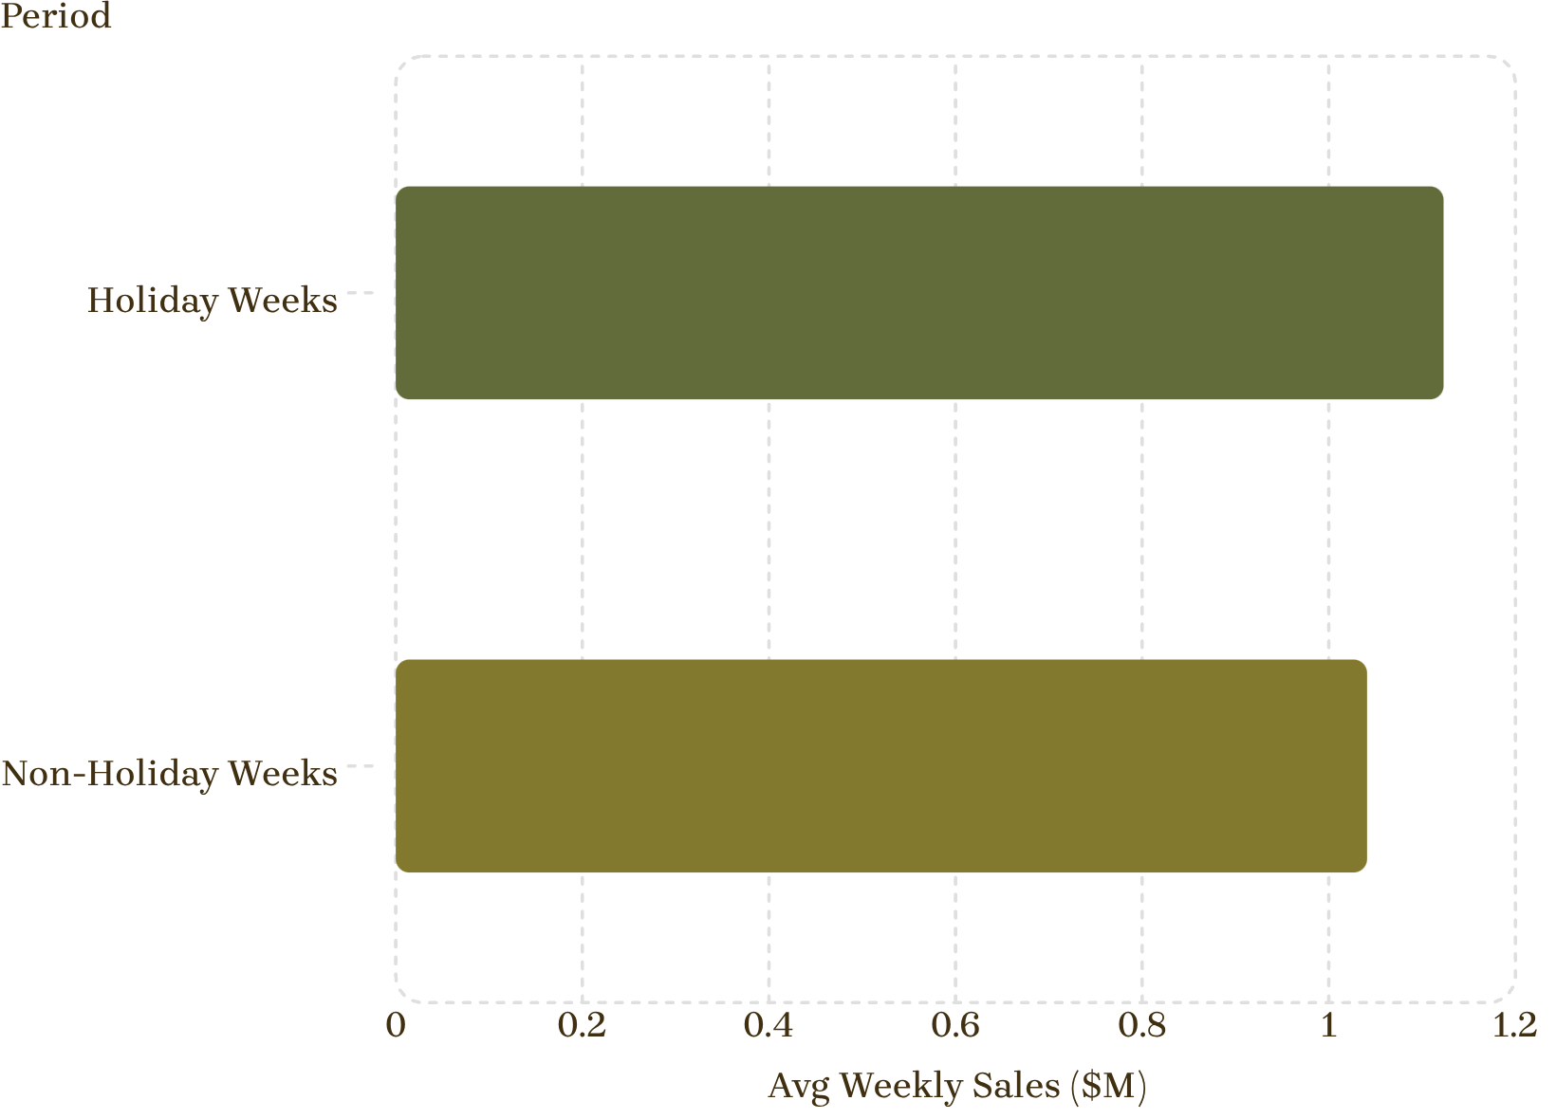
HOLIDAY ANALYSIS
Holiday vs. Non-Holiday Weekly Sales
Key Finding
Average weekly sales were higher during holiday weeks ($1.123M) compared to non-holiday weeks ($1.041M) across the analyzed dataset.
This consistent uplift during holiday periods highlights the importance of targeted promotions and inventory preparation around key calendar events.
This analysis identifies an association in historical data and does not establish that holidays alone caused the difference.

Slide 8
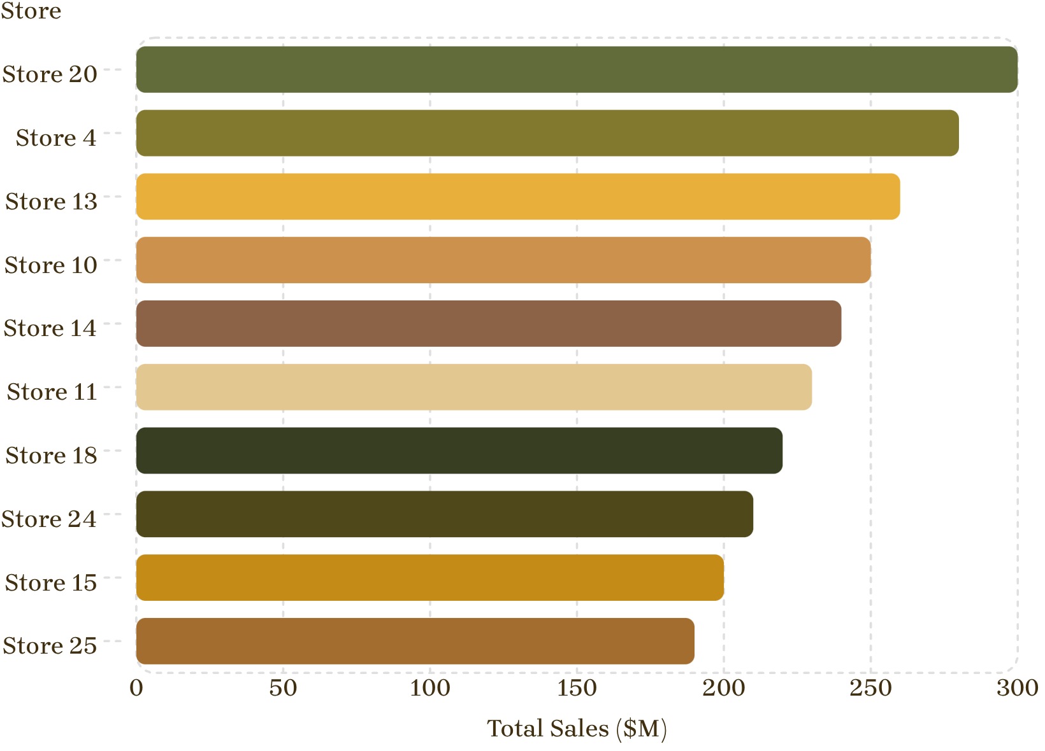
STORE PERFORMANCE
Top 10 Stores by Total Sales
Store-Level Insights
Store performance varies considerably across the 45 locations. Identifying high-performing stores helps understand where sales are most concentrated.
Supports resource allocation decisions
Informs inventory planning by location
Enables performance benchmarking across stores
Chart values are illustrative placeholders. Reference the Power BI dashboard for actual store-level figures.

Slide 9
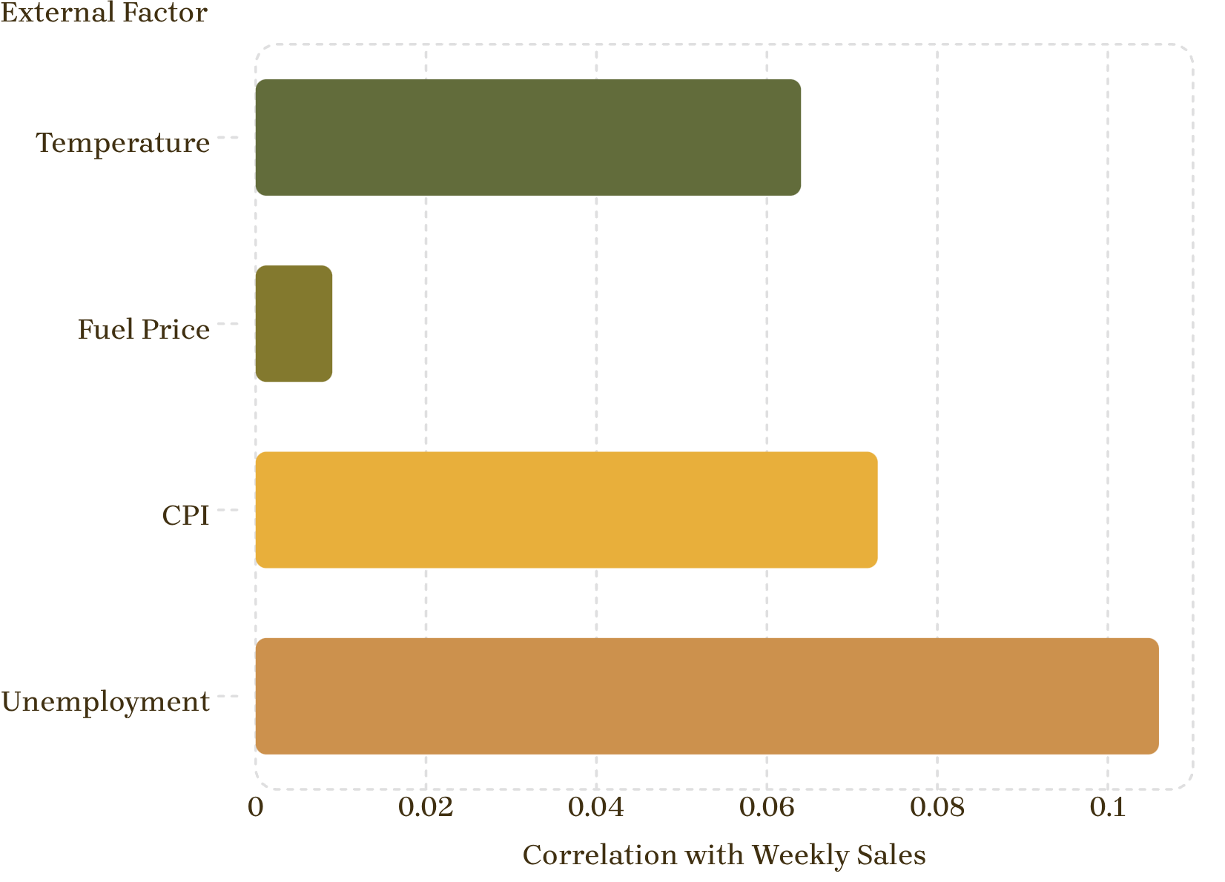
EXTERNAL FACTORS
Correlation Analysis: Sales vs. External Variables
What the Data Shows
All four external factors show weak linear correlations with weekly sales in this dataset:
These results indicate that none of these individual variables shows a strong linear relationship with weekly sales — though they may still have meaningful impact in combination with other factors.
Temperature: −0.064
Fuel Price: 0.009
CPI: −0.073
Unemployment: −0.106

Slide 10
CONCLUSION
Key Insights & Takeaways
📈 2011 Peak
🎄 Seasonal Lift
🎉 Holiday Uplift
Highest total sales at $2.448B; 2012 declined to $2.000B
December led monthly averages at $1.282M; November second at $1.147M
Holiday weeks averaged $1.123M vs. $1.041M for non-holiday weeks
🏪 Store Variation
🌡️ External Factors
Performance varies considerably across all 45 stores
Temperature, fuel, CPI, and unemployment showed weak linear correlations
"Turning historical sales data into actionable business insights."

