Slide 1
BREAST CANCER ANALYTICS • MEDICAL AI DECK
Breast Cancer
Predictive Analytics
Classification • Shrinkage Methods • Visualization • Diagnostics
A full statistical analysis of the Wisconsin Diagnostic Breast Cancer dataset.
Covering Problems 1–7: EDA, Logistic Regression, Ridge, LASSO, KNN, Naive Bayes.
Rows
Predictors
Best Accuracy
Class Split
569
30
97.4%
357/212

Slide 2
BREAST CANCER ANALYTICS • CONTENTS
Analysis Overview
Click any section to explore the full analysis.
P1
P2
P3
P4
Data Understanding
Logistic vs Linear
Multiple Regression
Diagnostics
Structure, distributions,
scatter plots, boxplots.
Simple vs multiple regression.
Model comparison.
Full model, significant
predictors, prediction.
VIF, multicollinearity,
outliers & influence.
View →
View →
View →
View →
P5
P6
P7
★
Model Selection
Shrinkage Methods
Classification
Conclusion
Train/test MSE,
cross-validation.
Ridge & LASSO paths.
Feature selection.
Logistic, KNN, Naive
Bayes + ROC curves.
Best model & key findings
summarised.
View →
View →
View →
View →

Slide 3
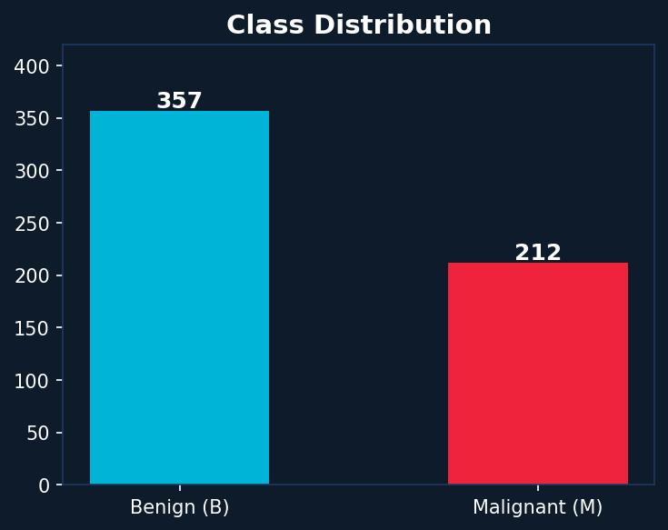
BREAST CANCER ANALYTICS • PROBLEM 1 – DATA UNDERSTANDING
Dataset Overview
Wisconsin Diagnostic Breast Cancer (WDBC) Dataset
Dataset Facts
Observations
569 patients
Features
30 numeric predictors
Response
diagnosis (B / M)
Benign (B)
357 cases (62.7%)
Malignant (M)
212 cases (37.3%)
Missing Values
None
Feature Groups
Mean, SE, Worst × 10

Slide 4
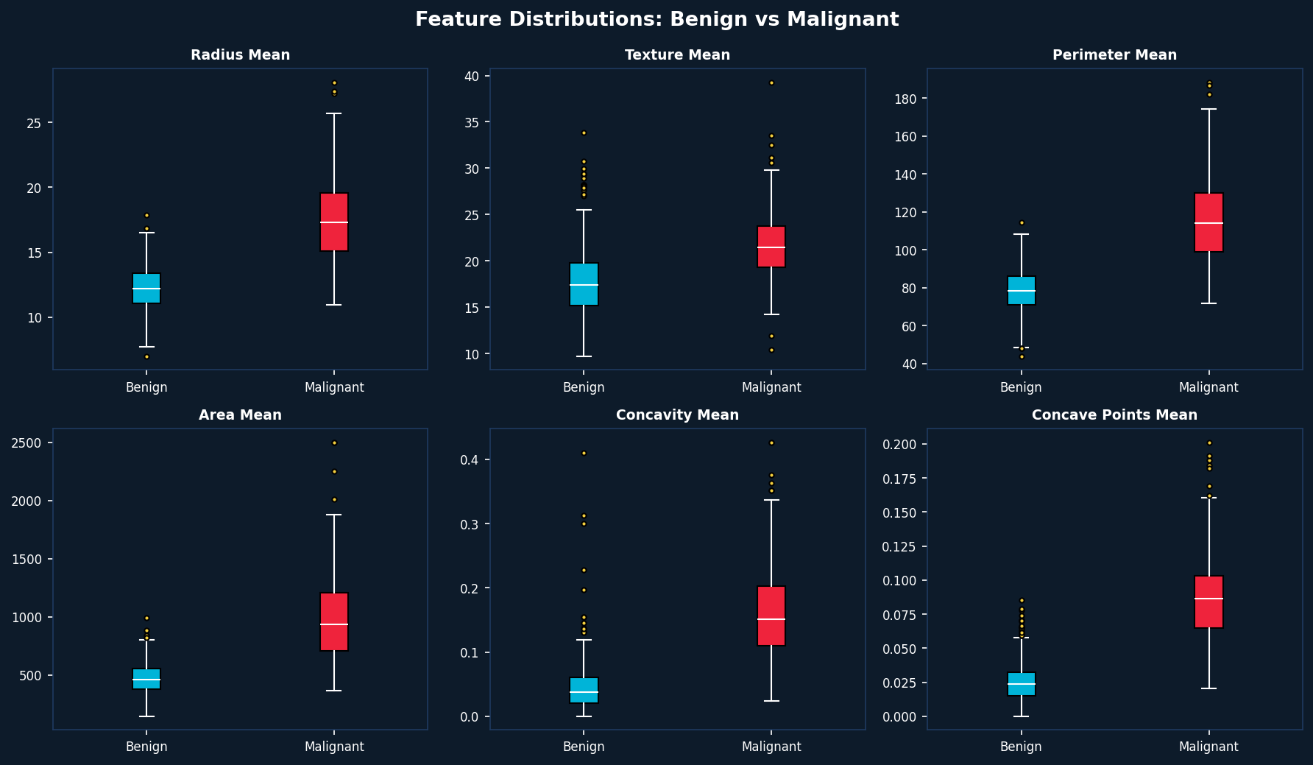
BREAST CANCER ANALYTICS • PROBLEM 1 – EDA & OUTLIER DETECTION
Feature Distributions & Outliers
Key Finding: Malignant tumors show higher median values and greater spread across all 6 features. Yellow dots are outliers — mostly extreme Malignant cases with unusually large cell areas.

Slide 5
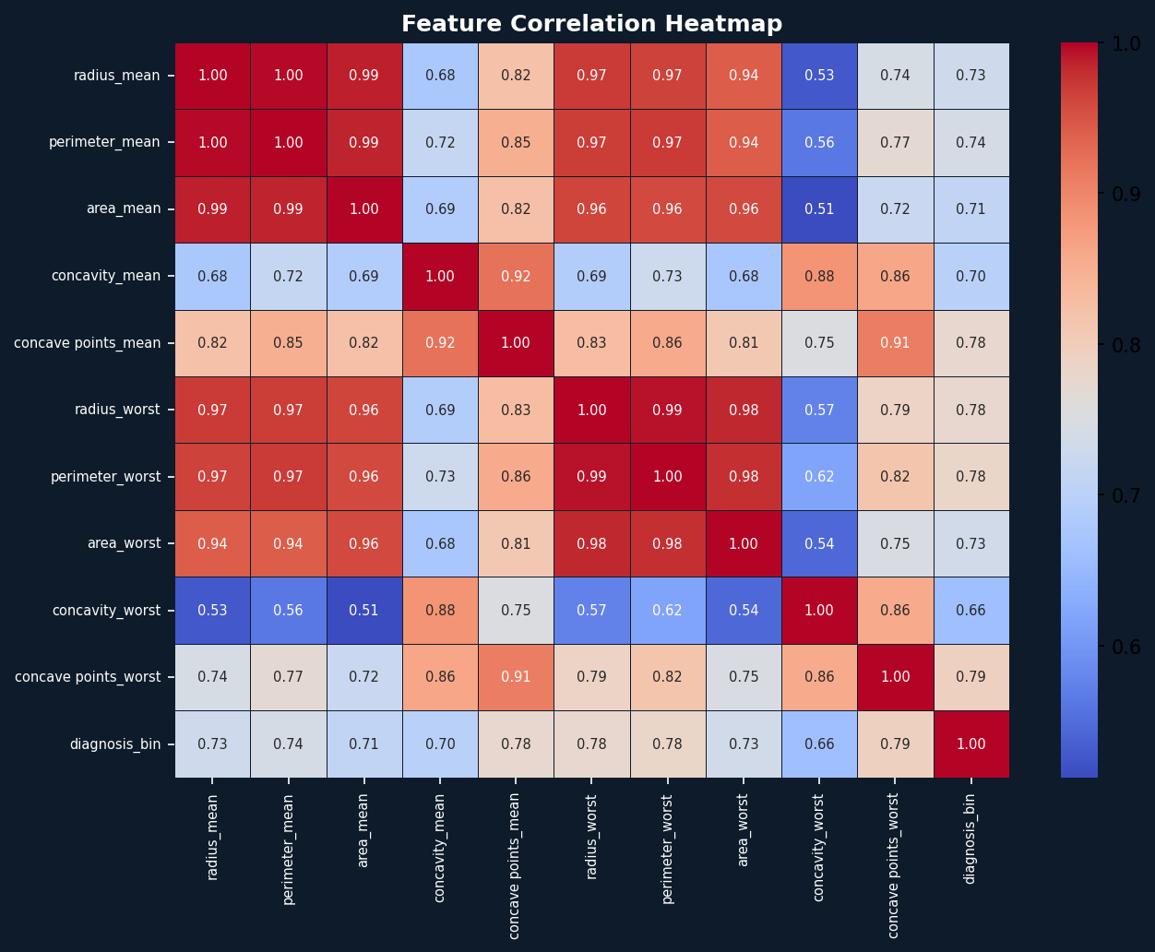
BREAST CANCER ANALYTICS • PROBLEM 4 – MULTICOLLINEARITY CHECK
Correlation Heatmap
Multicollinearity Notes
High correlation
radius, area, and perimeter are nearly collinear (r > 0.98)
Impact
Causes inflated VIF values and unstable regression coefficients
Solution
Ridge / LASSO shrinkage handles multicollinearity by penalizing coefficients
Diagnosis target
Strongest predictors: concave points_worst (r=0.79), perimeter_worst (r=0.78)

Slide 6
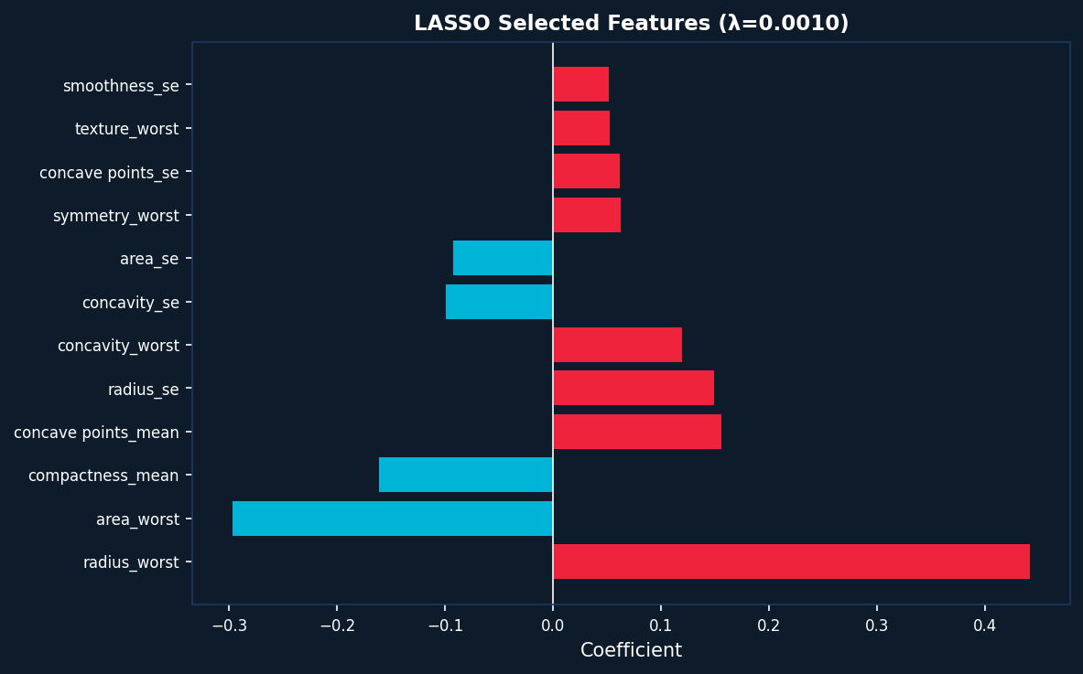
BREAST CANCER ANALYTICS • PROBLEM 6 – SHRINKAGE METHODS
Ridge & LASSO Regression
Ridge vs LASSO
Property
Ridge
LASSO
Penalty type
L2 (squared)
L1 (absolute)
Coefs → 0?
Never exactly
Yes (sparse)
Feature select
No
Yes
Best for
All features
relevant
Many irrelevant
features
WDBC result
Coefficients
shrunk
23 / 30 features
selected
LASSO Finding: At optimal λ = 0.001 (5-fold CV), LASSO selects 23 of 30 features. Red bars = features increasing malignancy risk. Blue bars = protective features.

Slide 7
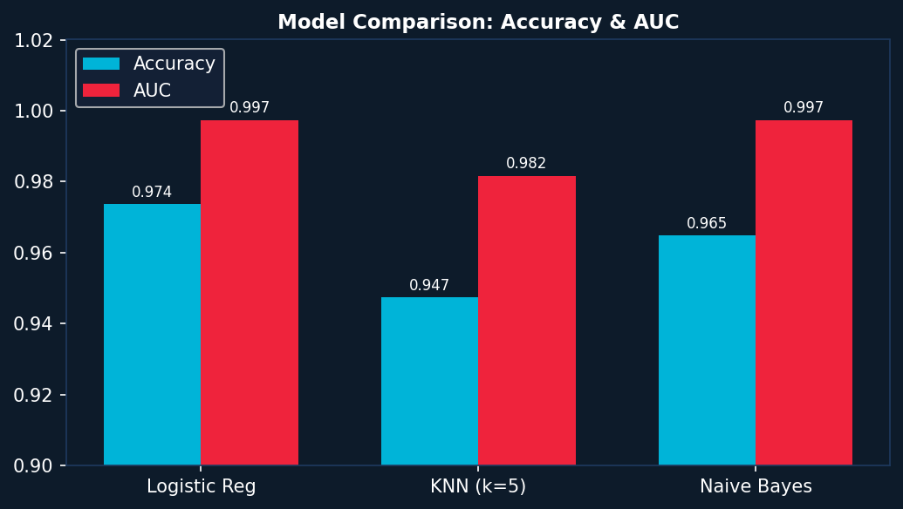
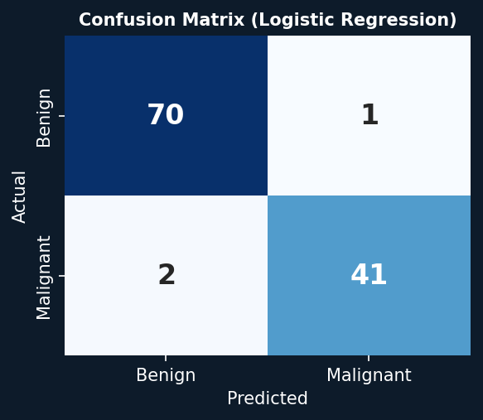
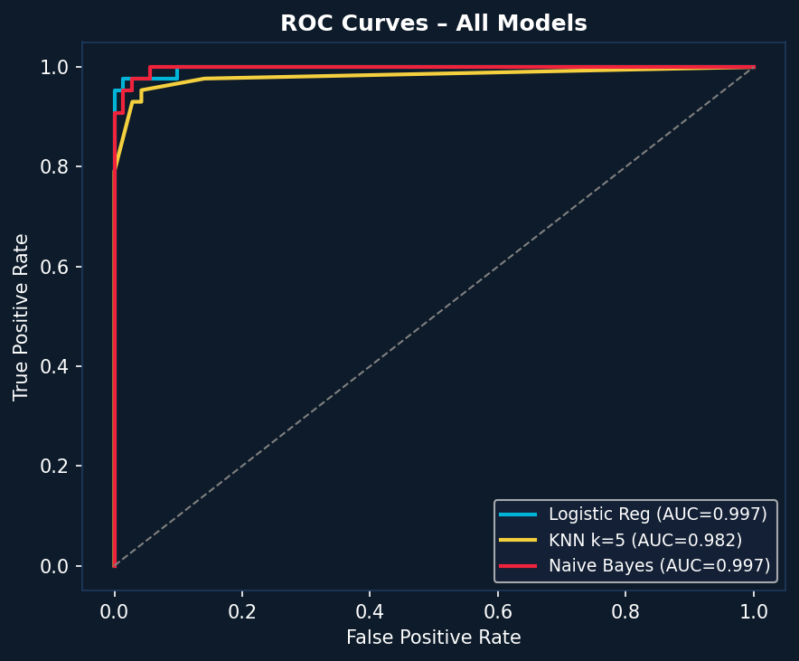
BREAST CANCER ANALYTICS • PROBLEM 7 – CLASSIFICATION METHODS
Classification Results
Model Performance
Model
Acc.
AUC
Logistic Reg
97.4%
0.997
KNN (k=5)
94.7%
0.982
Naive Bayes
96.5%
0.997
★ Best: Logistic Regression

Slide 8
BREAST CANCER ANALYTICS • PROBLEM 7 – ROC CURVES & CONFUSION MATRIX
Model Evaluation
Logistic Reg: only 3 errors (1 FP + 2 FN) on 114 test cases. AUC = 0.997 means near-perfect class separation.

Slide 9
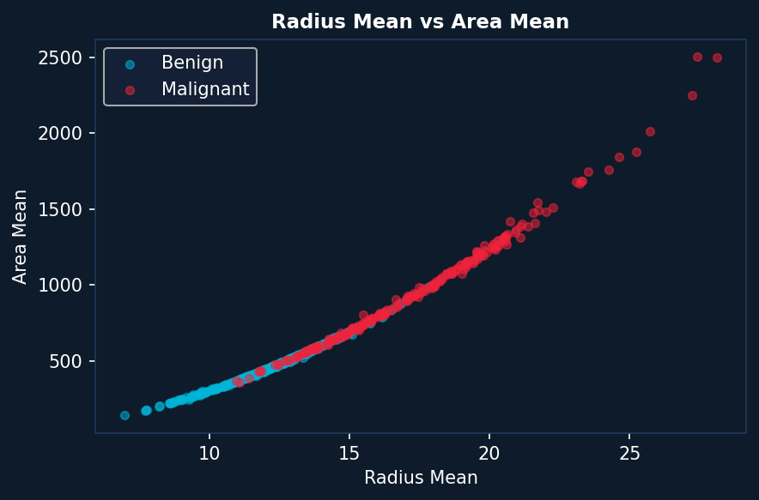
BREAST CANCER ANALYTICS • PROBLEM 1 – SCATTER ANALYSIS
Feature Scatter: Radius vs Area
Interpretation
▸ Clear separation between Benign (blue) and Malignant (red) clusters
▸ Malignant tumors occupy higher radius and area space
▸ Some overlap region exists — justifying ML model over simple threshold
▸ Strong linear trend between radius_mean and area_mean confirms collinearity
▸ This pattern repeats across most shape features

Slide 10
BREAST CANCER ANALYTICS • CONCLUSION
Conclusion & Takeaways
Best Model
Key Predictors
Feature Selection
Logistic Regression
Acc=97.4%, AUC=0.997
concave points_worst
perimeter_worst, radius_worst
LASSO selects 23/30
features at λ=0.001
Multicollinearity
Clinical Insight
Dataset
High VIF in radius, area,
perimeter (use Ridge/LASSO)
Irregular cell shapes are
the strongest cancer signal
569 patients, no missing
data, well-structured
Analysis by: Statistical Learning Methods | Dataset: UCI WDBC | Tools: Python · scikit-learn · Matplotlib

