Slide 1

30 DAYS SQL
Challenge
By Diya Shah

Slide 2
WORK SCHEDULE
01. Introduction | 02.CREATE Statement | 03.Filtering Data with WHERE | 04.Sorting Data with ORDER BY | 05.Aggregate Functions & GROUPBY
06.HAVING Clause | 07.SQL Practice & Quiz | 08.Joins-Basics | 09. Advanced Joins | 10.Subqueries
11.SET Operations | 12.String Functions | 13.Date And Time Operations | 14.Intermediate SQL Quiz | 15.Advanced Aggregate Functions
16. Windows Functions | 17. Common Table Expressions | 18. Indexes & Optimizations | 19.Transaction & Concurrency Control | 20. SQL Practice Quiz
21.Data Modeling and Normalization | 22.Stored Procedures and Functions | 23.Triggers and Events | 24.Data Import and Export | 25.SQL For Analytics
26.Error Handling and Debugging | 27. SQL Security | 28.Real World Project | 29.Final Revision | 30.FINAL ASSESSMENT
Welcome to 30 days SQL challenge

Slide 3

INTRODUCTION
Welcome to Day 1 of your SQL learning journey! 🎉
Every app you use—whether it's Instagram, Amazon, Netflix, or your banking app—stores massive amounts of data behind the scenes. SQL is the language that allows us to communicate with that data, making it one of the most valuable skills in data analytics, data science, software development, and business intelligence.
Today, we'll build a strong foundation by understanding what SQL is, why it matters, and how it powers modern data-driven applications.
Welcome to 30 days SQL challenge

Slide 4
SQL
Structured Query Language
SQL (Structured Query Language) is the standard language used to interact with relational databases. It enables users to store, retrieve, manage, and analyze data efficiently.
Think of SQL as a translator between you and the database. Instead of manually searching through millions of records, you can simply write a SQL query and get exactly the information you need within seconds.
With SQL, you can:
✅ Retrieve specific information from large datasets
✅ Add new records to a database
✅ Update existing information
✅ Delete unwanted data
✅ Create and modify database structures
✅ Control user access and permissions
✅ Generate reports and business insights
WHAT CAN YOU DO WITH SQL?

Slide 5
WHY LEARN SQL?
DATA SCIENCE
DATA ANALYTICS
DATABASE ADMINISTRATION
SOFTWARE DEVELOPMENT
WEB DEVELOPMENT
DATA STORAGE
SALES REPORTING
DATABASE MANAGEMENT

Slide 6
INFOGRAPHICS
WHAT IS DATABASE?
SQL SYNTAX
A database is an organized collection of data that is stored electronically and designed for easy access, management, and retrieval. It helps businesses store large amounts of information efficiently and securely
SQL uses simple English-like commands to interact with databases.
Example:
SELECT * FROM table_name;
Meaning:
SELECT → Retrieve data
* → All columns
FROM → Specify the table
table_name → Name of the table
DIFFERENT TYPES OF DATABASES?
IMPORTANT TERMINOLOGIES
Relational Databases (SQL-based, e.g., MySQL, PostgreSQL).
Non-Relational Databases (NoSQL, e.g., MongoDB).
Tables, Rows, and Columns.
Data Types and Primary Keys.

Slide 7
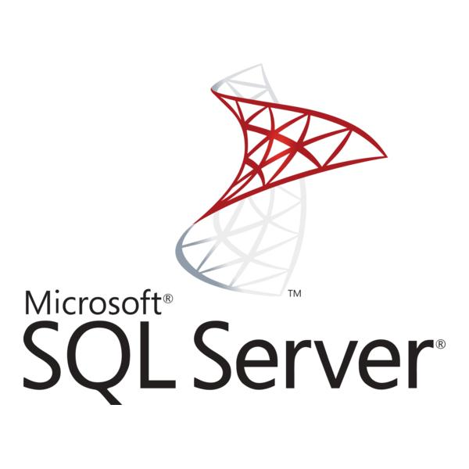

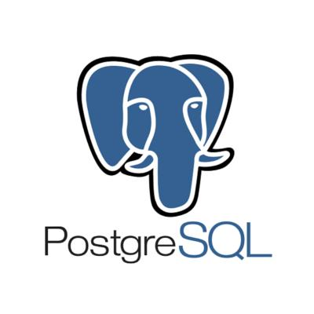

TYPES OF SQL
MySQL
SQL Server
A relational database management system developed by Microsoft, designed for enterprise-level applications and business intelligence.
An open-source relational database management system known for its speed, simplicity, and widespread use in web applications.
PostgreSQL
SQLite
A lightweight, serverless database that stores the entire database in a single file.
An advanced open-source relational database known for reliability, scalability, and support for complex queries.

Slide 8
SQL INSTALLATION GUIDE
Before diving into SQL, it’s important to set up a SQL environment on your system. Below are the installation instructions for various popular SQL database management systems.
1. MySQL Installation
Windows
Download MySQL Installer from the official website.
Run the installer and follow the installation wizard. Choose "Developer Default" to install MySQL Server and MySQL Workbench.
Set a root password when prompted during installation.
Complete the installation and launch MySQL Workbench to interact with your database.
macOS
Download MySQL DMG Archive from the official website.
Follow the instructions to install it.
Open System Preferences and click on the MySQL icon to start the server.
Use the Terminal to access the MySQL server by typing mysql -u root -p.
Linux (Ubuntu/Debian)
Open a terminal and run: sudo apt update sudo apt install mysql-server
Secure your MySQL installation: sudo mysql_secure_installation
After installation, log into MySQL using: sudo mysql -u root -p

Slide 9
2. PostgreSQL Installation
Windows
Download the PostgreSQL installer from EnterpriseDB.
Run the installer and follow the on-screen instructions.
Set a password for the default postgres role.
Open pgAdmin or use the command line to interact with your database.
macOS
Install PostgreSQL using Homebrew: brew install postgresql
Start the PostgreSQL service: brew services start postgresql
Access PostgreSQL through the terminal: psql postgres
Linux (Ubuntu/Debian)
Open a terminal and install PostgreSQL: sudo apt update sudo apt install postgresql postgresql-contrib
Switch to the PostgreSQL user: sudo -i -u postgres
Access PostgreSQL: psql

Slide 10
3. SQLite Installation
SQLite is a lightweight, file-based SQL database, useful for smaller projects or testing.
Windows
Download the precompiled binaries from SQLite Downloads Page.
Extract the downloaded file and place it in a folder (e.g., C:\sqlite).
Add the SQLite directory to your system’s PATH for easy access.
Open Command Prompt and type sqlite3 to interact with SQLite.
macOS
SQLite is pre-installed on macOS. Open Terminal and type:
sqlite3
Linux (Ubuntu/Debian)
Install SQLite via the terminal: sudo apt update sudo apt install sqlite3
Run SQLite:
sqlite3

Slide 11
4. SQL Server Installation (Microsoft SQL Server)
Windows
Download the SQL Server installer from the Microsoft website.
Run the installer and choose "Basic" or "Custom" installation.
Set up your SQL Server instance and authentication settings.
Use SQL Server Management Studio (SSMS) to manage your databases.
macOS (Using Docker)
Install Docker for macOS from the Docker website.
Pull the SQL Server Docker image: docker pull mcr.microsoft.com/mssql/server
Run the SQL Server container: docker run -e 'ACCEPT_EULA=Y' -e 'SA_PASSWORD=YourPassword123' -p 1433:1433 --name sql_server_container -d mcr.microsoft.com/mssql/server
Use a SQL client like Azure Data Studio or connect via sqlcmd to manage your database.

Slide 12
TERMINOLOGY
METADATA
Databases: contains one or more tables.
Relation: contains tuples / attributes.
Tuple: A set of fields which generally represent an "object" like a person/must person /music track .... ROWS
Attribute: one of the possibly many elements of data corresponding to the object represented by rows... COLUMNS.
Schema: A logical container inside a database. group related objects (tabres, views, procedures)
Metadata: describes the structure of the database
Primary Key: A unique identifier for each row in a table.
Foreign key: A column in one tare that references the primary key of another tables.
Indexes: The position of a curtain relation/data in a table
View: A virtual table created from ansgL query. doesn't store data, only shows results.
Query: A request to the databases to fetch and manipulate data.
Constraint: Rules applied on table columns to ensure data integrity
PROJECT | DATA
ROW-1
ROW-2
ROW-3
ROW-4
ROW-5
ATTRIBUTE
RELATIONSHIP
SCHEMA

Slide 13
CONCLUSIONS
Congratulations on completing Day 1 of your SQL journey! 🎉
Today, you built the foundation needed to work with databases and understand how SQL is used to manage and retrieve data.
You learned what a database is, explored the different types of databases, understood the role of SQL in modern applications, and became familiar with essential concepts such as tables, rows, columns, data types, and primary keys.
You also got your first glimpse of SQL syntax and discovered how SQL acts as the bridge between raw data and meaningful insights.

Slide 14
THANK YOU

