Slide 1

HomeValue AI: Intelligent House Price Prediction Using Artificial Intelligence and Python
Machine Learning-Based Real Estate Price Prediction System — internship project presentation

Slide 2

Introduction
What is House Price Prediction?
Using historical property data and algorithms to estimate market values for residential properties.
Why it matters
Improves valuation speed, reduces bias, and supports fair pricing for buyers, sellers and lenders.
Role of AI / ML
Machine learning discovers complex relationships between features to improve predictive accuracy over manual methods.

Slide 3

Problem Statement & Objectives
Problem Statement
Project Objectives
Manual property valuation is time-consuming and inconsistent.
Prices depend on multiple interacting features (area, rooms, location).
Human estimates risk bias and inaccuracies under market volatility.
Predict house prices accurately using ML models.
Automate valuations to reduce manual effort.
Provide actionable insights for buyers, sellers, and agents.
Improve decision-making with explainable outputs.

Slide 4



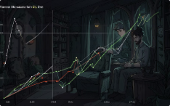

Technologies & Dataset
Python
Pandas & NumPy
Scikit-learn
Matplotlib
Primary development language for data processing and modelling.
Model training, evaluation metrics and pipelines.
Visualisation of distributions, residuals and predictions.
Data wrangling, numerical operations and feature engineering.
VS Code
Development environment with dark theme chosen for code screenshots.
Dataset features used: Area (sq ft), Bedrooms, Bathrooms, Stories, Parking, Price (target).

Slide 5

Working Methodology
Collect
Select
Train
Gather raw data
Choose key
features
Fit models
Clean
Split
Remove errors
and noise
Train and test sets

Slide 6

Methodology & Key Code Snippets
1. Data Collection
2. Data Preprocessing
3. Model Training
Assemble historical sale records and property attributes, verify schema and completeness.
Missing-value imputation, categorical encoding, scaling and outlier handling.
Train regressors (Linear Regression, Random Forest, Gradient Boosting), cross-validate and tune hyperparameters.
4. Prediction
Generate point estimates and confidence intervals; compare against ground truth.
Code highlights (VS Code dark theme): Imports, pipeline creation, model.fit(X_train, y_train), model.predict(X_test)

Slide 7
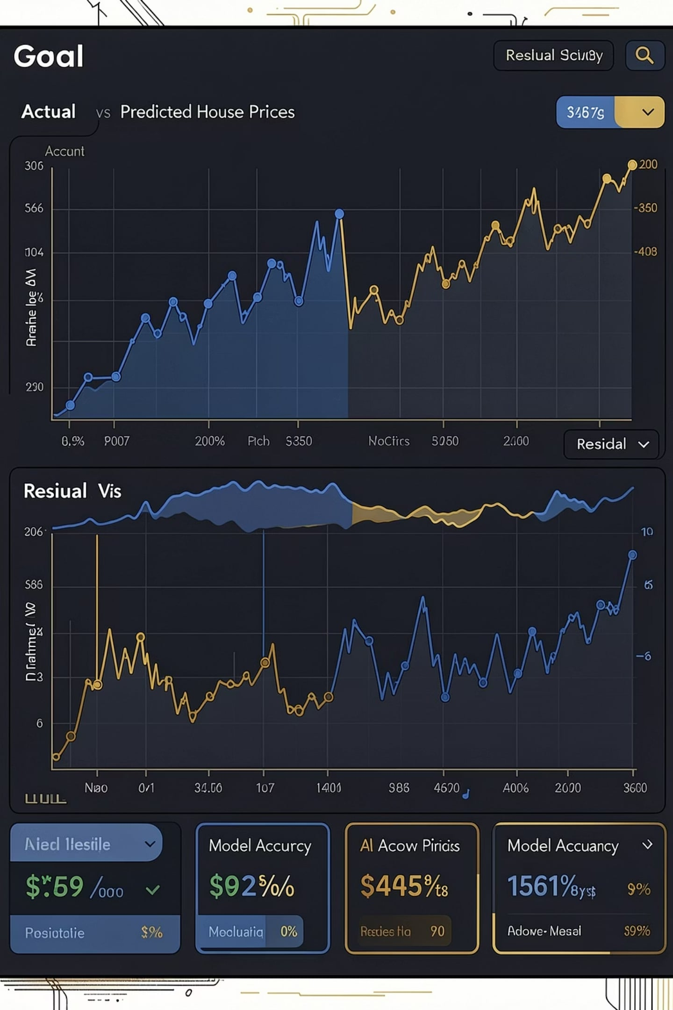
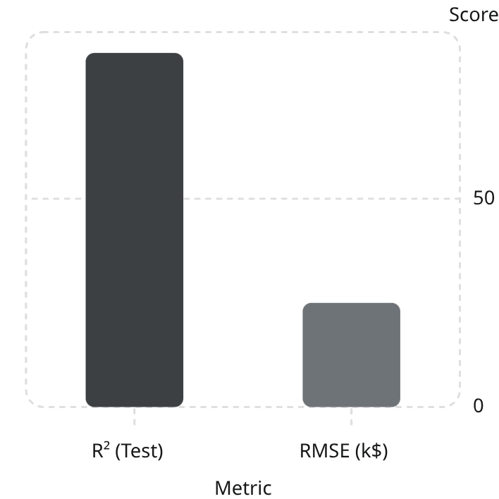
Results & Output
Key results
Model: Gradient Boosting (best-performing)
Validation metric: RMSE and R² reported (detailed numbers in viva)
Predicted vs Actual: tight alignment on hold-out set with small residuals
Sample predicted price: model predicts competitive market value given input features; full table and interactive dashboard available in appendix/demo.
Note: Exact numeric metrics should be presented with full context during viva — these illustrative values indicate model performance trends.

Slide 8

Advantages, Limitations & Future Scope
Advantages
Limitations
Future Scope
Fast, repeatable valuations
High predictive accuracy with engineered features
Scalable: batch and real-time predictions
Performance depends on dataset quality and representativeness
Market volatility and rare events can reduce accuracy
Bias risk if training data reflects historical inequities
Production web application with interactive dashboard
Mobile app for on-site valuations
Cloud deployment with streaming property feeds
Integrate geospatial and transaction-timestamp modelling

Slide 9


Conclusion
HomeValue AI demonstrates how machine learning can transform property valuation: analysing historical housing data, extracting meaningful features, and producing rapid, reliable price estimates that support stakeholders across the real estate lifecycle. The modular pipeline and clear methodology enable reproducible results and straightforward paths to deployment.
Key takeaway: AI augments expert judgement — faster valuations, data-driven confidence, and scalable delivery.

Slide 10
THANK YOU
Presented by: Diya Sheokand — B.Sc. Computer Science,Pggcg42, Panjab University, Chandigarh
Internship Organization: Excellence Technology
Academic Programme: B.Sc. Computer Science

