Slide 1
Same medicine, different DNA?
How variants in drug-response genes differ between East Asian and South Asian reference populations, and how to show it
Diya Srivastava
ID: 06774B
Scientific Visualization, MSc Computer Science (LM-18)
Università degli Studi di Milano
11/11/2026
Notes:
Hook: same medicine, different DNA? Then the project question.

Slide 2
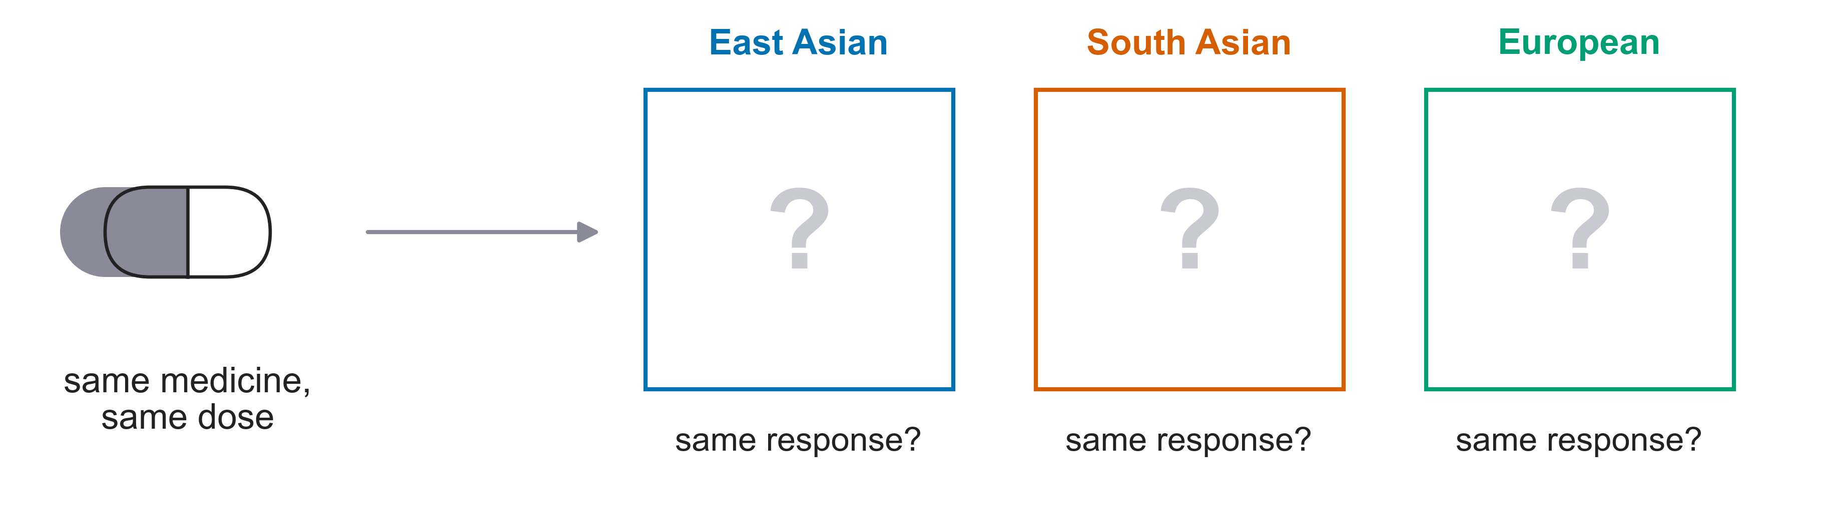
Do the same medicines work the same way for everyone?
Where do populations differ, and how do we show it?
Pharmacogene variation across ancestries
2
Notes:
Project question in plain words. Then: where do populations differ, and how do we show it?

Slide 3
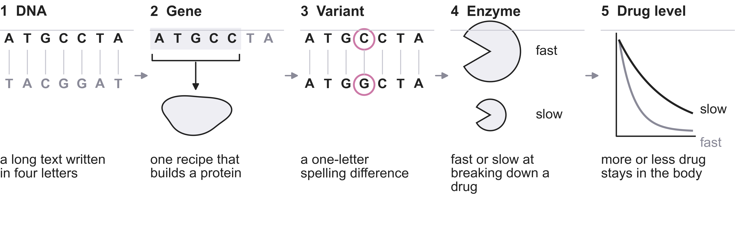
One DNA letter can change how a drug is processed
Figure 1. From DNA sequence to drug level (schematic, not data). Variant = highlighted letter.
Pharmacogene variation across ancestries
3
Notes:
Walk left to right. DNA is a recipe book; a gene is one recipe; a variant is a spelling difference; the enzyme the recipe builds works fast or slow; so drug level differs. Most variants are harmless. This field is pharmacogenomics.

Slide 4
Variants differ by ancestry: the VKORC1 example
Why it matters
Warfarin, a blood thinner, is dosed by gene.
CPIC publishes dosing guidance for VKORC1.
CPIC level A
Figure 2. People carrying the VKORC1 dose-lowering variant, by gnomAD reference group.
Data: gnomAD v4, CPIC. Analysis: this work.
Pharmacogene variation across ancestries
4
Notes:
Real data: VKORC1 dose-lowering variant carried by 99% of East Asians, 61% of Europeans, 32% of South Asians (gnomAD v4 reference groups). Warfarin is a blood thinner. CPIC has dosing guidance for VKORC1 [verify level A]. Carrying a variant means a guideline may apply, not that a different prescription is certain.
The gene is found on ch16 ans involved vitamin K epoxide reductase complex subunit 1 enzyme, an integral membrane protein in the liver's endoplasmic reticulum and affects blood clotting.

Slide 5
Open reference groups approximate two of Singapore's three communities
Singapore community
Open reference group
What this means
Chinese
East Asian
Reference groups, not residents
No Malay group (SG10K dataset not publicly available)
Frequency is not drug response
Malay
no open group
Indian
South Asian
Reference groups stand in for ancestry, not for residents.
Pharmacogene variation across ancestries
5
Notes:
Singapore: Chinese, Malay and Indian communities [verify]. gnomAD East Asian and South Asian groups stand in for Chinese and Indian ancestry; they are reference populations, not Singapore residents. gnomAD v4 has no Malay group. Plan change: the Singapore Genome Variation Project page now needs a university login (checked 2026-11-10) [verify], so we use open sources: gnomAD and CPIC. Carrying a variant means a guideline may apply, not that a different prescription is certain.

Slide 6
Three open sources feed one analysis
gnomAD v4
how common each variant is, per group
Analysis
107 CPIC genes: 21 level A, 86 other
81 random genes
Figures
F1 to F7
CPIC
which genes matter for which drugs
119 genes requested, 117 in gnomAD, 107 analysed
HGNC
official gene names: random comparison genes
120 requested, 117 returned, 81 passed filters
Accessed 2026-11-10 through public APIs and downloads, no login.
Pharmacogene variation across ancestries
6
Notes:
gnomAD: how common is each variant in each group. CPIC: which genes matter for which drugs. HGNC: official gene names, used only to draw random comparison genes. Counts are from our pulls on 2026-11-10: CPIC 119 genes requested, 117 returned by gnomAD, 107 analysed (21 level A, 86 other); random genes 120 requested, 117 returned, 81 passed filters.
HGNC is a resource for approved human gene nomenclature containing ~42000 gene symbols and names and 1300+ gene families and sets.

Slide 7
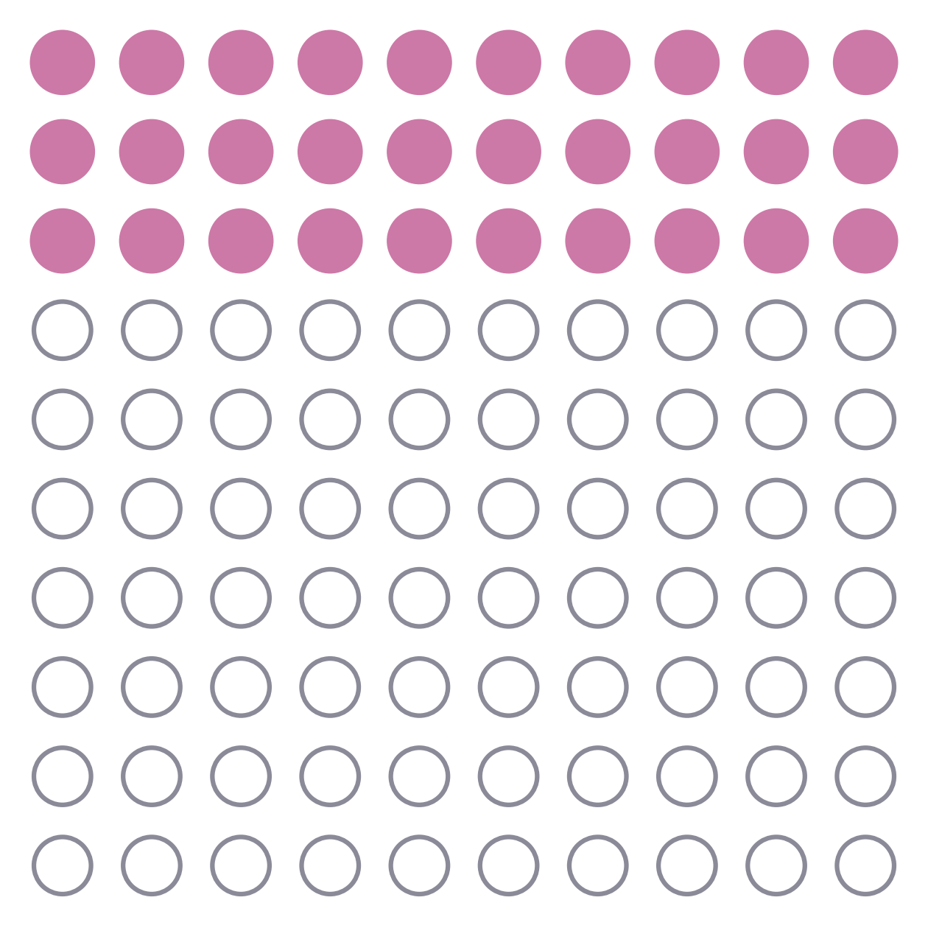
gnomAD shares variant counts per group, not genomes
PRODUCED BY
Broad Institute and collaborators
SOURCE
sequencing studies, pooled
CONTENTS
variant counts, not individuals
GROUPS
inferred ancestry labels
ACCESS
public API, no login
Figure 3. Allele frequency: how common a variant is. 30 of 100 carry it: 30%.
Illustration, not data.
Pharmacogene variation across ancestries
7
Notes:
gnomAD = Genome Aggregation Database, run by the Broad Institute [verify]. Data: DNA sequencing of very many people from research studies, pooled, anonymised and aggregated; order of a million people [verify]. Groups are genetic-ancestry labels inferred from the data, coarse [verify wording]. Access: public GraphQL API, no login, pulled 2026-11-10. Frequency = share carrying the variant; strictly allele frequency counts DNA copies, each person has two [verify].

Slide 8
CPIC grades each gene-drug pair from A to D
A
A: strongest evidence
PUBLISHES
21 genes
peer-reviewed dosing guidelines
B
11 genes
WE TAKE
genes, pairs, variants, effects
C
21 genes
D
54 genes
Evidence grade per gene-drug pair; bar length = genes analysed at that level
Pharmacogene variation across ancestries
8
Notes:
CPIC = Clinical Pharmacogenetics Implementation Consortium, an international expert group [verify]. Publishes peer-reviewed guidelines on adjusting a drug or dose by gene. Levels A to D; A = strongest evidence, action recommended [verify exact wording]. We take the gene list, the gene-drug pairs, and the defined variants and what they do.
CPIC evaluates specific genes to help doctors adjust drug selection or dosage based on a patient's genetic test results

Slide 9
Five questions structure the analysis
Q1
Which pharmacogenes differ most in allele frequency between East and South Asian reference populations?
Q2
Are genes with CPIC level A dosing guidelines more divergent than other pharmacogenes?
Q3
For selected gene-drug pairs, what share of each ancestry group carries a variant that CPIC links to altered drug response?
Q4
Are pharmacogenes more divergent between East and South Asians than random genes?
Q5
Does the population structure seen through pharmacogenes differ from that seen through random genes?
Pharmacogene variation across ancestries
9
Notes:
Read each question as written. Q1 descriptive; Q2 hypothesis test; Q3 clinically framed; Q4 baseline comparison; Q5 control.

Slide 10
Seven methods, each answering one question
1 FST
2 Gene level
3 Per-variant test
4 Permutation test
How different two groups' frequencies are (0 = identical)
A gene's variants pooled, not averaged (Bhatia ratio of sums)
Chi-square per variant, Benjamini-Hochberg over 3,313 tests
Shuffle labels: could chance explain it?
Q1
Q1, Q2
Q1
Q2, Q4
5 Random baseline
6 Carrier rate
7 PCA
81 random genes, same filters
Share carrying a curated CPIC allele (Hardy-Weinberg)
Summarises all groups on two axes
Q4
Q3
Q5
Pharmacogene variation across ancestries
10
Notes:
FST: how different two groups' variant frequencies are, 0 = identical; Hudson estimator, chosen over Weir-Cockerham because it does not assume the two groups are equally diverged [verify]. Gene level: the gene's common variants pooled, not averaged — Hudson numerators and denominators summed over the gene, the Bhatia et al. ratio-of-averages estimator (MAF at least 1%, at least 5 variants), because averaging per-variant ratios is unstable when a gene has few variants. Per-variant test: 2x2 chi-square on allele counts with Benjamini-Hochberg over all 3,313 tests, to show that significance saturates at this sample size. Permutation test: shuffle labels, chosen because it assumes no distribution for a skewed statistic. Random baseline: 81 non-pharmacogenes with the same filters, so 'more divergent' has something to be more than. Carrier rate: share with at least one curated CPIC allele (Hardy-Weinberg), the quantity a clinician would act on. PCA: deterministic, distances meaningful, no hyperparameters, unlike t-SNE or UMAP.

Slide 11
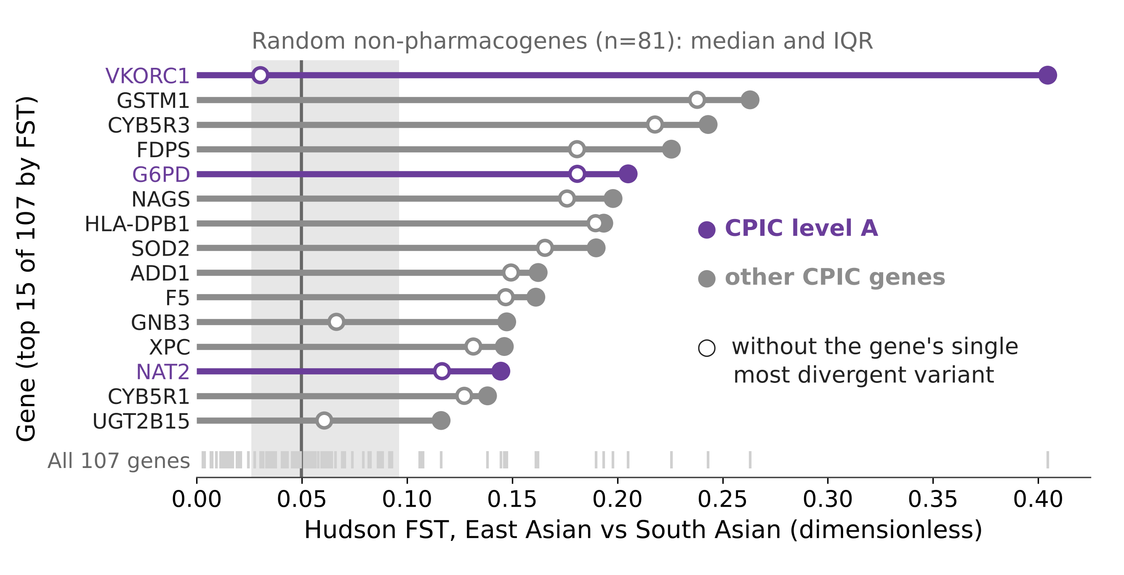
Answering Question 1: VKORC1 is a clear outlier
Finding
VKORC1 is the clear outlier: FST about 0.40.
Drop its most divergent variant and it falls to 0.03, inside the random-gene band.
GSTM1, the next highest, only falls from 0.26 to 0.24.
Figure 4 (Q1). Gene-level Hudson FST, East vs South Asian: top 15 of 107 CPIC genes. Hollow marker: the gene without its single most divergent variant. Grey band: random non-pharmacogenes (n = 81), median and IQR.
Data: gnomAD v4, CPIC. Analysis: this work.
Pharmacogene variation across ancestries
11
Notes:
Divergence is how differently common the same DNA variant is in two groups: zero means both groups carry it at the same rate, and the bigger the number, the further apart they are.
Slide 11 is a lollipop chart. A horizontal stem from zero out to the value, with a filled dot at the end, rows sorted by value. Y
Q1. Higher FST means the two groups differ more. Purple = CPIC level A. Random-gene band: median 0.050 (81 genes). Pharmacogene median 0.047. The slide shows the top 15 of 107 genes for legibility. The hollow markers are a delete-one jackknife asked the other way round: the lowest value obtainable by removing a single variant. VKORC1 is the one gene in the list whose rank rests on a single site — rs9923231, which is also the variant CPIC writes its warfarin dosing guideline about.
Hudson's Fst is a statistical measure used in population genetics to quantify genetic differentiation (distance) between two populations based on allele frequencies or single-nucleotide polymorphisms (SNPs)
Scale of values: Values range from 0 to 1:
0 means the populations share identical allele frequencies (no genetic differentiation).
1 means the populations are completely fixed for different alleles (no shared alleles).
Low values (e.g., a few percent) indicate high gene flow or recent common ancestry, which is typical for human populations across regions
Used in bioinformatics
\(F_{ST}\) stands for Fixation Index (with the subscript ST standing for Subpopulation relative to the Total population).
Breakdown of the Letters
F (Fixation / Inbreeding Coefficient): Originally introduced by geneticist Sewall Wright in the 1920s, F stands for the inbreeding coefficient or "fixation," which measures how close a population is to having only one version of a gene (an allele) fixed at 100% frequency.
S (Subpopulation): Refers to the individual groups or populations being compared.
T (Total): Refers to the combined total population made up of all the subpopulations pooled together.

Slide 12
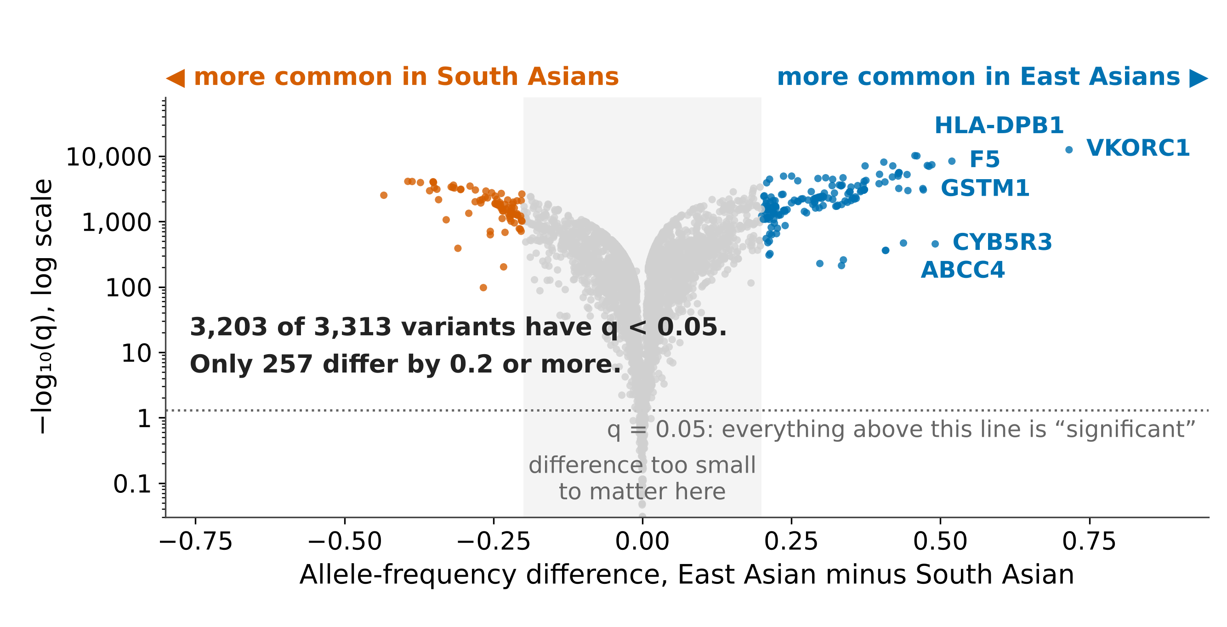
Nearly every variant differs “significantly”; few differ by much
Finding
3,203 of 3,313 variants have q < 0.05 (97%).
Only 257 differ by 0.2 or more.
So we rank genes by the size of the difference, not by the p-value.
Figure 5 (Q1). Every common variant in 117 CPIC genes, East Asian vs South Asian. Chi-square on allele counts, Benjamini-Hochberg over all 3,313 tests. Grey band: difference below 0.2.
Data: gnomAD v4, CPIC. Analysis: this work.
Pharmacogene variation across ancestries
12
Notes:
Q1, and the reason the rest of the talk ranks by effect size. With hundreds of thousands of alleles per group, a two-percentage-point difference already clears q = 0.05, so significance cannot pick out what matters. The y axis is log because the q-values span 0 to 10 to the minus 12,482; nothing is clipped. Counting alleles treats a person's two chromosomes as independent, which inflates significance further. The grey band is our judgement about what is worth attention, not a result.
Left or right = bigger difference; higher = stronger evidence.
I tested every variant one by one, and corrected for having run thousands of tests. Almost all of them came back significant. That tells you the test is measuring how much data I have, not how different the groups are. So for the rest of the talk I rank by the size of the difference instead.
In this slide the figure answers question one at the level of the single variant, ranking by the size of a difference rather than by statistical significance. This figure is a volcano plot, a scatter of all 3,313 common variants, where the x axis is the allele-frequency difference between the two groups, East Asian minus South Asian, running from minus 0.75 on the left to plus 0.75 on the right with a meaningful zero in the middle, and the y axis is the strength of the statistical evidence, written as minus log ten of the adjusted p-value, on a log scale because those values run from one all the way down to ten to the minus twelve thousand. Colour is redundant with the side of zero a point falls on, blue for more common in East Asians, orange for more common in South Asians, and grey for anything inside the narrow band in the middle. The analysis used here was a two-by-two chi-square test on each variant, where the four numbers in the table are how many copies were the reference letter and how many were the variant letter, in each of the two groups, and the test asks whether those four counts are further apart than chance would produce. Because I ran that test 3,313 times, and the usual five per cent threshold means being fooled about one time in twenty, roughly 166 variants would look different by luck alone even if none truly were, so I applied the Benjamini-Hochberg correction, which raises the bar in proportion to the number of tests so that among the variants I finally call different, at most five per cent should be flukes. I chose Benjamini-Hochberg rather than Bonferroni because Bonferroni guards against making even one false claim, which is too strict when I expect many variants to differ for real. What we observe is a V shape with a dense wall of points sitting far above the significance line: 3,203 of the 3,313 variants pass the corrected threshold, which is 97% of them, and only 257 differ by 0.2 or more. So the takeaway is that at gnomAD’s sample size a difference of two percentage points is already enough to be called significant, which means the test is measuring how much data I have rather than how different the groups are, and the only filter that separates the variants worth attention is the size of the difference itself.

Slide 13
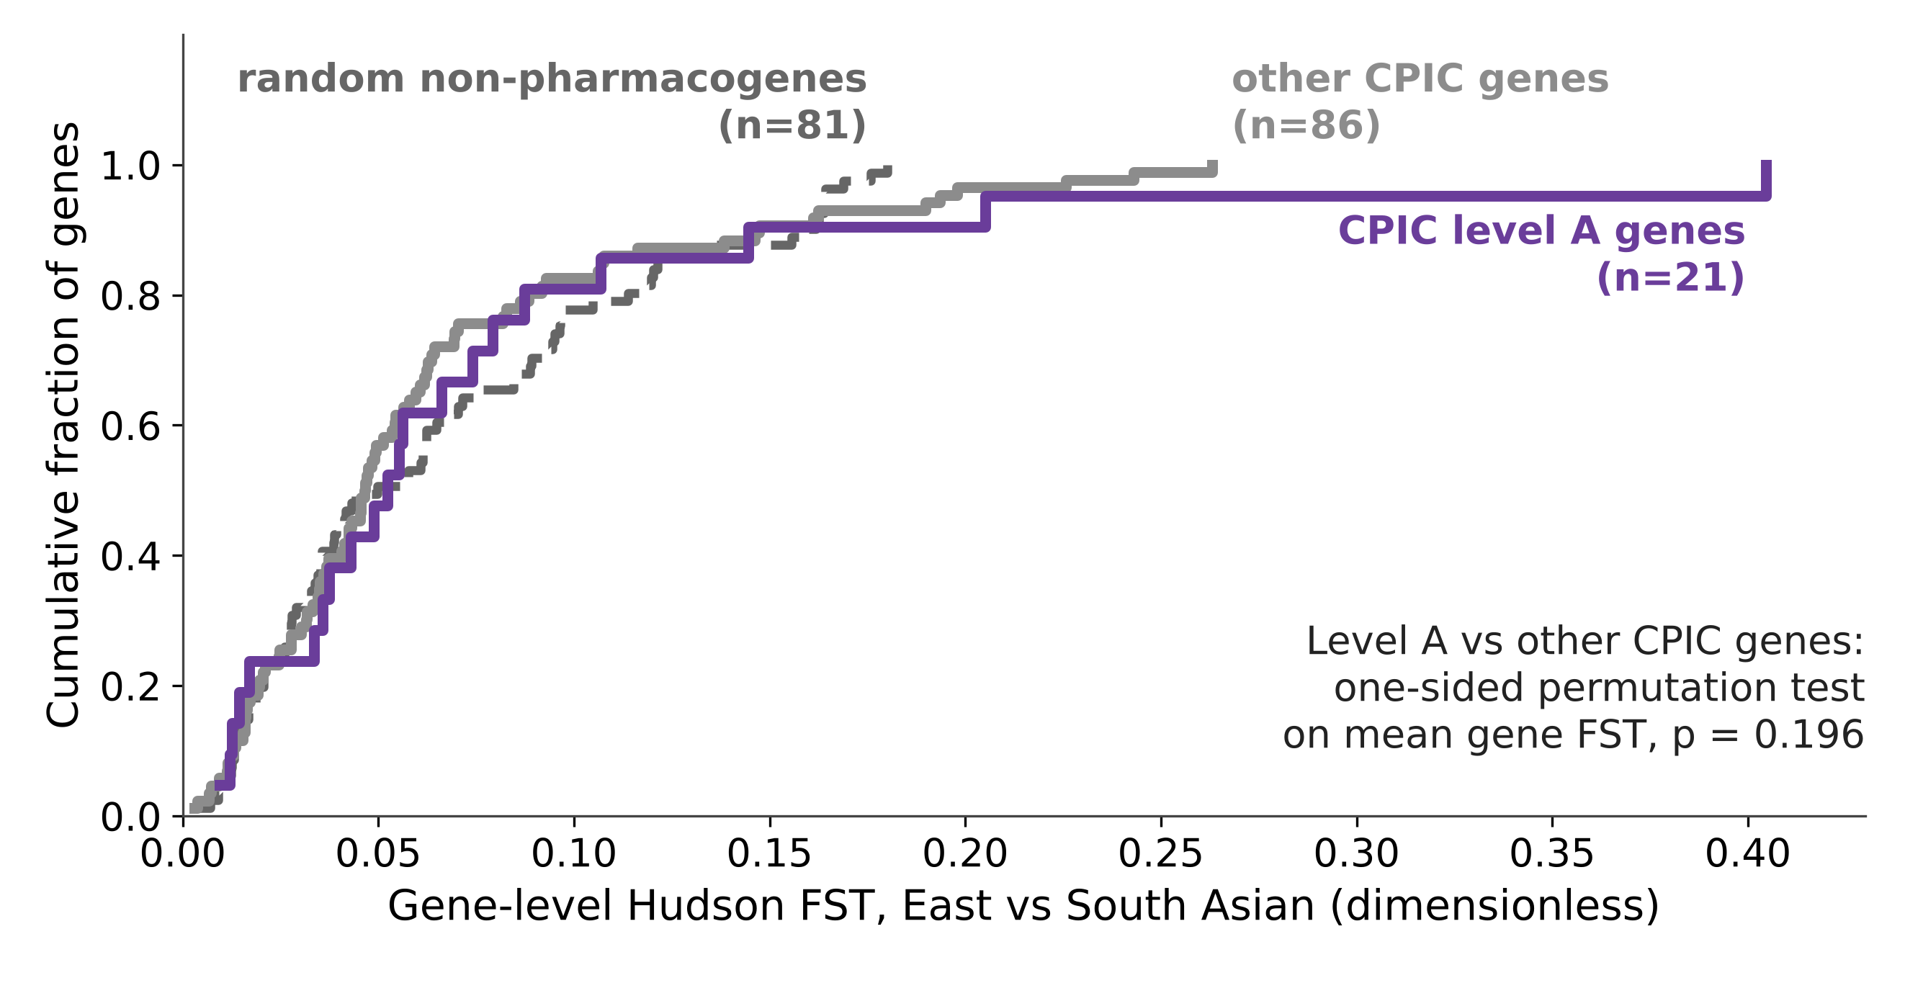
No evidence of extra divergence for guideline genes
Finding
Level A median 0.052 vs 0.047 for other genes (p = 0.20).
Pharmacogenes 0.047 vs random genes 0.050 (p = 0.53).
Figure 6 (Q2, Q4). Cumulative distribution of gene-level FST. One-sided permutation tests: level A vs other CPIC genes p = 0.196; pharmacogenes vs random genes p = 0.53.
Data: gnomAD v4, CPIC. Analysis: this work.
Pharmacogene variation across ancestries
13
Notes:
Q2 and Q4. Say 'no evidence of a difference', not 'no difference'. The random baseline has only 81 genes, so a small difference could be missed. A curve further right = larger differences.
In this slide the figure answers question two: do the genes that already carry a dosing guideline differ more between the two groups than ordinary genes do. This figure is a cumulative distribution curve, an ECDF, showing three sets of genes at once, where the x axis is the gene-level divergence score from zero to 0.4 and the y axis is the cumulative fraction of genes, from none at the bottom to all of them at the top. I chose this to show the entire distribution and judge the overlap themselves. The analysis used here was a one-sided permutation test, because it makes no assumption about the shape of the data, which matters when the statistic is skewed and the smallest group has only 21 genes, and I thought it was the honest choice for a comparison where I expected to find nothing. What we observe is that the three curves lie on top of each other across the whole range, with the purple guideline curve never pulling to the right of the two grey ones, and the medians are 0.052 against 0.047 with a p-value of 0.20, which means chance alone explains a gap of that size one time in five. So the takeaway is that there is no evidence that guideline genes diverge more, and that makes sense, because a gene earns a guideline when someone proves a clinical consequence, not when populations happen to differ.
his figure is a cumulative distribution curve, an ECDF, showing three sets of genes at once, where the x axis is the gene-level Hudson FST between East and South Asians, from zero to 0.4, and the y axis is the cumulative fraction of genes, from none at the bottom to all of them at the top. That x axis is the same quantity I ranked the genes by two slides ago: Hudson’s FST compares a variant’s frequency in two groups, zero meaning identical, and the gene’s value pools all of its common variants by summing numerators and denominators rather than averaging them. It is dimensionless, which is why the axis says so. I chose a cumulative curve rather than a boxplot because a box reduces each set to five numbers, and I wanted the audience to see the whole distribution and judge the overlap for themselves. The analysis used here was a one-sided permutation test on the difference in mean gene-level FST between the 21 level A genes and the 86 other pharmacogenes. Concretely: I measure that difference once, which comes to 0.013, then I shuffle the level A labels randomly among all 107 genes and measure it again, ten thousand times, with a fixed seed so the result reproduces. Shuffling destroys any real link between guideline status and divergence, so the ten thousand shuffled values show me what pure chance produces, and the p-value is simply the fraction of them that match or beat what I actually measured. It is one-sided because my hypothesis was directional, that guideline genes would be more divergent, not merely different. I chose a permutation test rather than a t-test because it assumes nothing about the shape of the data, and gene FST is heavily right-skewed with VKORC1 sitting far out at 0.40, and because one group has only 21 genes in it. What we observe is that the three curves lie on top of one another across the entire range, with the purple guideline curve never pulling to the right of the two grey ones, medians of 0.052 against 0.047, and a p-value of 0.20, meaning chance alone reproduces a gap this size about one time in five. The same machinery comparing all pharmacogenes against 81 random genes gives 0.53. So the takeaway is that there is no evidence that guideline genes diverge more, and I say no evidence of a difference rather than no difference, because with 21 genes a small effect could hide. That result makes sense: a gene earns a guideline when someone proves a clinical consequence, not when populations happen to differ at it.

Slide 14
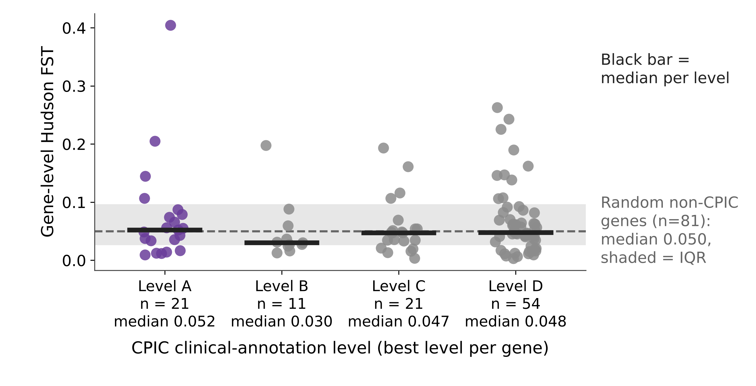
Divergence does not follow the CPIC evidence level
Finding
No trend across levels (p = 0.64).
Medians A 0.052, B 0.030, C 0.047, D 0.048.
Figure 7 (Q2). Gene-level FST by CPIC level (best level per gene); black bar = median. Trend test p = 0.64. Dashed line and band: random genes (median, IQR).
Data: gnomAD v4, CPIC. Analysis: this work.
Pharmacogene variation across ancestries
14
Notes:
Q2 by level. Spearman trend test p = 0.64. Level B has only 11 genes.
Each dot is a gene; the bar is the median.
In this slide the figure takes the same question and cuts it finer, to understand whether divergence tracks the strength of the clinical evidence. This figure is a strip plot, one column per CPIC evidence level, where the x axis is the level from A, the strongest evidence with a dosing action attached, down to D, and the y axis is the same gene-level divergence score as before, with a thick black bar marking the median of each column and a grey band showing where random genes sit. I plotted every gene as its own point . The analysis used here was a Spearman trend test, because the levels are ordered rather than independent categories, so the right question is whether the values rise or fall across them, and I thought a trend test answered that more directly than comparing pairs of columns. What we observe is that the four black bars sit at roughly the same height, with medians of 0.052, 0.030, 0.047 and 0.048 and a p-value of 0.64, and all four columns straddle the grey random-gene band. So the takeaway is that the evidence grade a gene carries tells you nothing about how much the populations differ at it, which is the same conclusion as the previous slide, reached a second way.

Slide 15
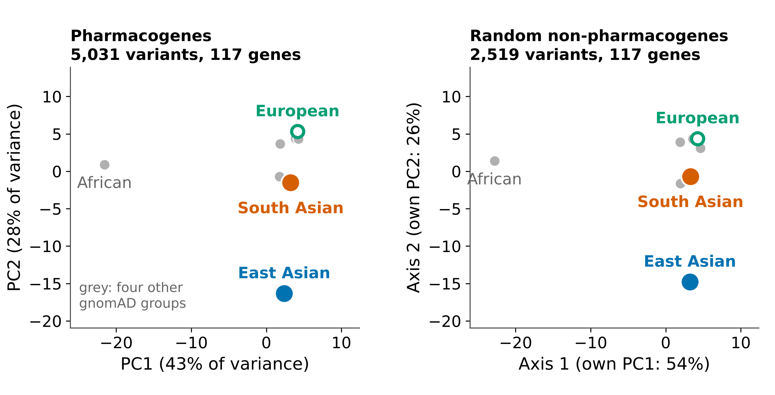
Population structure is nearly identical through pharmacogenes and random genes
Finding
Layouts nearly identical: Procrustes 0.01, distance correlation 0.99.
PC1 (43%): African; PC2 (28%): East Asian.
Figure 8 (Q5). PCA of allele frequencies across eight gnomAD groups; in grey, Finnish, Middle Eastern, Ashkenazi Jewish and admixed American. Right: random genes, Procrustes-aligned to the left.
Data: gnomAD v4, CPIC. Analysis: this work.
Pharmacogene variation across ancestries
15
Notes:
Q5. Distances reflect allele-frequency behaviour, not divergence time or clinical difference. With 1,000 variants per draw, pharmacogenes separate the groups as much as random variants (RMS 0.266 vs 0.265) but spread over more axes (PC1 share 0.44 vs 0.54). That last difference is an observation, not an explained result.
Closer points = more similar allele frequencies.
This data also comes from the gnomad dataset
the figure answers question five, whether the picture of human population structure you get by looking only at pharmacogenes differs from the one you get from ordinary genes. This figure is a pair of scatter plots from a principal component analysis, where each point is one of eight gnomAD population groups, the x axis is the first principal component and the y axis is the second, with the percentage of variation each axis captures written on the label. I used PCA rather than t-SNE or UMAP because PCA is deterministic, has no settings to tune, and its distances actually mean something. The right panel is rotated onto the left one by Procrustes alignment, because the sign and rotation of PCA axes are arbitrary, so without that step the two panels could look different for no real reason. What we observe is that both panels place the groups in the same arrangement, African pulled out along the first axis at 43%, East Asian along the second at 28%, South Asian close to European, and the leftover mismatch after alignment is 0.01 with a distance correlation of 0.99, which means the two pictures are the same to within rounding.
So the takeaway is that both of these variants point towards a lower warfarin dose, but each group reaches that through a different gene: East Asians far more often through VKORC1, South Asians far more often through CYP2C9. You cannot summarise a population’s response to a drug by looking at one gene, and carrying a variant means a guideline may apply, not that any individual needs a different prescription.

Slide 16
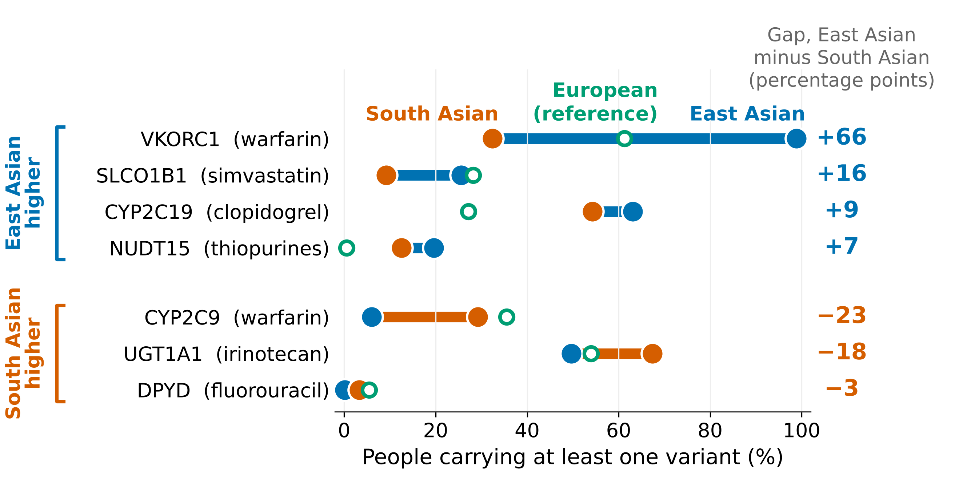
Where a variant lands matters: carrier rates differ widely between groups
Finding
VKORC1: 99% East Asian vs 32% South Asian.
CYP2C19: 63% vs 54% (European 27%).
A guideline may apply; no change is certain.
Figure 9 (Q3). People carrying at least one copy of the listed core variants (Hardy-Weinberg), per gene-drug pair; CPIC alleles, gnomAD v4. VKORC1: dose-lowering variant. UGT1A1 *28 via tag SNP. No Malay data.
Data: gnomAD v4, CPIC. Analysis: this work.
Pharmacogene variation across ancestries
16
Notes:
Q3. Not medical advice. DPYD is under-counted (2 of 4 variants retrieved).
Each dot is a group's share of carriers.
In this slide the figure answers question three (For selected gene-drug pairs, what share of each ancestry group carries a variant that CPIC links to altered drug response?)
which is the clinical one: for the variants that already have a dosing guideline, how many people in each group actually carry one. This figure is a connected dot plot, one row per gene-drug pair, where the x axis is the percentage of people carrying at least one copy, from zero to one hundred, and the y axis is the gene-drug pair itself, sorted by the size of the gap. Blue is East Asian, orange is South Asian, the hollow green ring is European as a reference, the bar connects the two groups being compared, and the number in the right margin is the gap in percentage points. I converted allele frequencies into carrier rates using Hardy-Weinberg
HW is a foundational rule in population genetics stating that allele and genotype frequencies in a population will remain constant from generation to generation in the absence of evolutionary influences.
because a frequency counts copies of a DNA letter, while a carrier rate counts people, and people are what a prescriber actually sees. I used a curated list of CPIC’s no-function and decreased-function alleles rather than every known variant, because some alleles travel together and adding them would double-count the same person. What we observe is that the top row stretches almost the full width of the plot: 99% of East Asians against 32% of South Asians for the VKORC1 warfarin variant, a 66 point gap, while CYP2C9, which also affects warfarin, runs 23 points the other way. So the takeaway is that one drug can have two genes pulling in opposite directions between the same two groups, and that carrying a variant means a guideline may apply, not that any individual needs a different prescription.

Slide 17
Key takeaways
1
0.40 vs 0.047
Divergence is everywhere; VKORC1 is the clear outlier.
VKORC1 vs typical pharmacogene (gene FST)
see slide 11
2
p = 0.20 | p = 0.53
No evidence that guideline genes or pharmacogenes diverge more.
level A vs other | pharmacogenes vs random genes
see slide 13
3
99% vs 32%
What matters clinically is where a difference lands.
VKORC1 variant carriers, East Asian vs South Asian
see slide 16
Pharmacogene variation across ancestries
17
Notes:
This slide collects the three numbers that answer the questions I set out with. The first is 0.40 against 0.047, VKORC1 against a typical pharmacogene, which came from the gene ranking and tells us divergence is everywhere but one gene stands apart, and as we saw that 0.40 rests on a single variant rather than the gene as a whole. The second is p of 0.20 and p of 0.53, the two permutation tests, which tell us there is no evidence that guideline genes or pharmacogenes as a class diverge more than ordinary genes, and I want to be clear that a null is a result, and these were the nulls I expected. The third is 99% against 32%, the carrier rates for the VKORC1 warfarin variant, which is the only number on this slide a clinician could act on. So the takeaway, and the sentence I would like you to remember, is that what matters is not how large a difference is, but where it lands.

Slide 18
Limits: reference groups, no Malay group, small baseline
Limitation | What it limits in our interpretation
Reference groups, not residents | Results describe reference populations only
No Malay group | One of three communities not covered
Groups compared by label | No inference about individuals
Frequency is not drug response | A guideline may apply; no change is certain
Only 81 random genes | A small difference could be missed
Some genes unread; DPYD low | Carrier rates for them are incomplete
Alleles counted, not people | p-values are inflated; we rank by effect size
Potential further research directions
Add Malay ancestry
Compare FST analysis against published values
Enlarge the random-gene baseline
Pharmacogene variation across ancestries
18
Notes:
Limitations from docs/02 section 2.5 and docs/04 known limitations. Next steps are proposals of this deck, not completed work.

Slide 19
Take-home message
Genomes differ between ancestry groups everywhere. Pharmacogenes are not unusual in how much they differ; what matters clinically is where a difference lands, as VKORC1 shows.
Pharmacogene variation across ancestries
19
Notes:
Framing from docs/02 section 2.6. Close by linking back to the hook: same medicine, different DNA.

Slide 20
References
Benjamini Y, Hochberg Y (1995). Controlling the false discovery rate: a practical and powerful approach to multiple testing. J R Stat Soc B 57, 289-300.
Chen S, et al. (2024). A genomic mutational constraint map using variation in 76,156 human genomes. Nature 625, 92-100.
Relling MV, Klein TE (2011). CPIC: Clinical Pharmacogenetics Implementation Consortium of the Pharmacogenomics Research Network. Clin Pharmacol Ther 89, 464-467.
Hudson RR, Slatkin M, Maddison WP (1992). Estimation of levels of gene flow from DNA sequence data. Genetics 132, 583-589.
Bhatia G, Patterson N, Sankararaman S, Price AL (2013). Estimating and interpreting FST: the impact of rare variants. Genome Res 23, 1514-1521.
International Warfarin Pharmacogenetics Consortium, Klein TE, et al. (2009). Estimation of the warfarin dose with clinical and pharmacogenetic data. N Engl J Med 360, 753-764.
Li J, et al. (2011). Global patterns of genetic diversity and signals of natural selection for human ADME genes. Hum Mol Genet 20, 528-540.
Moriyama T, et al. (2016). NUDT15 polymorphisms alter thiopurine metabolism and hematopoietic toxicity. Nat Genet 48, 367-373.
Pharmacogene variation across ancestries
20
Notes:
Appendix. Volume, issue and page numbers verified against PubMed and publisher records on 2026-11-11. Full list with DOIs in the repository README.

Slide 21
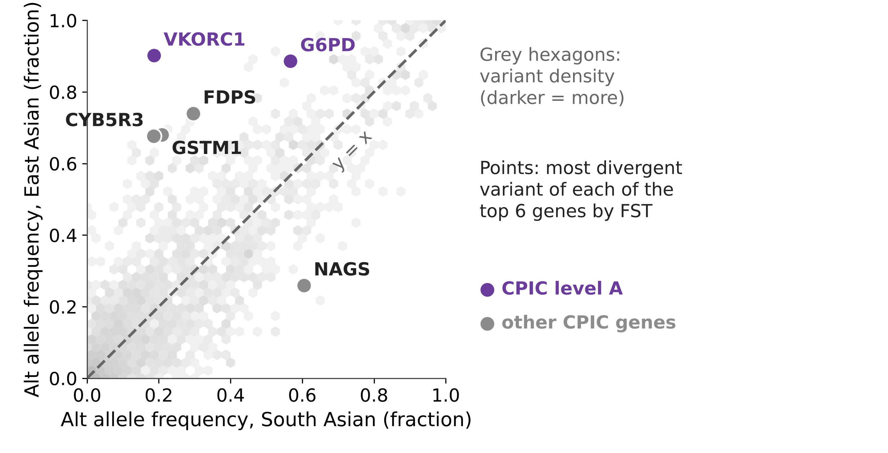
The most divergent variants sit in a handful of genes
Finding
VKORC1 and G6PD (level A) lie far from the diagonal.
Figure A1 (Q1). Alt allele frequency per variant, East vs South Asian; n = 3,313 common variants. Grey hexagons: variant density. Points: most divergent variant of each of the top 6 genes by FST.
Data: gnomAD v4, CPIC. Analysis: this work.
Pharmacogene variation across ancestries
21
Notes:
Appendix. Variant-level view of Q1.
Off the diagonal = the two groups differ.

Slide 22
Core alleles used for the carrier rates
Gene | Allele | rsID | East Asian | South Asian
CYP2C19 | *2 | rs4244285 | 30.36% | 32.03%
CYP2C19 | *3 | rs4986893 | 8.87% | 0.35%
CYP2C9 | *2 | rs1799853 | 0.02% | 4.85%
CYP2C9 | *3 | rs1057910 | 3.02% | 11.01%
CYP3A5 | *3 | rs776746 | 73.73% | 72.80%
DPYD | c.1129-5923C>G | rs75017182 | 0.06% | 1.62%
DPYD | c.2846A>T | rs67376798 | 0.00% | 0.05%
NUDT15 | *3 | rs116855232 | 10.33% | 6.47%
SLCO1B1 | *5 | rs4149056 | 13.73% | 4.71%
UGT1A1 | *6 | rs4148323 | 16.45% | 1.92%
UGT1A1 | *80+*28 | rs887829 | 12.59% | 40.95%
VKORC1 | -1639G>A | rs9923231 | 89.17% | 17.81%
Data: gnomAD v4, CPIC. Frequencies are allele frequencies. VKORC1 variant and UGT1A1 tag SNP as in the carrier analysis.
Pharmacogene variation across ancestries
22
Notes:
Appendix. Curated CPIC alleles; frequencies from gnomAD v4 (reference groups).

