Slide 1
Enterprise Supply Chain
Data Platform (ESCDP)
Sprint 0, Sprint 1, Sprint 2 & Sprint 3
Project initiation • ETL ingestion • Data quality • Star schema • Simulated ingestion • Power BI analytics
Progress presentation based on the capstone brief and project artifacts
ESCDP | Sprint 0–3
1

Slide 2
Business Background
Why a unified supply-chain data platform is needed
ABC Global Manufacturing Ltd. operates across manufacturing plants, distribution centers, warehouses, logistics partners, and retail outlets.
Operational data is generated by separate enterprise systems across different business functions.
Independent systems make end-to-end visibility and cross-process analysis difficult.
The platform aims to bring heterogeneous datasets into a common data foundation for reliable reporting.
ESCDP | Sprint 0–3
3

Slide 3
Project Objectives
Target outcomes defined in the capstone brief
Data integration
Collect supply-chain data from multiple enterprise systems.
Data quality
Clean, validate, and standardize logistics and inventory data.
Data warehouse
Store curated datasets in PostgreSQL for analytical use.
Traceability foundation
Keep the solution structured for metadata and lineage work later.
Analytics readiness
Support inventory, logistics, supplier, and executive reporting.
ESCDP | Sprint 0–3
4

Slide 4
Technology Stack
Tools used or defined for the ESCDP project
Pentaho Data Integration
Visual ETL transformations and Table Output steps.
PostgreSQL
Relational database for staging and warehouse structures.
Python / Pandas
Profiling, data-quality checks, and cleaning workflows.
Git & GitHub
Version control and project artifact history.
Power BI
Reporting platform identified in the project technology stack.
ESCDP | Sprint 0–3
5

Slide 5
Sprint 0 — Project Initiation
Preparing the project before development
Study the supply-chain business processes.
Identify business stakeholders and enterprise data sources.
Define project scope and prepare the Business Requirements Document (BRD).
Design the high-level solution architecture.
Create the Git repository, enterprise repository structure, and product/sprint backlog.
Prepare the project charter and initiation deliverables.
ESCDP | Sprint 0–3
6

Slide 6
High-Level Solution Architecture
End-to-end flow across ingestion, quality, warehouse, and operational demo
Source systems
SCM • ERP • WMS
TMS • Vendor • Logistics
Ingestion
Pentaho ETL
Input & transformation
Data storage
PostgreSQL
Staging layer
Data preparation
Python / Pandas_x000B_Profiling & cleaning
Reporting & monitoring
SQL checks • Power BI_x000B_Dashboard evidence
Warehouse
Fact & dimension
tables
Sprint 3 adds a separate demo path: processed CSVs → Python replay → staging.realtime_events. This is simulated streaming, not a live external feed.
ESCDP | Sprint 0–3
8

Slide 7
Sprint 1 — Data Discovery & Ingestion
Building the raw-data landing and staging layer
Analyze the enterprise source systems and prepare a source inventory.
Prepare a data dictionary describing the source fields.
Develop Pentaho transformations for CSV, Excel, JSON, XML, and SQL-derived data.
Load source records into PostgreSQL staging tables.
Use logging and basic exception handling where configured.
Keep project code and artifacts under version control.
ESCDP | Sprint 0–3
9

Slide 8
Ten Supply-Chain Datasets
Source domains included in the ingestion workflow
Distribution Center
Warehouse locations and operating measures
Inventory Management
Order-item quantity, prices, totals, and discounts
Logistics Tracking
Delivery status and late-delivery risk
Order Fulfillment
Order dates, status, customer, and destination
Procurement
Purchase orders, quantities, prices, freight, and dates
Supply Chain Management
Market, region, and geographic fields
Transportation Management
Shipping mode and shipping-duration fields
Vendor Management
Vendor, manufacturing site, terms, and delivery dates
Warehouse Management (WMS)
Product, category, department, and order-item details
Enterprise Resource Planning (ERP)
Customer, order, sales, and profit fields
ESCDP | Sprint 0–3
10

Slide 9
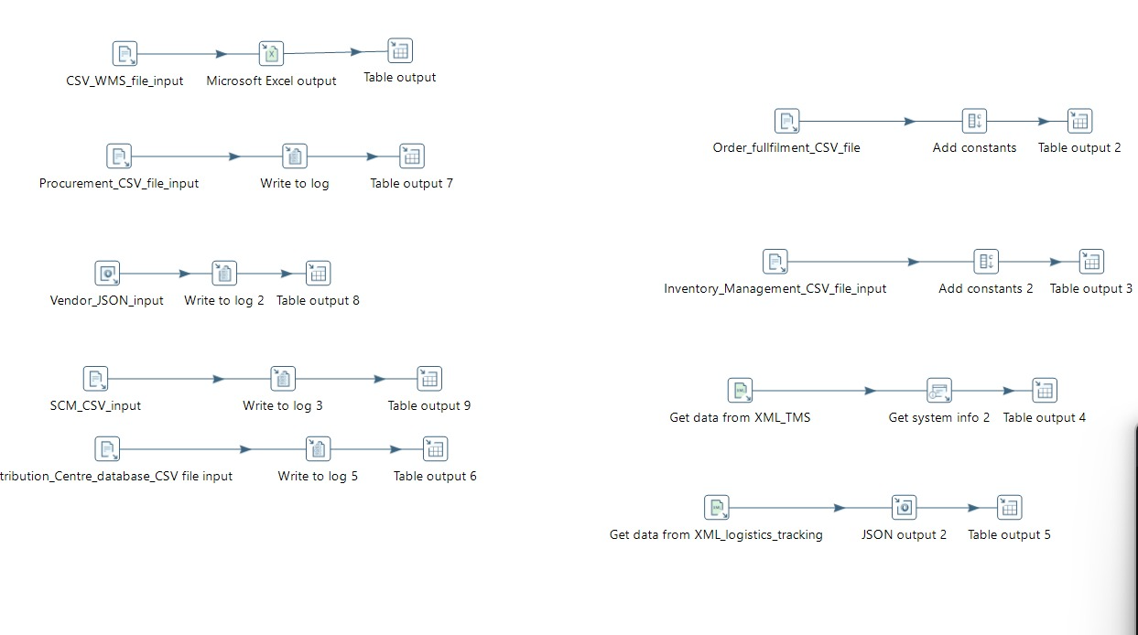
Sprint 1 — Pentaho Pipeline Evidence
User-provided transformation screenshot
The screenshot shows separate input-to-output flows for the listed source datasets.
ESCDP | Sprint 0–3
12

Slide 10
PostgreSQL Staging Tables
Landing tables for source-aligned data
A dedicated staging schema separates source-level ingestion from analytical warehouse tables.
Staging table definitions preserve the original source column names, including spaces and punctuation.
Quoted identifiers are required in PostgreSQL for names such as "Order Item Quantity".
TEXT columns can be used as an initial landing type, followed by validation and conversion where appropriate.
Staging tables provide the basis for profiling, transformation, and later warehouse loading.
Source field
"Order Item Quantity"
PostgreSQL syntax
"Order Item Quantity" TEXT
ESCDP | Sprint 0–3
14

Slide 11
Sprint 2 — Data Profiling & Storage
Transforming raw data into more trusted datasets
Profile the datasets with Python to inspect rows, columns, and missing-value patterns.
Identify potential duplicate records and missing logistics or shipment details.
Review supplier and warehouse data-quality issues.
Clean and standardize data before loading into the analytical warehouse.
Design the star schema and create SQL scripts for fact and dimension tables.
Continue project updates in Git.
ESCDP | Sprint 0–3
15

Slide 12
Data Cleaning & Standardization
Cleaning decisions applied by the Python workflow
Missing markers
Normalize common blank/null representations.
Empty columns
Remove columns with 100% missing values where detected.
Text & duplicates
Trim whitespace and remove exact duplicate rows.
Missing categorical values may be filled with an appropriate existing category when justified.
Missing dates and identifiers are retained for review instead of inventing values.
Processed outputs are written as CSV files under data/processed/; raw files remain unchanged.
Generated reports document cleaning summary, issues, imputations, and processing errors.
ESCDP | Sprint 0–3
17

Slide 13
Data Quality & Cleaning Reports
Artifacts produced by the Python workflow
cleaning_summary.csv
Processing status, input/output row counts, and dropped-column counts.
cleaning_issues.csv
Removed empty columns, duplicate rows, and missing values retained for review.
imputation_report.csv
Records which columns were filled, how many values, and the selected method.
cleaning_errors.csv
Records source files that failed to process and the associated error.
Review these reports before treating the processed datasets as ready for warehouse loading.
ESCDP | Sprint 0–3
18

Slide 14
Sprint 2 — Star Schema Design
Based on the supplied Star_schema_new.sql
dim_shipping_mode
Shipping method
dim_date
Calendar attributes
dim_geography
Location and region
Six fact tables
fact_order_sales • fact_inventory • fact_shipping
fact_warehouse • fact_procurement • fact_delivery
dim_customer
Customer details
dim_warehouse
Warehouse attributes
dim_product
Product/category details
dim_vendor
Vendor attributes
dim_order
Order type/status/date
The diagram summarizes the supplied schema; actual fact-to-dimension joins must be validated.
ESCDP | Sprint 0–3
19

Slide 15
Fact Tables & Business Measures
Six fact tables are defined in the supplied SQL
fact_order_sales
Sales, profit, benefit, and profit ratio
fact_inventory
Quantity, prices, totals, and discounts
fact_shipping
Delivery risk, shipping days, and status
fact_warehouse
Inventory, capacity, utilization, and shipment counts
fact_procurement
Purchase quantities, prices, freight, and insurance
fact_delivery
Scheduled/delivered dates and delivery status
ESCDP | Sprint 0–3
21

Slide 16
Fact Grain & Relationship Checks
Important validation before loading warehouse tables
fact_order_sales: intended grain is one row per order.
fact_inventory: intended grain is one row per source inventory/order-item line.
fact_shipping: intended grain is one consolidated shipping record per order, if the source supports it.
fact_warehouse: intended grain is one warehouse snapshot per date and product, where available.
fact_procurement: intended grain is one procurement line per source ID.
fact_delivery: intended grain is one procurement/vendor delivery record.
Check source keys and row multiplicity to prevent duplicate joins and inflated totals.
ESCDP | Sprint 0–3
22

Slide 17
Sprint 3 — Analytics & Simulated Real-Time Ingestion
Extending the platform from warehouse design toward operational monitoring
Objective
Demonstrate incremental arrival of supply-chain records in PostgreSQL and present warehouse metrics through Power BI.
Simulated real-time ingestion
Python replays cleaned CSV records from data/processed and inserts them incrementally into staging.realtime_events.
Analytics layer
The warehouse star schema provides a structured model for sales, inventory, shipping, procurement, warehouse, and delivery analysis.
Dashboard evidence
Power BI report pages cover supply-chain overview, inventory analytics, and logistics/delivery analytics.
ESCDP | Sprint 0–3 • 26

Slide 18
Sprint 3 — Simulated Ingestion Architecture
The current demo replays existing records; it is not a live external event feed
1 Processed CSVs
data/processed/
10 source domains
2 Python ingestion
realtime_ingestion.py
Read • validate • pace
3 PostgreSQL staging
staging.realtime_events
JSONB payload + timestamp
4 SQL verification
Counts • latest events
source and timestamp checks
Basic controls
• Empty/all-blank row checks
• Duplicate prevention by source file + row number
• Inserted / skipped / invalid / failed counts
PostgreSQL event record
• source_dataset, source_file, source_row_number
• ingestion_time
• payload stored as JSONB
Demo pacing is configurable (e.g., 0.5 seconds per successful insert). Repeated loops skip already-ingested source rows.
ESCDP | Sprint 0–3 • 27

Slide 19
Warehouse Star Schema — Dimensions & Facts
Warehouse model defined in the supplied SQL; validate source-key mappings before loading facts
dim_date
dim_geography
FACT TABLES
• fact_order_sales
• fact_inventory
• fact_shipping
• fact_warehouse
• fact_procurement
• fact_delivery
dim_customer
dim_warehouse
dim_product
dim_vendor
dim_shipping_mode
dim_order
Dimensions describe the business context; fact tables store measurable activity. Foreign keys, grain, and joins must be checked to avoid double counting.
ESCDP | Sprint 0–3 • 28

Slide 20
Star Schema — Table Responsibilities
Eight dimensions and six facts are defined in the supplied PostgreSQL DDL
Dimensions (8)
dim_date, dim_customer, dim_product, dim_geography, dim_warehouse, dim_vendor, dim_shipping_mode, dim_order.
Order & inventory facts
fact_order_sales stores sales/profit measures; fact_inventory stores quantity, prices, totals, and discounts.
Logistics & warehouse facts
fact_shipping stores delivery risk/status and shipping-day measures; fact_warehouse stores inventory, capacity, utilization, and operational measures.
Procurement & delivery facts
fact_procurement stores purchase quantities, values, prices, freight, and insurance; fact_delivery stores scheduled/delivered dates and delivery duration/status.
Important mapping caveat
The SQL includes safeguards and nullable keys where source mappings are not yet verified. Validate product-to-inventory and procurement-to-vendor mappings before loading facts.
ESCDP | Sprint 0–3 • 29

Slide 21
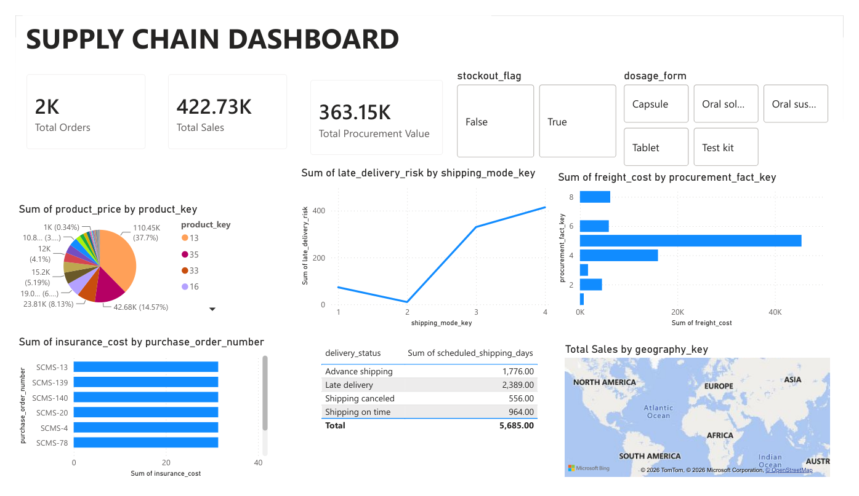
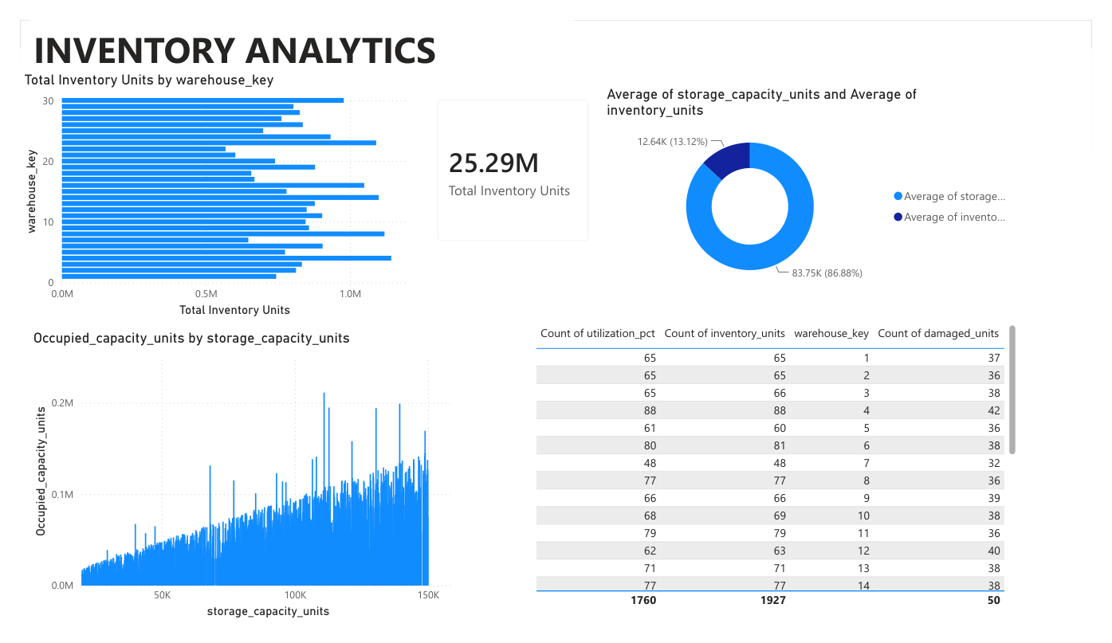
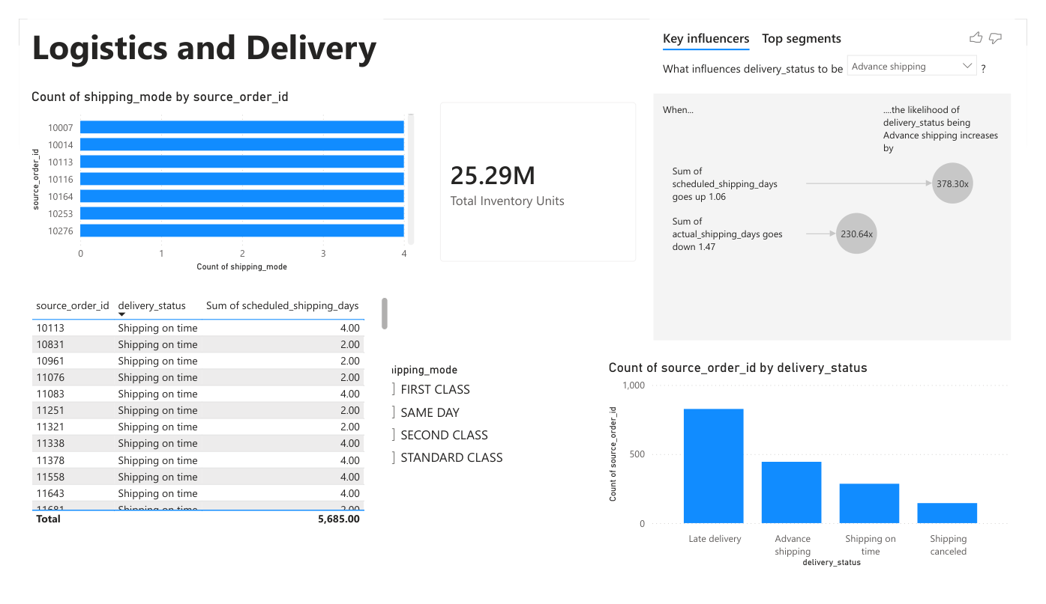
Sprint 3 — Power BI Dashboard Evidence
User-provided dashboard export: supply-chain overview, inventory, and delivery
Supply Chain Dashboard
Inventory Analytics
Logistics and Delivery
Examples shown in the report: total orders and sales, procurement value, inventory units/capacity, delivery status, shipping modes, freight and insurance costs. Verify KPI definitions and relationships before presenting figures as final business results.
ESCDP | Sprint 0–3 • 30

Slide 22
Sprint 3 — Validation & Demonstration
What was implemented and how it can be demonstrated
Event table
staging.realtime_events stores event_id, source_dataset, source_file, source_row_number, ingestion_time, and JSONB payload.
Duplicate handling
A unique constraint on source_file + source_row_number and ON CONFLICT DO NOTHING prevents the same source row being inserted repeatedly during replay.
Verification
Use SQL to inspect the latest events, count records by source dataset, and check ingestion timestamps while the script is running.
Observed run
At one checkpoint, the table contained 680 records and the validation-error table showed zero logged validation errors. These are checkpoint observations, not guaranteed totals for every run.
Current limitation
This is simulated streaming from files, not Kafka or live ERP/WMS events. The star-schema DDL is defined; final fact loading and business-key reconciliation require validation.
ESCDP | Sprint 0–3 • 31

Slide 23
ESCDP — Sprint 0 to Sprint 3 Summary
Project progress across initiation, ingestion, quality, warehouse design, and analytics
Sprint 0 — Initiation
Business context, objectives, scope, high-level architecture, and planning artifacts.
Sprint 1 — Data discovery & ingestion
Ten heterogeneous source datasets, Pentaho pipeline evidence, and PostgreSQL staging preparation.
Sprint 2 — Data quality & warehouse design
Python profiling/cleaning reports, data quality checks, and star-schema SQL with eight dimensions and six facts.
Sprint 3 — Ingestion demo & analytics
Simulated incremental ingestion into PostgreSQL, duplicate handling, basic validation/error reporting, SQL verification, and Power BI dashboard pages.
Next validation priorities
Confirm fact-table grain, validate source-key mappings, reconcile dashboard totals to source records, and document any remaining data-quality exceptions.
ESCDP | Sprint 0–3 • 32

