Slide 1
Simple data visualization with ggplot2
Benjamin Soibam, PhD
CS 5301 – Programming Foundations for Data Analytics

Slide 2
Reference for the slides
Chapters 1 of R for Data Science Book Hadley Wickham and Garrett Grolemund
http://www.cookbook-r.com/Graphs/

Slide 3
R package to for graphics plots
ggplot2
How to install it ?
>install.packages("ggplot2")
You need to load it before using it
>library("ggplot2")
If you install “tidyverse” package, ggplot2 comes with it

Slide 4
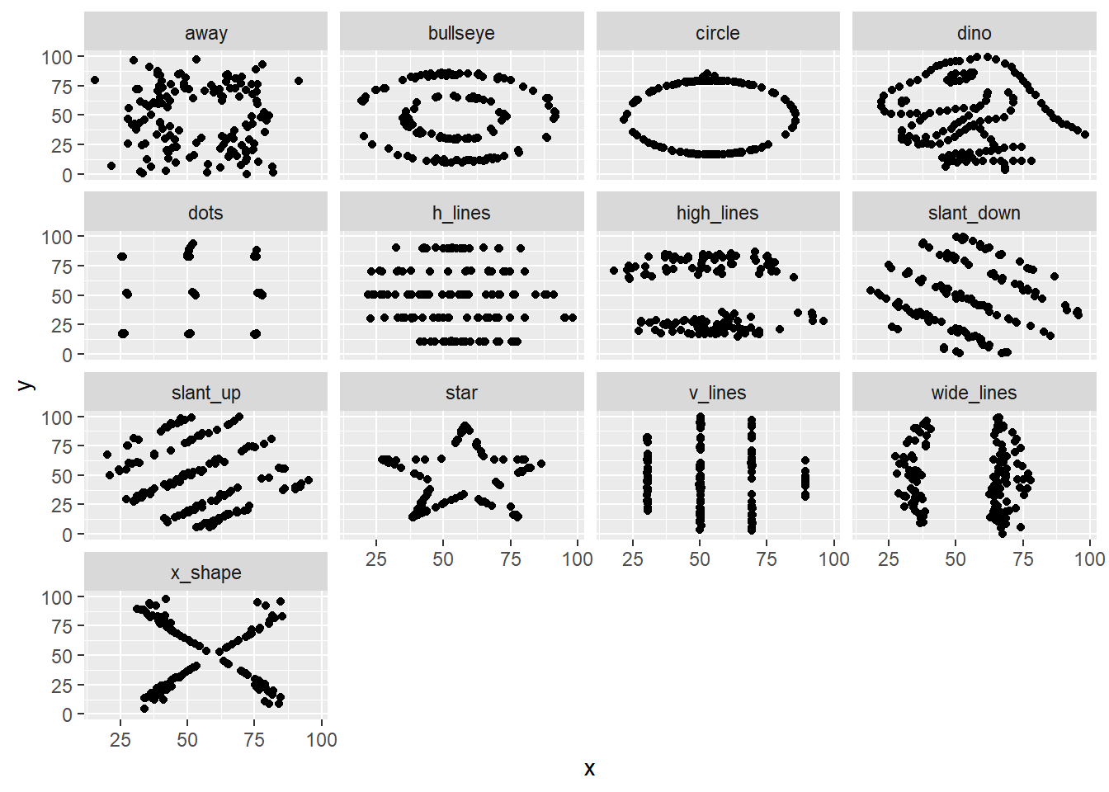
Need for visualization
These 13 datasets (the Datasaurus, plus 12 others) each have the same summary statistics (x/y mean, x/y standard deviation, and Pearson's correlation) to two decimal places, while being drastically different in appearance.
https://www.autodeskresearch.com/publications/samestats

Slide 5
Code to produce the plot in previous slide
Don’t worry about the code at this point
library(ggplot2)
data <- read.table('C:\\Users\\soibamb\\Dropbox\\Teaching\\CS5301/Visualizations\\SameStatsDataAndImages\\datasets\\DatasaurusDozen.tsv',sep="\t",header=T)
ggplot(data=data) + geom_point(aes(x=x,y=y)) + facet_wrap(~dataset)

Slide 6
Installing tidyverse
>install.packages("tidyverse")
>library(tidyverse)
There is a data frame (mpg) that comes with this library
mpg
#> # A tibble: 234 × 11
#> manufacturer model displ year cyl trans drv
#> <chr> <chr> <dbl> <int> <int> <chr> <chr>
#> 1 audi a4 1.8 1999 4 auto(l5) f
#> 2 audi a4 1.8 1999 4 manual(m5) f
....
Columns

Slide 7
ggplot2 cheat sheet
https://www.rstudio.com/wp-content/uploads/2015/03/ggplot2-cheatsheet.pdf
Reference available here http://ggplot2.tidyverse.org/reference/

Slide 8
ggplot2 basic idea
Draw a graph using the
basic components
data
geoms: visual marks that
represent the data
Coordinate system
Display
Map variables in the data set
To aesthetic properties such as
size, color and x, y locations

Slide 9
XY scatter plots
Plot displ (X-Axis) and hwy (Y-Axis)
>ggplot(data = mpg) + geom_point( aes(x = displ, y = hwy))
Creates a
coordinate system
Display as points
Specify what to go in x and y axis
Data frame
Empty plot
Add new layer
Shows a negative relationship
You can add more layers
After this

Slide 10
> head(mpg)
# A tibble: 6 × 11
manufacturer model displ year cyl trans drv cty hwy fl class
<chr> <chr> <dbl> <int> <int> <chr> <chr> <int> <int> <chr> <chr>
1 audi a4 1.8 1999 4 auto(l5) f 18 29 p compact
2 audi a4 1.8 1999 4 manual(m5) f 21 29 p compact
3 audi a4 2.0 2008 4 manual(m6) f 20 31 p compact
4 audi a4 2.0 2008 4 auto(av) f 21 30 p compact
5 audi a4 2.8 1999 6 auto(l5) f 16 26 p compact
6 audi a4 2.8 1999 6 manual(m5) f 18 26 p compact
Class of cars
Count of cars for each car class in table format
> table(mpg$class)
2seater compact midsize minivan pickup subcompact suv
5 47 41 11 33 35 62

Slide 11
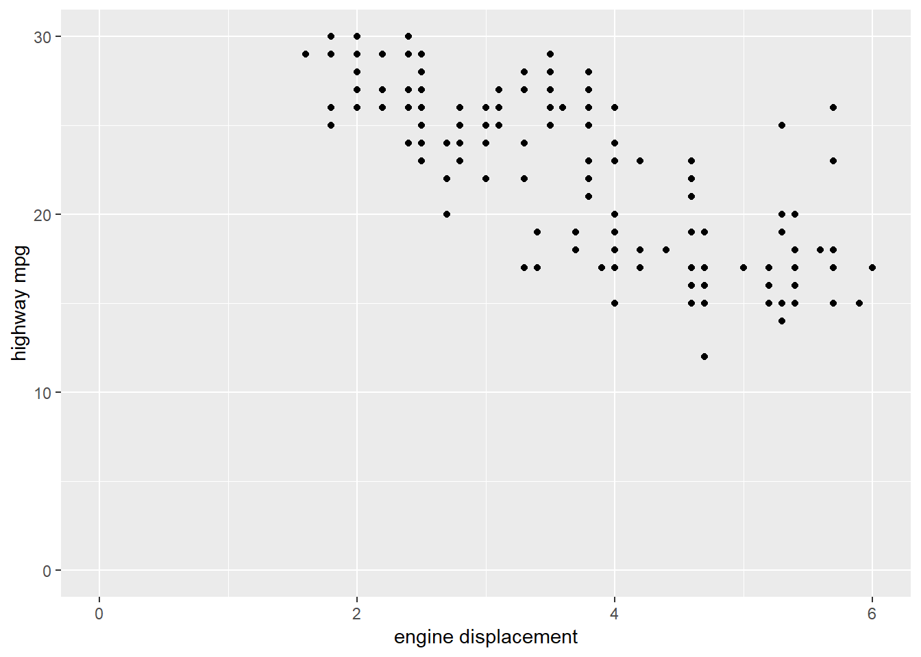
Limit the range on the x and y-axis
>ggplot(data=mpg) + geom_point(aes(x=displ,y=hwy)) +
xlab("engine displacement") +
ylab("highway mpg")+
xlim(c(0,6))+
ylim(c(0,30))

Slide 12
Saving a plot to an image file using ggsave
>ggplot(data=mpg) + geom_point(aes(x=displ,y=hwy)) +
xlab("engine displacement") +
ylab("highway mpg")+
xlim(c(0,6))+
ylim(c(0,30))
>ggsave("mtcars.pdf")
>ggsave("mtcars.png")

Slide 13
Saving a plot to an image file using ggsave
Allows to provide Custom size image with custom resolution
ggsave(filename, width = ?, height = ? , units = c("in"),
dpi = 300)

Slide 14
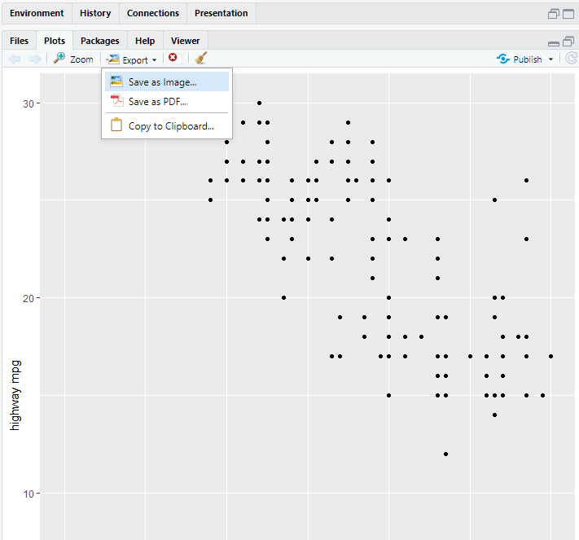
Saving a plot to an image file using ggsave
Save using the
interactive mode

Slide 15
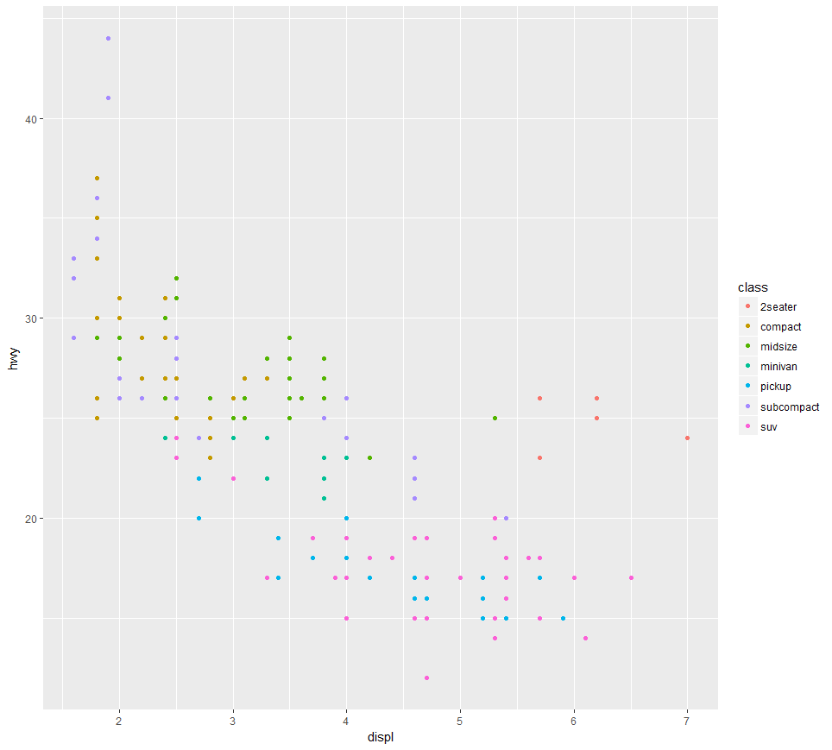
Color based on the class the car belongs
(has to be a factor for some R Studio versions)
>ggplot(data = mpg) + geom_point(aes(x = displ, y = hwy, color = class))
Color based on the
class the car belongs

Slide 16
#size of points based on the class of the car belongs to
>ggplot(data = mpg) + geom_point(aes(x = displ, y = hwy, size = class))
#transparency of points based on the class the car belongs
>ggplot(data = mpg) + geom_point(aes(x = displ, y = hwy, alpha = class))
#Shape of the points based on the class the car belongs
>ggplot(data = mpg) + geom_point(aes(x = displ, y = hwy, shape = class))
#color of all points = blue
>ggplot(data = mpg) + geom_point(aes(x = displ, y = hwy), color = “blue”,size=3)
size
transparency
shape
Color = blue

Slide 17
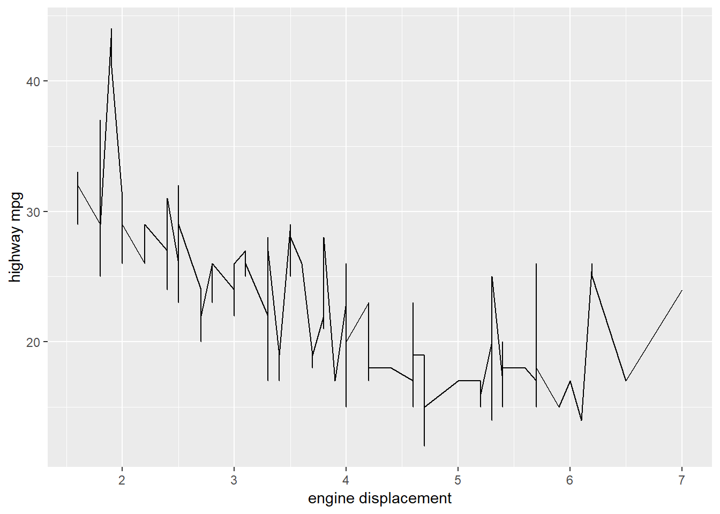
Line plots
ggplot(data=mpg) + geom_line(aes(x=displ,y=hwy)) + xlab("engine displacement") + ylab("highway mpg")
Lines connecting (x,y) points

Slide 18
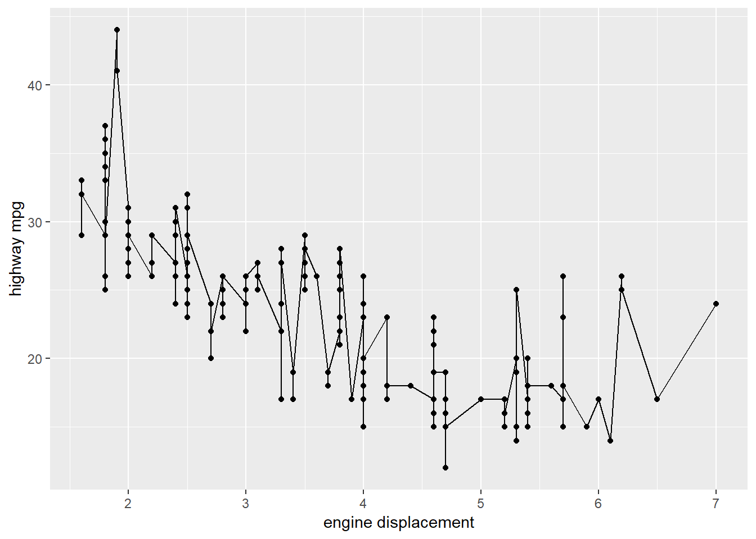
Line plots
ggplot(data=mpg) +
geom_line(aes(x=displ,y=hwy)) +
geom_point(aes(x=displ,y=hwy)) +
xlab("engine displacement")+
ylab("highway mpg")
Lines and xy scatter plot overlay

Slide 19
Facets
Useful for categorical variables, is to split your plot into
facets, subplots that each display one subset of the data.

Slide 20
Use facet_wrap
ggplot(data = mpg) +
geom_point(aes(x = displ, y = hwy)) +
facet_wrap(~ class, nrow = 2)
~ class is a formula (which is name of a data structure in R)
class is the name of column you want to use to create subplots
(it should be categorical)
nrow is the number of rows of subplots you want to use.

Slide 21
ggplot(data = mpg) +
geom_point(aes(x = displ, y = hwy)) +
facet_wrap(~ class, nrow = 2)

Slide 22
facet your plot on the combination of two variables
Use facet_grid
ggplot(data = mpg) +
geom_point(aes(x = displ, y = hwy)) +
facet_grid(drv ~ cyl)
Subplots using all possible combinations using drv and cyl
cyl
> table(mpg$cyl)
4 5 6 8
81 4 79 70
> table(mpg$drv)
4 f r
103 106 25
drv

Slide 23
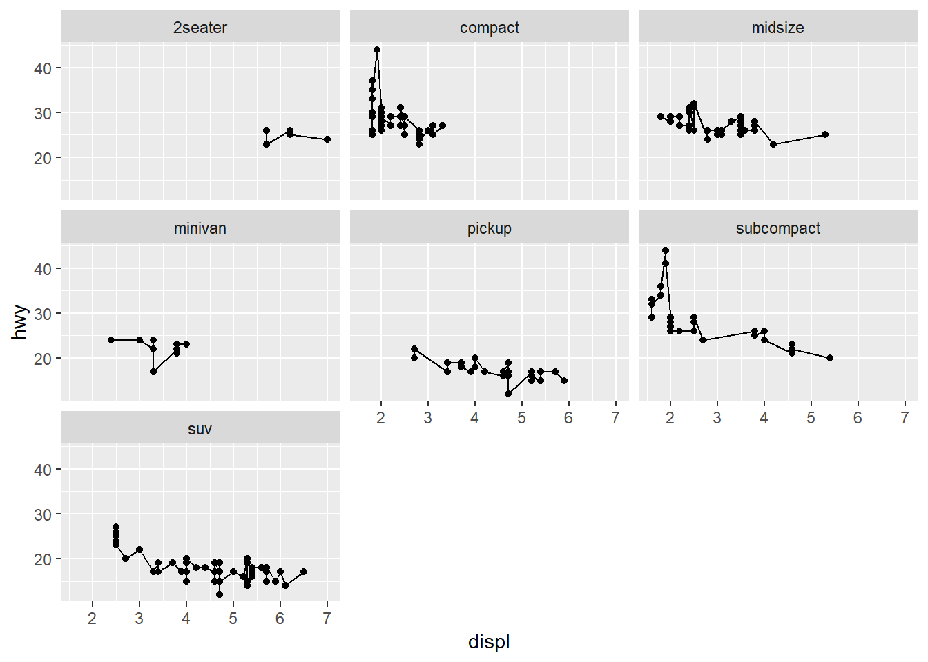
Can you create the following plot
Subplot for each class

Slide 24
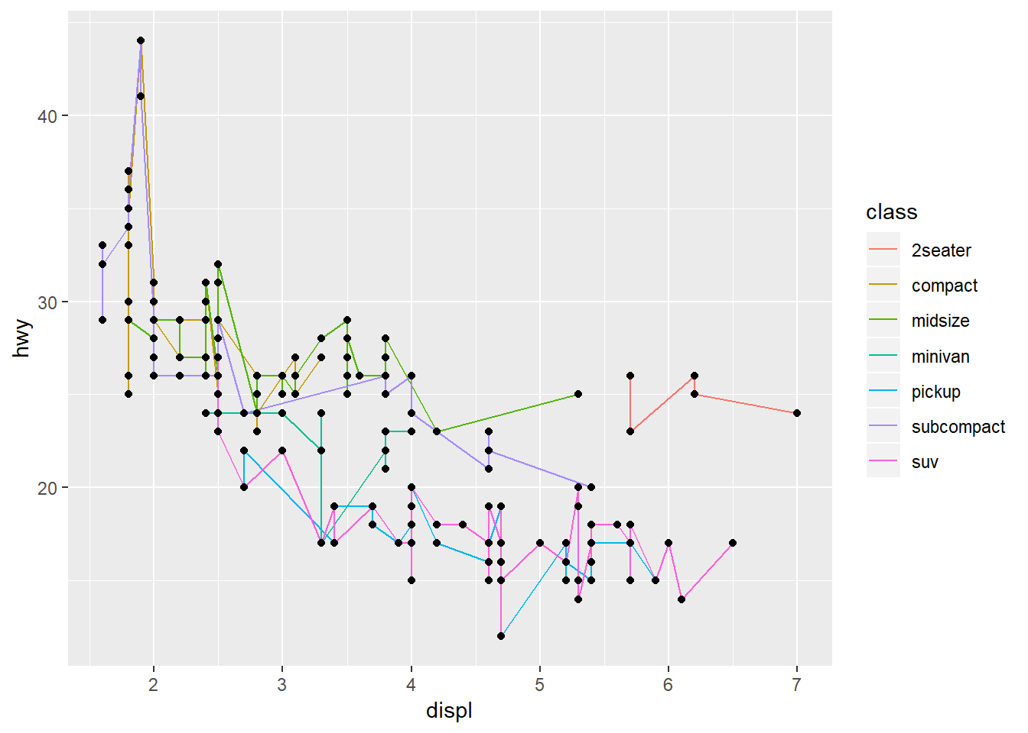
Can you create the following plot
Line color depends on car class

Slide 25
Statistical transformations: bar graphs
The diamonds dataset comes in ggplot2 and contains information about ~54,000 diamonds, including the price, carat, color, clarity, and cut of each diamond.
> str(diamonds)
Classes ‘tbl_df’, ‘tbl’ and 'data.frame': 53940 obs. of 10 variables:
$ carat : num 0.23 0.21 0.23 0.29 0.31 0.24 0.24 0.26 0.22 0.23 ...
$ cut : Ord.factor w/ 5 levels "Fair"<"Good"<..: 5 4 2 4 2 3 3 3 1 3 ...
$ color : Ord.factor w/ 7 levels "D"<"E"<"F"<"G"<..: 2 2 2 6 7 7 6 5 2 5 ...
$ clarity: Ord.factor w/ 8 levels "I1"<"SI2"<"SI1"<..: 2 3 5 4 2 6 7 3 4 5 ...
$ depth : num 61.5 59.8 56.9 62.4 63.3 62.8 62.3 61.9 65.1 59.4 ...
$ table : num 55 61 65 58 58 57 57 55 61 61 ...
$ price : int 326 326 327 334 335 336 336 337 337 338 ...
$ x : num 3.95 3.89 4.05 4.2 4.34 3.94 3.95 4.07 3.87 4 ...
$ y : num 3.98 3.84 4.07 4.23 4.35 3.96 3.98 4.11 3.78 4.05 ...
$ z : num 2.43 2.31 2.31 2.63 2.75 2.48 2.47 2.53 2.49 2.39 ...
> dim(diamonds)
[1] 53940 10

Slide 26
Statistical transformations: bar graphs
Let’s use the diamonds data
head(diamonds)
## # A tibble: 6 x 10
## carat cut color clarity depth table price x y z
## <dbl> <ord> <ord> <ord> <dbl> <dbl> <int> <dbl> <dbl> <dbl>
## 1 0.23 Ideal E SI2 61.5 55 326 3.95 3.98 2.43
## 2 0.21 Premium E SI1 59.8 61 326 3.89 3.84 2.31
## 3 0.23 Good E VS1 56.9 65 327 4.05 4.07 2.31
## 4 0.290 Premium I VS2 62.4 58 334 4.2 4.23 2.63
## 5 0.31 Good J SI2 63.3 58 335 4.34 4.35 2.75
## 6 0.24 Very Good J VVS2 62.8 57 336 3.94 3.96 2.48

Slide 27
Statistical transformations: bar graphs
Display the frequency of diamonds for each type of ‘cut’
ggplot(data = diamonds) + geom_bar(aes(x = cut))
On x-axis display cut (a variable from diamonds)
geom_bar: to create frequency/histogram plots

Slide 28
geom_bar()

Slide 29
Extract statistical transformed data from ggplot
> y <- ggplot(data = diamonds) + geom_bar(aes(x = cut))
> pg <- ggplot_build(y)
> pg$data
[[1]]
y count prop x PANEL group ymin ymax xmin xmax colour fill size linetype alpha
1 1610 1610 1 1 1 1 0 1610 0.55 1.45 NA grey35 0.5 1 NA
2 4906 4906 1 2 1 2 0 4906 1.55 2.45 NA grey35 0.5 1 NA
3 12082 12082 1 3 1 3 0 12082 2.55 3.45 NA grey35 0.5 1 NA
4 13791 13791 1 4 1 4 0 13791 3.55 4.45 NA grey35 0.5 1 NA
5 21551 21551 1 5 1 5 0 21551 4.55 5.45 NA grey35 0.5 1 NA

Slide 30
geom_bar()
Display proportion instead of frequency count
ggplot(data = diamonds) +
geom_bar(aes(x = cut, y = ..prop.., group = 1))

Slide 31
Stacked bars
ggplot(data = diamonds) +
geom_bar(aes(x = cut, fill = clarity))
Count the number of diamonds for all possible combinations for “cut” and “clarity”. The stacking is performed automatically by the position adjustment specified by the position argument
The above ggplot is same as this
ggplot(data = diamonds) +
geom_bar(aes(x = cut, fill = clarity,position=“stacked”))

Slide 32
If you don’t want stacked bars
You have three options
position=“identity” will place each object exactly where it falls in the context of the graph. This is not very useful for bars, because it overlaps them.
position=“dodge” places overlapping objects directly beside one another. This makes it easier to compare individual values:
position=“fill” works like stacking, but makes each set of stacked bars the same height. This makes it easier to compare proportions across groups.

Slide 33
ggplot(data = diamonds) +
geom_bar(
mapping = aes(x = cut, fill = clarity), position = "fill")
ggplot(data = diamonds) +
geom_bar(
mapping = aes(x = cut, fill = clarity), position = "dodge")

Slide 34
Histogram plots
Working with continous data. In the diamonds data, carat column is real numbers not categorical like diamond cut.
head(diamonds)
## # A tibble: 6 x 10
## carat cut color clarity depth table price x y z
## <dbl> <ord> <ord> <ord> <dbl> <dbl> <int> <dbl> <dbl> <dbl>
## 1 0.23 Ideal E SI2 61.5 55 326 3.95 3.98 2.43
## 2 0.21 Premium E SI1 59.8 61 326 3.89 3.84 2.31
## 3 0.23 Good E VS1 56.9 65 327 4.05 4.07 2.31
## 4 0.290 Premium I VS2 62.4 58 334 4.2 4.23 2.63
## 5 0.31 Good J SI2 63.3 58 335 4.34 4.35 2.75
## 6 0.24 Very Good J VVS2 62.8 57 336 3.94 3.96 2.48

Slide 35
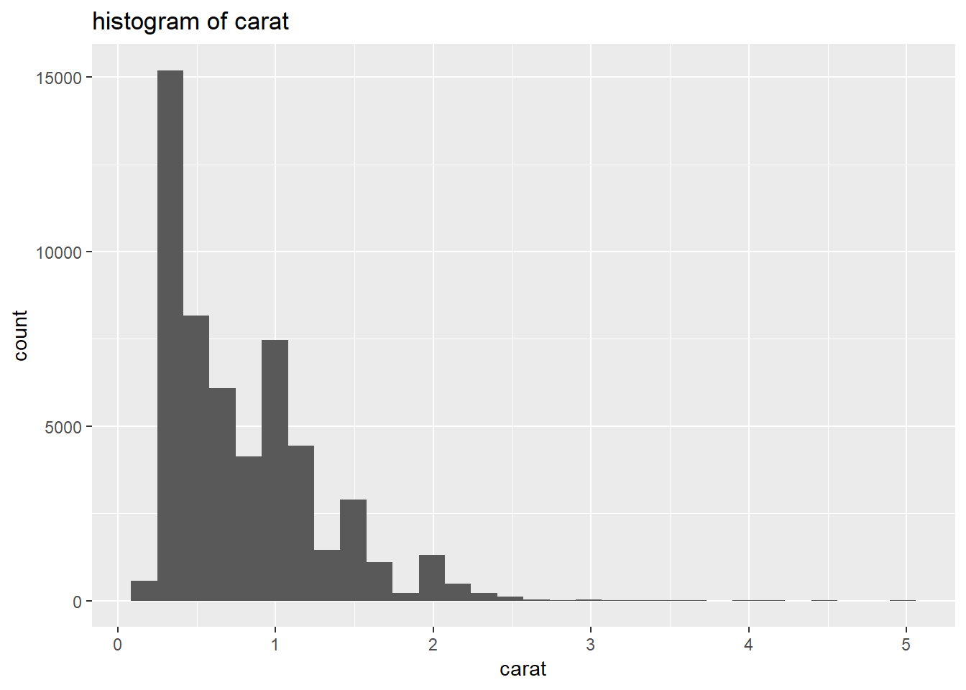
Histogram plots
ggplot(data = diamonds) + geom_histogram(aes(x=carat),binwidth=1) + ggtitle('histogram of carat')
Visualize the distribution of a single continuous variable by dividing the x axis into bins and counting the number of observations in each bin

Slide 36
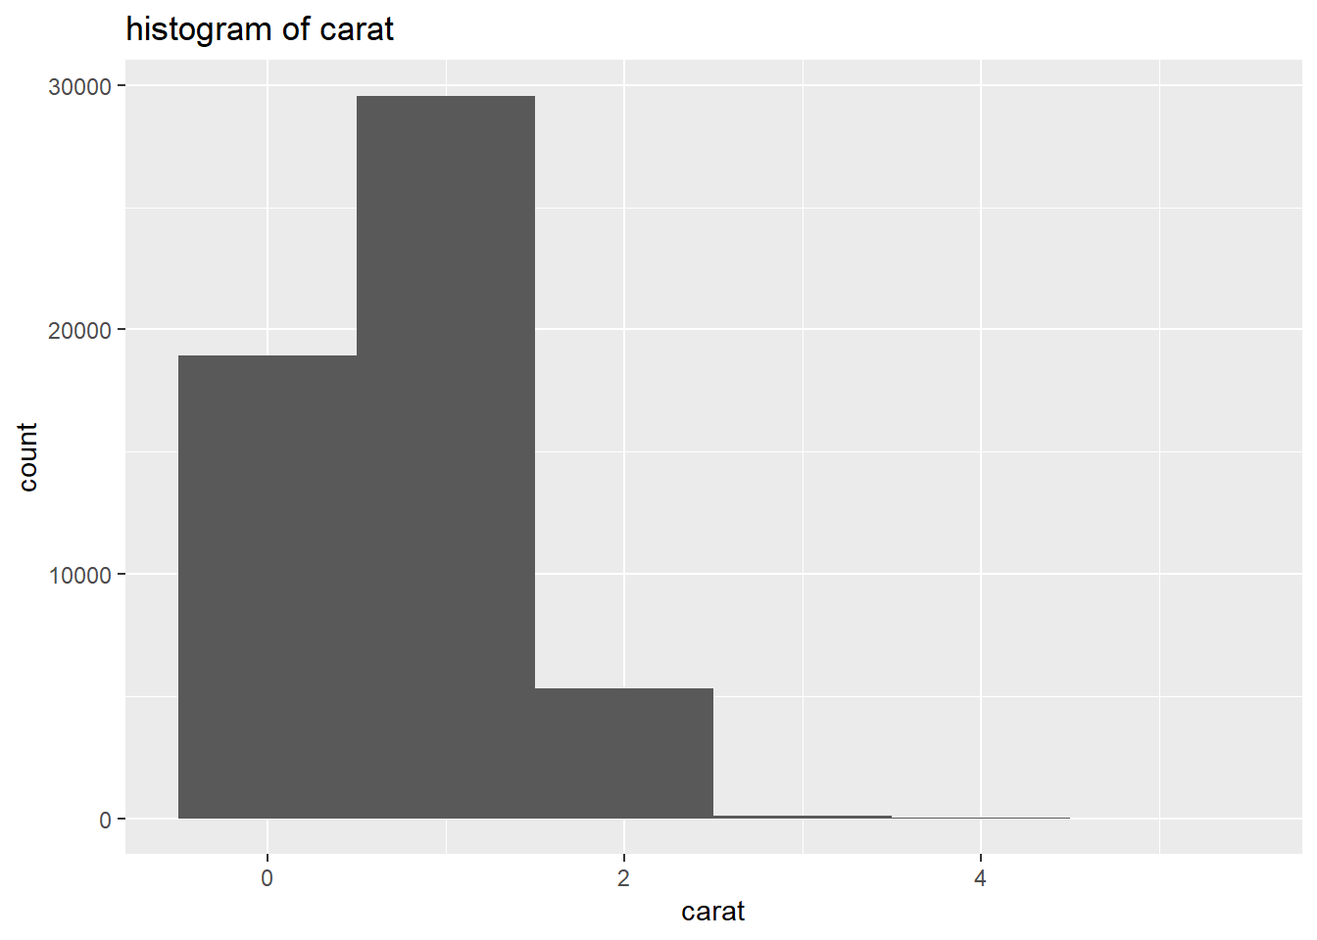
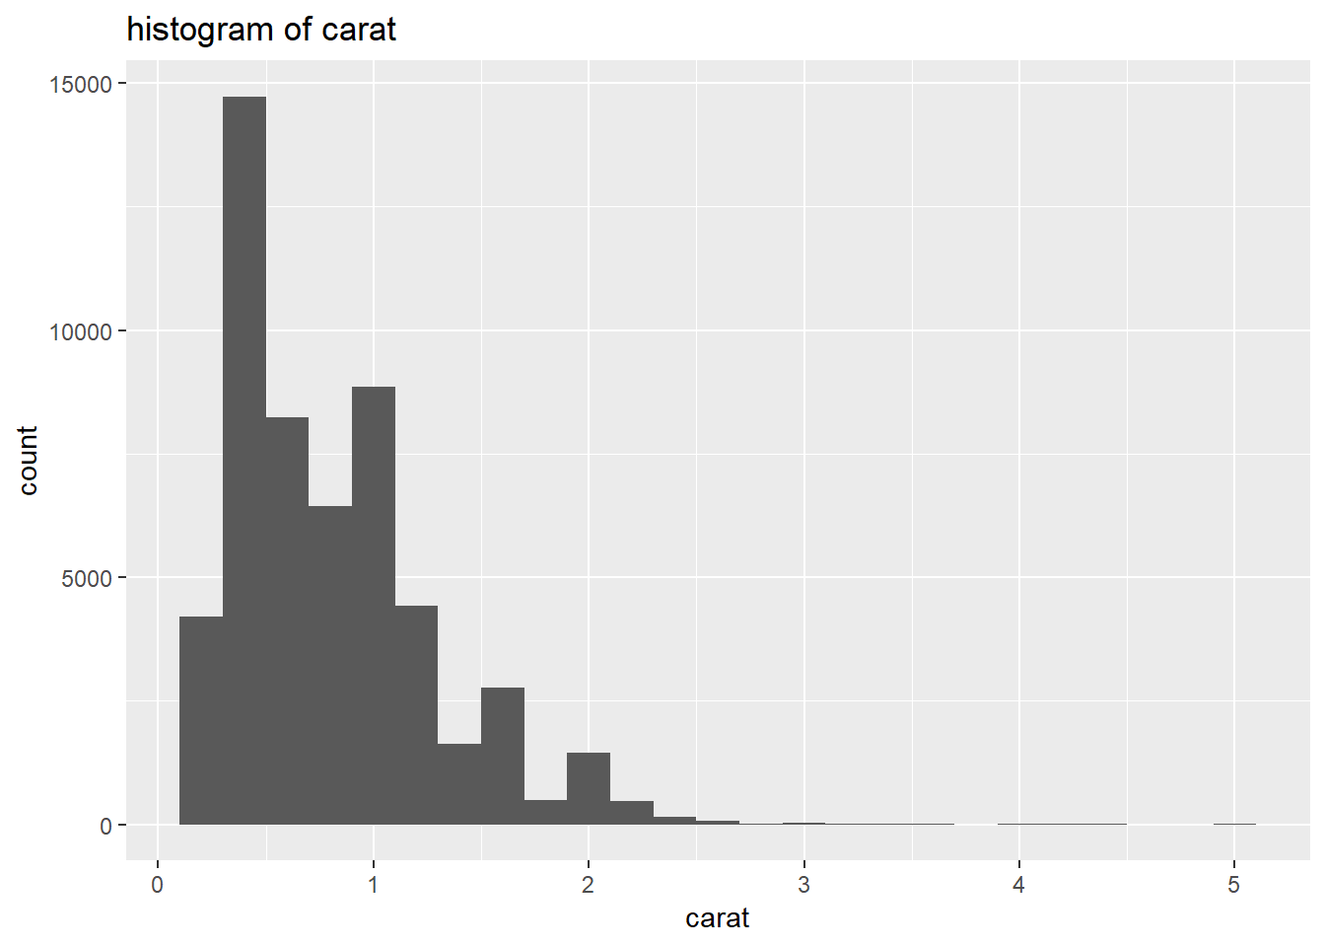
Histogram plots
Can also change bin width
ggplot(data = diamonds) + geom_histogram(aes(x=carat),binwidth=1) + ggtitle('histogram of carat')
ggplot(data = diamonds) + geom_histogram(aes(x=carat),binwidth=0.2) + ggtitle('histogram of carat')

Slide 37
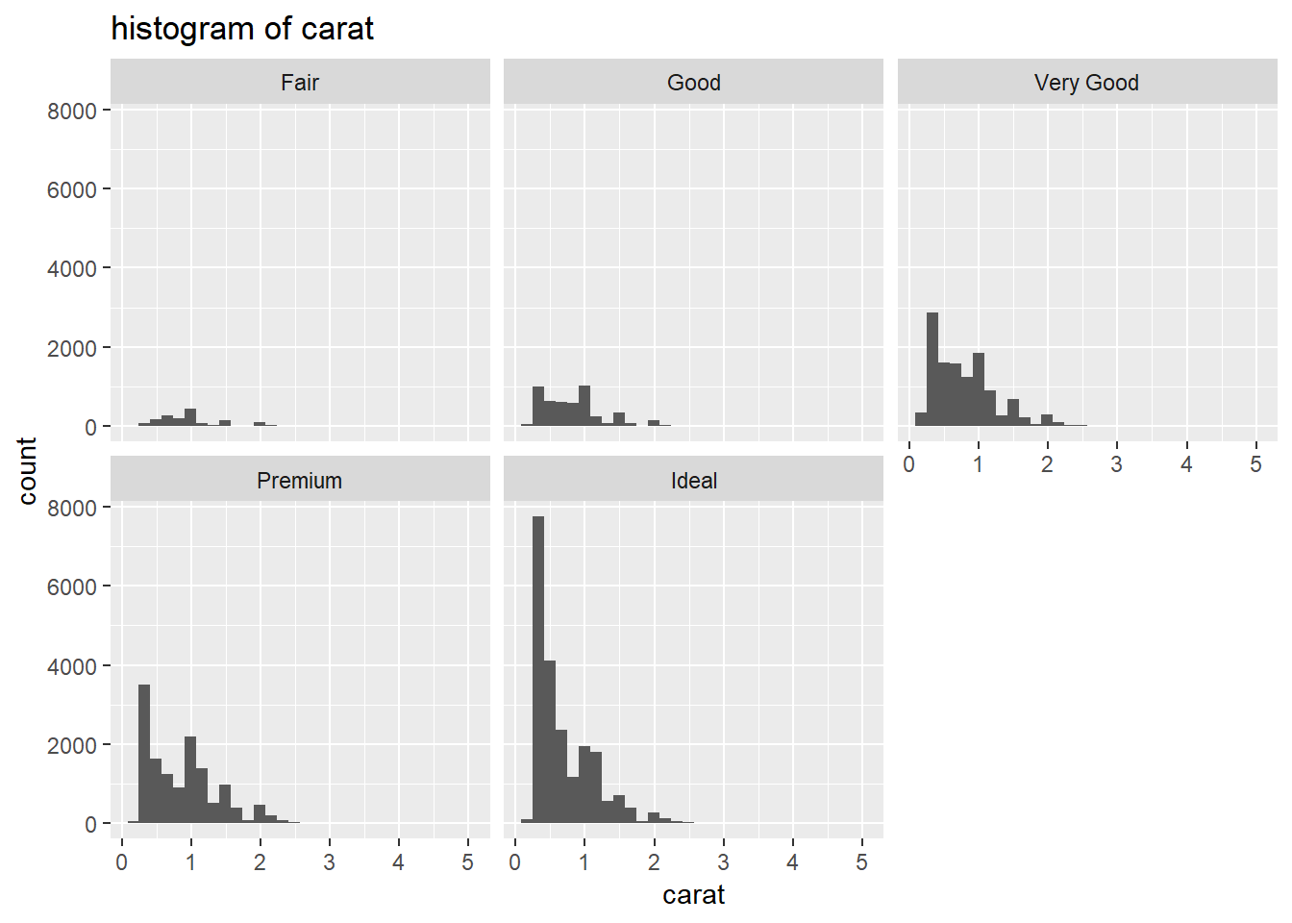
Histogram plots
Histogram subplots for each diamond cut
ggplot(data = diamonds) + geom_histogram(aes(x=carat))+ facet_wrap(~cut) + ggtitle('histogram of carat')

Slide 38
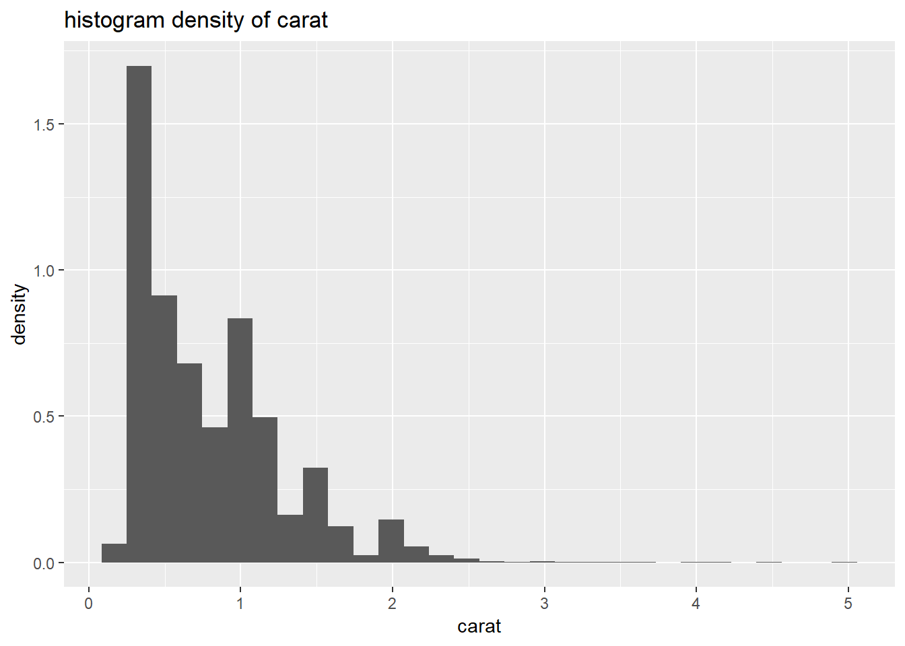
Histogram plots
Histogram density plot for carat
ggplot(data = diamonds) + geom_histogram(aes(x=carat,y=..density..)) + ggtitle('histogram density of carat')
density of a bin =
(bin_count/total_count)/bin_width
Density of a bin is not the same
as frequency

Slide 39
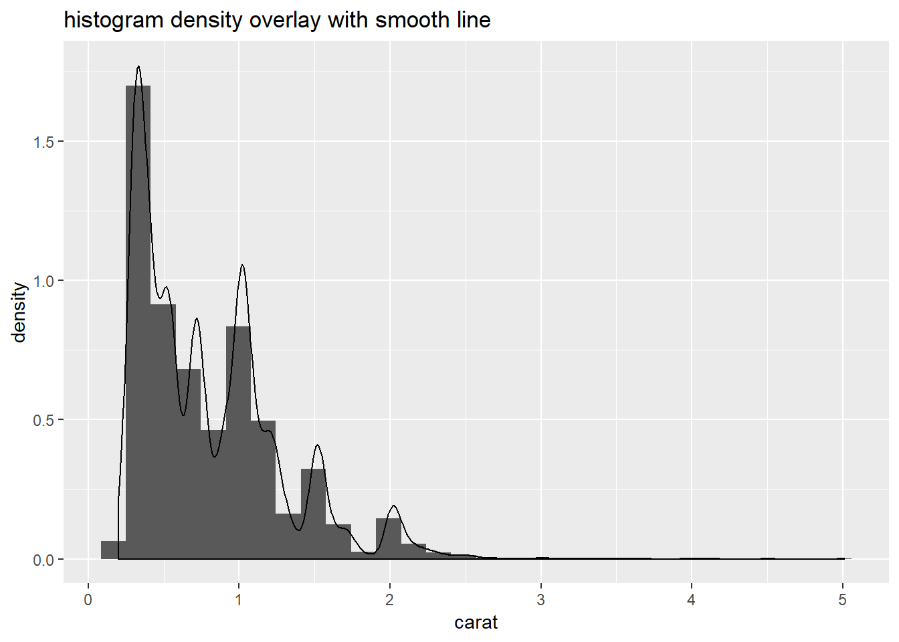
Histogram plots
Histogram density plot overlay with smooth line for carat
ggplot(data = diamonds) + geom_histogram(aes(x=carat,y=..density..)) + geom_density(aes(x=carat)) + ggtitle('histogram density overlay with smooth line')
density of a bin =
(bin_count/total_count)/bin_width
Density of a bin is not the same
as frequency

Slide 40
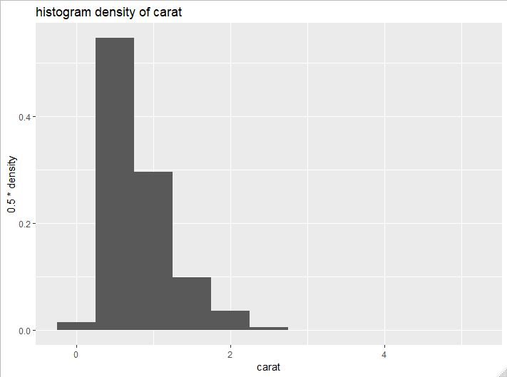
Histogram plots
Proportion plot
binwidth = 0.5
ggplot(data = diamonds) + geom_histogram(aes(x=carat,y=binwidth*..density..),binwidth=bindiwth) + ggtitle('histogram density overlay with smooth line')

Slide 41
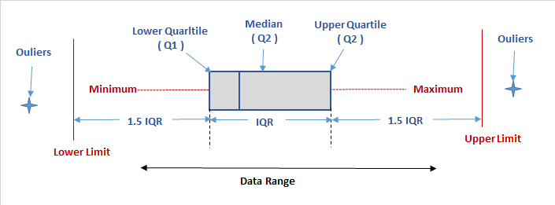
Boxplot
The box plot is a quick way of examining one or more sets of data graphically.
Median
The third quartile (Q₃) is the middle value between the median and the highest value of the data set.
The first quartile (Q₁) is defined as the middle number between the smallest number and the median of the data set.
http://www.physics.csbsju.edu/stats/box2.html
https://en.wikipedia.org/wiki/Quartile

Slide 42
Boxplot

Slide 43
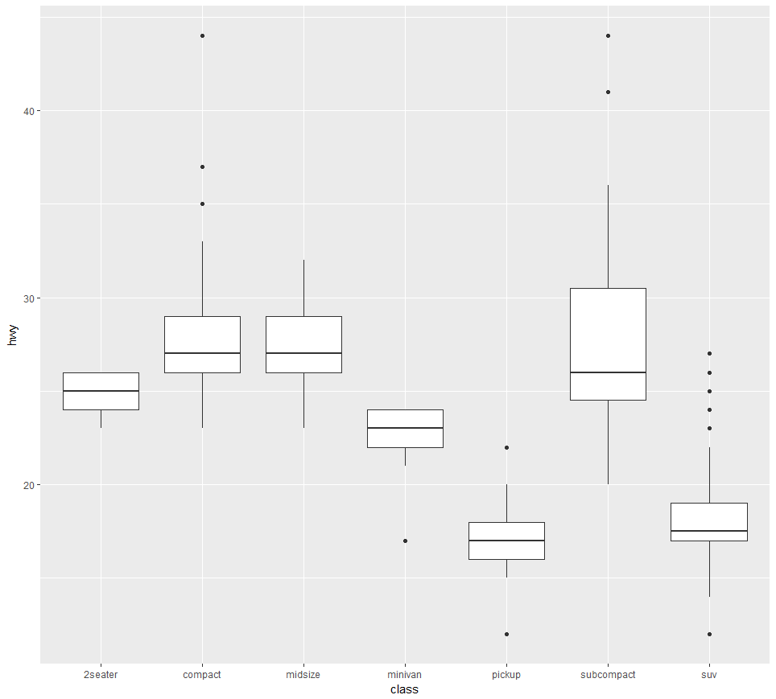
geom_boxplot
> ggplot(data = mpg)+ geom_boxplot( aes(x = class, y = hwy))
Create box plots of “hwy”
for different classes of cars
hwy
Different class of cars

Slide 44
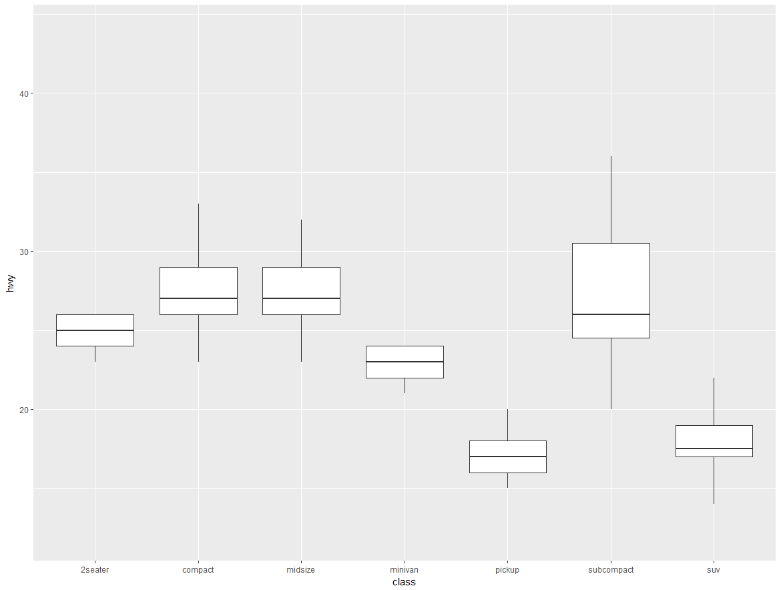
geom_boxplot
> ggplot(data = mpg)+ geom_boxplot( aes(x = class, y = hwy), outlier.shape = NA)
Create box plots of “hwy”
for different classes of cars
DON’T SHOW outliers
hwy
Different class of cars

Slide 45
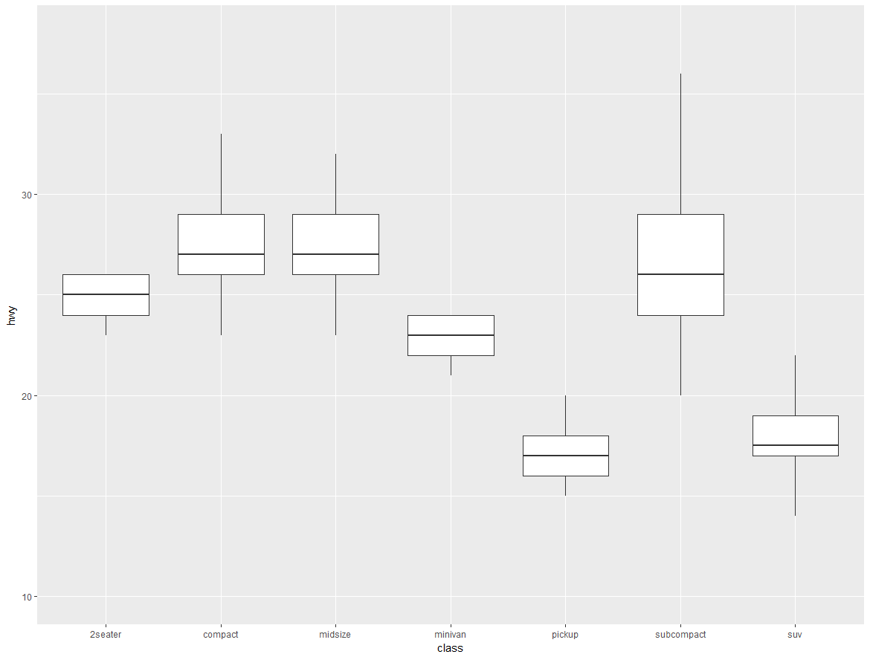
geom_boxplot
ggplot(data = mpg)+ geom_boxplot( aes(x = class, y = hwy), outlier.shape = NA,na.rm=TRUE) + scale_y_continuous(limits = c(10,38))
Create box plots of “hwy”
for different classes of cars
DON’T SHOW outliers
Control the Y-AXIS limits
hwy
Different class of cars

Slide 46
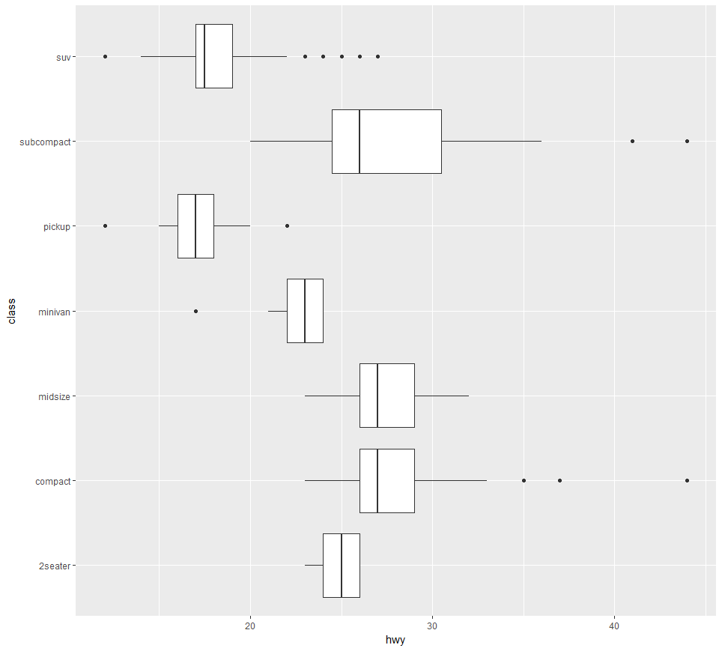
geom_boxplot
> ggplot(data = mpg)+ geom_boxplot( aes(x = class, y = hwy)) + coord_flip()
Create box plots of “hwy”
for different classes of cars
with a flipped coordinate
Different class of cars
hwy

Slide 47
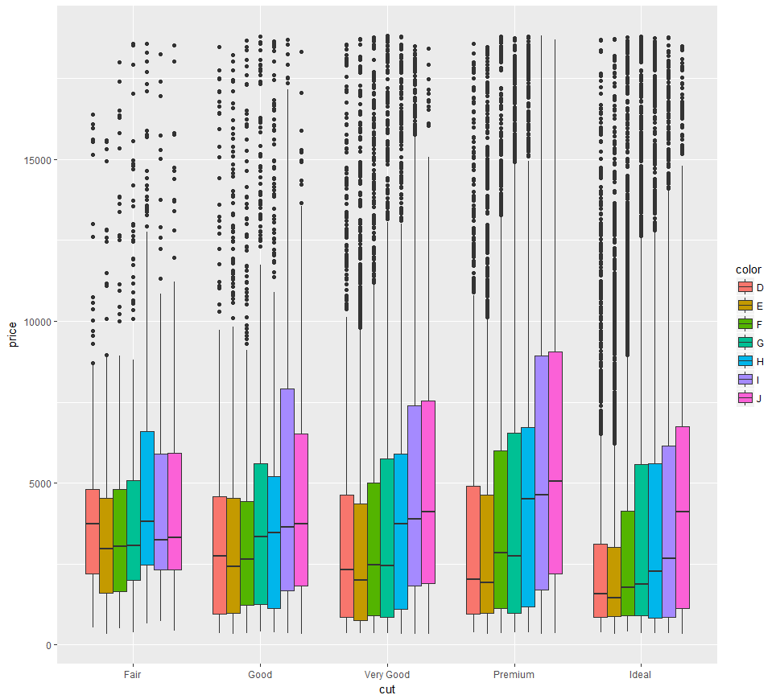
grouped boxplots
ggplot(data = diamonds)+ geom_boxplot( aes(x = cut, y = price,fill=color))
Generate boxplots of price for
diamonds for different
combinations of
cuts and color
Here cut is in each axis. For each cut type, there are boxplots for each color type

Slide 48
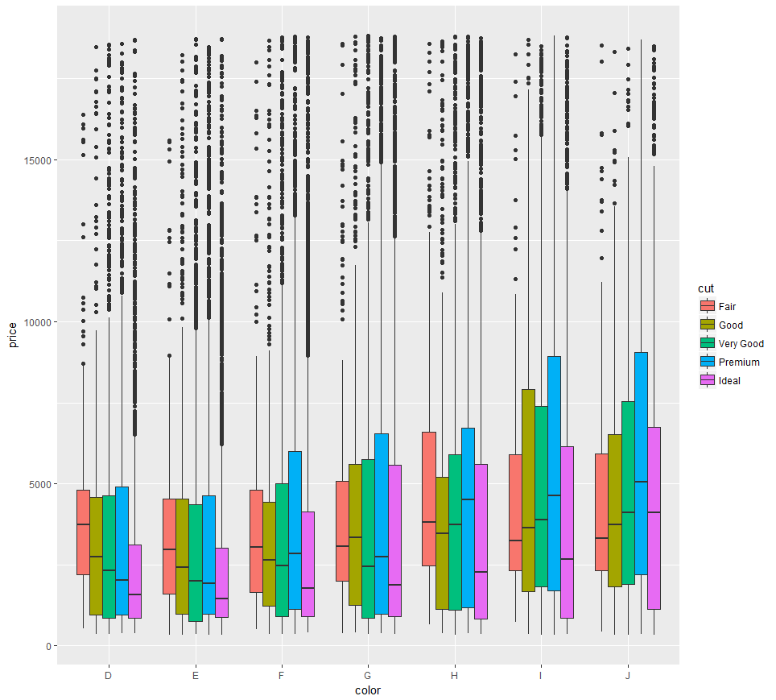
grouped boxplots
Here color is in each axis. For each color, there are boxplots for each cut type
ggplot(data = diamonds)+ geom_boxplot( aes(x = color, y = price,fill=cut))

Slide 49
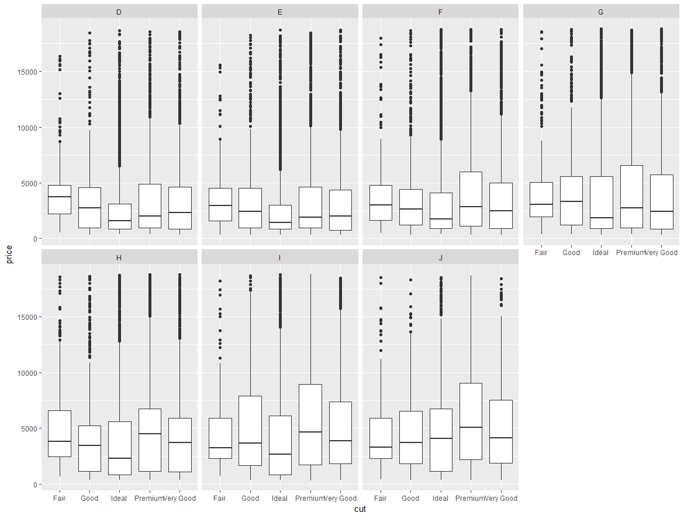
Can you come up with a plot like this ?
Subplots represent different colors of the diamonds

Slide 50
Alternatives to Box plots
Read the file BoxPlots.tsv with five columns
data <- read.table('C:\\Users\\soibamb\\Dropbox\\Teaching\\CS5301\\Visualizations\\SameStatsDataAndImages\\datasets\\BoxPlots.tsv',sep="\t",header=TRUE,row.names = 1)
head(data)
## left lines normal right split
## 0 -9.769107 -9.766561 -9.76 -9.760000 -9.766412
## 1 -9.763145 -9.740994 -9.72 -9.053335 -9.769702
## 2 -9.747123 -9.766780 -9.68 -8.508799 -9.769886
## 3 -9.766589 -9.769112 -9.64 -8.239064 -9.766518
## 4 -9.762826 -9.767437 -9.60 -8.824667 -9.769776
## 5 -9.766694 -9.763220 -9.56 -8.070533 -9.755486

Slide 51
Median look similar across the column
summary(data)
## left lines normal right
## Min. :-9.76964 Min. :-9.769575 Min. :-9.76 Min. :-9.760
## 1st Qu.:-2.68999 1st Qu.:-2.689993 1st Qu.:-2.68 1st Qu.:-2.680
## Median :-0.00999 Median :-0.007132 Median : 0.00 Median : 0.000
## Mean :-1.17780 Mean :-0.831733 Mean : 0.00 Mean : 1.174
## 3rd Qu.: 2.67007 3rd Qu.: 2.670236 3rd Qu.: 2.68 3rd Qu.: 2.680
## Max. : 9.75025 Max. : 9.756001 Max. : 9.76 Max. : 9.760
## split
## Min. :-9.769886
## 1st Qu.:-2.689989
## Median :-0.003099
## Mean :-0.003060
## 3rd Qu.: 2.680000
## Max. : 9.760000

Slide 52
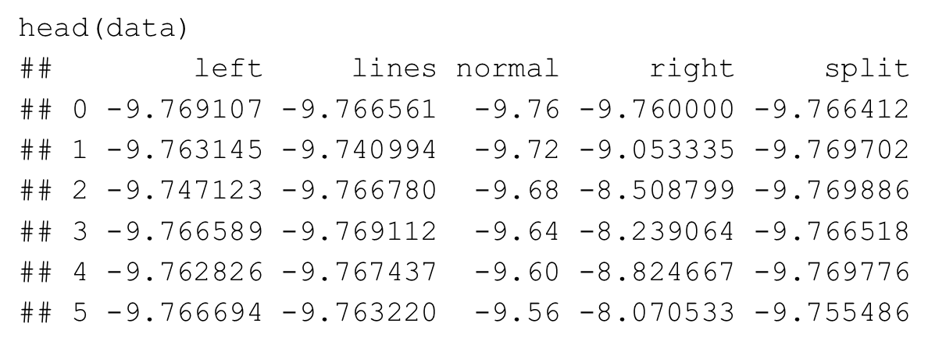
Prepare data in a right form to be usable by ggplot2
library(reshape2)
new_data <- melt(data)
## No id variables; using all as measure variables
head(new_data)
## variable value
## 1 left -9.769107
## 2 left -9.763145
## 3 left -9.747123
## 4 left -9.766589
## 5 left -9.762826
## 6 left -9.766694
Col names from original format in variable
column of new format
Corresponding values in original format in
Value column of new format
Original format

Slide 53
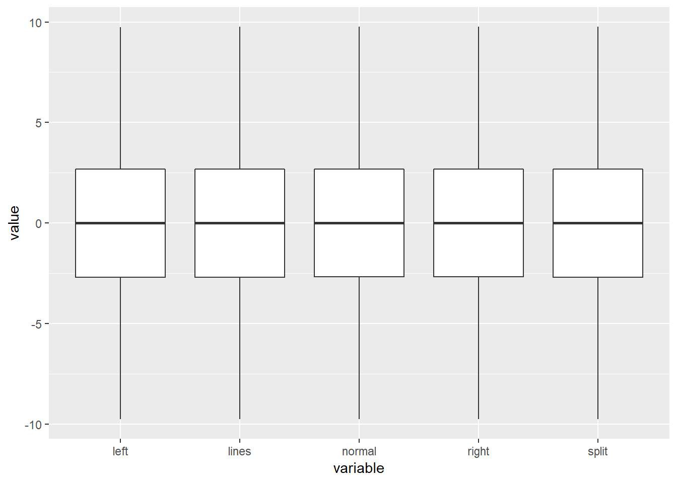
Boxplot can be misleading
Boxplot show all five data are similar
ggplot(data=new_data) + geom_boxplot(aes(x=variable,y=value),outlier.shape = NA)

Slide 54
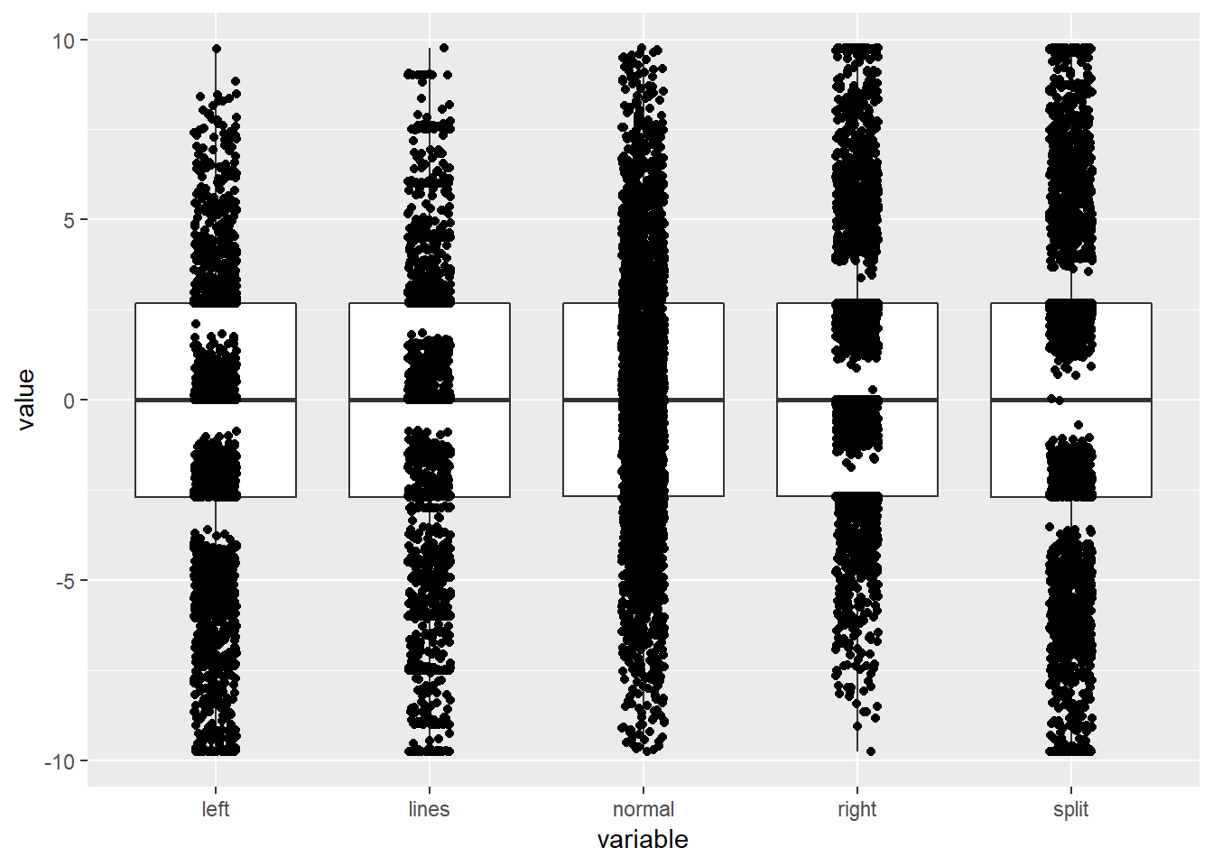
Boxplot can be misleading (2)
Add a jitter plot to the box plot to show distribution
Data look different now
ggplot(data=new_data) + geom_boxplot(aes(x=variable,y=value),outlier.shape = NA) + geom_jitter(aes(x=variable,y=value),position=position_jitter(width=.1, height=0))
Within each variable,
horizontal Locations of
points are randomized
between
-width and +width

Slide 55
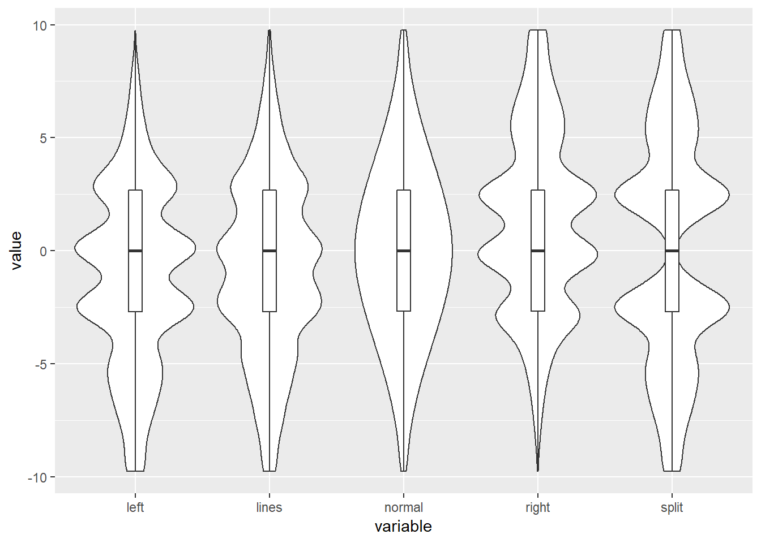
Boxplot can be misleading (3)
Violin plot + overlay a box plot with small width
ggplot(data=new_data) + geom_violin(aes(x=variable,y=value)) + geom_boxplot(aes(x=variable,y=value),width=0.1)
High density of points
Low density of points

Slide 56
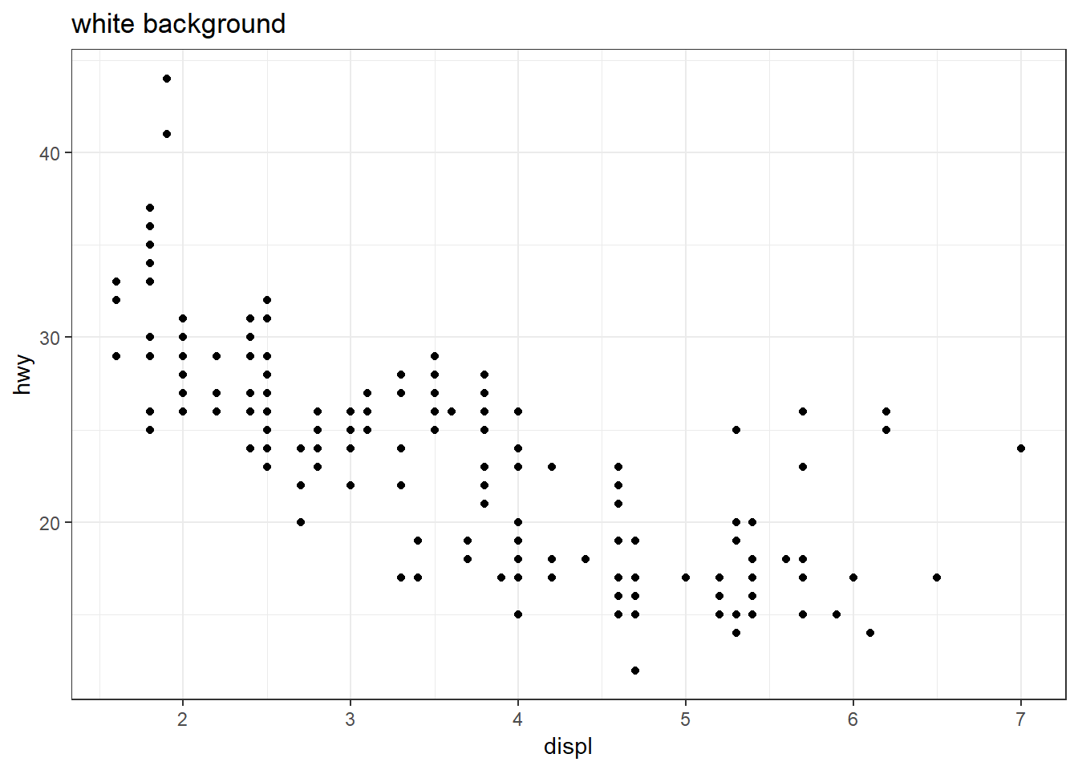
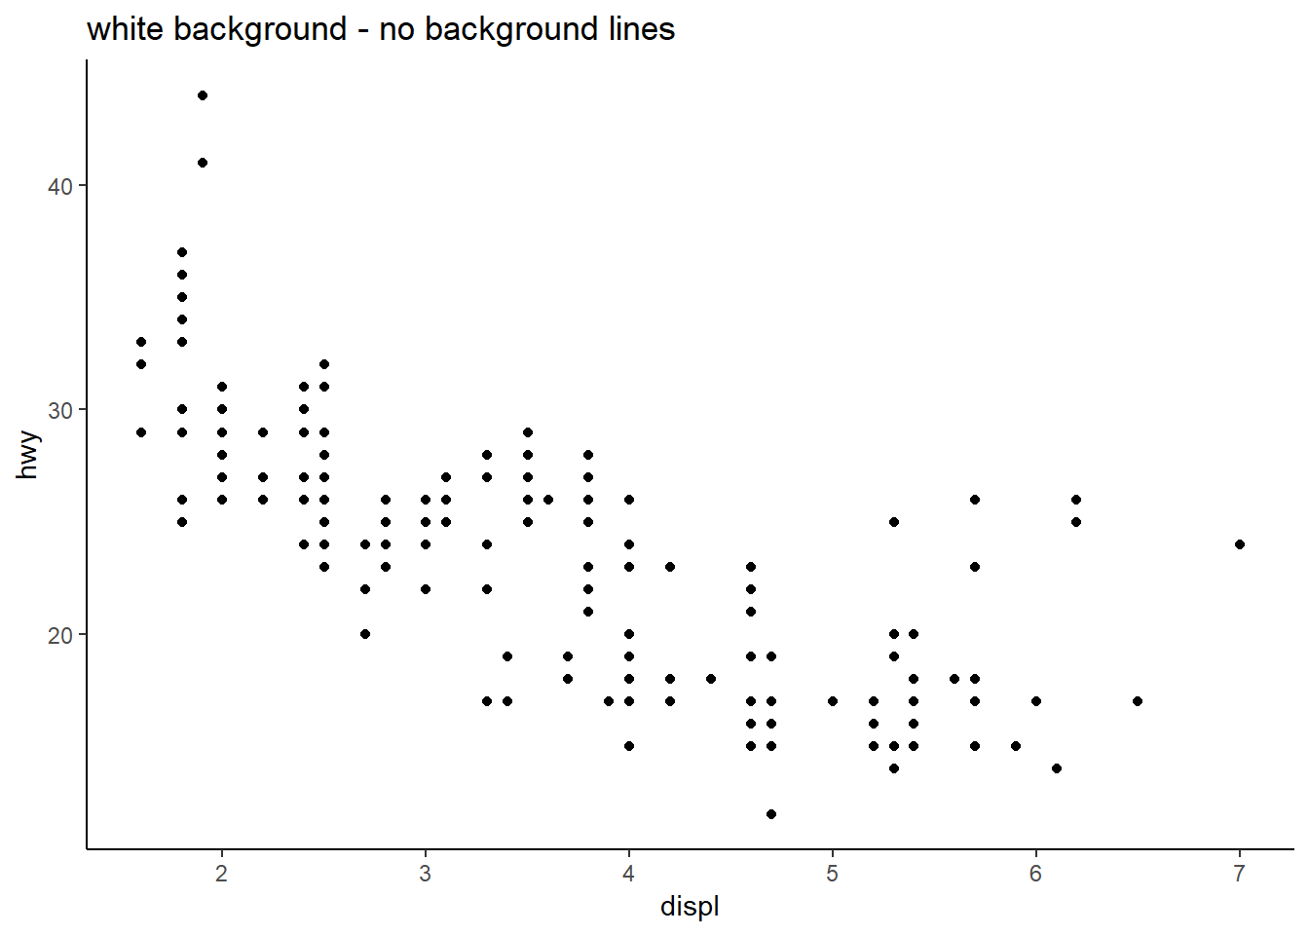
Changing background
ggplot(data=mpg) + geom_point(aes(x=displ,y=hwy)) + theme_bw() + ggtitle("white background")
ggplot(data=mpg) + geom_point(aes(x=displ,y=hwy)) + theme_classic() + ggtitle("white background - no background lines")

