Slide 1
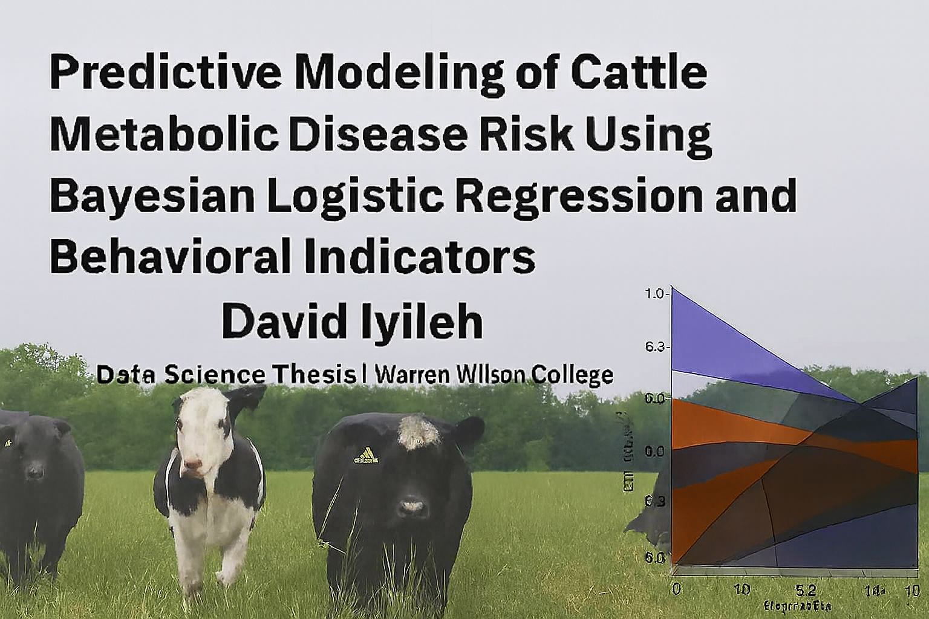
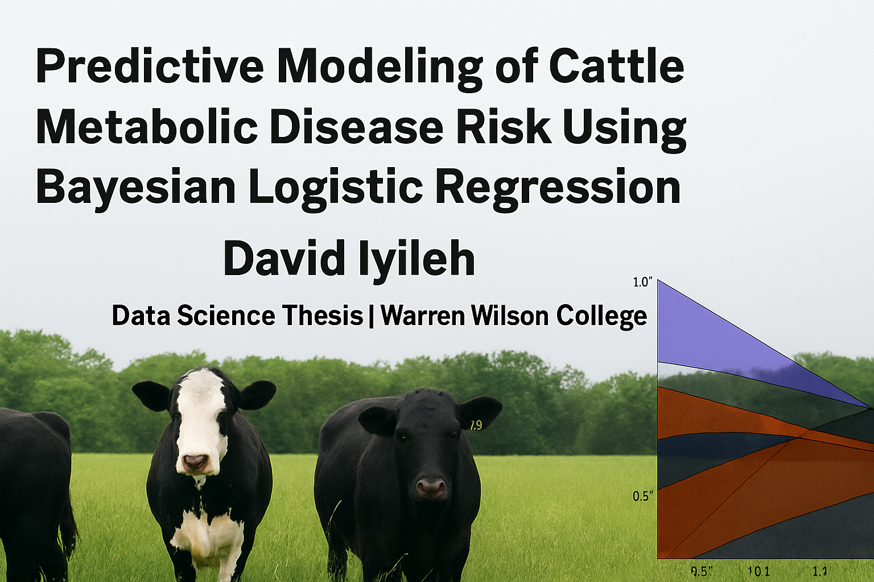

Slide 2
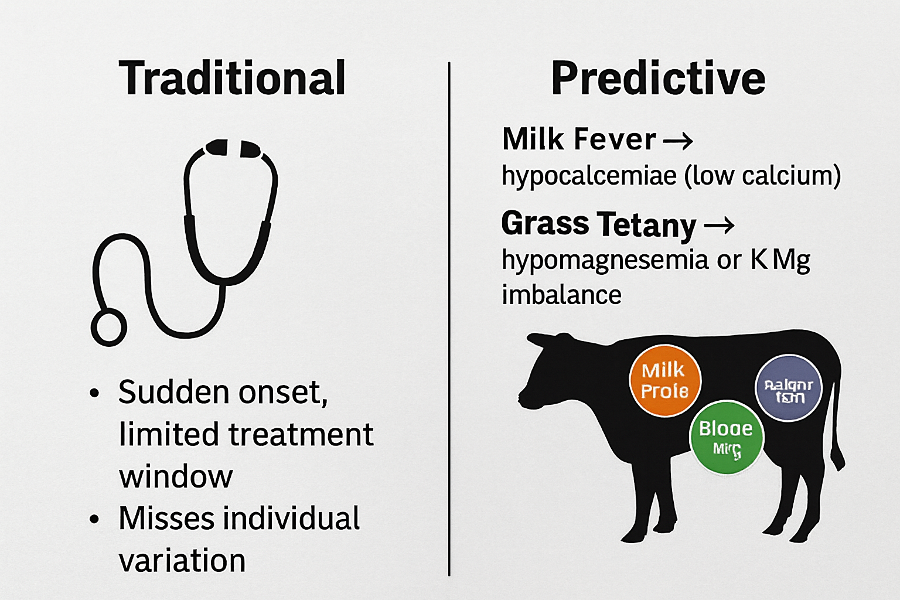
Research Problems
Goal:
These diseases strike suddenly, and traditional diagnostics rely on thresholds or visual symptoms.
My research addresses the gap by modeling individualized risk probabilities
Symptoms:
Grass Tetany: A magnesium deficiency disorder in cattle causing muscle tremors, excitability, and sudden collapse, often triggered by grazing lush spring pastures.
Milk Fever: A calcium deficiency around calving that leads to muscle weakness, cold extremities, and recumbency, especially in older dairy cows.

Slide 3
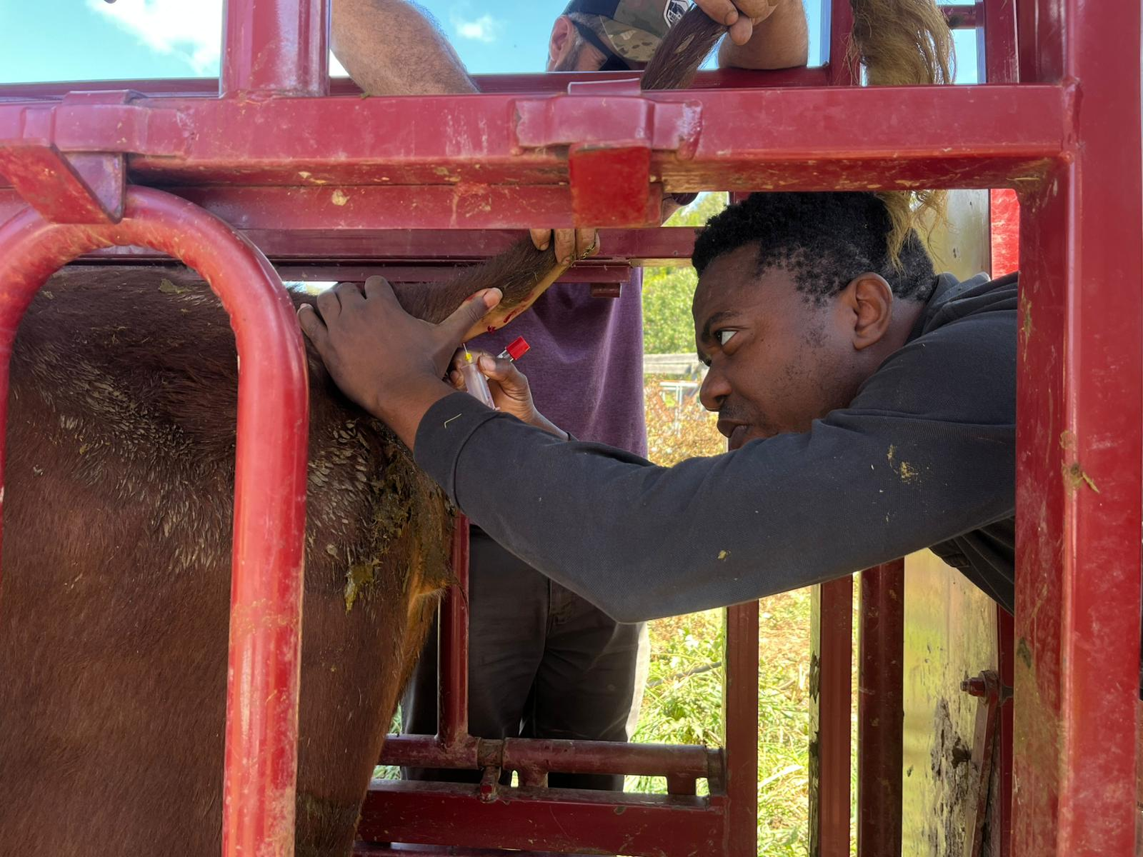
Objective & Data Sources
Objective:
To develop interpretable machine learning models that detect early metabolic vulnerability by integrating mineral thresholds, behavioral indicators, and temporal dynamics.
Data Source:
We use longitudinal cattle health data from Warren Wilson College’s working farm, including:
Biochemical assays (ICP-OES, AAS) for calcium, magnesium, and potassium levels
Behavioral metrics such as chute score and exit velocity
Real-world conditions reflecting ecological variability and physiological stress

Slide 4
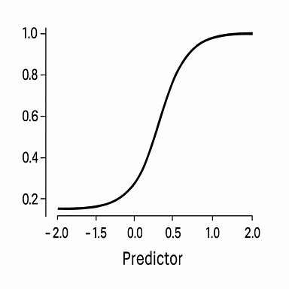
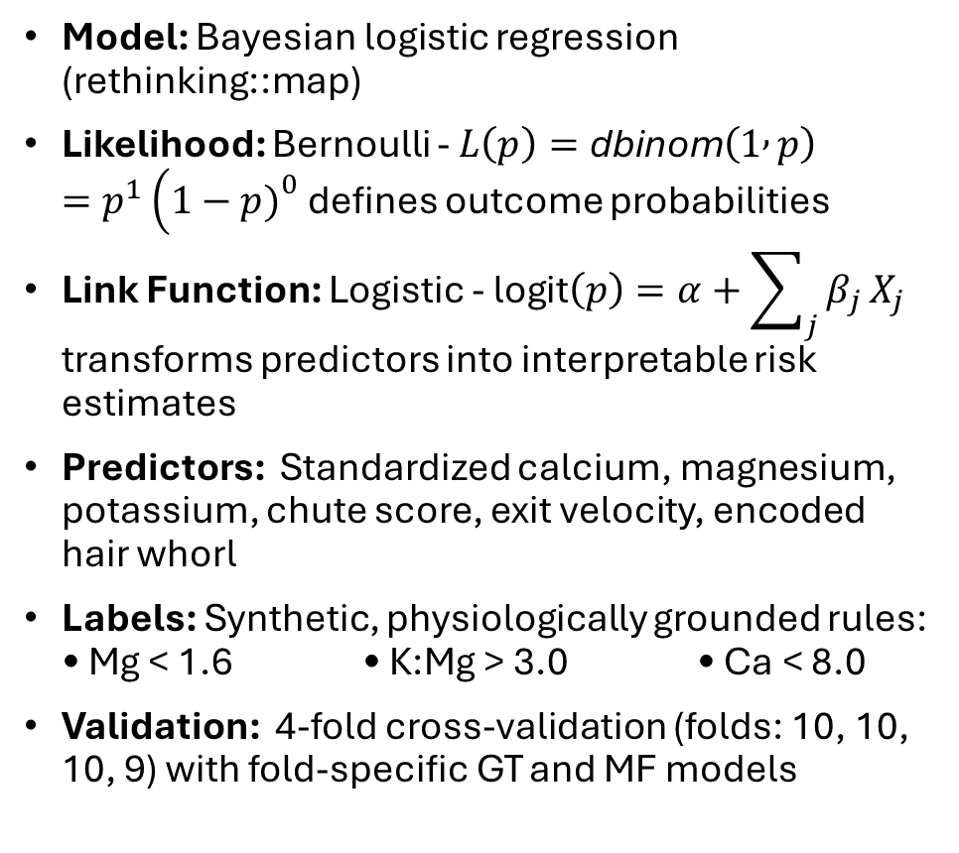
Methodology Overview
Model: Bayesian logistic regression (rethinking::map)
Likelihood: Bernoulli - $L\left(p\right)=\text{dbinom}\left(1 , p\right)=p^{1}\left(1−p{\left.)\right.}^{0}\right.$ defines outcome probabilities
Link Function: Logistic - $\text{logit}\left(p\right)=α+\sum_{j}{β_{j}}X_{j}$ transforms predictors into interpretable risk estimates
Predictors: Standardized calcium, magnesium, potassium, chute score, exit velocity, encoded hair whorl
Labels: Synthetic, physiologically grounded rules: • Mg < 1.6 • K:Mg > 3.0 • Ca < 8.0
Validation: 4-fold cross-validation (folds: 10, 10, 10, 9) with fold-specific GT and MF models
Notes:
Modeling Approach: We apply Bayesian logistic regression with physiologically grounded labels, integrating mineral and behavioral predictors through cross‑validated models

Slide 5
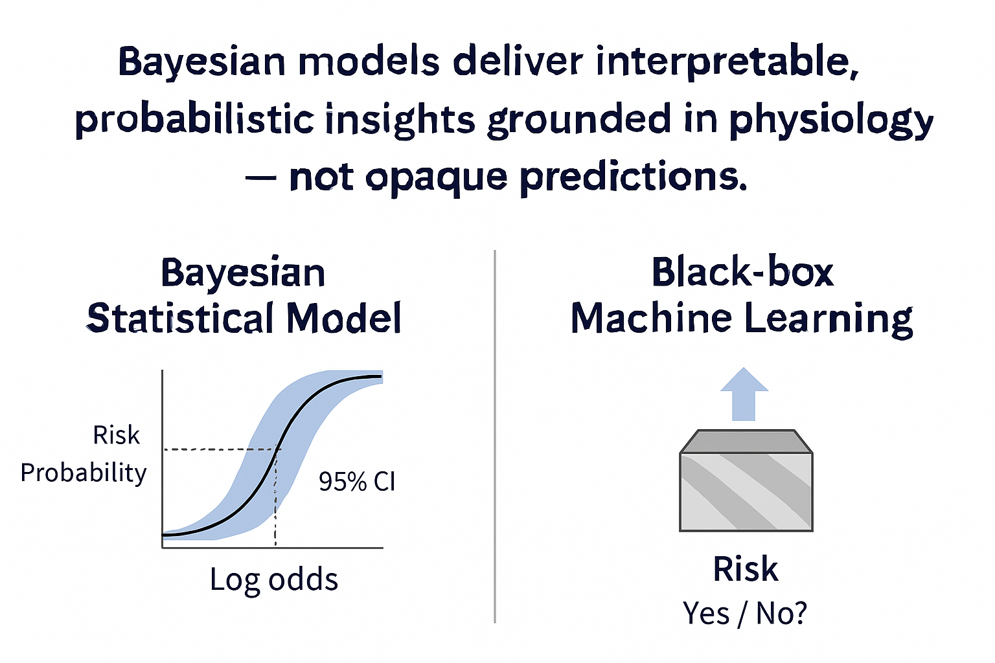
Why Bayesian (and not black‑box ML?)
Probabilities, not flags:
Outputs are continuous risk probabilities per cow, not binary yes/no labels.
Uncertainty is explicit :
Posterior distributions and HPDIs quantify confidence, not just point estimates.
Interpretability is physiological:
Coefficients map directly to mineral thresholds and behavioral indicators.
Data reality is respected:
Bayesian methods handle small, imbalanced datasets without sacrificing rigor.
From Physiology to Probabilities:
Bayesian models deliver interpretable, probabilistic insights grounded in physiology — not opaque predictions.”

Slide 6
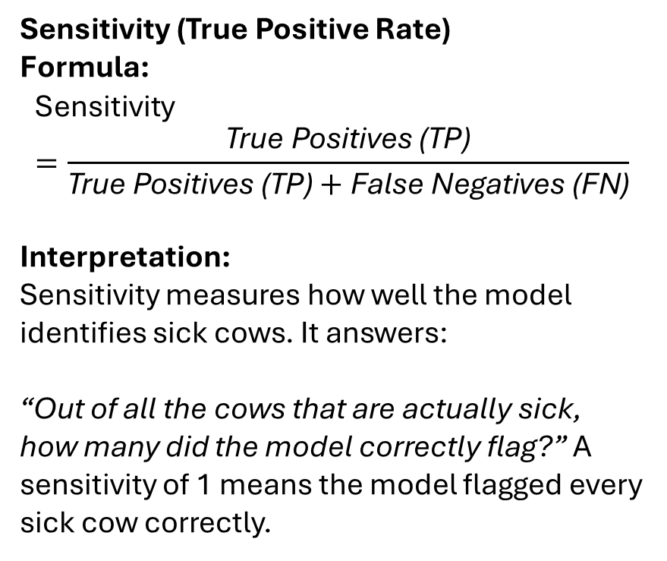
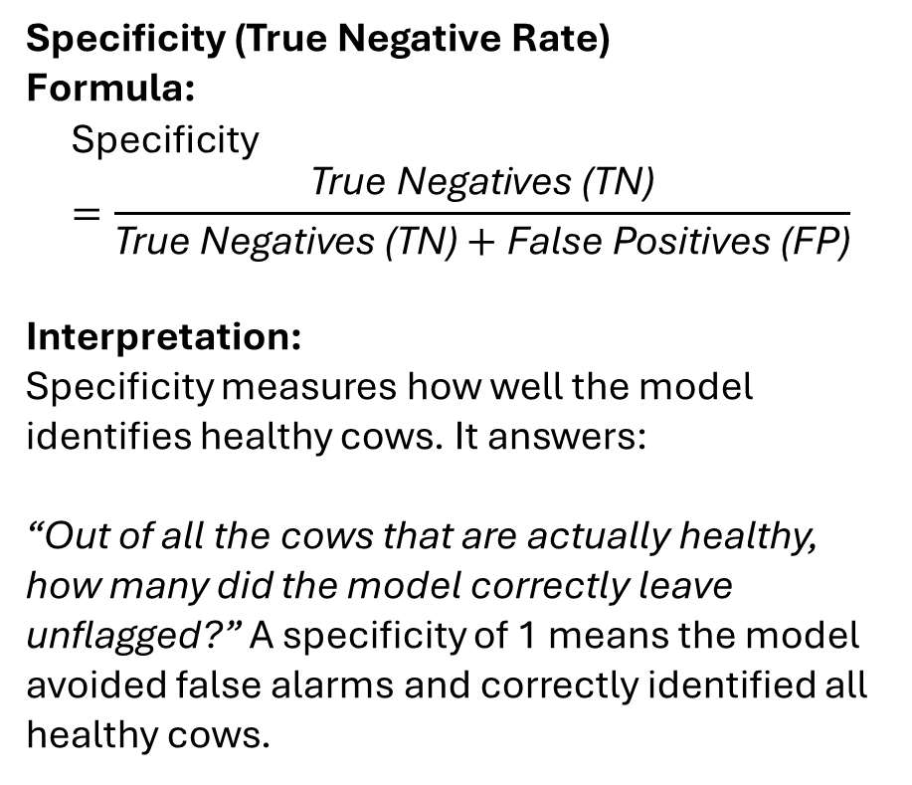
Diagnostic Metrics for Model Evaluation
Specificity (True Negative Rate)
Formula:
$$\text{Specificity}=\frac{\text{True} \text{Negatives}\text{ (}\text{TN}\text{)}}{\text{True} \text{Negatives}\text{ (}\text{TN}\text{)}+\text{False} \text{Positives}\text{ (}\text{FP}\text{)}}$$
Interpretation:
Specificity measures how well the model identifies healthy cows. It answers:
“Out of all the cows that are actually healthy, how many did the model correctly leave unflagged?” A specificity of 1 means the model avoided false alarms and correctly identified all healthy cows.
Sensitivity (True Positive Rate)
Formula:
$$\text{Sensitivity}=\frac{\text{True} \text{Positives}\text{ (}\text{TP}\text{)}}{\text{True} \text{Positives}\text{ (}\text{TP}\text{)}+\text{False} \text{Negatives}\text{ (}\text{FN}\text{)}}$$
Interpretation:
Sensitivity measures how well the model identifies sick cows. It answers:
“Out of all the cows that are actually sick, how many did the model correctly flag?” A sensitivity of 1 means the model flagged every sick cow correctly.

Slide 7
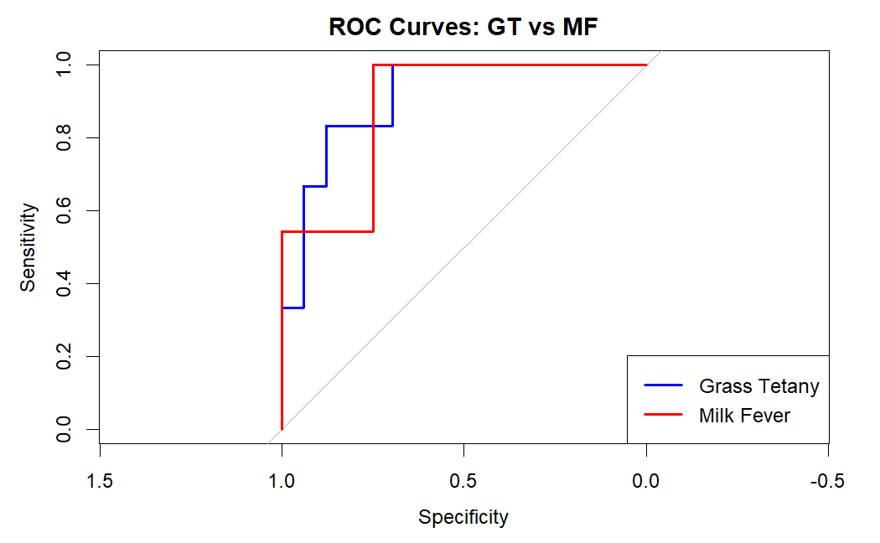
ROC Curves – Sensitivity vs Specificity
Sensitivity (True Positive Rate): Measures how well the model identifies sick cows. A sensitivity of 1 means the model flags every sick cow correctly.
Specificity (True Negative Rate): Measures how well the model identifies healthy cows. A specificity of 1 means the model avoids false alarms and correctly identifies all healthy cows.
False Positive Rate (1 - Specificity): The proportion of healthy cows incorrectly flagged as sick.
Elbow Points: Represent optimal trade-offs between sensitivity and specificity — where the model performs best diagnostically.

Slide 8
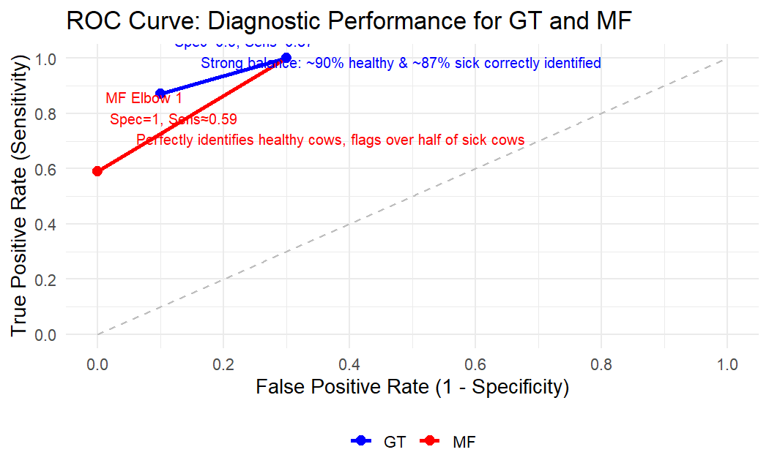
ROC Curve: Diagnostic Accuracy of Milk Fever vs Grass Tetany
MF Elbow 1 (Red, Spec = 1, Sens ≈ 0.59): Perfectly identifies healthy cows, but misses ~40% of sick cows.
MF Elbow 2 (Red, Spec ≈ 0.7, Sens = 1): Flags all sick cows, correctly identifies 70% of healthy cows.
GT Elbow 1 (Blue, Spec ≈ 0.9, Sens ≈ 0.87): Strong balance ~90% healthy and ~87% sick cows correctly identified.
GT Elbow 2 (Blue, Spec ≈ 0.7, Sens = 1): Flags all sick cows, correctly identifies 70% of healthy cows.
Random Classifier (Dashed line): Baseline performance, showing chance‑level separation.
Notes:
So overall, the red MF curve emphasizes trade‑offs between strict specificity and full sensitivity, while the blue GT curve demonstrates a more balanced diagnostic profile. The dashed line shows what random guessing would look like, and both tests clearly outperform it

Slide 9
Results Overview
ROC Curve Performance
ROC:
  Milk Fever (MF) curve shows stronger discrimination — clear separation from random classifier
  Grass Tetany (GT) curve weaker — reflects challenge of rare-event prediction
Accuracy:
Model-based predictions:
  GT accuracy = 84.6%
  MF accuracy = 89.7%
Rule-based flags (thresholds):
  GT accuracy = 97.4%
  MF accuracy = 100%
Insight: Deterministic flags are highly accurate but lack nuance. Model predictions add uncertainty quantification and better generalization.
Coefficient Effects (Posterior HDPI)
Lower Ca and Mg → strong increase in predicted risk
Chute and Exit scores → weak associations with stress physiology
Hair whorl position → small but directional behavioral effect
Notes:
ROC Curve Insights:
Overall, ROC curves highlight the model’s ability to discriminate risk, with Milk Fever showing strong separation and Grass Tetany reflecting the inherent challenge of rare‑event prediction

Slide 10
Confusion Matrix: Diagnostic Performance for GT and MF
This table compares the cows flagged as ‘at risk’ by our model against their actual health outcomes. It shows how well the risk‑flagging aligns with reality.”
Grass Tetany (GT)
Milk Fever (MF)
 | Sick | Healthy
Flagged | TP: 5 Sick cows correctly flagged, no false alarms | FP: 0 No healthy cows incorrectly flagged
Not Flagged | FN: 1 Sick cow missed | TN: 33 Healthy cows correctly identified
 | Sick | Healthy
Flagged | TP: 35 Sick cows correctly flagged, no false alarms | FP: 4 Healthy cows incorrectly flagged
Not Flagged | FN: 0 No sick cows missed (perfect sensitivity) | TN: 0 No healthy cows correctly identified
This confusion matrix shows that Grass Tetany detection achieved high specificity with one false negative, while Milk Fever detection reached perfect sensitivity but produced four false positives.

Slide 11
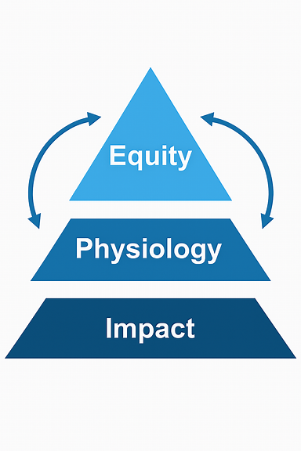
Conclusion – Key Narrative
Bayesian modeling strengthens herd health diagnostics by combining accuracy, interpretability, and uncertainty quantification.
Milk Fever vs. Grass Tetany: reliable, physiologically grounded predictions for Milk Fever; rare-event challenges but validated signals for Grass Tetany.
Broader impact: actionable dashboards connect predictive analytics to real-world decision-making and translational health applications.
Predictive modeling is not just a statistical tool — it’s a pathway to equity, physiology, and impact.

Slide 12
Citations
Xiao, S., Dhand, N. K., Wang, Z., Hu, K., Thomson, P. C., House, J. K., & Khatkar, M. S. (2025). Review of applications of deep learning in veterinary diagnostics and animal health. Frontiers in Veterinary Science, 12, 1511522. https://doi.org/10.3389/fvets.2025.1511522 →
Discusses how machine learning and deep learning are applied in veterinary diagnostics, including biomarker-based disease prediction.
Stewart, A. J. (2025). Hypomagnesemic tetany in cattle and sheep. In MSD Veterinary Manual. Retrieved from https://www.msdvetmanual.com/metabolic-disorders/disorders-of-magnesium-metabolism/hypomagnesemic-tetany-in-cattle-and-sheep →
Provides veterinary background on Grass Tetany, its link to magnesium deficiency, and diagnostic thresholds.
Harris, S., Shallcrass, M., & Cohen, S. (2024). A review of animal-based welfare indicators for calves and cattle. Ruminants, 4(4), 565–601. https://doi.org/10.3390/ruminants4040040 → Reviews behavioral indicators (chute and exit scores, hair whorl) as predictors of cattle stress and health.
Hitchcock, D. B. (2024). Bayesian logistic regression models. STAT 535: Chapter 13 Lecture Notes. University of South Carolina. Retrieved from https://people.stat.sc.edu/hitchcock/stat535slides13BRBhandout.pdf →
Explains Bayesian logistic regression foundations, including dbinom and logit functions used in my modeling.
Lee, S. (2025). Precision–Recall Curve: A comprehensive guide. Number Analytics Blog. Retrieved from https://www.numberanalytics.com/blog/precision-recall-curve-comprehensive-guide →
Explains PR curves and why they are critical for imbalanced datasets like cattle disease prediction.

Slide 13

Acknowledgement
Dr. Christopher Potvin, Dr. Elizabeth Benavides, and Dr. Langdon Martin.
Mathematics Department and NSURS Program
Warren Wilson College Farm Crew and Managers
Cape Eleuthera Institute
Thanks to the audience and open to questions
Notes:
I want to close by acknowledging the people who made this work possible. First, my mentors — Dr. Christopher Potvin, Dr. Elizabeth Benavides, and Professor Langdon Martin — whose guidance shaped both the technical rigor and the broader vision of this thesis. I also thank my collaborator at the Warren Wilson College farm for caring for the cattle used in this project, and my colleagues at the Cape Eleuthera Institute, who taught me the importance of cultural responsiveness and ecological context in analytics.
I am grateful to Warren Wilson College Data Science/Mathematics Department and the NSURS program for providing the academic foundation and support to pursue this interdisciplinary work. Finally, I thank my family and community for their encouragement and resilience, which gave me the strength to carry this project forward. This thesis is as much about people as it is about data, and I am deeply appreciative of everyone who contributed to its success.

