Slide 1
Stock Price Simulation using ARIMA and CART Models
Midterm Presentation
5-31-2024
Yilun (Aaron) Ma,
Shuhan (Susan) Yi,
Jason (Zikai) Fang,
Bowen (Lucas) Lu

Slide 2
Introduction
Objective:
Use different methods, including traditional regression models like ARIMA and more advanced machine learning models like Decision Trees to simulate and explain the change of stock returns every day
Compare the difference of the two and potentially develop a trading algorithm based on simulations
Datasets:
yfinance
Tools:
Juypter Notebook
Github
Numpy, Statsmodels, sklearn, etc

Slide 3
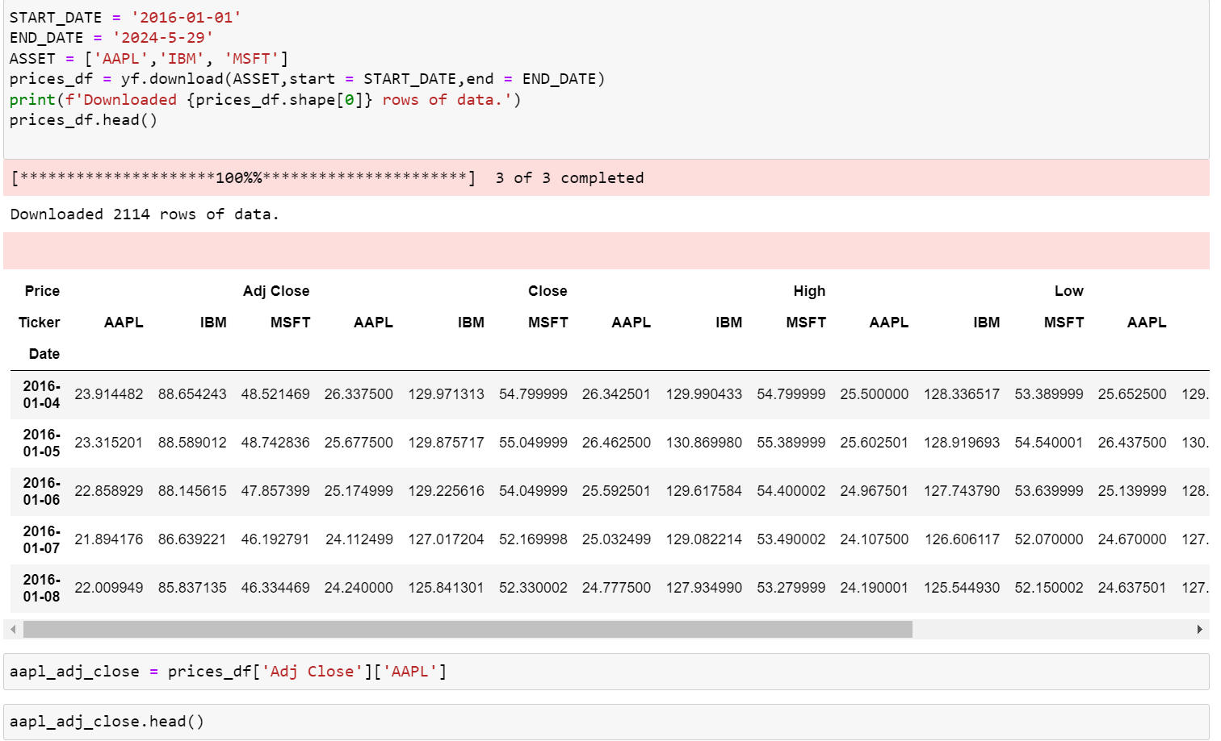
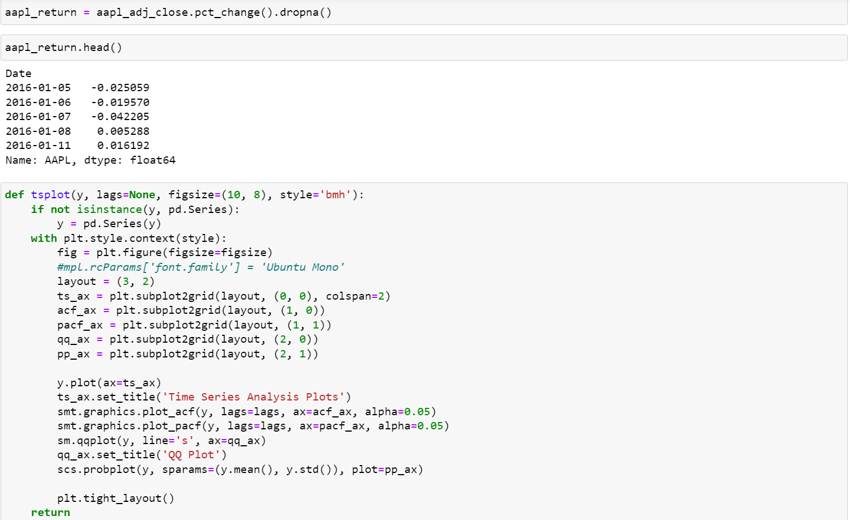
ARIMA MODEL
Data Selection
Yfinance is a powerful package on python that allow us to get the price information for almost every stock at NYSE
We use yfinance to get the adjusted closing price of Aaple(AAPL), and turn the price into return rate so that the data are stationary
Lastly, we clean the data and make a set of analysis plots

Slide 4
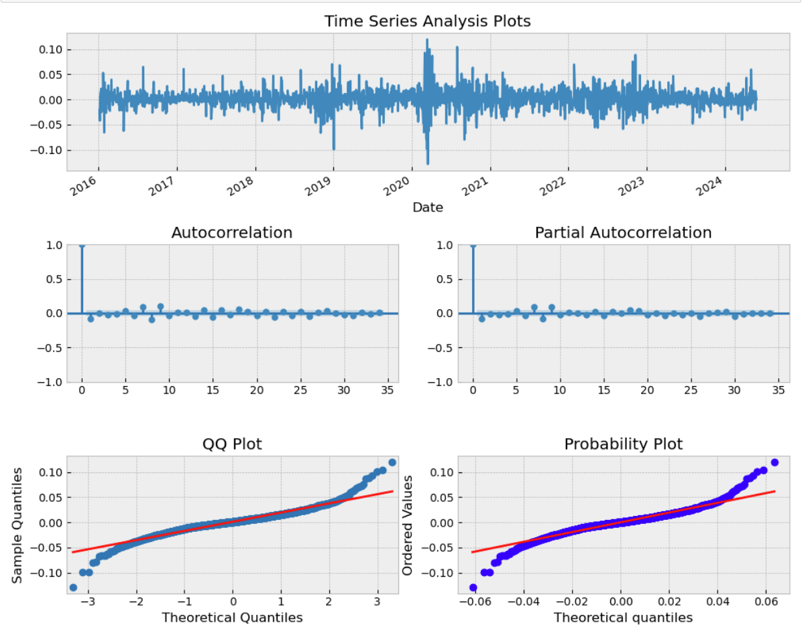
ARIMA MODEL
Data Selection
Yfinance is a powerful package on python that allow us to get the price information for almost every stock at NYSE
We use yfinance to get the adjusted closing price of Aaple(AAPL), and turn the price into return rate so that the data are stationary
Lastly, we clean the data and make a set of analysis plots

Slide 5
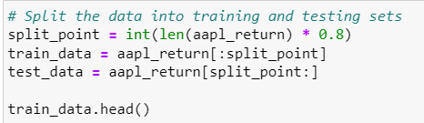
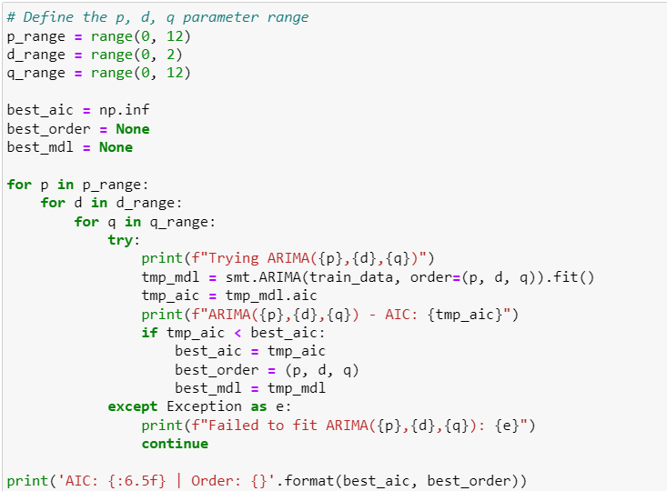
ARIMA MODEL
Train the Model
We split the data into two parts
80% old data used to train the model
20% more recent data used to test the model
Now we can use the ARIMA model in statsmodel to fit our data
To find the ideal model, we use a for loop to iterate and find the best model based on Akaike information criterion(AIC)

Slide 6
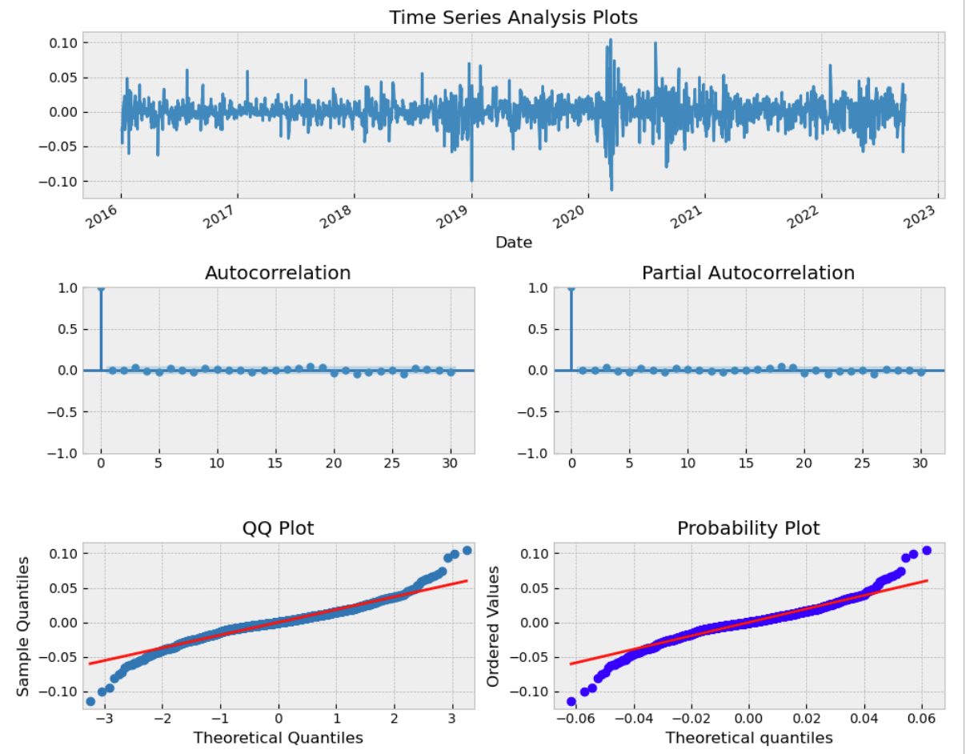
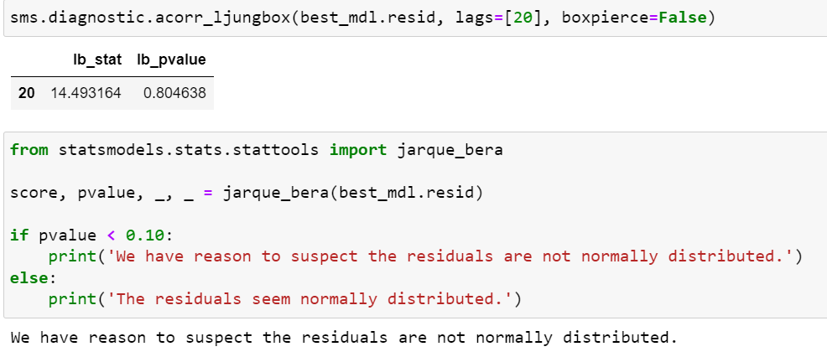
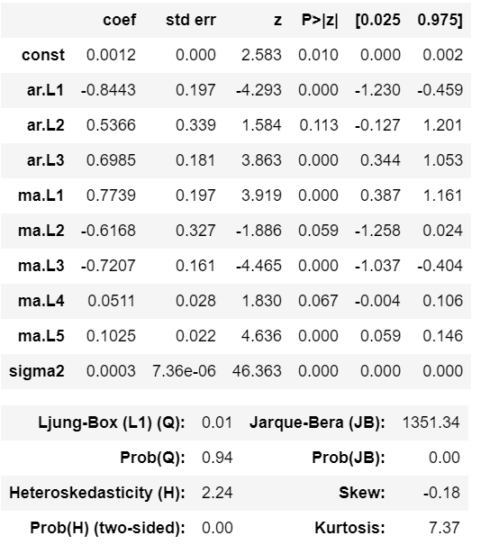
ARIMA MODEL
Result
We draw the analysis plots based on the model’s residual
The AutoCorrelation and Partial AutoCorrelation is low
However, the residual are still not normal
Then we test our best model with the test data set
Remind that we use a rolling forecast
We use the 1st to kth data to predict the return on the next first date
Then use 2nd to kth data and the prediction on the (k+1)th data to predict the return on the next data with the same model
…

Slide 7
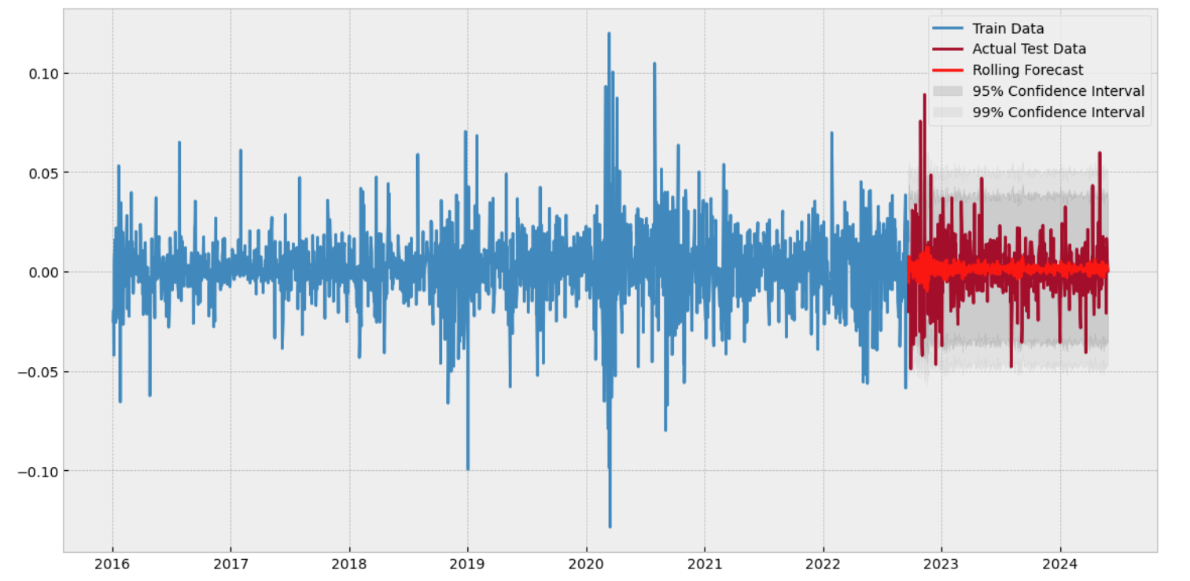

ARIMA MODEL
Result
We draw the analysis plots based on the model’s residual
The AutoCorrelation and Partial AutoCorrelation is low
However, the residual are still not normal
Then we test our best model with the test data set, which gives us a satisfying result
Remind that we use a rolling forecast
We use the 1st to kth data to predict the return on the next first date
Then use 2nd to kth data and the prediction on the (k+1)th data to predict the return on the next data with the same model
…

Slide 8
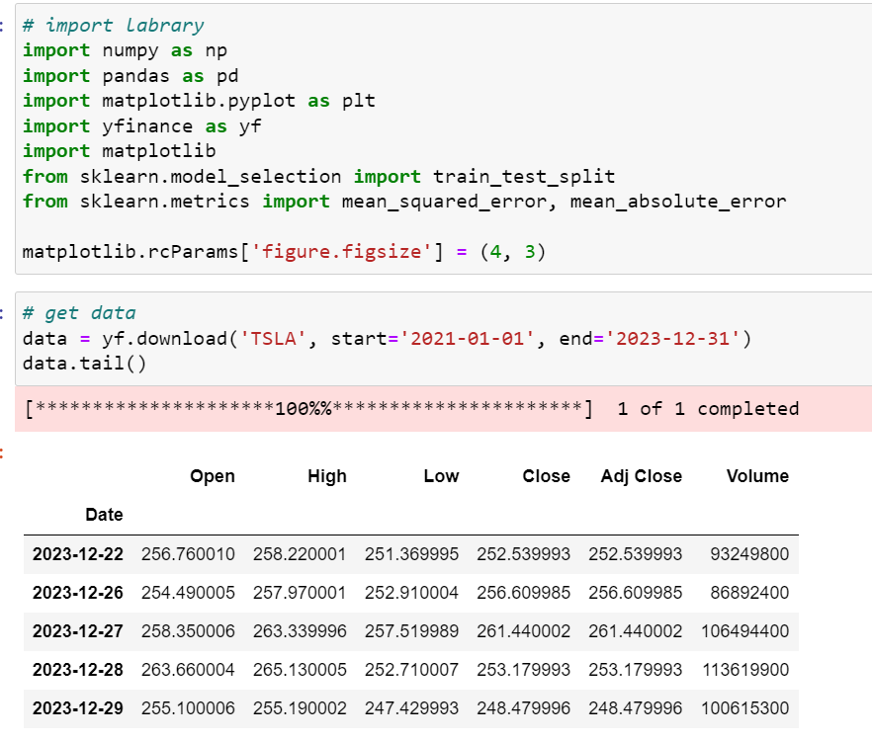
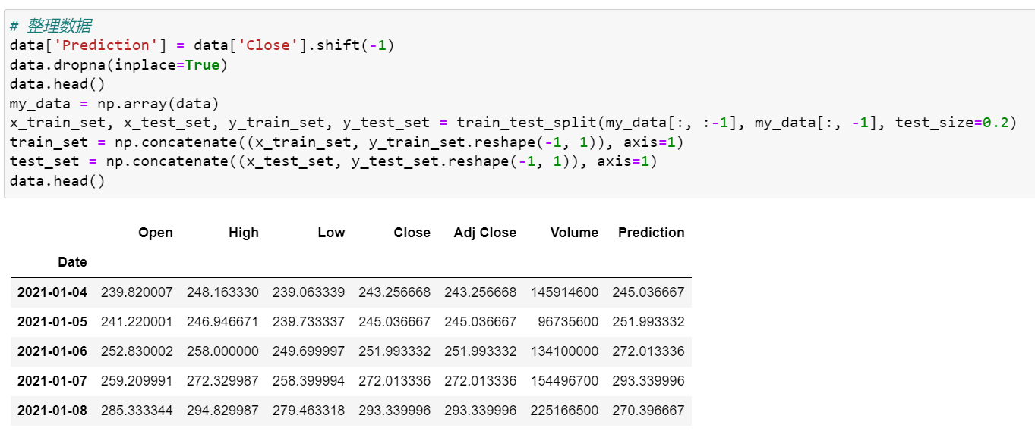
CART MODEL
Data Selection/Cleaning/Splitting
Now we use the stock price of Tesla(TSLA) as our dataset for CART Model
We make an additional column “Prediction” as our target of the model
We then clean the dataset and use the split function to split the dataset into two parts
80% for training
20% for testing

Slide 9
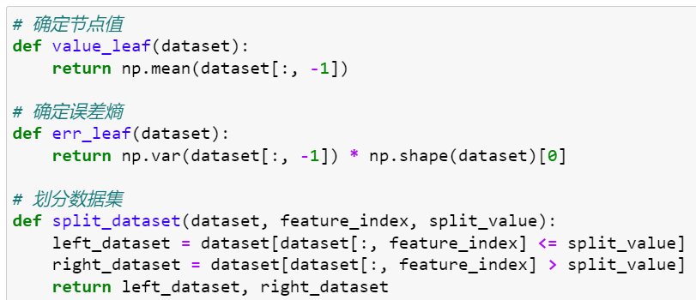
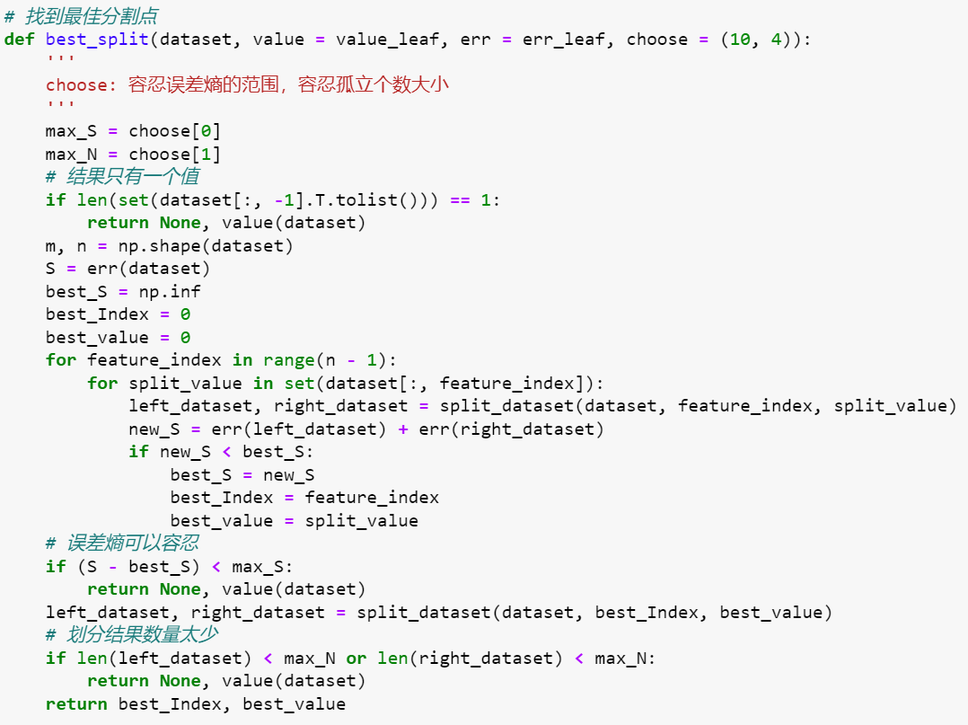
CART MODEL
Build the model
We first build our model by defining our node value and our measure of error
Next, we define how we split the data and use the functions to find the best split which minimize the error
With those functions, we build a decision tree by keep splitting at the best point
After that, we prune our tree to prevent overfitting
Lastly, we use this tree model to forecast the result

Slide 10
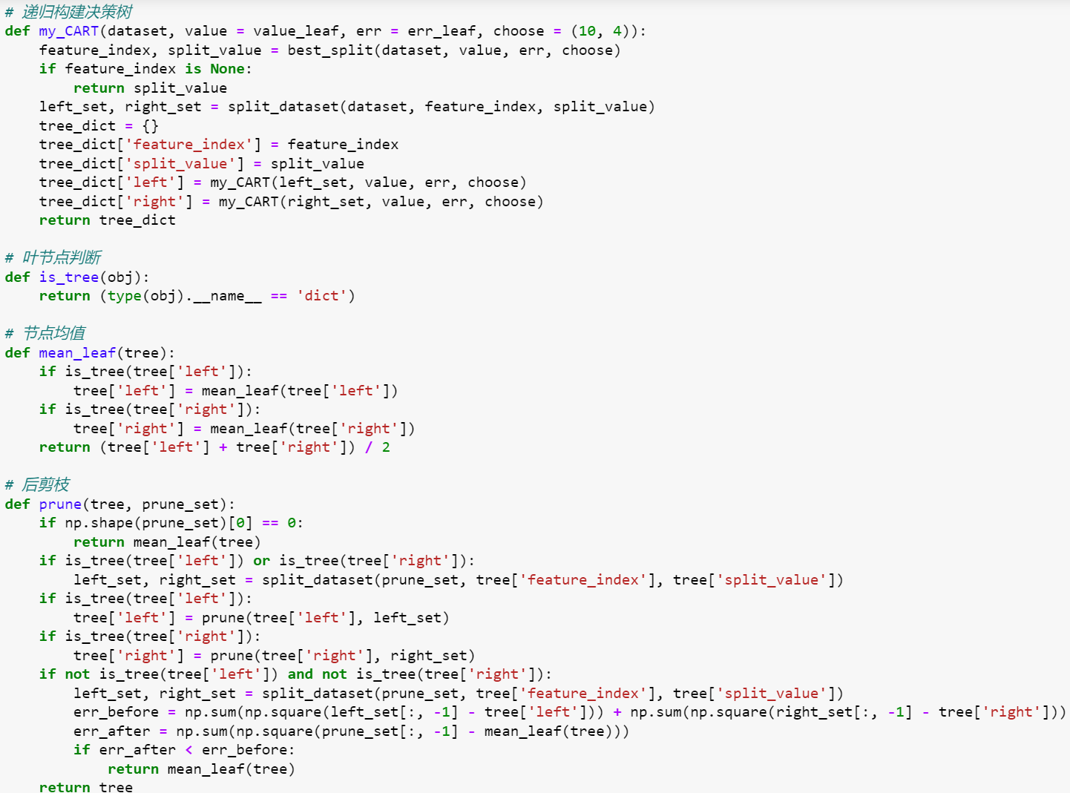
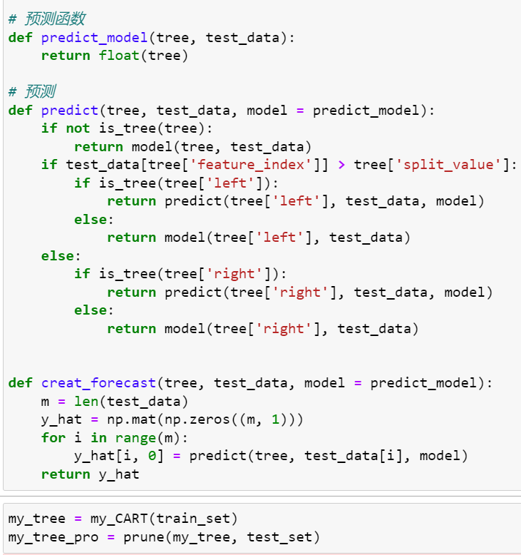
CART MODEL
Build the model
We first build our model by defining our node value and our measure of error
Next, we define how we split the data and use the functions to find the best split which minimize the error
With those functions, we build a decision tree by keep splitting at the best point
After that, we prune our tree to prevent overfitting
Lastly, we use this tree model to forecast the result

Slide 11
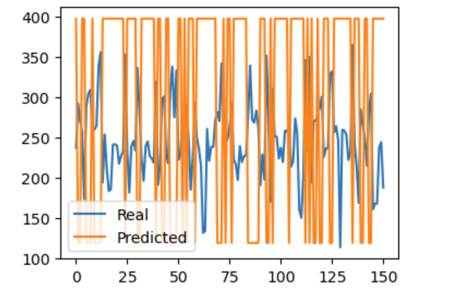
CART MODEL
Result

Slide 12
Mid-term Reflection and future plan
ARIMA model seems to be able to explain most of the fluctuation, but further tests shows that there are still some flaws that cannot be explained
The decision tree model may be a better idea which may also explains more. However, it seems that it is showing more classification result other than regression result
This only predicts the data, but not provide an algorithm for trading
Future Steps:
Try to revise the ARIMA model
Idea from Susan: SARIMAX(Seasonal Autoregressive Integrated Moving Average with Exogenous Regressors)?
Turn the CART model into a regression model?
Apply these methods to calculate the Bollinger Band, which can be utilized for a trading algorithm()

Slide 13
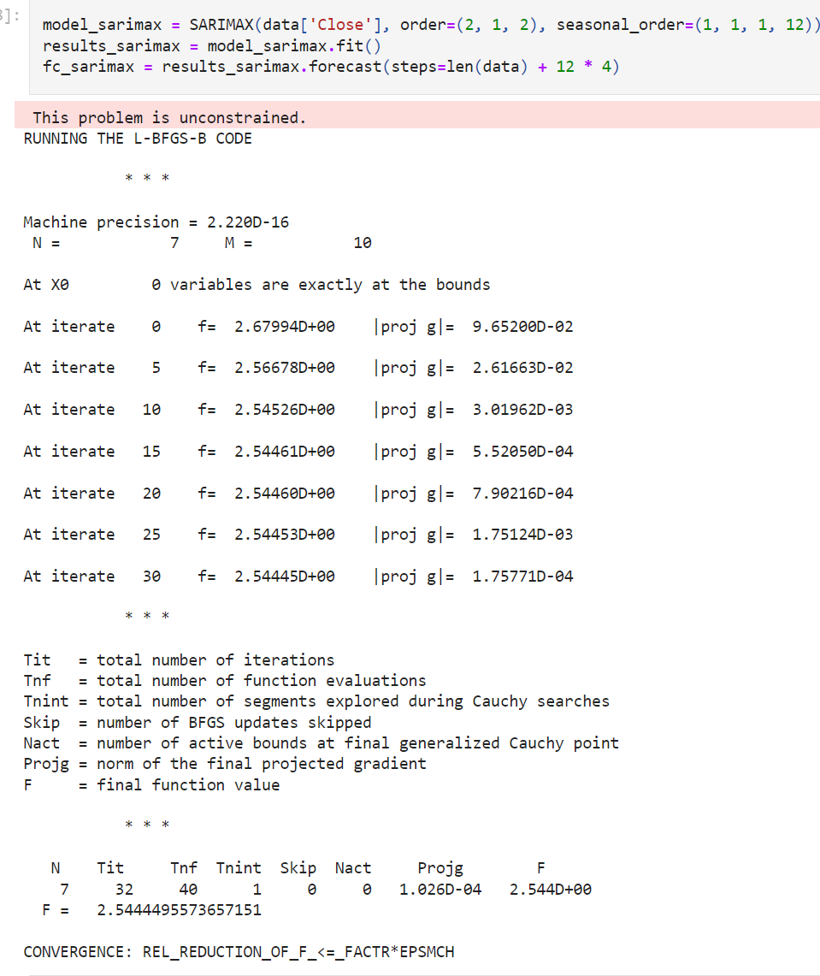
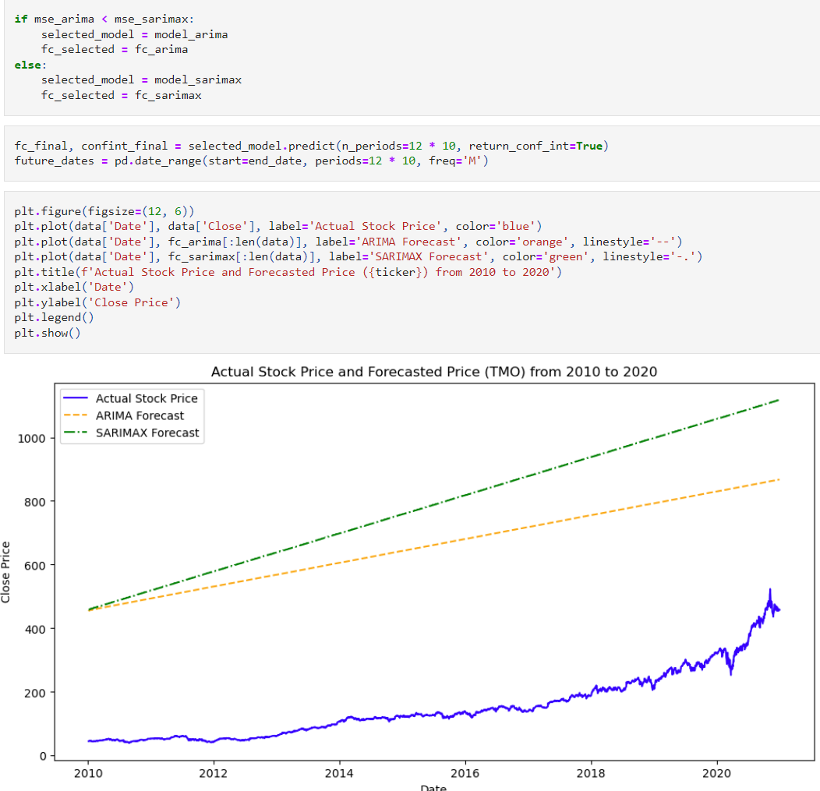
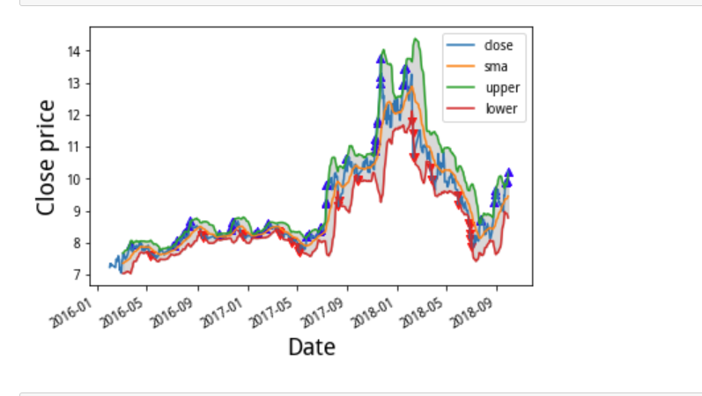
Future Plan
Try to revise the ARIMA model
Idea from Susan: SARIMAX(Seasonal Autoregressive Integrated Moving Average with Exogenous Regressors)?
Turn the CART model into a regression model?
Apply these methods to calculate the Bollinger Band, which can be utilized for a trading algorithm()
Ongoing Codes and Graphs contributed by Teammates

Slide 14
Thank you so much for you listening!

