Slide 1

Bayan AI
بيان
Interprets between doctors and patients in Qatar, and catches what gets lost.
Team QH-129 · Qai × Hugging Face Hackathon O1 · Doha, 5–7 Nov 2026
Notes:
We’re Team QH-129. This is Bayan, Arabic for clarity. It interprets between doctors and patients in Qatar, and catches what gets lost in translation. Let me start with one patient.

Slide 2
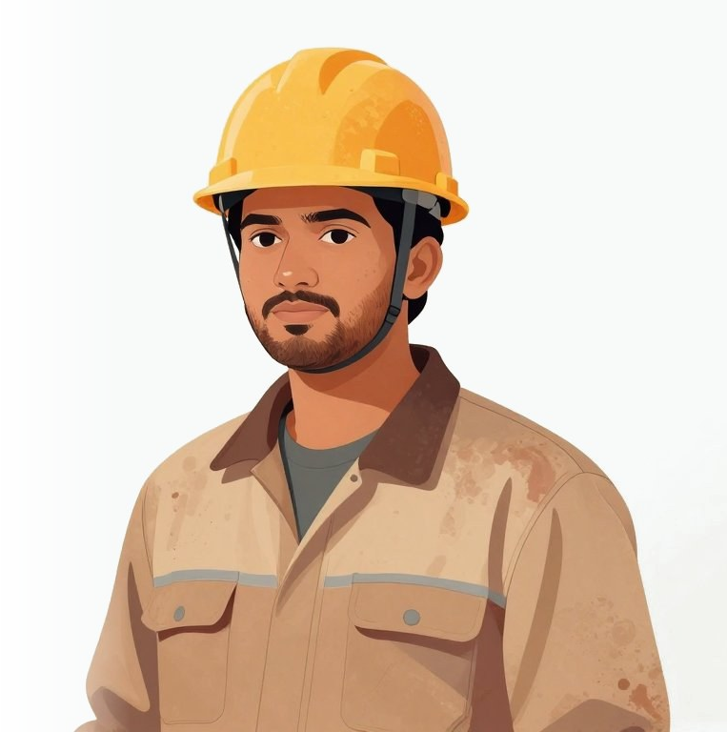
Meet Anurag
29, a Nepali construction worker in Doha
ANURAG SAYS
“My chest is burning. It’s just gyastrik.”
ग्यास्ट्रिक (gyastrik) is Nepali for “gastric”
THE DOCTOR HEARS
A stomach problem, like reflux
IT COULD BE
His heart
Notes:
Meet Anurag, a 29-year-old Nepali construction worker. He says his chest is burning, and that it’s just gyastrik, the Nepali word for gastric. His doctor hears a stomach problem and thinks reflux. But for Nepali speakers, gyastrik can hide cardiac pain. It could be his heart.

Slide 3
When doctor and patient don’t share a language, people get hurt
9 in 10
77%
200 of 571
people living in Qatar are not Qatari (an estimate)
of errors by ad hoc interpreters had clinical consequences
cardiovascular deaths among young Nepali workers in Qatar were estimated preventable
A Weill Cornell Medicine-Qatar study at Hamad General Hospital found most outpatients had struggled to get care because of language, with Hindi and Urdu speakers hit hardest. They relied on untrained nurses, family members, gestures and mixed languages.
Notes:
Roughly nine in ten people in Qatar aren’t Qatari. When whoever is nearby interprets, 77 percent of their errors have clinical consequences. A Weill Cornell Medicine-Qatar study at Hamad found most outpatients had struggled to get care because of language. And researchers estimated that up to 200 of 571 cardiovascular deaths among young Nepali workers were preventable.

Slide 4
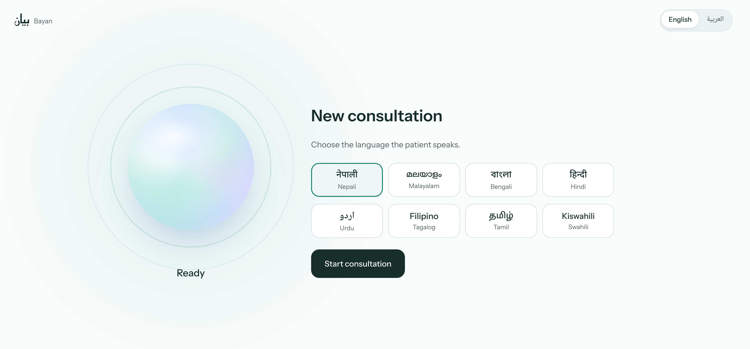


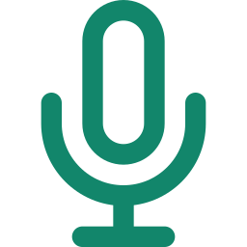
Pick the patient’s language, then just talk
One tablet on the desk. After one tap, Bayan hears both people, works out who is speaking, and speaks each sentence to the other within seconds.
8 patient languages
Nepali, Malayalam, Bengali, Hindi, Urdu, Filipino, Tamil, Swahili
English or Arabic
for the doctor’s screen
Nothing to press
while the two of them talk
Notes:
This is Bayan’s start screen. The doctor picks the language the patient speaks, from eight, and chooses English or Arabic for their own screen. One tap starts the consultation; after that there are no buttons. Bayan hears both people, works out who is speaking, and speaks each sentence to the other within seconds.

Slide 5
Bayan catches two dangers before Anurag goes home
1
2
3
4
He says “gyastrik”
An idiom note
Two silent alerts
The doctor acts
The doctor sees his exact words
Usually reflux, but it can mask heart pain
Penicillin allergy vs amoxicillin. No ECG before discharge. Bayan holds the sentence back.
Orders an ECG and a troponin test
Notes:
Here’s the demo moment. Anurag says gyastrik, and the doctor gets an idiom note: it can mask cardiac pain. Then two silent alerts: a penicillin allergy against amoxicillin, and chest pain with no ECG or troponin. Bayan holds that sentence back instead of speaking it to Anurag. The doctor orders the tests.

Slide 6



Both people leave with something they can use
FOR THE DOCTOR
FOR ANURAG
An English clinical note, ready for the hospital record
A care plan in Nepali
Written as Subjective, Objective, Assessment and Plan, the standard format for medical records.
A PDF with a medicine-time grid, red-flag symptoms and the emergency number 999, sent by WhatsApp and SMS, plus an MP3 read aloud for patients who cannot read.
A licensed clinician approves every output before it is sent.
Notes:
When the doctor says “Bayan, end consultation,” two things come out. The doctor gets an English clinical note for the record, in the standard Subjective, Objective, Assessment and Plan format. Anurag gets his care plan in Nepali, as a PDF, on WhatsApp and SMS, and as audio if he can’t read.

Slide 7




Bayan hears, translates and checks every sentence
Option A
Listen
Translate
Speak
Hears both people and knows who is speaking
Turns each sentence into the other person’s language
Says it aloud within seconds
Behind the scenes, 81 cited safety rules check every sentence and alert the doctor silently.
Built entirely on Hugging Face, with gpt-oss-120b and Qatar’s own Fanar model
Notes:
Bayan does three things for every sentence: it listens and works out who is speaking, translates into the other person’s language, and speaks it aloud within seconds. Behind the scenes, 81 cited safety rules check what was said and alert the doctor silently. It’s all built on Hugging Face, including Qatar’s own Fanar model.

Slide 8
Every sentence is interpreted and checked for safety
Option B
1 · Interpret, within seconds
Listen
Identify
Transcribe
Translate
Speak
Hears both people
Knows who is speaking
Writes down the words
Into the other language
Says it aloud
2 · Protect, at the same time
Pick out facts
Check 81 rules
Silent alert
Hold the sentence
Allergies and medicines
Each cites a medical guideline
Doctor’s screen only
Not spoken until the doctor reviews
Runs on Hugging Face; full model list on backup slide 16
Notes:
Bayan does two jobs on every sentence. First, it interprets: it listens, works out who is speaking, writes down the words, translates them and says them aloud within seconds. Second, at the same time, it protects the patient: it picks out allergies and medicines, checks them against 81 cited rules, alerts the doctor silently, and if something is dangerous, holds the sentence back until the doctor has reviewed it.

Slide 9
A cascade, so safety checks can read the text
Every sentence, live (target: 3 seconds or less)
Listen
Detect language
Transcribe
Translate
Speak
Silero VAD
VoxLingua107
Whisper (doctor), IndicConformer (patient)
gpt-oss-120b + Fanar
Indic Parler-TTS, Kokoro
In the background, from the same text
Pick out facts
Check 81 rules
Silent alert
gpt-oss-120b, in the same call
Deterministic, on CPU
Doctor’s screen only
Why not one speech-to-speech model? No open model can speak Nepali or Malayalam end to end, and it would leave no text to check.
Notes:
Every sentence goes through the same chain: listen, detect the language, transcribe, translate and speak, with a target of three seconds or less. In the background, the same text is used to pick out facts like allergies and medicines, check them against 81 cited rules, and raise silent alerts for the doctor. We chose a cascade because no open model can speak Nepali or Malayalam end to end, and the text in the middle is what makes the safety checks possible.

Slide 10
Every layer of Bayan runs on Hugging Face
Live now
Next
Layer | On Hugging Face
App | Gradio Space with live audio (FastRTC)
Brain | gpt-oss-120b on Inference Providers
Hearing | Whisper, IndicConformer and VoxLingua107
Voice | Indic Parler-TTS (patient), Kokoro (English)
GPU worker | Private Space on one L4, asleep when idle
Fanar, Qatar’s own Arabic model, for doctors who speak Arabic
Idiom dataset published on the Hub
Qwen3-4B fine-tune trained on HF Jobs
Every model and repo name: backup slide 16
Notes:
Everything runs on Hugging Face. Live today: a Gradio Space with live audio, gpt-oss-120b on Inference Providers, open speech models on a private GPU Space that sleeps when idle, and Kokoro for English. Next: Qatar’s own Fanar model for Arabic-speaking doctors, our idiom dataset on the Hub, and a fine-tuned Qwen model trained on HF Jobs.

Slide 11


A consultation costs about $0.015, roughly three times less than a naive build
$0.015
$0.047
About $32
$25
per consultation (estimate)
naive build (estimate)
of the $100 pool planned
kept in reserve
Actual spend: [add final spend before the pitch]
One gpt-oss-120b call per sentence both translates and extracts facts; we pay per use
Safety rules run on CPU in milliseconds; silence is never sent
Notes:
We pay per use: one gpt-oss-120b call per sentence does both the translation and the fact extraction. Safety rules run on CPU for free, and we only send speech, never silence. That’s about one and a half cents a consultation, an estimate, and about 32 of our 100 dollars.

Slide 12


Rules, not the language model, decide drug and allergy checks
Safety
Privacy
81 deterministic rules, each citing an FDA label or a guideline such as NICE, AHA/ACC or ESC
The language model only extracts facts, and every alert quotes the words it is based on
The literal translation is always shown; unclear speech gets a spoken “Did you mean…?”
A clinician acknowledges every alert and approves every output
No audio is stored
Sessions live in memory and are erased on close; patient links expire
Designed to follow Qatar’s PDPPL (Law No. 13 of 2016), with an on-prem path that keeps data in the country
Notes:
Bayan never diagnoses or prescribes. The language model only extracts facts; 81 cited rules make the safety calls, and every alert quotes the words it’s based on. No audio is stored, and the design follows Qatar’s data protection law.

Slide 13
What is not done yet, and what closes each gap
Not done yet | Next step
The 59 idioms and 81 rules come from the literature, not yet clinician-reviewed | Clinician review of every idiom and rule
Native-language demo lines are machine drafts | Native-speaker verification
Tier-1 voices are a target until the smoke test passes | Run the smoke test for all eight patient languages
The fine-tuned model has not shipped | Ship it only if it passes the eval gates
Some speech models are CC-BY-NC-4.0 | Use them for non-commercial research and demo only
All demo consultations are synthetic | Clinical validation before any real patient use
Notes:
We want to be plain about where this stands. The idioms and rules aren’t clinician-reviewed yet, the native lines are machine drafts, and the demo is synthetic. Each gap has a clear next step, starting with clinician review.

Slide 14
Most medical AI saves the doctor time.
Bayan protects the patient.
بيان
Bayan AI, Team QH-129
huggingface.co/spaces/dullgrey/team-qh-129-bayan-app
Notes:
Most medical AI saves the doctor time. Bayan protects the patient: their safety, their understanding and their dignity. We’re Team QH-129, and you can try Bayan on our Space now.

Slide 15
Sources
Patients’ Bill of Rights in 8 languages: Ministry of Public Health, dhp.moph.gov.qa/en/Pages/FTPDownloads.aspx
Language barriers at Hamad General Hospital: Weill Cornell Medicine-Qatar study of 84 outpatients, Journal of Health Communication, 2017. doi.org/10.1080/10810730.2017.1296507; reported in Gulf Times, gulf-times.com/story/553525
77% of ad hoc interpreter errors consequential: Flores et al., Pediatrics, 2003. pubmed.ncbi.nlm.nih.gov/12509547
Up to 200 of 571 deaths preventable: Pradhan et al., Cardiology, 2019 (authors’ estimate). doi.org/10.1159/000500853
Cost per consultation and budget: team estimates from list prices
Notes:
Backup slide with every source behind the numbers in this deck.

Slide 16
Full Hugging Face stack, live and next
Job | Hugging Face piece | Status
App | Gradio Space dullgrey/team-qh-129-bayan-app on cpu-upgrade | Live
Clinical brain | openai/gpt-oss-120b via Inference Providers (Cerebras): translation plus fact extraction, as JSON | Live
Arabic grounding | QCRI/Fanar-1-9B-Instruct, Qatar’s national Arabic model, via Inference Providers | Next
Speech to text | whisper-large-v3-turbo (doctor), indic-conformer-600m-multilingual (patient) | Live
Text to speech | indic-parler-tts (patient, streamed), Kokoro-82M (English) | Live
Turn-taking | FastRTC with Silero VAD, lang-id-voxlingua107-ecapa (scores only English, Arabic and the patient language) | Live
Voice worker | Private GPU Space on one L4 ($0.80/h), asleep when idle | Live
Dataset | dullgrey/team-qh-129-bayan-idioms on the Hub | Next
Fine-tune | LoRA on Qwen3-4B-Instruct-2507 with TRL and PEFT on HF Jobs, shipped only if it passes eval gates | Next
Notes:
Backup slide with every model and repo behind the Hugging Face slide, and which parts are live today.

