Slide 1
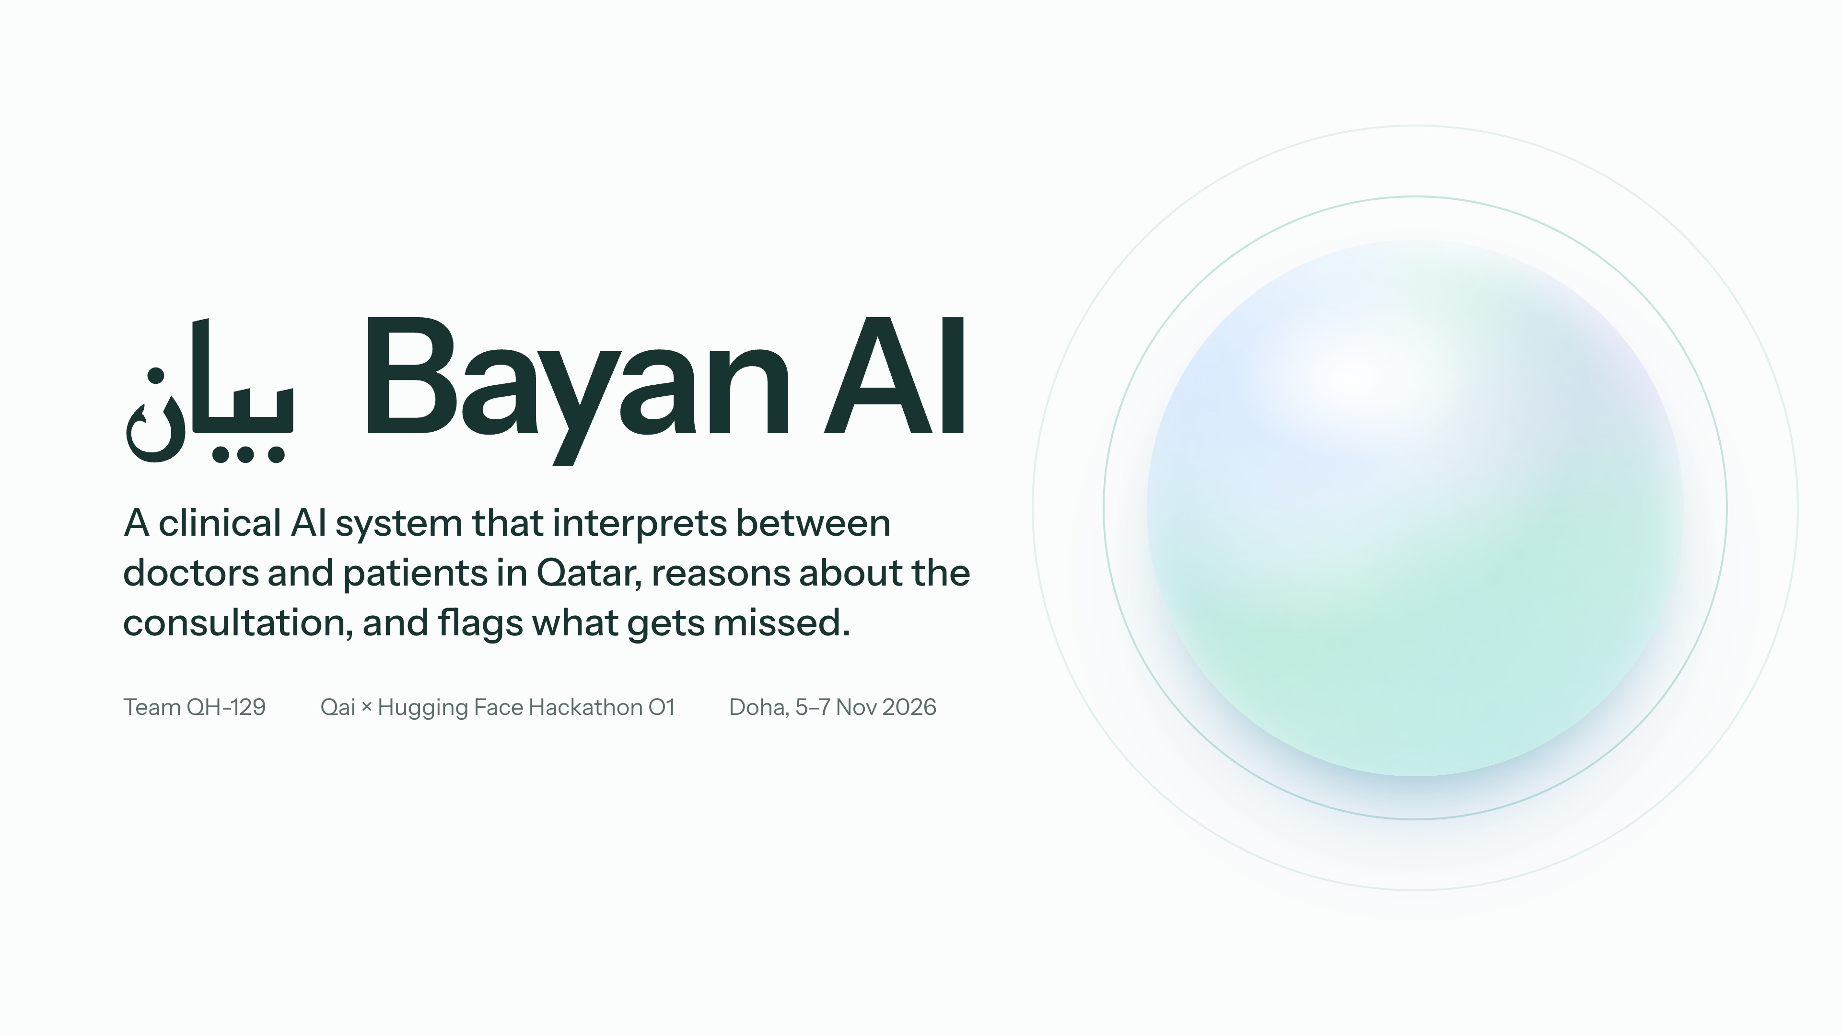
Notes:
0:00–0:07
Hello, we're team QH-129. This is Bayan, a clinical AI system for consultations in Qatar. First, a patient.

Slide 2
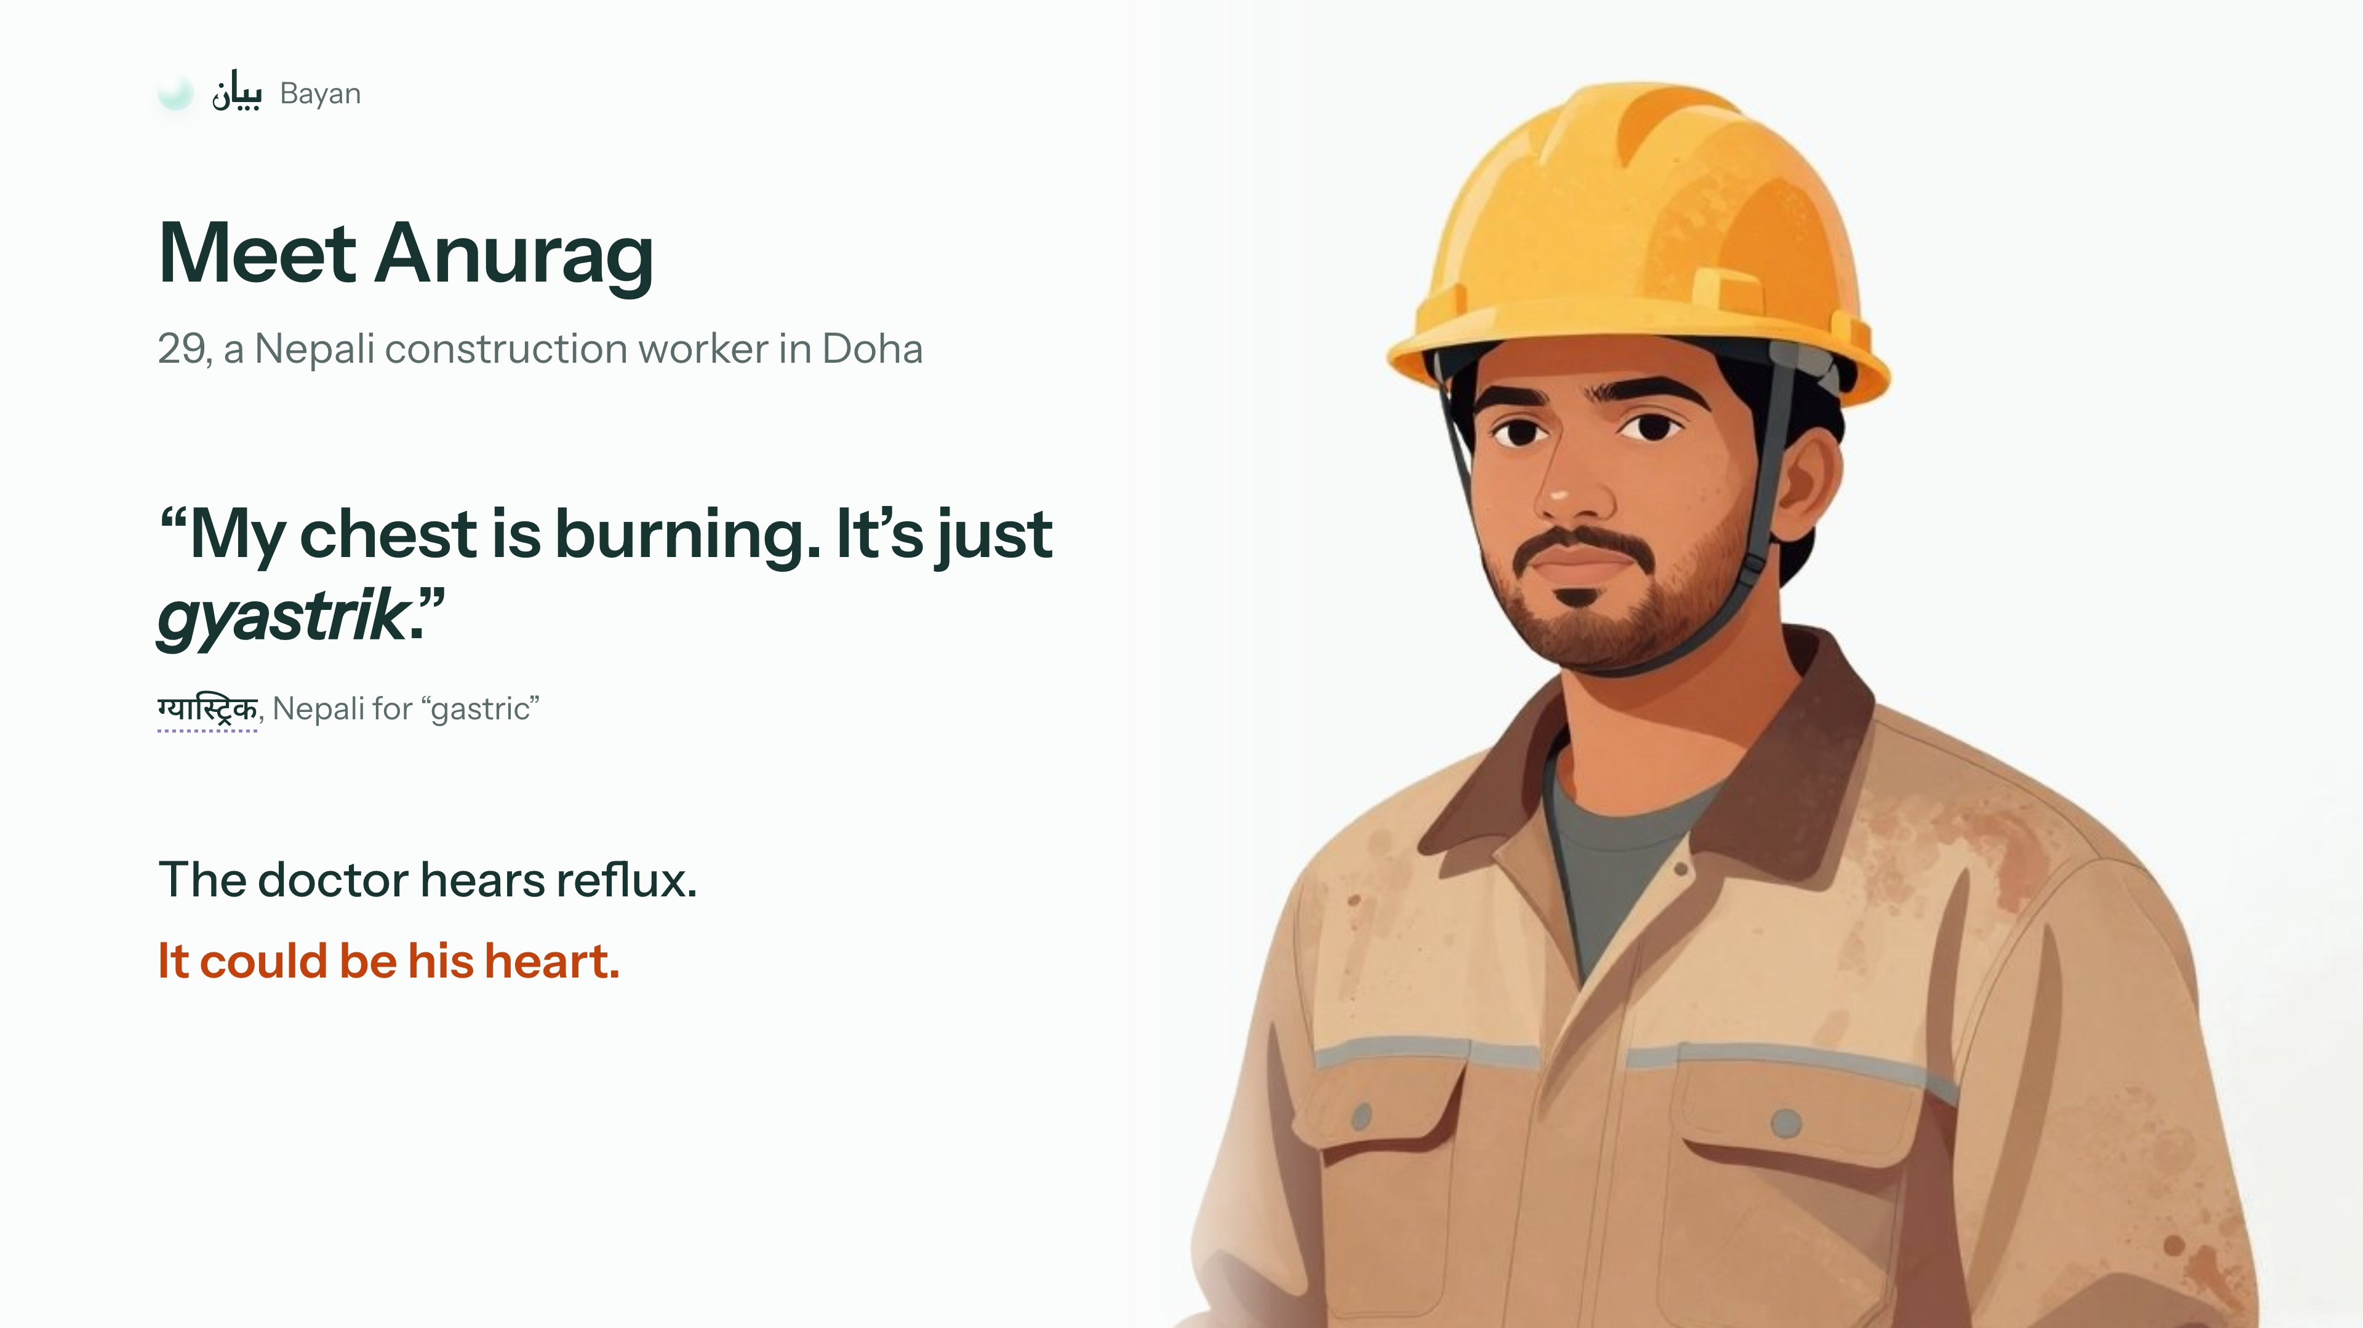
Notes:
0:07–0:19
Meet Anurag, a Nepali construction worker in Doha. He says his chest is burning, "just gyastrik", Nepali for gastric. The doctor hears reflux. It could be his heart.

Slide 3
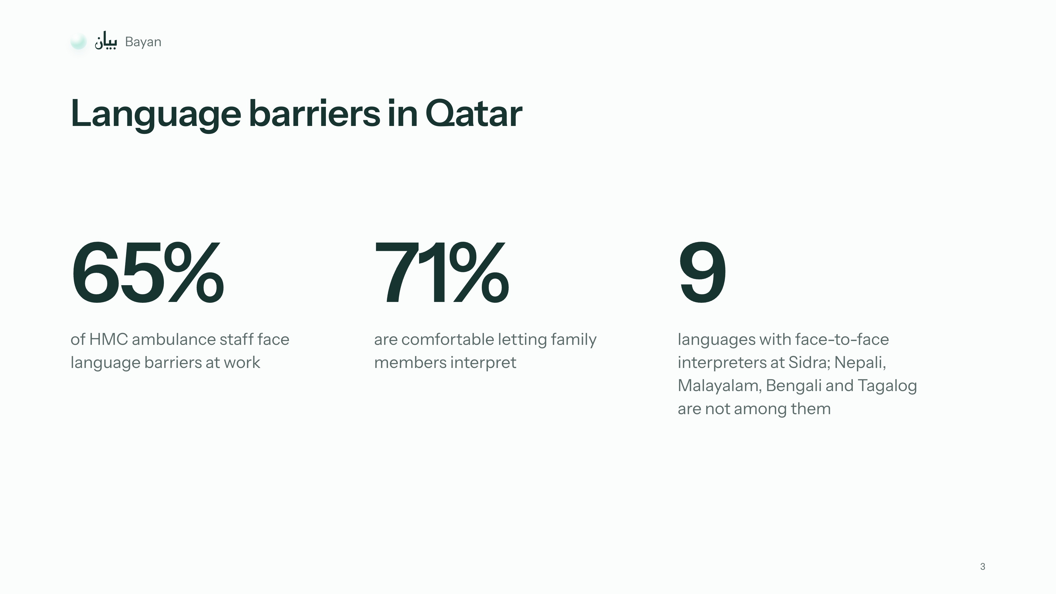
Notes:
0:19–0:29
Anurag is made up, but the problem is real. 65% of HMC ambulance staff face language barriers at work. And that affects safety.

Slide 4
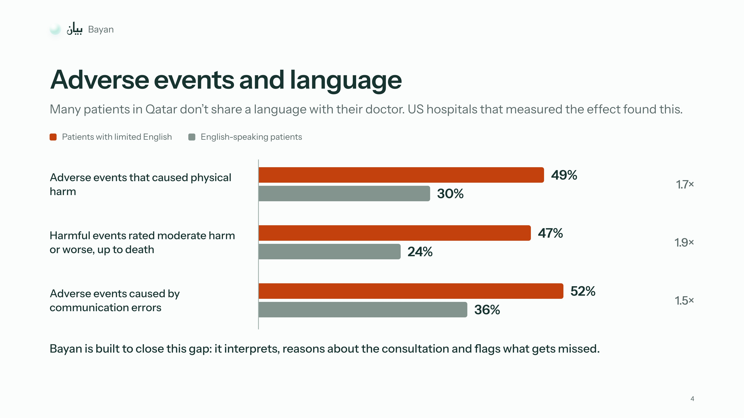
Notes:
0:29–0:38
In US hospitals that measured it, 49% of adverse events in patients with limited English caused physical harm, against 30% for English speakers.

Slide 5
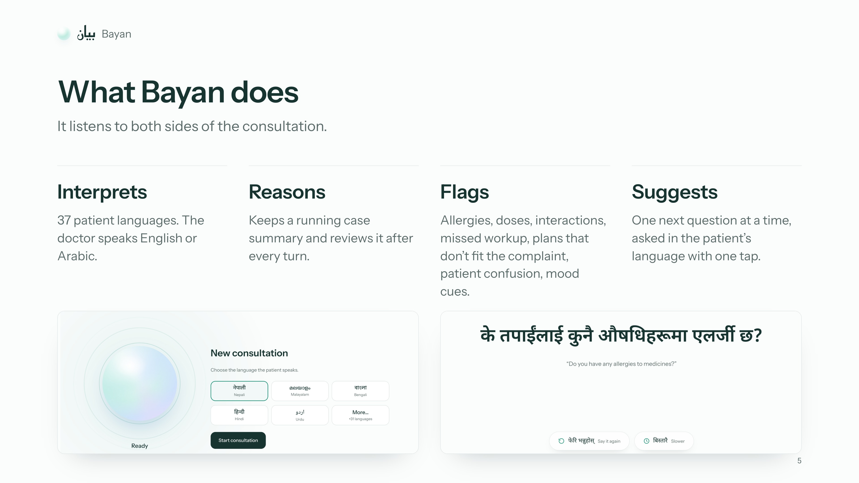
Notes:
0:38–0:49
Bayan listens to both sides. It interprets in 37 patient languages, keeps a running case summary, and suggests one next question at a time. Here it is.

Slide 6
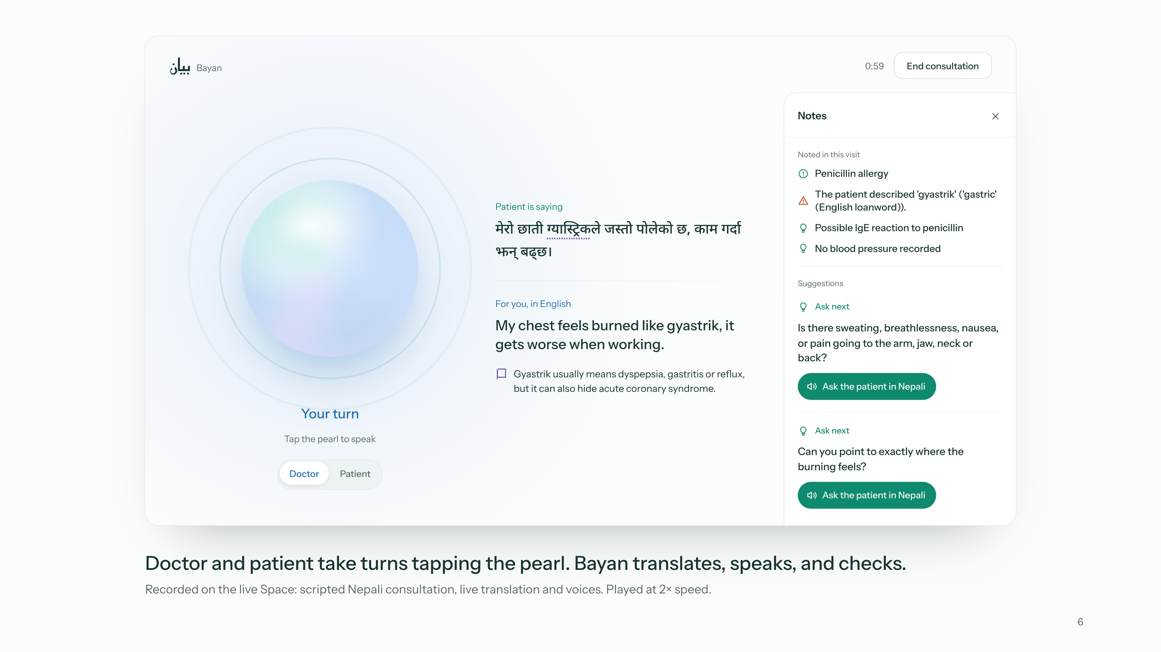
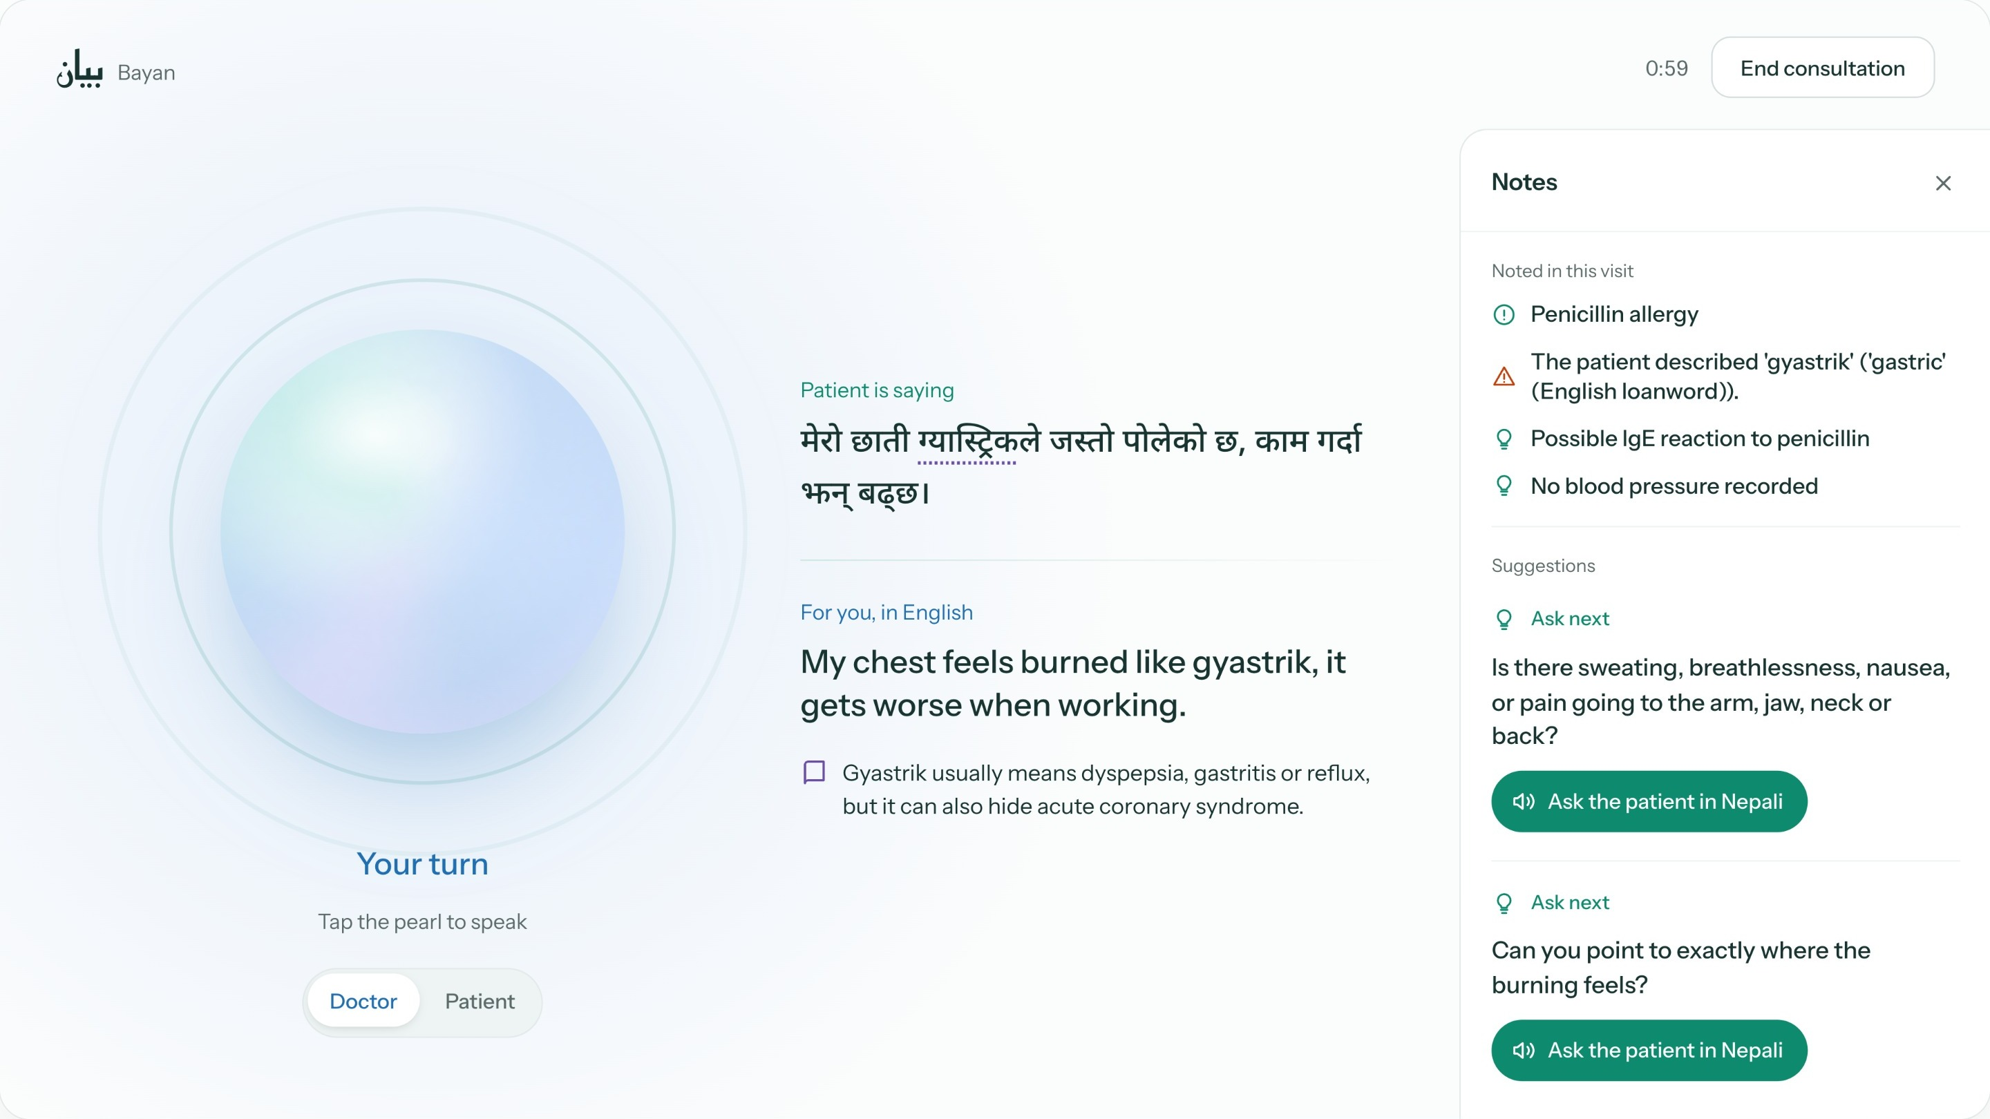
Notes:
0:49–1:35
0:00 This is a recording of our Space. The patient picks Nepali and consents.
0:03 The doctor asks about allergies, and the patient hears it in Nepali.
0:09 He says a penicillin injection once made him swell.
0:15 Now he says his chest burns, gyastrik. A card flags it, and Bayan suggests the next question.
0:24 The doctor taps it, and it is asked in Nepali.
0:33 Then the doctor prescribes amoxicillin, and Bayan pauses it.
0:37 The doctor changes the plan.
0:42 (advance)

Slide 7
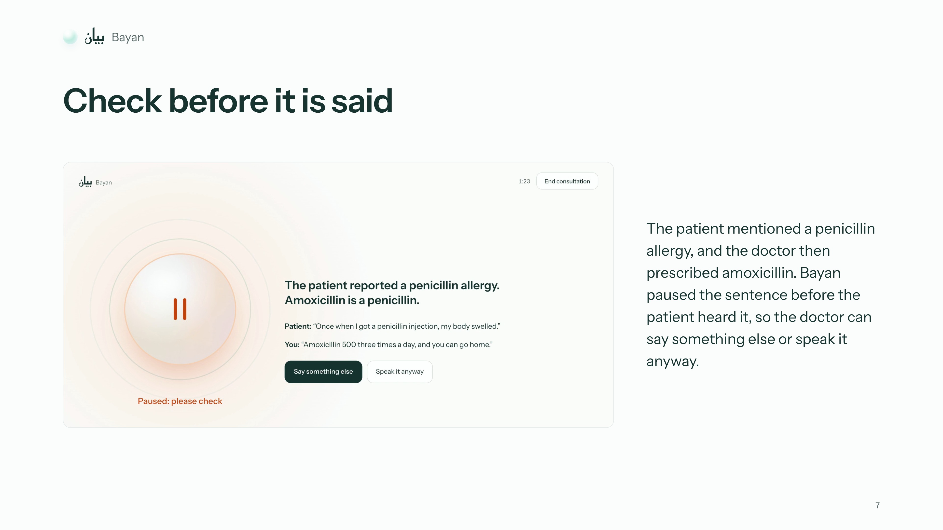
Notes:
1:35–1:45
Bayan paused that sentence before the patient heard it, because amoxicillin is a penicillin. The doctor can say something else or speak it anyway.

Slide 8
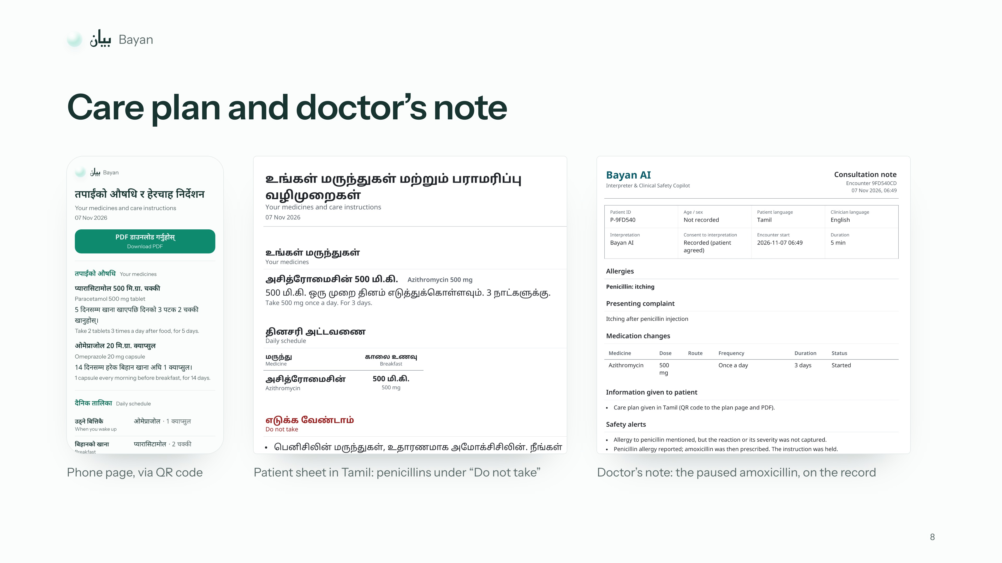
Notes:
1:45–1:56
When the visit ends, the patient gets a care plan in his own language by QR code, and the doctor gets a note. Here's how it works.

Slide 9
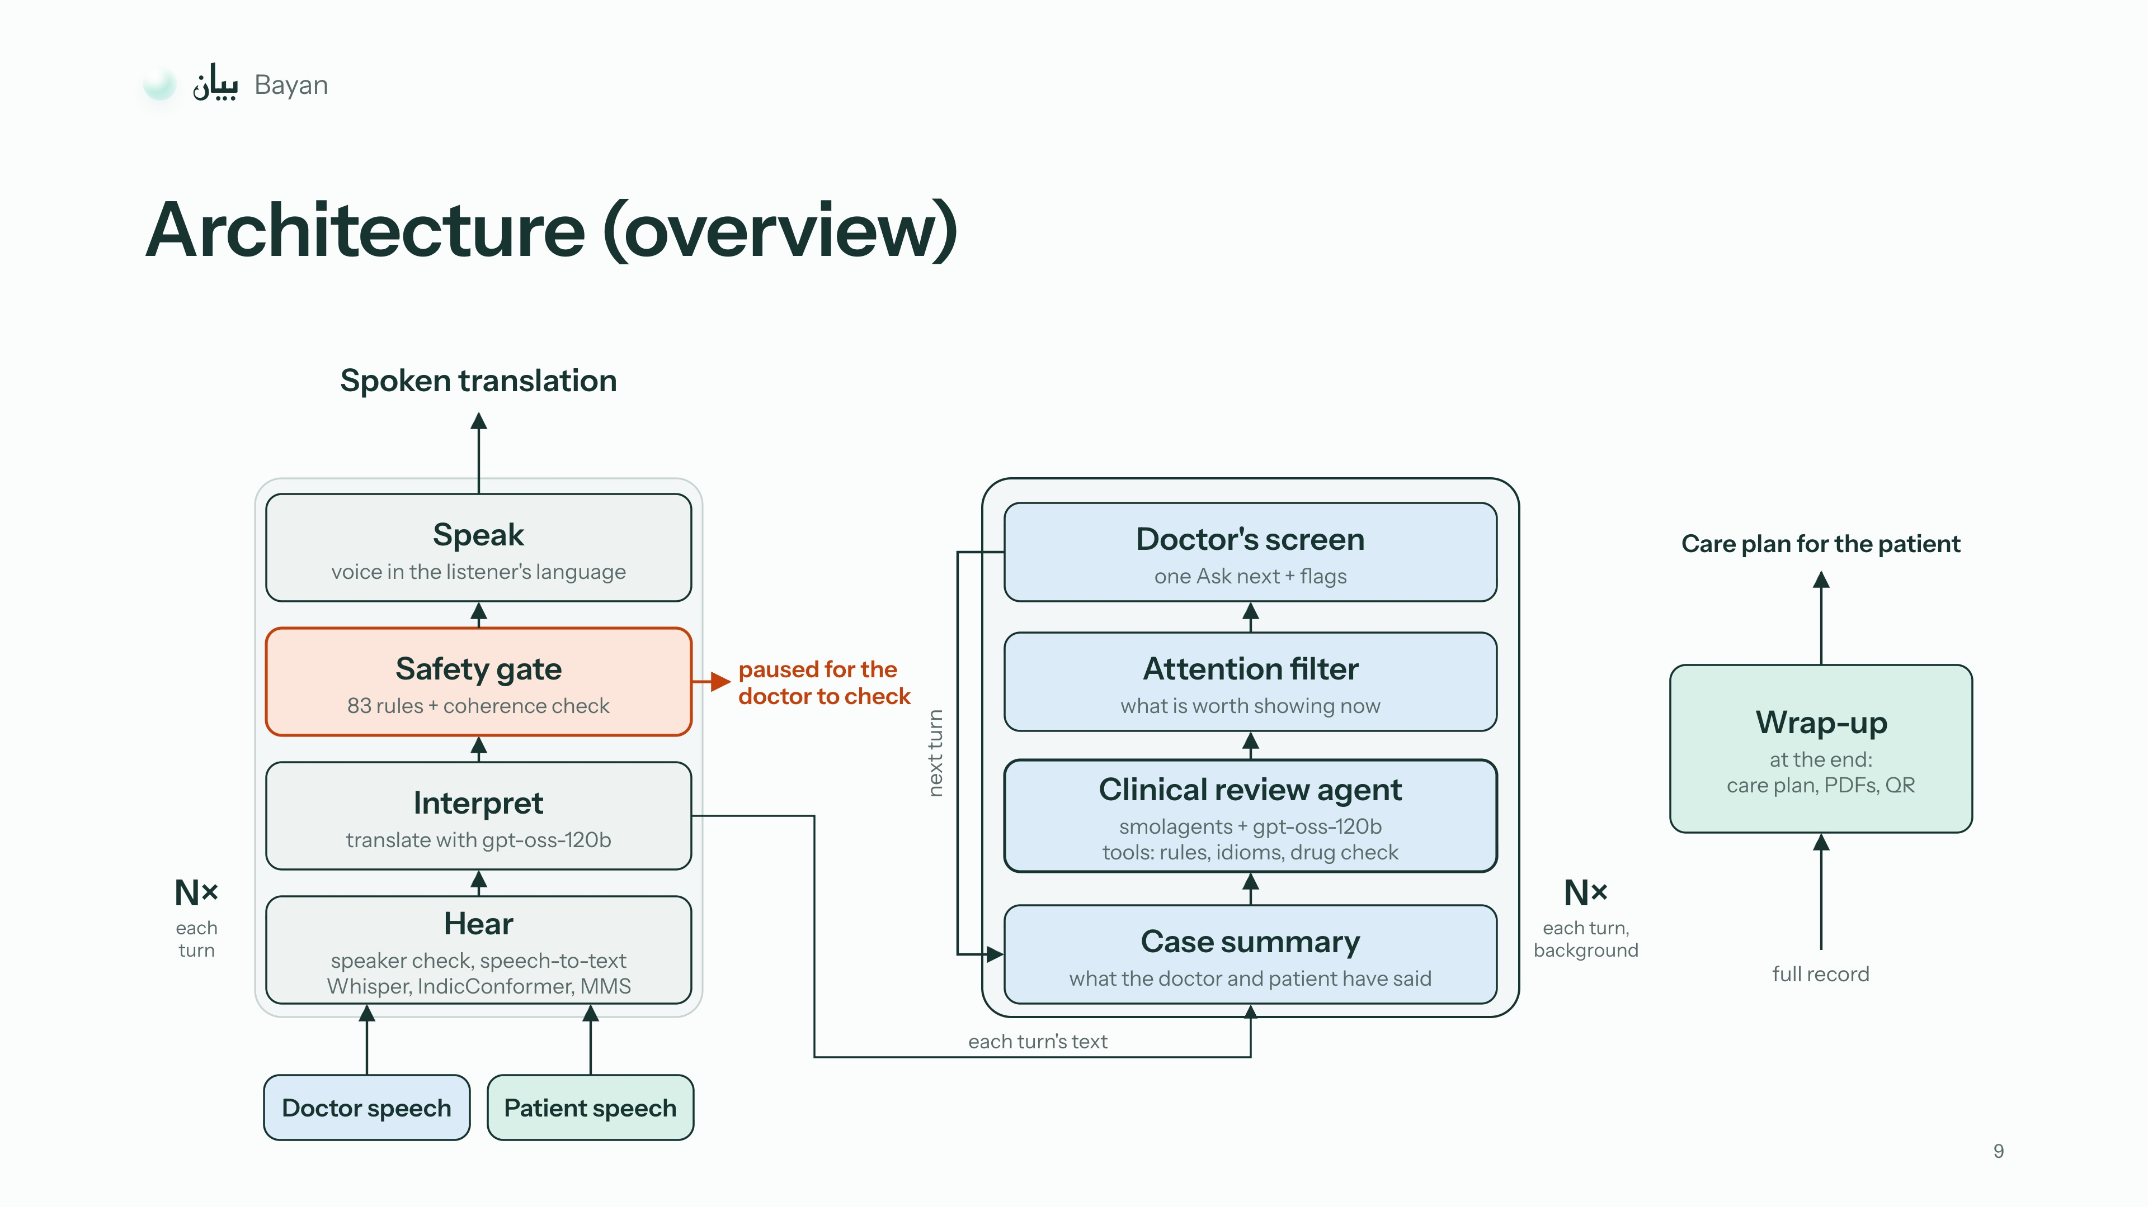
Notes:
1:56–2:08
Each turn is heard, translated and checked before it is spoken. In the background, a smolagents agent reviews the case and picks one thing to show the doctor.

Slide 10
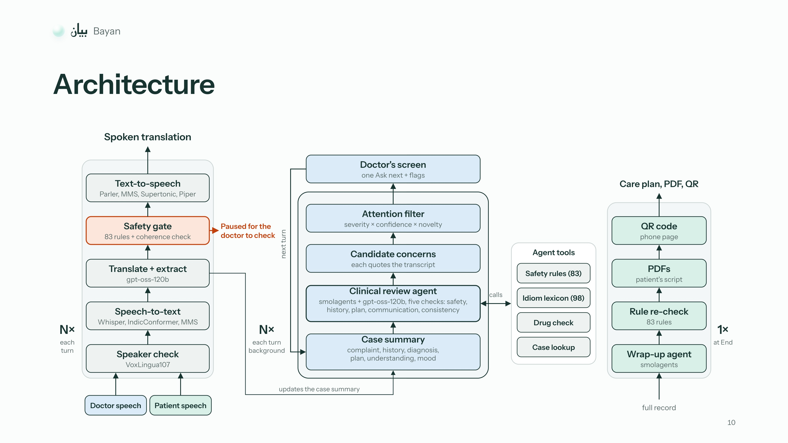
Notes:
Skip in the talk, keep for questions. Press → twice from slide 9. If you present this slide instead of slide 9, say the same line as on slide 9.

Slide 11
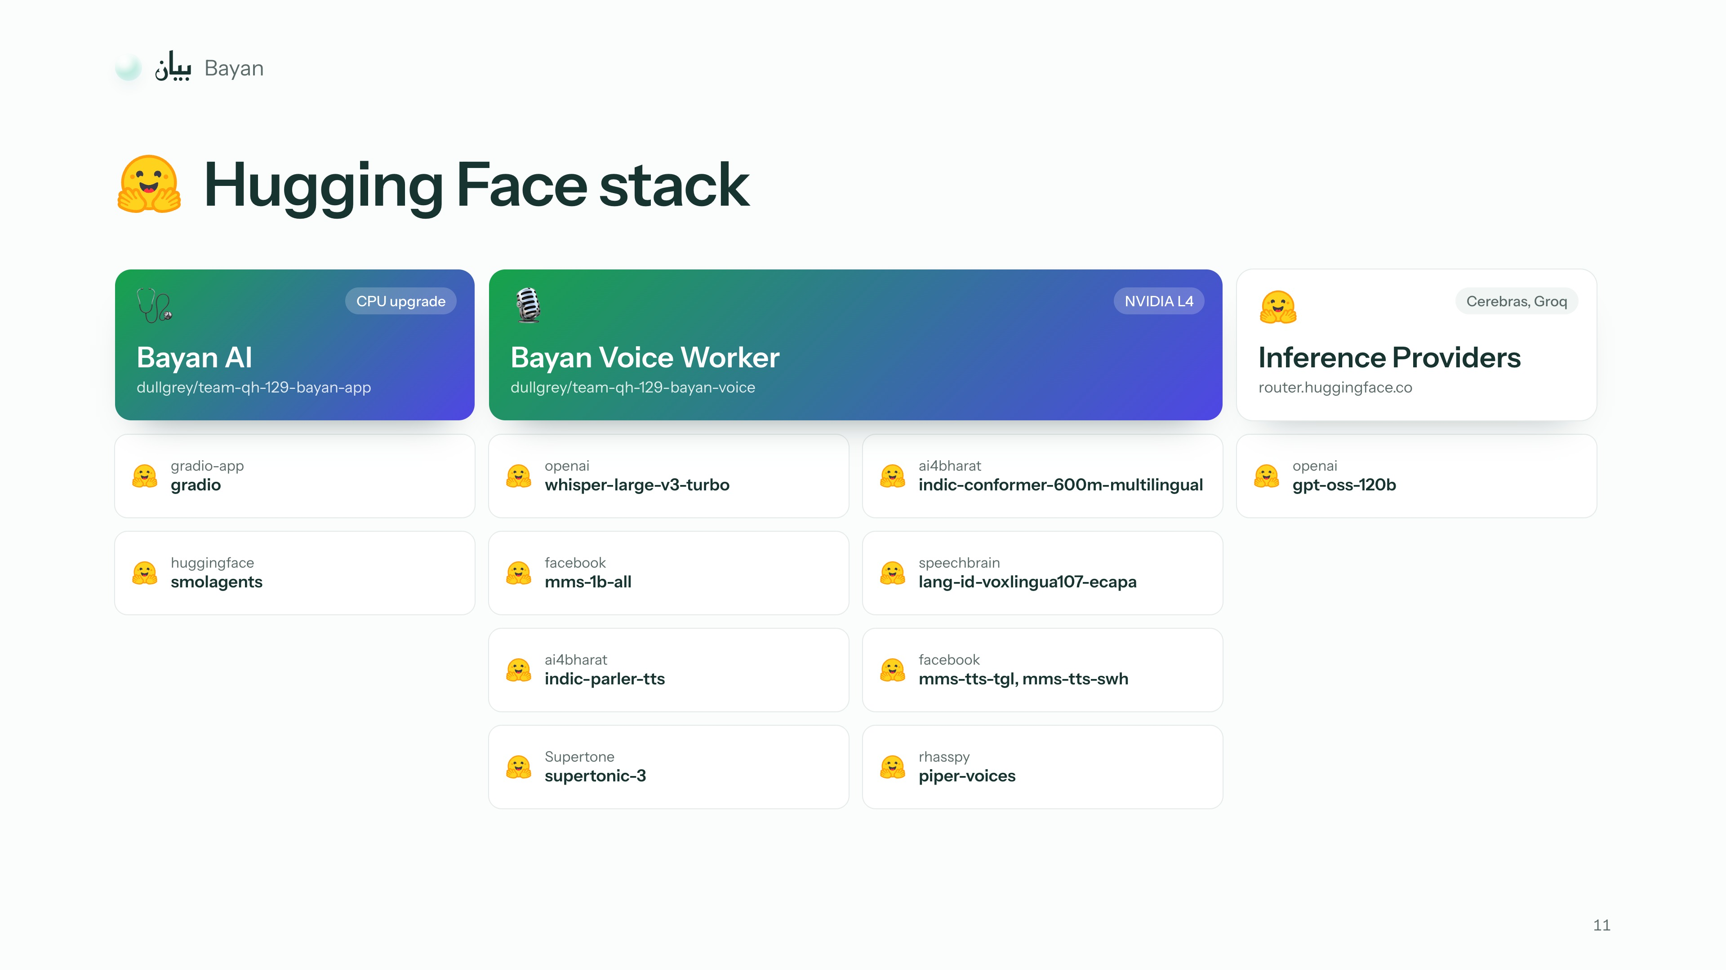
Notes:
2:08–2:13
It all runs on Hugging Face Spaces, with gpt-oss-120b through Inference Providers.

Slide 12
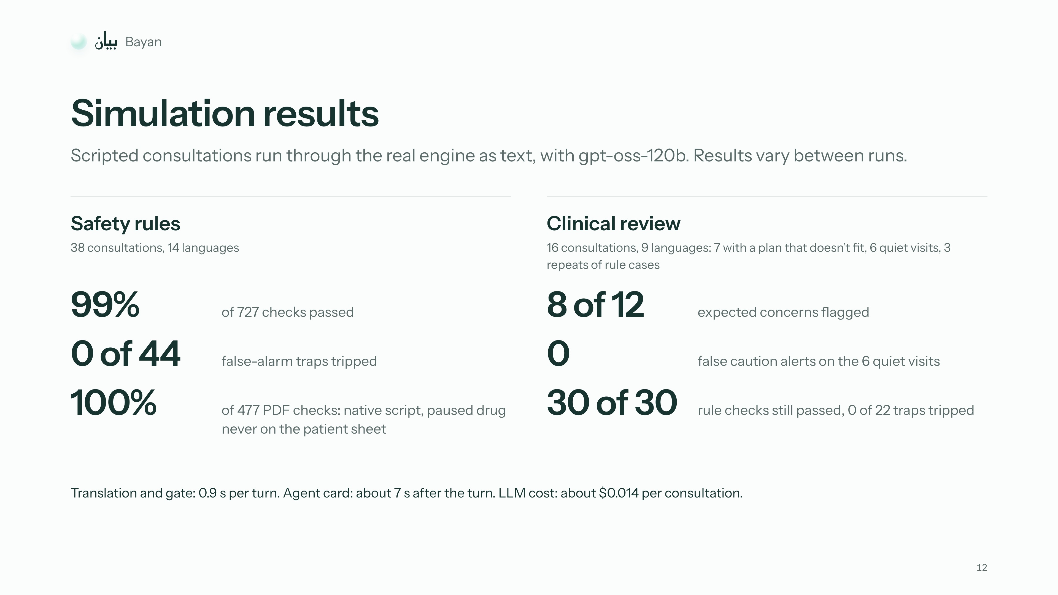
Notes:
2:13–2:25
In scripted tests, the safety rules passed 99% of 727 checks with no false alarms, and the clinical review flagged 8 of 12 expected concerns. Results vary between runs.

Slide 13
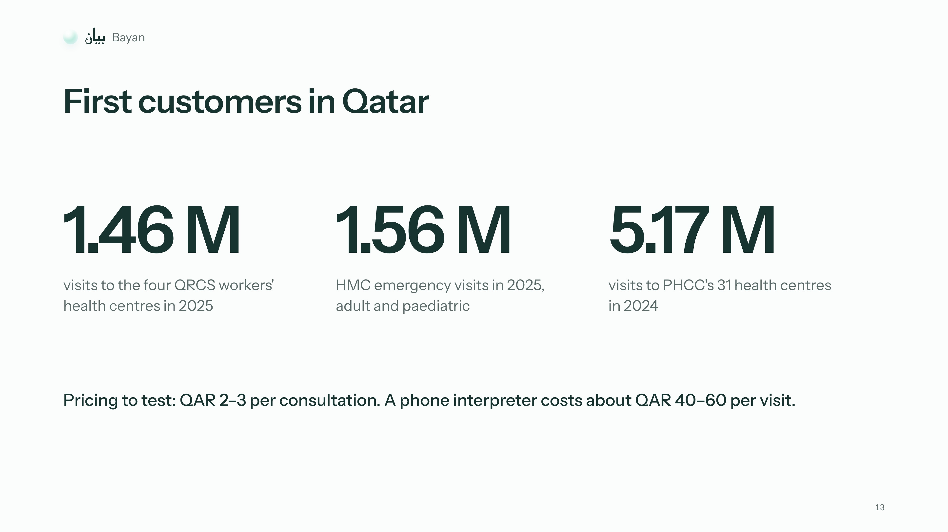
Notes:
2:25–2:31
In Qatar, we'd start with the QRCS workers' health centres, then HMC and PHCC.

Slide 14
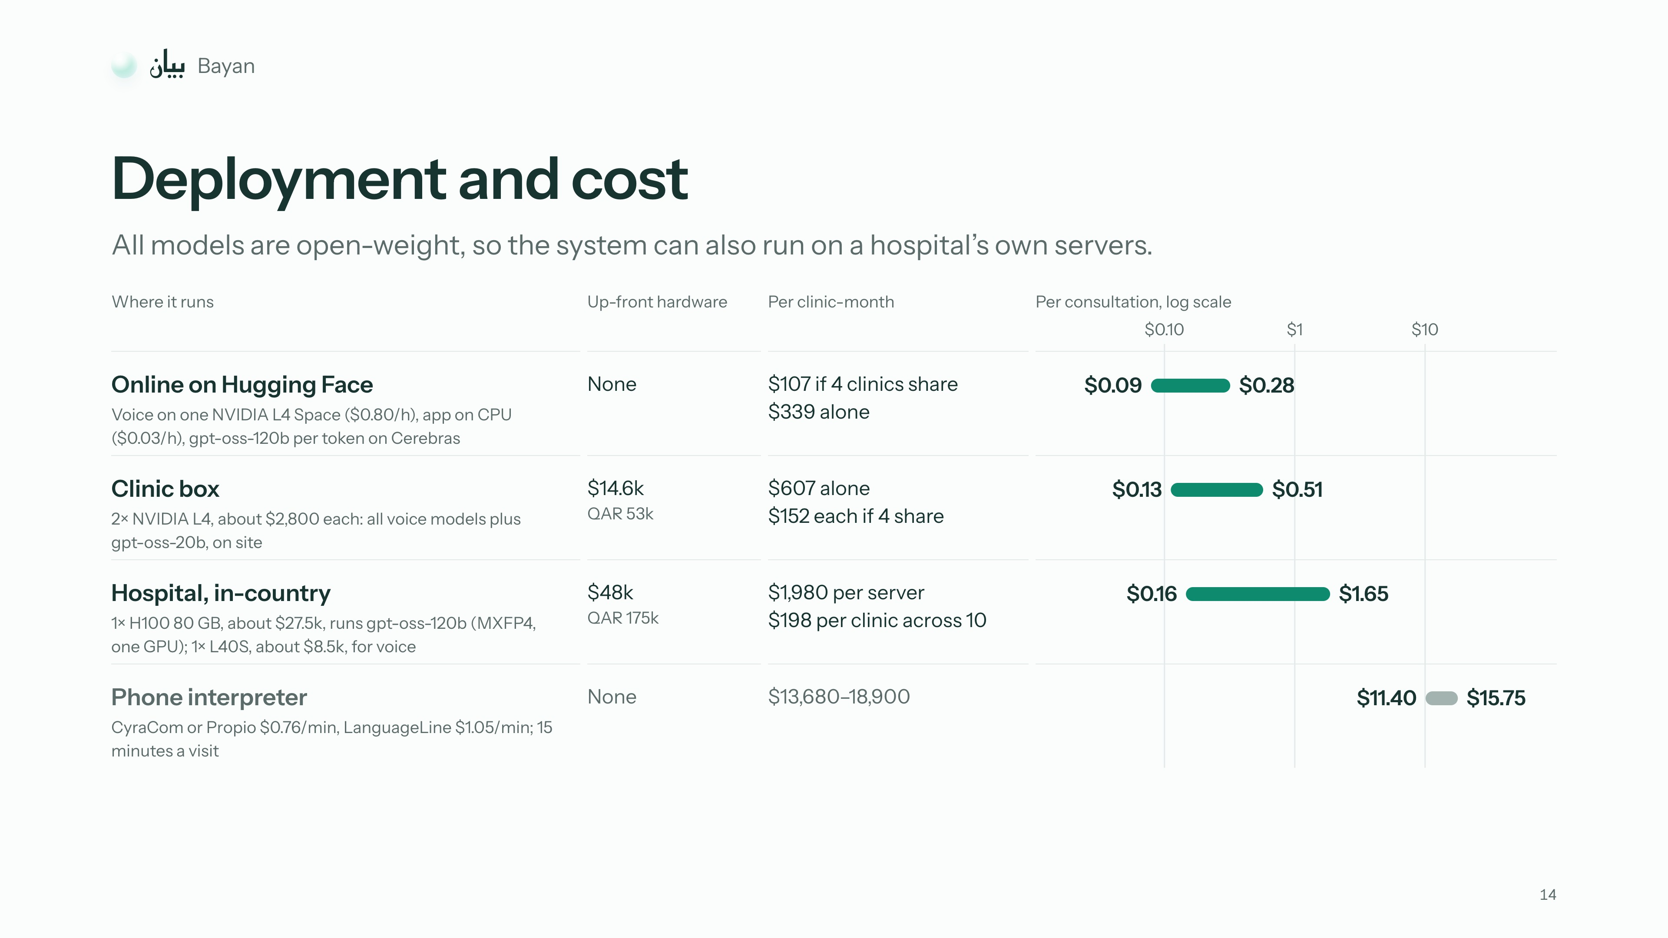
Notes:
2:31–2:43
On Hugging Face it costs 9 to 28 cents a consultation, and hospitals can run it on their own servers. A phone interpreter costs about 11 to 16 dollars.

Slide 15
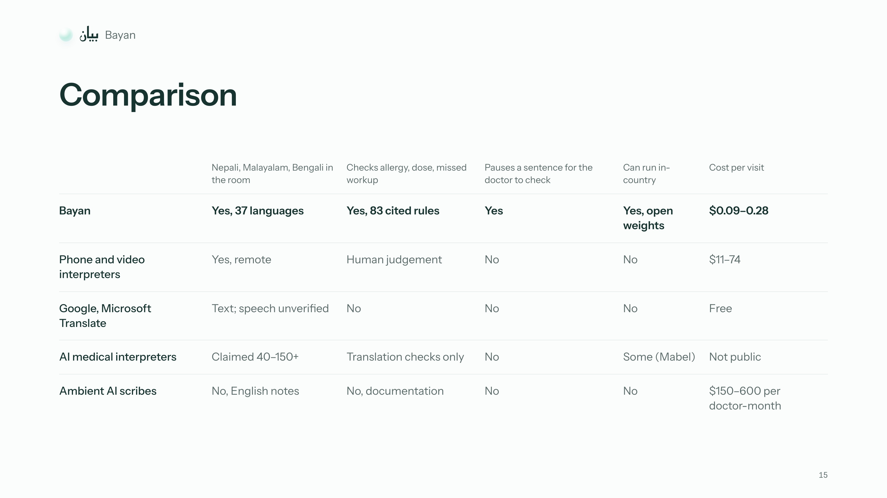
Notes:
2:43–2:49
Other tools translate or take notes. None we found checks the consultation as it happens.

Slide 16
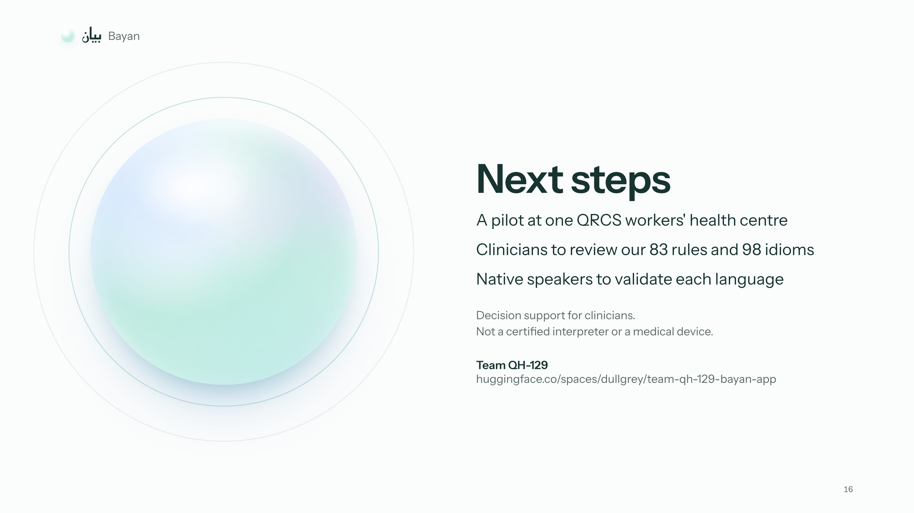
Notes:
2:49–2:57
It isn't a certified interpreter yet. Next, we need a pilot clinic, clinician review of our rules, and native-speaker testing.

Slide 17
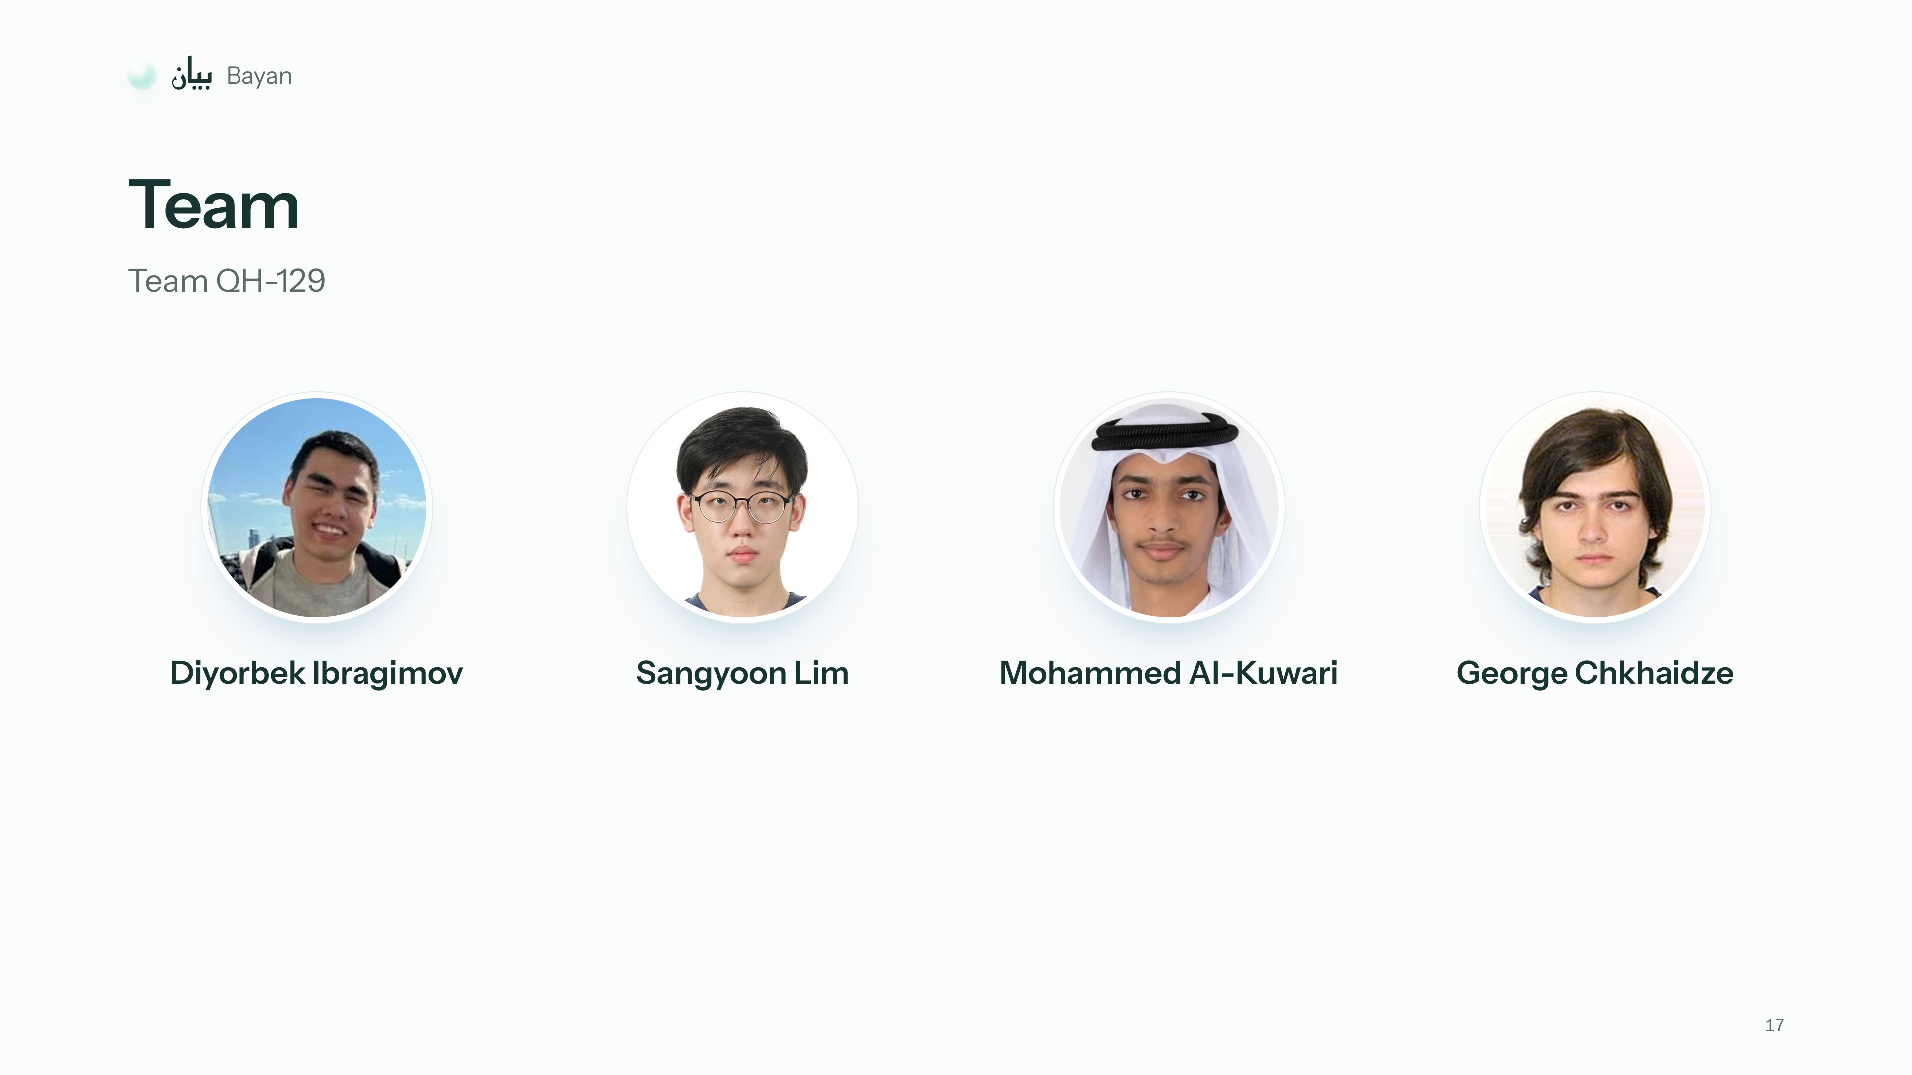
Notes:
2:57–3:00
This is our team. Thank you.

Slide 18
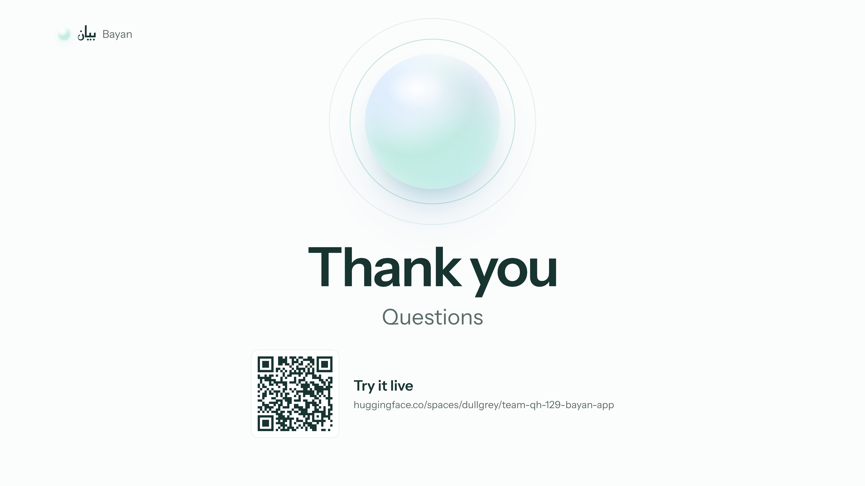
Notes:
after 3:00
Leave this up during questions. The QR code opens the Space (have the access code ready).

