Slide 1


Java Design Pattern Chapter 2: Factory Pattern
Peter H. Chen, PhDEE/EMBA

Slide 2

2 Factory Pattern

Slide 3

2 Factory Pattern
Introduction
https://www.tutorialspoint.com/design_pattern/factory_pattern.htm
Factory pattern is one of the most used design patterns in Java.
This type of design pattern comes under creational pattern as this pattern provides one of the best ways to create an object.
In Factory pattern, we create object without exposing the creation logic to the client and refer to newly created object using a common interface.
Java Design Pattern - CS596

Slide 4
2.1 Implementation

Slide 5
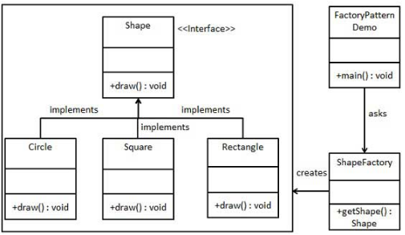
2.1 Implementation
Introduction
https://www.tutorialspoint.com/design_pattern/factory_pattern.htm
We're going to create a Shape interface and concrete classes implementing the Shape interface. A factory class ShapeFactory is defined as a next step.
FactoryPatternDemo, our demo class will use ShapeFactory to get a Shape object.
It will pass information (CIRCLE / RECTANGLE / SQUARE) to ShapeFactory to get the type of object it needs.
Java Design Pattern - CS596

Slide 6
2.1 Implementation
Introduction
https://www.tutorialspoint.com/design_pattern/factory_pattern.htm
Step 1: Create an interface Shape.java
public interface Shape {
void draw();
}
Java Design Pattern - CS596

Slide 7
2.1 Implementation
Introduction
https://www.tutorialspoint.com/design_pattern/factory_pattern.htm
Step 2: Create concrete classes implementing the same interface. Rectangle.java (1)
public class Rectangle implements Shape {
@Override
public void draw() {
System.out.println("Inside Rectangle::draw() method.");
}
}
Java Design Pattern - CS596

Slide 8
2.1 Implementation
Introduction
https://www.tutorialspoint.com/design_pattern/factory_pattern.htm
Step 2: Create concrete classes implementing the same interface.
Square.java (1)
public class Square implements Shape {
@Override
public void draw() {
System.out.println("Inside Square::draw() method.");
}
}
Java Design Pattern - CS596

Slide 9
2.1 Implementation
Introduction
https://www.tutorialspoint.com/design_pattern/factory_pattern.htm
Step 2: Create concrete classes implementing the same interface.
Square.java (2)
public class Square implements Shape {
@Override
public void draw() {
System.out.println("Inside Square::draw() method.");
}
}
Java Design Pattern - CS596

Slide 10
2.1 Implementation
Introduction
https://www.tutorialspoint.com/design_pattern/factory_pattern.htm
Step 2: Create concrete classes implementing the same interface.
Circle.java (3)
public class Circle implements Shape {
@Override
public void draw() {
System.out.println("Inside Circle::draw() method.");
}
}
Java Design Pattern - CS596

Slide 11
2.1 Implementation
Introduction
https://www.tutorialspoint.com/design_pattern/factory_pattern.htm
Step 3: Create a Factory to generate object of concrete class based on given information.
ShapeFactory.java (4)
public class ShapeFactory {
//use getShape method to get object of type shape
public Shape getShape(String shapeType){
if(shapeType == null) {
return null;
}
if(shapeType.equalsIgnoreCase("CIRCLE")){
return new Circle();
} else if(shapeType.equalsIgnoreCase("RECTANGLE")){
return new Rectangle();
} else if(shapeType.equalsIgnoreCase("SQUARE")){
return new Square();
}
return null;
}
}
Java Design Pattern - CS596

Slide 12
2.1 Implementation
Introduction
https://www.tutorialspoint.com/design_pattern/factory_pattern.htm
Step 4: Use the Factory to get object of concrete class by passing an information such as type.
FactoryPatternDemo.java (5)
public class FactoryPatternDemo {
public static void main(String[] args) {
ShapeFactory shapeFactory = new ShapeFactory();
//get an object of Circle and call its draw method.
Shape shape1 = shapeFactory.getShape("CIRCLE");
//call draw method of Circle
shape1.draw();
//get an object of Rectangle and call its draw method.
Shape shape2 = shapeFactory.getShape("RECTANGLE");
//call draw method of Rectangle
shape2.draw();
//get an object of Square and call its draw method.
Shape shape3 = shapeFactory.getShape("SQUARE");
//call draw method of circle
shape3.draw();
}
}
Java Design Pattern - CS596

Slide 13
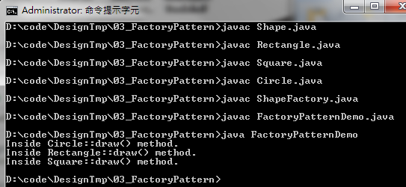
2.1 Implementation
Introduction
https://www.tutorialspoint.com/design_pattern/factory_pattern.htm
Step 5: Run FactoryPatternDemo.
Java Design Pattern - CS596

Slide 14

END of CHAPTER 2

