Slide 1


Java Design Pattern Chapter 4: Singleton
Peter H. Chen, PhDEE/EMBA

Slide 2

4 Singleton Pattern

Slide 3

4 Singleton Pattern
Introduction
https://www.tutorialspoint.com/design_pattern/singleton_pattern.htm
Singleton pattern is one of the simplest design patterns in Java.
This type of design pattern comes under creational pattern as this pattern provides one of the best ways to create an object.
This pattern involves a single class which is responsible to create an object while making sure that only single object gets created.
This class provides a way to access its only object which can be accessed directly without need to instantiate the object of the class.
Design Pattern - CS596

Slide 4
4.1 Singleton Pattern Implementation

Slide 5
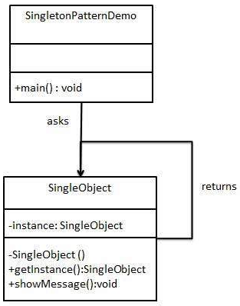
4.1 Singleton Pattern Implementation
Introduction
https://www.tutorialspoint.com/design_pattern/singleton_pattern.htm
We're going to create a SingleObject class. SingleObject class have its constructor as private and have a static instance of itself.
SingleObject class provides a static method to get its static instance to outside world.
We use SingletonPatternDemo class and SingleObject class to get a SingleObject object.
Design Pattern - CS596

Slide 6
4.2 Step 1: Create Singleton Class

Slide 7
4.2 Step 1: Create Singleton Class
Introduction
https://www.tutorialspoint.com/design_pattern/singleton_pattern.htm
SingleObject.java
public class SingleObject {
//create an object of SingleObject
private static SingleObject instance = new SingleObject();
//make the constructor private so that this class cannot be instantiated
private SingleObject(){}
//Get the only object available
public static SingleObject getInstance(){
return instance;
}
public void showMessage(){
System.out.println("Hello World!");
}
}
Design Pattern - CS596

Slide 8
4.3 Step 2: Singleton Object

Slide 9

4.3 Step 2: Singleton Object
Introduction
https://www.tutorialspoint.com/design_pattern/singleton_pattern.htm
You cannot create new object for singleton object.
SingletonPatternDemo.java
public class SingletonPatternDemo {
public static void main(String[] args) {
// illegal construct
//Compile Time Error: The constructor SingleObject() is not visible
SingleObject object = new SingleObject();
//Get the only object available
// SingleObject object = SingleObject.getInstance();
//show the message
object.showMessage();
}
}
Design Pattern - CS596

Slide 10
4.3 Step 2: Singleton Object
Introduction
https://www.tutorialspoint.com/design_pattern/singleton_pattern.htm
Get the only object from the singleton class.
SingletonPatternDemo.java
public class SingletonPatternDemo {
public static void main(String[] args) {
// illegal construct
//Compile Time Error: The constructor SingleObject() is not visible
//SingleObject object = new SingleObject();
//Get the only object available
SingleObject object = SingleObject.getInstance();
//show the message
object.showMessage();
}
}
Design Pattern - CS596

Slide 11

END of CHAPTER 4

