Slide 1


Java Design Pattern Chapter 5: Build Pattern
Peter H. Chen, PhDEE/EMBA

Slide 2

5 Build Pattern

Slide 3

5 Build Pattern
Introduction
https://www.tutorialspoint.com/design_pattern/builder_pattern.htm
Builder pattern builds a complex object using simple objects and using a step by step approach.
This type of design pattern comes under creational pattern as this pattern provides one of the best ways to create an object.
A Builder class builds the final object step by step.
This builder is independent of other objects.
Java Design Pattern - CS596

Slide 4
5.1 Build Pattern Implementation

Slide 5
5.1 Build Pattern Implementation
Introduction
https://www.tutorialspoint.com/design_pattern/builder_pattern.htm
We have considered a business case of fast-food restaurant where a typical meal could be a burger and a cold drink.
Burger could be either a Veg Burger or Chicken Burger and will be packed by a wrapper.
Cold drink could be either a Coke or Pepsi and will be packed in a bottle.
We are going to create
an Item interface representing food items, such as, burgers and cold drinks and concrete classes implementing the Item interface and
a Packing interface representing packaging of food items and concrete classes implementing the Packing interface as burger would be packed in wrapper and cold drink would be packed as bottle.
We then create a Meal class having ArrayList of Item and a MealBuilder to build different types of Meal objects by combining Item.
BuilderPatternDemo, our demo class will use MealBuilder to build a Meal.
Java Design Pattern - CS596

Slide 6
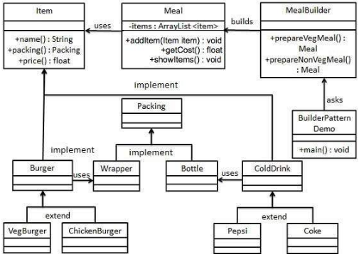
5.1 Build Pattern Implementation
Introduction
https://www.tutorialspoint.com/design_pattern/builder_pattern.htm
Item and Packing Interface:
Java Design Pattern - CS596

Slide 7
5.2 Step 1: Create Item Interface

Slide 8
5.2 Create Item Interface
Introduction
https://www.tutorialspoint.com/design_pattern/builder_pattern.htm
Create an interface Item representing food item and packing.
Item.java
public interface Item {
public String name();
public Packing packing();
public float price();
}
Create Packing Interface.
Packing.java
public interface Packing {
public String pack();
}
Java Design Pattern - CS596

Slide 9
5.3 Step 2: Create Concrete Packing

Slide 10
5.3 Step 2: Create Concrete Packing
Introduction
https://www.tutorialspoint.com/design_pattern/builder_pattern.htm
Create concrete classes implementing the Packing interface.
Wrapper.java
public class Wrapper implements Packing {
@Override
public String pack() {
return "Wrapper";
}
}
Bottle.java
public class Bottle implements Packing {
@Override
public String pack() {
return "Bottle";
}
}
Java Design Pattern - CS596

Slide 11
5.4 Step 3: Create Abstract Classes

Slide 12
5.4 Step 3: Create Abstract Class for Burger and Drink
Introduction
https://www.tutorialspoint.com/design_pattern/builder_pattern.htm
Create concrete classes implementing the Packing interface.
Burger.java
public abstract class Burger implements Item {
@Override
public Packing packing() {
return new Wrapper();
}
@Override
public abstract float price();
}
Java Design Pattern - CS596

Slide 13
5.4 Step 3: Create Abstract Class for Burger and Drink
Introduction
https://www.tutorialspoint.com/design_pattern/builder_pattern.htm
ColdDrink.java
public abstract class ColdDrink implements Item {
@Override
public Packing packing() {
return new Bottle();
}
@Override
public abstract float price();
}
Java Design Pattern - CS596

Slide 14
5.5 Step 4: Create Concrete Classes

Slide 15
5.5 Step 4: Create Concrete Class
Introduction
https://www.tutorialspoint.com/design_pattern/builder_pattern.htm
Create concrete classes extending Burger and ColdDrink classes
VegBurger.java
public class VegBurger extends Burger {
@Override
public float price() {
return 25.0f;
}
@Override
public String name() {
return "Veg Burger";
}
}
Java Design Pattern - CS596

Slide 16
5.5 Step 4: Create Concrete Class
Introduction
https://www.tutorialspoint.com/design_pattern/builder_pattern.htm
ChickenBurger.java
public class ChickenBurger extends Burger {
@Override
public float price() {
return 50.5f;
}
@Override
public String name() {
return "Chicken Burger";
}
}
Java Design Pattern - CS596

Slide 17
5.5 Step 4: Create Concrete Class
Introduction
https://www.tutorialspoint.com/design_pattern/builder_pattern.htm
Coke.java
public class Coke extends ColdDrink {
@Override
public float price() {
return 30.0f;
}
@Override
public String name() {
return "Coke";
}
}
Java Design Pattern - CS596

Slide 18
5.5 Step 4: Create Concrete Class
Introduction
https://www.tutorialspoint.com/design_pattern/builder_pattern.htm
Pepsi.java
public class Pepsi extends ColdDrink {
@Override
public float price() {
return 35.0f;
}
@Override
public String name() {
return "Pepsi";
}
}
Java Design Pattern - CS596

Slide 19
5.6 Step 5: Create Composite Class

Slide 20
5.6 Step 5: Create Composite Class
Introduction
https://www.tutorialspoint.com/design_pattern/builder_pattern.htm
Create a Meal class having Item objects defined above.
Meal.java
import java.util.ArrayList;
import java.util.List;
public class Meal {
private List<Item> items = new ArrayList<Item>();
public void addItem(Item item){
items.add(item);
}
public float getCost(){
float cost = 0.0f;
for (Item item : items) {
cost += item.price();
}
return cost;
}
public void showItems(){
for (Item item : items) {
System.out.print("Item : " + item.name());
System.out.print(", Packing : " + item.packing().pack());
System.out.println(", Price : " + item.price());
}
}
}
Java Design Pattern - CS596

Slide 21
5.7 Step 6: Create Builder Class

Slide 22
5.7 Step 6: Create Builder Class
Introduction
https://www.tutorialspoint.com/design_pattern/builder_pattern.htm
Create a MealBuilder class, the actual builder class responsible to create Meal objects.
MealBuilder.java
public class MealBuilder {
public Meal prepareVegMeal (){
Meal meal = new Meal();
meal.addItem(new VegBurger());
meal.addItem(new Coke());
return meal;
}
public Meal prepareNonVegMeal (){
Meal meal = new Meal();
meal.addItem(new ChickenBurger());
meal.addItem(new Pepsi());
return meal;
}
}
Java Design Pattern - CS596

Slide 23
5.8 Step 7: Create Builder Pattern Demo

Slide 24
5.8 Step 7: Create Builder Pattern Demo
Introduction
https://www.tutorialspoint.com/design_pattern/builder_pattern.htm
BuiderPatternDemo uses MealBuider to demonstrate builder pattern.
BuilderPatternDemo.java
public class BuilderPatternDemo {
public static void main(String[] args) {
MealBuilder mealBuilder = new MealBuilder();
Meal vegMeal = mealBuilder.prepareVegMeal();
System.out.println("Veg Meal");
vegMeal.showItems();
System.out.println("Total Cost: " + vegMeal.getCost());
Meal nonVegMeal = mealBuilder.prepareNonVegMeal();
System.out.println("\n\nNon-Veg Meal");
nonVegMeal.showItems();
System.out.println("Total Cost: " + nonVegMeal.getCost());
}
}
Java Design Pattern - CS596

Slide 25
5.9 Step 8: Run Builder Pattern Demo

Slide 26
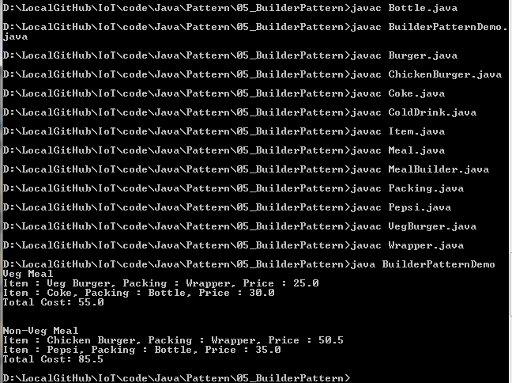
5.9 Step 8: Run Builder Pattern Demo
Introduction
https://www.tutorialspoint.com/design_pattern/builder_pattern.htm
Run BuilderPatternDemo.java
$ java BuilderPatternDemo
Java Design Pattern - CS596

Slide 27

END of CHAPTER 5

