Slide 1


Java Design Pattern Chapter 6: Prototype Pattern
Peter H. Chen, PhDEE/EMBA

Slide 2

6 Prototype Pattern

Slide 3

6 Prototype Pattern
Introduction
https://www.tutorialspoint.com/design_pattern/prototype_pattern.htm
Prototype pattern refers to creating duplicate object while keeping performance in mind.
This type of design pattern comes under creational pattern as this pattern provides one of the best ways to create an object.
This pattern involves implementing a prototype interface which tells to create a clone of the current object.
This pattern is used when creation of object directly is costly.
For example, an object is to be created after a costly database operation.
We can cache the object, returns its clone on next request and update the database as and when needed thus reducing database calls.
Java Design Pattern - CS596

Slide 4
6.1 Prototype Pattern Implementation

Slide 5
6.1 Prototype Pattern Implementation
Introduction
https://www.tutorialspoint.com/design_pattern/prototype_pattern.htm
We are going to create an abstract class Shape and concrete classes extending the Shape class.
A class ShapeCache is defined as a next step which stores shape objects in a Hashtable and returns their clone when requested.
Java Design Pattern - CS596

Slide 6
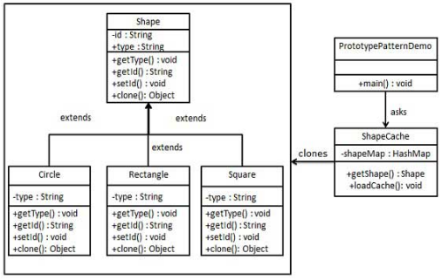
6.1 Prototype Pattern Implementation
Introduction
https://www.tutorialspoint.com/design_pattern/prototype_pattern.htm
In PrototypPatternDemo, we will use ShapeCache class to get a Shape object.
Java Design Pattern - CS596

Slide 7
6.2 Step 1: Cloneable Interface

Slide 8
6.2 Step 1: Cloneable Interface
Introduction
https://www.tutorialspoint.com/design_pattern/prototype_pattern.htm
Create an abstract class implementing Cloneable interface.
Shape.java
public abstract class Shape implements Cloneable {
private String id;
protected String type;
abstract void draw();
public String getType(){
return type;
}
public String getId() {
return id;
}
public void setId(String id) {
this.id = id;
}
public Object clone() {
Object clone = null;
try {
clone = super.clone();
} catch (CloneNotSupportedException e) {
e.printStackTrace();
}
return clone;
}
}
Java Design Pattern - CS596

Slide 9
6.3 Step 2: Create Concrete Class

Slide 10
6.3 Step 2: Create Concrete Class
Introduction
https://www.tutorialspoint.com/design_pattern/prototype_pattern.htm
Create concrete classes extending the above class.
Rectangle.java
public class Rectangle extends Shape {
public Rectangle(){
type = "Rectangle";
}
@Override
public void draw() {
System.out.println("Inside Rectangle::draw() method.");
}
}
Java Design Pattern - CS596

Slide 11
6.3 Step 2: Create Concrete Class
Introduction
https://www.tutorialspoint.com/design_pattern/prototype_pattern.htm
Square.java
public class Square extends Shape {
public Square(){
type = "Square";
}
@Override
public void draw() {
System.out.println("Inside Square::draw() method.");
}
}
Java Design Pattern - CS596

Slide 12
6.3 Step 2: Create Concrete Class
Introduction
https://www.tutorialspoint.com/design_pattern/prototype_pattern.htm
Circle.java
public class Circle extends Shape {
public Circle(){
type = "Circle";
}
@Override
public void draw() {
System.out.println("Inside Circle::draw() method.");
}
}
Java Design Pattern - CS596

Slide 13
6.4 Step 3: Concrete Database Class

Slide 14
6.4 Step 3: Concrete Database Class
Introduction
https://www.tutorialspoint.com/design_pattern/prototype_pattern.htm
Create a class to get concrete classes from database and store them in a Hashtable.
ShapeCache.java
import java.util.Hashtable;
public class ShapeCache {
private static Hashtable<String, Shape> shapeMap = new Hashtable<String, Shape>();
public static Shape getShape(String shapeId) {
Shape cachedShape = shapeMap.get(shapeId);
return (Shape) cachedShape.clone();
}
// for each shape run database query and create shape
// shapeMap.put(shapeKey, shape);
// for example, we are adding three shape
public static void loadCache() {
Circle circle = new Circle();
circle.setId("1");
shapeMap.put(circle.getId(),circle);
Square square = new Square();
square.setId("2");
shapeMap.put(square.getId(),square);
Rectangle rectangle = new Rectangle();
rectangle.setId("3");
shapeMap.put(rectangle.getId(), rectangle);
}
}
Java Design Pattern - CS596

Slide 15
6.5 Step 4: Prototype Pattern Demo

Slide 16
6.5 Step 4: Prototype Pattern Demo
Introduction
https://www.tutorialspoint.com/design_pattern/prototype_pattern.htm
PrototypePatternDemo uses ShapeCache class to get clones of shapes stored in a Hashtable.
PrototypePatternDemo.java
public class PrototypePatternDemo {
public static void main(String[] args) {
ShapeCache.loadCache();
Shape clonedShape = (Shape) ShapeCache.getShape("1");
System.out.println("Shape : " + clonedShape.getType());
Shape clonedShape2 = (Shape) ShapeCache.getShape("2");
System.out.println("Shape : " + clonedShape2.getType());
Shape clonedShape3 = (Shape) ShapeCache.getShape("3");
System.out.println("Shape : " + clonedShape3.getType());
}
}
Java Design Pattern - CS596

Slide 17
6.6 Step 5: Run Prototype Pattern Demo

Slide 18
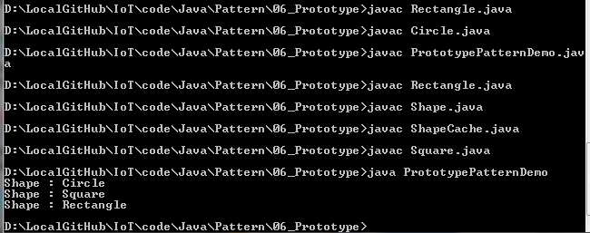
6.6 Step 5: Run Prototype Pattern Demo
Introduction
https://www.tutorialspoint.com/design_pattern/prototype_pattern.htm
Run PrototypePatternDemo.java
Java Design Pattern - CS596

Slide 19

END of CHAPTER 6

