Slide 1


Java Design Pattern Chapter 7: Adapter Pattern
Peter H. Chen, PhDEE/EMBA

Slide 2

7 Adapter Pattern

Slide 3

7 Adapter Pattern
Introduction
https://www.tutorialspoint.com/design_pattern/adapter_pattern.htm
Adapter pattern works as a bridge between two incompatible interfaces.
This type of design pattern comes under structural pattern as this pattern combines the capability of two independent interfaces.
This pattern involves a single class which is responsible to join functionalities of independent or incompatible interfaces.
A real life example could be a case of card reader which acts as an adapter between memory card and a laptop.
You plugin the memory card into card reader and card reader into the laptop so that memory card can be read via laptop.
We are demonstrating use of Adapter pattern via following example in which an audio player device can play mp3 files only and wants to use an advanced audio player capable of playing vlc and mp4 files.
Java Design Pattern - CS596

Slide 4
7.1 Adapter Pattern Implementation

Slide 5
7.1 Adapter Pattern Implementation
Introduction
https://www.tutorialspoint.com/design_pattern/adapter_pattern.htm
We have
A MediaPlayer interface and a concrete class AudioPlayer implementing the MediaPlayer interface.
A AudioPlayer can play mp3 format audio files by default.
We have another interface AdvancedMediaPlayer and concrete classes implementing the AdvancedMediaPlayer interface. These classes can play vlc and mp4 format files.
We want to make AudioPlayer to play other formats as well. To attain this, we have created an adapter class MediaAdapter which implements the MediaPlayer interface and uses AdvancedMediaPlayer objects to play the required format.
AudioPlayer uses the adapter class MediaAdapter passing it the desired audio type without knowing the actual class which can play the desired format.
AdapterPatternDemo, our demo class will use AudioPlayer class to play various formats.
Java Design Pattern - CS596

Slide 6
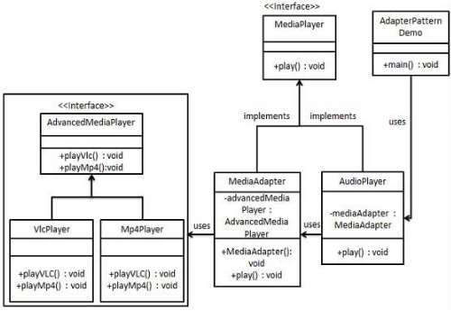
7.1 Adapter Pattern Implementation
Introduction
https://www.tutorialspoint.com/design_pattern/adapter_pattern.htm
Adapter Pattern Implementation Diagram:
Java Design Pattern - CS596

Slide 7
7.2 Step 1: Create Interface

Slide 8
7.2 Step 1: Create Interface
Introduction
https://www.tutorialspoint.com/design_pattern/adapter_pattern.htm
Create interfaces for Media Player and Advanced Media Player.
MediaPlayer.java
public interface MediaPlayer {
public void play(String audioType, String fileName);
}
AdvancedMediaPlayer.java
public interface AdvancedMediaPlayer {
public void playVlc(String fileName);
public void playMp4(String fileName);
}
Java Design Pattern - CS596

Slide 9
7.3 Step 2: Create Concrete Class

Slide 10
7.3 Step 2: Create Concrete Class
Introduction
https://www.tutorialspoint.com/design_pattern/adapter_pattern.htm
Create concrete classes implementing the AdvancedMediaPlayer interface.
VlcPlayer.java
public class VlcPlayer implements AdvancedMediaPlayer{
@Override
public void playVlc(String fileName) {
System.out.println("Playing vlc file. Name: "+ fileName);
}
@Override
public void playMp4(String fileName) {
//do nothing
}
}
Java Design Pattern - CS596

Slide 11
7.3 Step 2: Create Concrete Class
Introduction
https://www.tutorialspoint.com/design_pattern/adapter_pattern.htm
Mp4Player.java
public class Mp4Player implements AdvancedMediaPlayer{
@Override
public void playVlc(String fileName) {
//do nothing
}
@Override
public void playMp4(String fileName) {
System.out.println("Playing mp4 file. Name: "+ fileName);
}
}
Java Design Pattern - CS596

Slide 12
7.4 Step 3: Create Media Adapter

Slide 13
7.4 Step 3: Create Media Adapter
Introduction
https://www.tutorialspoint.com/design_pattern/adapter_pattern.htm
Create adapter class implementing the MediaPlayer interface.
MediaAdapter.java
public class MediaAdapter implements MediaPlayer {
AdvancedMediaPlayer advancedMusicPlayer;
public MediaAdapter(String audioType){
if(audioType.equalsIgnoreCase("vlc") ){
advancedMusicPlayer = new VlcPlayer();
}else if (audioType.equalsIgnoreCase("mp4")){
advancedMusicPlayer = new Mp4Player();
}
}
@Override
public void play(String audioType, String fileName) {
if(audioType.equalsIgnoreCase("vlc")){
advancedMusicPlayer.playVlc(fileName);
}
else if(audioType.equalsIgnoreCase("mp4")){
advancedMusicPlayer.playMp4(fileName);
}
}
}
Java Design Pattern - CS596

Slide 14
7.5 Step 4: Create Audio Player Interface

Slide 15
7.4 Step 4: Create Audio Player Interface
Introduction
https://www.tutorialspoint.com/design_pattern/adapter_pattern.htm
Create concrete class implementing the AudioPlayer interface.
AudioPlayer.java
public class AudioPlayer implements MediaPlayer {
MediaAdapter mediaAdapter;
@Override
public void play(String audioType, String fileName) {
//inbuilt support to play mp3 music files
if(audioType.equalsIgnoreCase("mp3")){
System.out.println("Playing mp3 file. Name: " + fileName);
}
//mediaAdapter is providing support to play other file formats
else if(audioType.equalsIgnoreCase("vlc") || audioType.equalsIgnoreCase("mp4")){
mediaAdapter = new MediaAdapter(audioType);
mediaAdapter.play(audioType, fileName);
} else{
System.out.println("Invalid media. " + audioType + " format not supported");
}
}
}
Java Design Pattern - CS596

Slide 16
7.6 Step 5: Adapter Pattern Demo

Slide 17
7.6 Step 5: Adapter Pattern Demo
Introduction
https://www.tutorialspoint.com/design_pattern/adapter_pattern.htm
Use the AudioPlayer to play different types of audio formats.
AdapterPatternDemo.java
public class AdapterPatternDemo {
public static void main(String[] args) {
AudioPlayer audioPlayer = new AudioPlayer();
audioPlayer.play("mp3", "beyond the horizon.mp3");
audioPlayer.play("mp4", "alone.mp4");
audioPlayer.play("vlc", "far far away.vlc");
audioPlayer.play("avi", "mind me.avi");
}
}
Java Design Pattern - CS596

Slide 18
7.7 Step 6: Run Adapter Pattern Demo

Slide 19
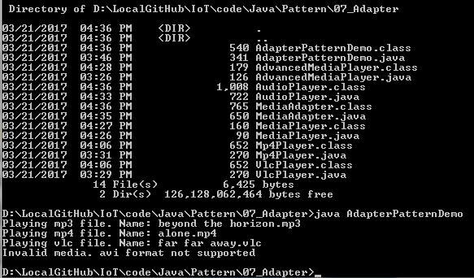
7.7 Step 6: Run Adapter Pattern Demo
Introduction
https://www.tutorialspoint.com/design_pattern/adapter_pattern.htm
Run Adapter Pattern Demo.
Java Design Pattern - CS596

Slide 20

END of CHAPTER 7

