Slide 1


Java Design Pattern Chapter 8: Bridge Pattern
Peter H. Chen, PhDEE/EMBA

Slide 2

8 Bridge Pattern

Slide 3

8 Bridge Pattern
Introduction
https://www.tutorialspoint.com/design_pattern/bridge_pattern.htm
Bridge is used when we need to decouple an abstraction from its implementation so that the two can vary independently.
This type of design pattern comes under structural pattern as this pattern decouples implementation class and abstract class by providing a bridge structure between them.
This pattern involves an interface which acts as a bridge which makes the functionality of concrete classes independent from interface implementer classes.
Both types of classes can be altered structurally without affecting each other.
We are demonstrating use of Bridge pattern via following example in which a circle can be drawn in different colors using same abstract class method but different bridge implementer classes.
Java Design Pattern - CS596

Slide 4
8.1 Bridge Pattern Implementation

Slide 5
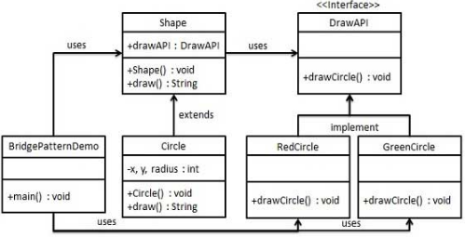
8.1 Bridge Pattern Implementation
Introduction
https://www.tutorialspoint.com/design_pattern/bridge_pattern.htm
We have a DrawAPI interface which is acting as a bridge implementer and concrete classes RedCircle, GreenCircle implementing the DrawAPI interface.
Shape is an abstract class and will use object of DrawAPI.
BridgePatternDemo, our demo class will use Shape class to draw different colored circle.
Java Design Pattern - CS596

Slide 6
8.2 Step 1: Create Bridge Interface

Slide 7
8.2 Step 1: Create Bridge Interface
Introduction
https://www.tutorialspoint.com/design_pattern/bridge_pattern.htm
Create bridge implementer interface.
DrawAPI.java
public interface DrawAPI {
public void drawCircle(int radius, int x, int y);
}
Java Design Pattern - CS596

Slide 8
8.3 Step 2: Concrete Bridge Class

Slide 9
8.3 Step 2: Concrete Bridge Class
Introduction
https://www.tutorialspoint.com/design_pattern/bridge_pattern.htm
Create concrete bridge implementer classes implementing the DrawAPI interface.
RedCircle.java
public interface DrawAPI {
public void drawCircle(int radius, int x, int y);
}
GreenCircle.java
public class GreenCircle implements DrawAPI {
@Override
public void drawCircle(int radius, int x, int y) {
System.out.println("Drawing Circle[ color: green, radius: “
+ radius + ", x: " + x + ", " + y + "]");
}
}
Java Design Pattern - CS596

Slide 10
8.4 Step 3: Abstract Class Shape

Slide 11
8.4 Step 3: Abstract Class Shape
Introduction
https://www.tutorialspoint.com/design_pattern/bridge_pattern.htm
Create an abstract class Shape using the DrawAPI interface.
Shape.java
public interface DrawAPI {
public void drawCircle(int radius, int x, int y);
}
Java Design Pattern - CS596

Slide 12
8.5 Step 4: Concrete Class

Slide 13
8.5 Step 4: Concrete Class
Introduction
https://www.tutorialspoint.com/design_pattern/bridge_pattern.htm
Create concrete class implementing the Shape interface.
Circle.java
public class Circle extends Shape {
private int x, y, radius;
public Circle(int x, int y, int radius, DrawAPI drawAPI) {
super(drawAPI);
this.x = x;
this.y = y;
this.radius = radius;
}
public void draw() {
drawAPI.drawCircle(radius,x,y);
}
}
Java Design Pattern - CS596

Slide 14
8.6 Step 5: Bridge Pattern Demo

Slide 15
8.6 Step 5: Bridge Pattern Demo
Introduction
https://www.tutorialspoint.com/design_pattern/bridge_pattern.htm
Use the Shape and DrawAPI classes to draw different colored circles.
BridgePatternDemo.java
public class BridgePatternDemo {
public static void main(String[] args) {
Shape redCircle = new Circle(100,100, 10, new RedCircle());
Shape greenCircle = new Circle(100,100, 10, new GreenCircle());
redCircle.draw();
greenCircle.draw();
}
}
Java Design Pattern - CS596

Slide 16
8.7 Step 6: Run Bridge Pattern Demo

Slide 17
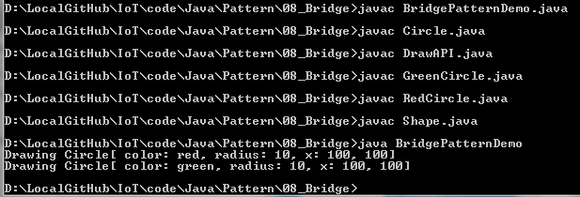
8.7 Step 6: Run Bridge Pattern Demo
Introduction
https://www.tutorialspoint.com/design_pattern/bridge_pattern.htm
Run BridgePatternDemo.java
Java Design Pattern - CS596

Slide 18

END of CHAPTER 8

