Slide 1


Java Design Pattern Chapter 9: Filter Pattern
Peter H. Chen, PhDEE/EMBA

Slide 2

9 Filter Pattern

Slide 3

9 Filter Pattern
Introduction
https://www.tutorialspoint.com/design_pattern/filter_pattern.htm
Filter pattern or Criteria pattern is a design pattern that enables developers to filter a set of objects using different criteria and chaining them in a decoupled way through logical operations.
This type of design pattern comes under structural pattern as this pattern combines multiple criteria to obtain single criteria.
Java Design Pattern - CS596

Slide 4
9.1 Filter Pattern Implementation

Slide 5
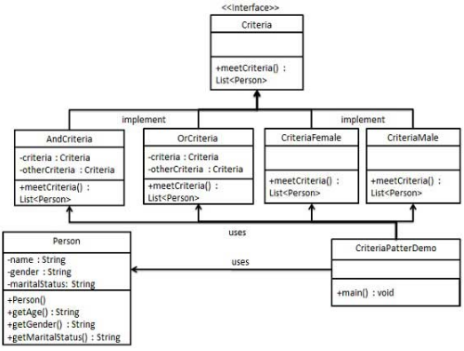
9.1 Filter Pattern Implementation
Introduction
https://www.tutorialspoint.com/design_pattern/filter_pattern.htm
We're going to create a Person object, Criteria interface and concrete classes implementing this interface to filter list of Person objects.
CriteriaPatternDemo, our demo class uses Criteria objects to filter List of Person objects based on various criteria and their combinations.
Java Design Pattern - CS596

Slide 6
9.2 Step 1: Create Class for Criteria

Slide 7
9.2 Step 1: Create Class for Criteria
Introduction
https://www.tutorialspoint.com/design_pattern/filter_pattern.htm
Create a class on which criteria is to be applied.
Person.java
public class Person {
private String name;
private String gender;
private String maritalStatus;
public Person(String name, String gender, String maritalStatus){
this.name = name;
this.gender = gender;
this.maritalStatus = maritalStatus;
}
public String getName() {
return name;
}
public String getGender() {
return gender;
}
public String getMaritalStatus() {
return maritalStatus;
}
}
Java Design Pattern - CS596

Slide 8
9.2 Step 1: Create Class for Criteria

Slide 9
9.2 Step 1: Create Class for Criteria
Introduction
https://www.tutorialspoint.com/design_pattern/filter_pattern.htm
Create a class on which criteria is to be applied.
Person.java
public class Person {
private String name;
private String gender;
private String maritalStatus;
public Person(String name, String gender, String maritalStatus){
this.name = name;
this.gender = gender;
this.maritalStatus = maritalStatus;
}
public String getName() {
return name;
}
public String getGender() {
return gender;
}
public String getMaritalStatus() {
return maritalStatus;
}
}
Java Design Pattern - CS596

Slide 10
9.3 Step 2: Interface for Criteria

Slide 11
9.3 Step 2: Interface for Criteria
Introduction
https://www.tutorialspoint.com/design_pattern/filter_pattern.htm
Create an interface for Criteria.
Criteria.java
import java.util.List;
public interface Criteria {
public List<Person> meetCriteria(List<Person> persons);
}
Java Design Pattern - CS596

Slide 12
9.4 Step 3: Concrete Class for Criteria Interface

Slide 13
9.4 Step 3: Concrete Class for Criteria Interface
Introduction
https://www.tutorialspoint.com/design_pattern/filter_pattern.htm
Create concrete classes implementing the Criteria interface.
CriteriaMale.java
import java.util.ArrayList;
import java.util.List;
public class CriteriaMale implements Criteria {
@Override
public List<Person> meetCriteria(List<Person> persons) {
List<Person> malePersons = new ArrayList<Person>();
for (Person person : persons) {
if(person.getGender().equalsIgnoreCase("MALE")){
malePersons.add(person);
}
}
return malePersons;
}
}
Java Design Pattern - CS596

Slide 14
9.4 Step 3: Concrete Class for Criteria Interface
Introduction
https://www.tutorialspoint.com/design_pattern/filter_pattern.htm
CriteriaFemale.java
import java.util.ArrayList;
import java.util.List;
public class CriteriaFemale implements Criteria {
@Override
public List<Person> meetCriteria(List<Person> persons) {
List<Person> femalePersons = new ArrayList<Person>();
for (Person person : persons) {
if(person.getGender().equalsIgnoreCase("FEMALE")){
femalePersons.add(person);
}
}
return femalePersons;
}
}
Java Design Pattern - CS596

Slide 15
9.4 Step 3: Concrete Class for Criteria Interface
Introduction
https://www.tutorialspoint.com/design_pattern/filter_pattern.htm
CriteriaSingle.java
import java.util.ArrayList;
import java.util.List;
public class CriteriaSingle implements Criteria {
@Override
public List<Person> meetCriteria(List<Person> persons) {
List<Person> singlePersons = new ArrayList<Person>();
for (Person person : persons) {
if(person.getMaritalStatus().equalsIgnoreCase("SINGLE")){
singlePersons.add(person);
}
}
return singlePersons;
}
}
Java Design Pattern - CS596

Slide 16
9.4 Step 3: Concrete Class for Criteria Interface
Introduction
https://www.tutorialspoint.com/design_pattern/filter_pattern.htm
AndCriteria.java
import java.util.List;
public class AndCriteria implements Criteria {
private Criteria criteria;
private Criteria otherCriteria;
public AndCriteria(Criteria criteria, Criteria otherCriteria) {
this.criteria = criteria;
this.otherCriteria = otherCriteria;
}
@Override
public List<Person> meetCriteria(List<Person> persons) {
List<Person> firstCriteriaPersons = criteria.meetCriteria(persons);
return otherCriteria.meetCriteria(firstCriteriaPersons);
}
}
Java Design Pattern - CS596

Slide 17
9.4 Step 3: Concrete Class for Criteria Interface
Introduction
https://www.tutorialspoint.com/design_pattern/filter_pattern.htm
OrCriteria.java
import java.util.List;
public class OrCriteria implements Criteria {
private Criteria criteria;
private Criteria otherCriteria;
public OrCriteria(Criteria criteria, Criteria otherCriteria) {
this.criteria = criteria;
this.otherCriteria = otherCriteria;
}
@Override
public List<Person> meetCriteria(List<Person> persons) {
List<Person> firstCriteriaItems = criteria.meetCriteria(persons);
List<Person> otherCriteriaItems = otherCriteria.meetCriteria(persons);
for (Person person : otherCriteriaItems) {
if(!firstCriteriaItems.contains(person)){
firstCriteriaItems.add(person);
}
}
return firstCriteriaItems;
}
}
Java Design Pattern - CS596

Slide 18
9.5 Step 4: Criteria Pattern Demo

Slide 19
9.5 Step 4: Criteria Pattern Demo
Introduction
https://www.tutorialspoint.com/design_pattern/filter_pattern.htm
Use different Criteria and their combination to filter out persons.
CriteriaPatternDemo.java (1)
import java.util.ArrayList;
import java.util.List;
public class CriteriaPatternDemo {
public static void main(String[] args) {
List<Person> persons = new ArrayList<Person>();
persons.add(new Person("Robert","Male", "Single"));
persons.add(new Person("John", "Male", "Married"));
persons.add(new Person("Laura", "Female", "Married"));
persons.add(new Person("Diana", "Female", "Single"));
persons.add(new Person("Mike", "Male", "Single"));
persons.add(new Person("Bobby", "Male", "Single"));
Java Design Pattern - CS596

Slide 20
9.5 Step 4: Criteria Pattern Demo
Introduction
https://www.tutorialspoint.com/design_pattern/filter_pattern.htm
CriteriaPatternDemo.java (2)
Criteria male = new CriteriaMale();
Criteria female = new CriteriaFemale();
Criteria single = new CriteriaSingle();
Criteria singleMale = new AndCriteria(single, male);
Criteria singleOrFemale = new OrCriteria(single, female);
System.out.println("Males: ");
printPersons(male.meetCriteria(persons));
System.out.println("\nFemales: ");
printPersons(female.meetCriteria(persons));
System.out.println("\nSingle Males: ");
printPersons(singleMale.meetCriteria(persons));
System.out.println("\nSingle Or Females: ");
printPersons(singleOrFemale.meetCriteria(persons));
}
Java Design Pattern - CS596

Slide 21
9.5 Step 4: Criteria Pattern Demo
Introduction
https://www.tutorialspoint.com/design_pattern/filter_pattern.htm
CriteriaPatternDemo.java (3)
public static void printPersons(List<Person> persons){
for (Person person : persons) {
System.out.println("Person : [ Name : " + person.getName()
+ ", Gender : " + person.getGender() + ", Marital Status : "
+ person.getMaritalStatus() + " ]");
}
}
}
Java Design Pattern - CS596

Slide 22
9.6 Step 5: Run Criteria Pattern Demo

Slide 23
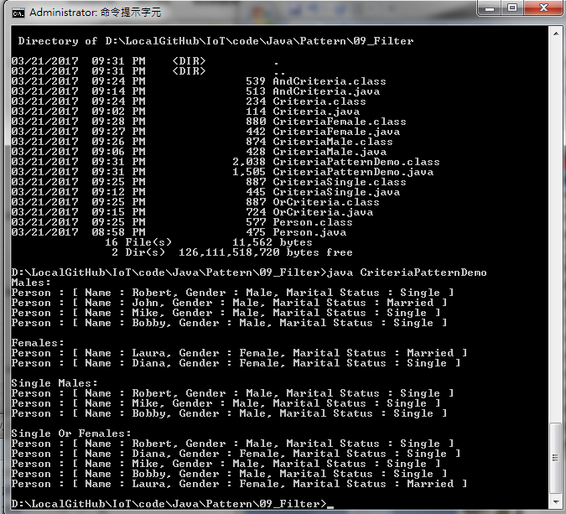
9.6 Step 5: Run riteria Pattern Demo
Introduction
https://www.tutorialspoint.com/design_pattern/filter_pattern.htm
Run CriteriaPatternDemo.java
Java Design Pattern - CS596

Slide 24

END of CHAPTER 9

