Slide 1


Java Design Pattern Chapter 10: Composite Pattern
Peter H. Chen, PhDEE/EMBA

Slide 2

10 Composite Pattern

Slide 3

10 Composite Pattern
Introduction
https://www.tutorialspoint.com/design_pattern/composite_pattern.htm
Composite pattern is used where we need to treat a group of objects in similar way as a single object.
Composite pattern composes objects in term of a tree structure to represent part as well as whole hierarchy.
This type of design pattern comes under structural pattern as this pattern creates a tree structure of group of objects.
This pattern creates a class that contains group of its own objects.
This class provides ways to modify its group of same objects.
We are demonstrating use of composite pattern via following example in which we will show employees hierarchy of an organization.
Java Design Pattern - CS596

Slide 4
10.1 Composite Pattern Implementation

Slide 5
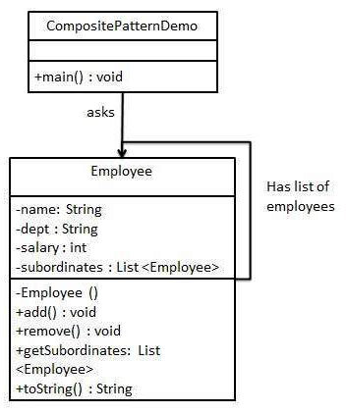
10.1 Composite Pattern Implementation
Introduction
https://www.tutorialspoint.com/design_pattern/composite_pattern.htm
We have a class Employee which acts as composite pattern actor class.
CompositePatternDemo, our demo class will use Employee class to add department level hierarchy and print all employees.
Java Design Pattern - CS596

Slide 6
10.2 Step 1: Employee Class

Slide 7
10.2 Step 1: Employee Class
Introduction
https://www.tutorialspoint.com/design_pattern/composite_pattern.htm
Create Employee class having list of Employee objects.
Employee.java
import java.util.ArrayList;
import java.util.List;
public class Employee {
private String name;
private String dept;
private int salary;
private List<Employee> subordinates;
// constructor
public Employee(String name,String dept, int sal) {
this.name = name;
this.dept = dept;
this.salary = sal;
subordinates = new ArrayList<Employee>();
}
public void add(Employee e) {
subordinates.add(e);
}
public void remove(Employee e) {
subordinates.remove(e);
}
public List<Employee> getSubordinates(){
return subordinates;
}
public String toString(){
return ("Employee :[ Name : " + name + ", dept : "
+ dept + ", salary :" + salary+" ]");
}
}
Java Design Pattern - CS596

Slide 8
10.3 Step 2: Composite Pattern Demo

Slide 9
10.3 Step 2: Composite Pattern Demo
Introduction
https://www.tutorialspoint.com/design_pattern/composite_pattern.htm
Use the Employee class to create and print employee hierarchy.
CompositePatternDemo.java (1).
public class CompositePatternDemo {
public static void main(String[] args) {
Employee CEO = new Employee("John","CEO", 30000);
Employee headSales = new Employee("Robert","Head Sales", 20000);
Employee headMarketing = new Employee("Michel","Head Marketing", 20000);
Employee clerk1 = new Employee("Laura","Marketing", 10000);
Employee clerk2 = new Employee("Bob","Marketing", 10000);
Employee salesExecutive1 = new Employee("Richard","Sales", 10000);
Employee salesExecutive2 = new Employee("Rob","Sales", 10000);
CEO.add(headSales);
CEO.add(headMarketing);
Java Design Pattern - CS596

Slide 10
10.3 Step 2: Composite Pattern Demo
Introduction
https://www.tutorialspoint.com/design_pattern/composite_pattern.htm
CompositePatternDemo.java (2)
headSales.add(salesExecutive1);
headSales.add(salesExecutive2);
headMarketing.add(clerk1);
headMarketing.add(clerk2);
//print all employees of the organization
System.out.println(CEO);
for (Employee headEmployee : CEO.getSubordinates()) {
System.out.println(headEmployee);
for (Employee employee : headEmployee.getSubordinates()) {
System.out.println(employee);
}
}
}
}
Java Design Pattern - CS596

Slide 11
10.4 Run Composite Pattern Demo

Slide 12
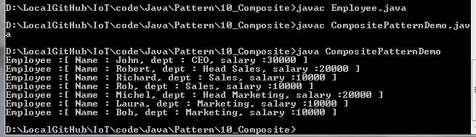
10.4 Run Composite Pattern Demo
Introduction
https://www.tutorialspoint.com/design_pattern/composite_pattern.htm
Run CompositePatternDemo.java.
Java Design Pattern - CS596

Slide 13

END of CHAPTER 10

