Slide 1


Java Design Pattern Chapter 11: Decorator Pattern
Peter H. Chen, PhDEE/EMBA

Slide 2

11 Decorator Pattern

Slide 3

11 Decorator Pattern
Introduction
https://www.tutorialspoint.com/design_pattern/decorator_pattern.htm
Decorator pattern allows a user to add new functionality to an existing object without altering its structure.
This type of design pattern comes under structural pattern as this pattern acts as a wrapper to existing class.
This pattern creates a decorator class which wraps the original class and provides additional functionality keeping class methods signature intact.
We are demonstrating the use of decorator pattern via following example in which we will decorate a shape with some color without alter shape class.
Java Design Pattern - CS596

Slide 4
11.1 Decorator Pattern Implementation

Slide 5
11.1 Decorator Pattern Implementation
Introduction
https://www.tutorialspoint.com/design_pattern/decorator_pattern.htm
We're going to create a Shape interface and concrete classes implementing the Shape interface.
We will then create an abstract decorator class ShapeDecorator implementing the Shape interface and having Shape object as its instance variable.
RedShapeDecorator is concrete class implementing ShapeDecorator.
DecoratorPatternDemo, our demo class will use RedShapeDecorator to decorate Shape objects.
Java Design Pattern - CS596

Slide 6
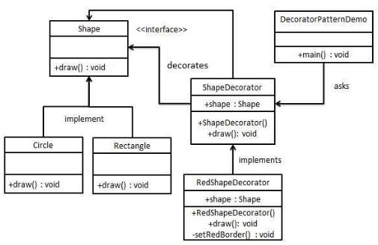
11.1 Decorator Pattern Implementation
Introduction
https://www.tutorialspoint.com/design_pattern/decorator_pattern.htm
Decorator Pattern Implementation:
Java Design Pattern - CS596

Slide 7
11.2 Step 1: Shape Interface

Slide 8
11.2 Step 1: Shape Interface
Introduction
https://www.tutorialspoint.com/design_pattern/decorator_pattern.htm
Create an interface.
Shape.java
public interface Shape {
void draw();
}
Java Design Pattern - CS596

Slide 9
11.3 Step 2: Concrete Class

Slide 10
11.3 Step 2: Concrete Class
Introduction
https://www.tutorialspoint.com/design_pattern/decorator_pattern.htm
Create concrete classes implementing the same interface.
Rectangle.java
public class Rectangle implements Shape {
@Override
public void draw() {
System.out.println("Shape: Rectangle");
}
}
Java Design Pattern - CS596

Slide 11
11.3 Step 2: Concrete Class
Introduction
https://www.tutorialspoint.com/design_pattern/decorator_pattern.htm
Circle.java
public class Circle implements Shape {
@Override
public void draw() {
System.out.println("Shape: Circle");
}
}
Java Design Pattern - CS596

Slide 12
11.4 Step 3: Abstract Decorator Class

Slide 13
11.4 Step 3: Abstract Decorator Class
Introduction
https://www.tutorialspoint.com/design_pattern/decorator_pattern.htm
Create abstract decorator class implementing the Shape interface.
ShapeDecorator.java
public abstract class ShapeDecorator implements Shape {
protected Shape decoratedShape;
public ShapeDecorator(Shape decoratedShape){
this.decoratedShape = decoratedShape;
}
public void draw(){
decoratedShape.draw();
}
}
Java Design Pattern - CS596

Slide 14
11.5 Step 4: Concrete Decorator

Slide 15
11.5 Step 4: Concrete Decorator
Introduction
https://www.tutorialspoint.com/design_pattern/decorator_pattern.htm
Create concrete decorator class extending the ShapeDecorator class.
RedShapeDecorator.java
public class RedShapeDecorator extends ShapeDecorator {
public RedShapeDecorator(Shape decoratedShape) {
super(decoratedShape);
}
@Override
public void draw() {
decoratedShape.draw();
setRedBorder(decoratedShape);
}
private void setRedBorder(Shape decoratedShape){
System.out.println("Border Color: Red");
}
}
Java Design Pattern - CS596

Slide 16
11.6 Step 5: Decorator Pattern Demo

Slide 17
11.6 Step 5: Decorator Pattern Demo
Introduction
https://www.tutorialspoint.com/design_pattern/decorator_pattern.htm
Use the RedShapeDecorator to decorate Shape objects.
DecoratorPatternDemo.java
public class DecoratorPatternDemo {
public static void main(String[] args) {
Shape circle = new Circle();
Shape redCircle = new RedShapeDecorator(new Circle());
Shape redRectangle = new RedShapeDecorator(new Rectangle());
System.out.println("Circle with normal border");
circle.draw();
System.out.println("\nCircle of red border");
redCircle.draw();
System.out.println("\nRectangle of red border");
redRectangle.draw();
}
}
Java Design Pattern - CS596

Slide 18
11.7 Step 6: Run Decorator Pattern Demo

Slide 19
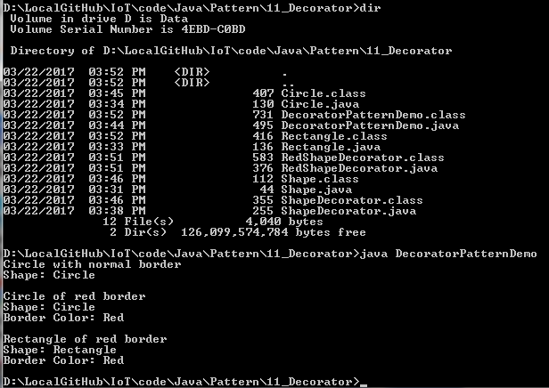
11.7 Step 6: Run Decorator Pattern Demo
Introduction
https://www.tutorialspoint.com/design_pattern/decorator_pattern.htm
Run DecoratorPatternDemo.java
Java Design Pattern - CS596

Slide 20

END of CHAPTER 11

