Slide 1


Java Design Pattern Chapter 13: Flyweight Pattern
Peter H. Chen, PhDEE/EMBA

Slide 2

13 Flyweight Pattern

Slide 3

13 Flyweight Pattern
Introduction
https://www.tutorialspoint.com/design_pattern/flyweight_pattern.htm
Flyweight pattern is primarily used to reduce the number of objects created and to decrease memory footprint and increase performance.
This type of design pattern comes under structural pattern as this pattern provides ways to decrease object count thus improving the object structure of application.
Flyweight pattern tries to reuse already existing similar kind objects by storing them and creates new object when no matching object is found.
We will demonstrate this pattern by drawing 20 circles of different locations but we will create only 5 objects.
Only 5 colors are available so color property is used to check already existing Circle objects.
Java Design Pattern - CS596

Slide 4
13 Flyweight Pattern
Introduction
https://en.wikipedia.org/wiki/Flyweight_pattern
A Flyweight pattern is a software design pattern.
A Flyweight is an object that minimizes memory usage by sharing as much data as possible with other similar objects.
A Flyweight is a way to use objects in large numbers when a simple repeated representation would use an unacceptable amount of memory.
Often some parts of the object state can be shared, and it is common practice to hold them in external data structures and pass them to the flyweight objects temporarily when they are used.
Java Design Pattern - CS596

Slide 5
13 Flyweight Pattern
Introduction
https://en.wikipedia.org/wiki/Flyweight_pattern
Word Processor Example:
A classic example usage of the flyweight pattern is the data structures for graphical representation of characters in a word processor.
It might be desirable to have, for each character in a document, a glyph object containing its font outline, font metrics, and other formatting data, but this would amount to hundreds or thousands of bytes for each character.
Instead, for every character there might be a reference to a flyweight glyph object shared by every instance of the same character in the document; only the position of each character (in the document and/or the page) would need to be stored internally.
String interning Example:
In other contexts the idea of sharing identical data structures is called hash consing.
Java Design Pattern - CS596

Slide 6
13.1 Flyweight Pattern Implementation

Slide 7
13.1 Flyweight Pattern Implementation
Introduction
https://www.tutorialspoint.com/design_pattern/facade_pattern.htm
We are going to create a Shape interface and concrete class Circle implementing the Shape interface.
A factory class ShapeFactory is defined as a next step.
ShapeFactory has a HashMap of Circle having key as color of the Circle object.
Whenever a request comes to create a circle of particular color to ShapeFactory, it checks the circle object in its HashMap, if object of Circle found, that object is returned otherwise a new object is created, stored in hashmap for future use, and returned to client.
FlyWeightPatternDemo, our demo class, will use ShapeFactory to get a Shape object.
It will pass information (red / green / blue/ black / white) to ShapeFactory to get the circle of desired color it needs.
Java Design Pattern - CS596

Slide 8
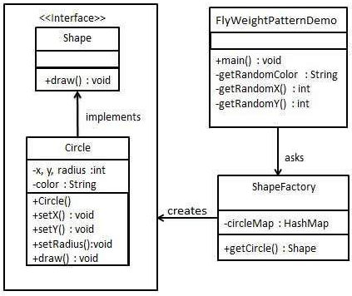
13.1 Flyweight Pattern Implementation
Introduction
https://www.tutorialspoint.com/design_pattern/flyweight_pattern.htm
Flyweight Pattern Implementation Diagram.
Java Design Pattern - CS596

Slide 9
13.2 Step 1: Create Interface

Slide 10
13.2 Step 1: Create Interface
Introduction
https://www.tutorialspoint.com/design_pattern/flyweight_pattern.htm
Create an interface.
Shape.java
public interface Shape {
void draw();
}
Java Design Pattern - CS596

Slide 11
13.3 Step 2: Concrete Class

Slide 12
13.3 Step 2: Concrete Class
Introduction
https://www.tutorialspoint.com/design_pattern/flyweight_pattern.htm
Create concrete class implementing the same interface.
Circle.java
public class Circle implements Shape {
private String color;
private int x;
private int y;
private int radius;
public Circle(String color){
this.color = color;
}
public void setX(int x) {
this.x = x;
}
public void setY(int y) {
this.y = y;
}
public void setRadius(int radius) {
this.radius = radius;
}
@Override
public void draw() {
System.out.println("Circle: Draw() [Color : " + color + ", x : "
+ x + ", y :" + y + ", radius :" + radius);
}
}
Java Design Pattern - CS596

Slide 13
13.4 Step 3: Create Factory

Slide 14
13.4 Step 4: Create Factory
Introduction
https://www.tutorialspoint.com/design_pattern/flyweight_pattern.htm
Use the factory to get object of concrete class by passing an information such as color.
FlyweightPatternDemo.java
import java.util.HashMap;
public class ShapeFactory {
private static final HashMap<String, Shape> circleMap
= new HashMap<String, Shape>();
public static Shape getCircle(String color) {
Circle circle = (Circle)circleMap.get(color);
if(circle == null) {
circle = new Circle(color);
circleMap.put(color, circle);
System.out.println("Creating circle of color : " + color);
}
return circle;
}
}
Java Design Pattern - CS596

Slide 15
13.5 Step 4: Flyweight Pattern Demo

Slide 16
13.5 Step 4: Flyweight Pattern Demo
Introduction
https://www.tutorialspoint.com/design_pattern/flyweight_pattern.htm
Use the factory to get object of concrete class by passing an information such as color.
FlyweightPatternDemo.java (1)
public class FlyweightPatternDemo {
private static final String colors[] = { "Red", "Green", "Blue", "White", "Black" };
public static void main(String[] args) {
for(int i=0; i < 20; ++i) {
Circle circle = (Circle)ShapeFactory.getCircle(getRandomColor());
circle.setX(getRandomX());
circle.setY(getRandomY());
circle.setRadius(100);
circle.draw();
}
}
Java Design Pattern - CS596

Slide 17
13.5 Step 4: Flyweight Pattern Demo
Introduction
https://www.tutorialspoint.com/design_pattern/flyweight_pattern.htm
Use the factory to get object of concrete class by passing an information such as color.
FlyweightPatternDemo.java (2)
private static String getRandomColor() {
return colors[(int)(Math.random()*colors.length)];
}
private static int getRandomX() {
return (int)(Math.random()*100 );
}
private static int getRandomY() {
return (int)(Math.random()*100);
}
}
Java Design Pattern - CS596

Slide 18
13.6 Step 5: Run Flyweight Pattern Demo

Slide 19
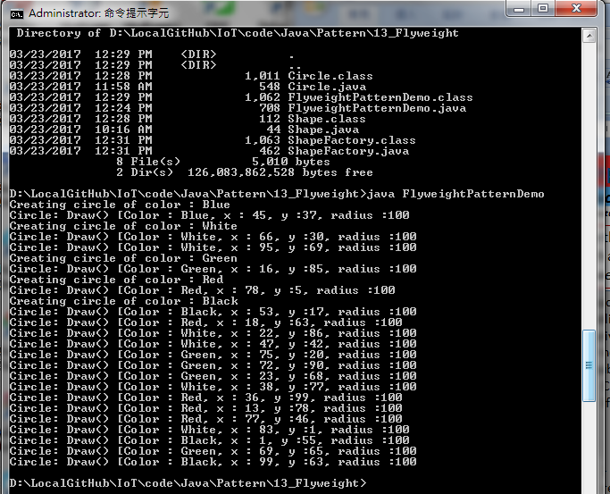
13.6 Step 5: Run Flyweight Pattern Demo
Introduction
https://www.tutorialspoint.com/design_pattern/flyweight_pattern.htm
Run FlyweightPatternDemo.java (2)
Java Design Pattern - CS596

Slide 20

END of CHAPTER 13

