Slide 1


Java Design Pattern Chapter 14: Proxy Pattern
Peter H. Chen, PhDEE/EMBA

Slide 2

14 Proxy Pattern

Slide 3

14 Proxy Pattern
Introduction
https://www.tutorialspoint.com/design_pattern/proxy_pattern.htm
In proxy pattern, a class represents functionality of another class.
This type of design pattern comes under structural pattern.
In proxy pattern, we create object having original object to interface its functionality to outer world.
Java Design Pattern - CS596

Slide 4
14.1 Proxy Pattern Implementation

Slide 5
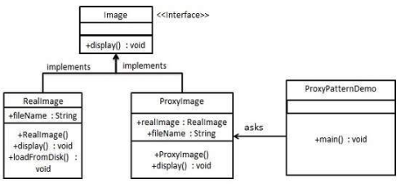
14.1 Proxy Pattern Implementations
Introduction
https://www.tutorialspoint.com/design_pattern/proxy_pattern.htm
We are going to create an Image interface and concrete classes implementing the Image interface.
ProxyImage is a a proxy class to reduce memory footprint of RealImage object loading.
ProxyPatternDemo, our demo class, will use ProxyImage to get an Image object to load and display as it needs.
Java Design Pattern - CS596

Slide 6
14.2 Step 1: Create Interface

Slide 7
14.2 Step 1: Create Interface
Introduction
https://www.tutorialspoint.com/design_pattern/proxy_pattern.htm
Create an interface.
Image.java
public interface Image {
void display();
}
Java Design Pattern - CS596

Slide 8
14.3 Step 2: Interface Concrete Class

Slide 9
14.3 Step 2: Interface Concrete Class
Introduction
https://www.tutorialspoint.com/design_pattern/proxy_pattern.htm
Create concrete classes implementing the same interface.
RealImage.java
public class RealImage implements Image {
private String fileName;
public RealImage(String fileName){
this.fileName = fileName;
loadFromDisk(fileName);
}
@Override
public void display() {
System.out.println("Displaying " + fileName);
}
private void loadFromDisk(String fileName){
System.out.println("Loading " + fileName);
}
}
Java Design Pattern - CS596

Slide 10
14.3 Step 2: Interface Concrete Class
Introduction
https://www.tutorialspoint.com/design_pattern/proxy_pattern.htm
ProxyImage.java
public class ProxyImage implements Image{
private RealImage realImage;
private String fileName;
public ProxyImage(String fileName){
this.fileName = fileName;
}
@Override
public void display() {
if(realImage == null){
realImage = new RealImage(fileName);
}
realImage.display();
}
}
Java Design Pattern - CS596

Slide 11
14.4 Step 3: Use ProxyImage

Slide 12
14.4 Step 3: Use ProxyImage
Introduction
https://www.tutorialspoint.com/design_pattern/proxy_pattern.htm
Use the ProxyImage to get object of RealImage class when required.
ProxyPatternDemo.java
public class ProxyPatternDemo {
public static void main(String[] args) {
Image image = new ProxyImage("test_10mb.jpg");
//image will be loaded from disk
image.display();
System.out.println("");
//image will not be loaded from disk
image.display();
}
}
Java Design Pattern - CS596

Slide 13
14.5 Step 4: Run ProxyImage

Slide 14
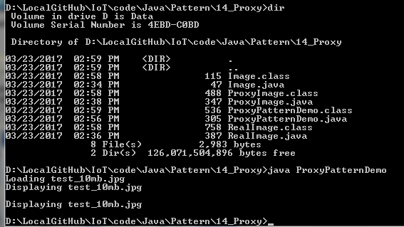
14.5 Step 4: Run ProxyImage
Introduction
https://www.tutorialspoint.com/design_pattern/proxy_pattern.htm
Run ProxyPatternDemo.java
Java Design Pattern - CS596

Slide 15

END of CHAPTER 14

