Slide 1


Java Design Pattern Chapter 15: Pattern Chain
Peter H. Chen, PhDEE/EMBA

Slide 2

15 Pattern Chain

Slide 3

15 Pattern Chain
Introduction
https://www.tutorialspoint.com/design_pattern/chain_of_responsibility_pattern.htm
As the name suggests, the chain of responsibility pattern creates a chain of receiver objects for a request.
This pattern decouples sender and receiver of a request based on type of request. This pattern comes under behavioral patterns.
In this pattern, normally each receiver contains reference to another receiver. If one object cannot handle the request then it passes the same to the next receiver and so on.
Java Design Pattern - CS596

Slide 4
15.1 Pattern Chain Implementation

Slide 5
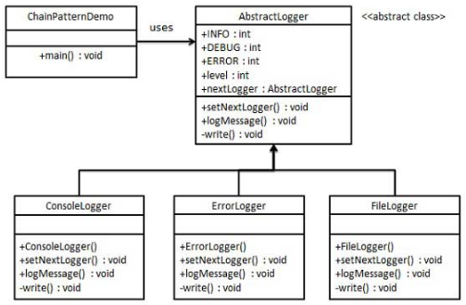
15.1 Pattern Chain Implementation
Introduction
https://www.tutorialspoint.com/design_pattern/chain_of_responsibility_pattern.htm
We have created an abstract class AbstractLogger with a level of logging.
Then we have created three types of loggers extending the AbstractLogger.
Each logger checks the level of message to its level and print accordingly otherwise does not print and pass the message to its next logger.
Java Design Pattern - CS596

Slide 6
15.2 Step 1: Abstract Logger Class

Slide 7
15.2 Step 1: Abstract Logger Class
Introduction
https://www.tutorialspoint.com/design_pattern/chain_of_responsibility_pattern.htm
Create an abstract logger class.
AbstractLogger.java (1)
public abstract class AbstractLogger {
public static int INFO = 1;
public static int DEBUG = 2;
public static int ERROR = 3;
protected int level;
//next element in chain or responsibility
protected AbstractLogger nextLogger;
public void setNextLogger(AbstractLogger nextLogger){
this.nextLogger = nextLogger;
}
Java Design Pattern - CS596

Slide 8
15.2 Step 1: Abstract Logger Class
Introduction
https://www.tutorialspoint.com/design_pattern/chain_of_responsibility_pattern.htm
Create an abstract logger class.
AbstractLogger.java (1)
public void logMessage(int level, String message){
if(this.level <= level){
write(message);
}
if(nextLogger !=null){
nextLogger.logMessage(level, message);
}
}
abstract protected void write(String message);
}
Java Design Pattern - CS596

Slide 9
15.3 Step 2: Concrete Class

Slide 10
15.3 Step 2: Concrete Class
Introduction
https://www.tutorialspoint.com/design_pattern/chain_of_responsibility_pattern.htm
Create concrete classes extending the logger.
ConsoleLogger.java
public class ConsoleLogger extends AbstractLogger {
public ConsoleLogger(int level){
this.level = level;
}
@Override
protected void write(String message) {
System.out.println("Standard Console::Logger: " + message);
}
}
Java Design Pattern - CS596

Slide 11
15.3 Step 2: Concrete Class
Introduction
https://www.tutorialspoint.com/design_pattern/chain_of_responsibility_pattern.htm
FileLogger.java
public class FileLogger extends AbstractLogger {
public FileLogger(int level){
this.level = level;
}
@Override
protected void write(String message) {
System.out.println("File::Logger: " + message);
}
}
Java Design Pattern - CS596

Slide 12
15.3 Step 2: Concrete Class
Introduction
https://www.tutorialspoint.com/design_pattern/chain_of_responsibility_pattern.htm
ErrorLogger.java
public class ErrorLogger extends AbstractLogger {
public ErrorLogger(int level){
this.level = level;
}
@Override
protected void write(String message) {
System.out.println("Error Console::Logger: " + message);
}
}
Java Design Pattern - CS596

Slide 13
15.4 Step 3: Chain Pattern Demo

Slide 14
15.4 Step 3: Chain Pattern Demo
Introduction
https://www.tutorialspoint.com/design_pattern/chain_of_responsibility_pattern.htm
Create different types of loggers. Assign them error levels and set next logger in each logger. Next logger in each logger represents the part of the chain.
ChainPatternDemo.java (1)
public class ChainPatternDemo {
private static AbstractLogger getChainOfLoggers(){
AbstractLogger errorLogger = new ErrorLogger(AbstractLogger.ERROR);
AbstractLogger fileLogger = new FileLogger(AbstractLogger.DEBUG);
AbstractLogger consoleLogger = new ConsoleLogger(AbstractLogger.INFO);
errorLogger.setNextLogger(fileLogger);
fileLogger.setNextLogger(consoleLogger);
return errorLogger;
}
Java Design Pattern - CS596

Slide 15
15.4 Step 3: Chain Pattern Demo
Introduction
https://www.tutorialspoint.com/design_pattern/chain_of_responsibility_pattern.htm
ChainPatternDemo.java (2)
public static void main(String[] args) {
AbstractLogger loggerChain = getChainOfLoggers();
loggerChain.logMessage (AbstractLogger.INFO,
"This is an information.");
loggerChain.logMessage (AbstractLogger.DEBUG,
"This is an debug level information.");
loggerChain.logMessage (AbstractLogger.ERROR,
"This is an error information.");
}
}
Java Design Pattern - CS596

Slide 16
15.5 Step 4: Run Chain Pattern Demo

Slide 17
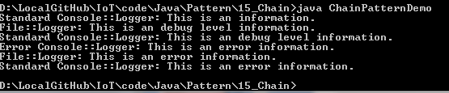
15.5 Step 4: Run Chain Pattern Demo
Introduction
https://www.tutorialspoint.com/design_pattern/chain_of_responsibility_pattern.htm
Run ChainPatternDemo.java
Java Design Pattern - CS596

Slide 18

END of CHAPTER 15

