Slide 1


Java Design Pattern Chapter 16: Command Pattern
Peter H. Chen, PhDEE/EMBA

Slide 2

16 Command Pattern

Slide 3

16 Command Pattern
Introduction
https://www.tutorialspoint.com/design_pattern/command_pattern.htm
Command pattern is a data driven design pattern and falls under behavioral pattern category.
A request is wrapped under an object as command and passed to invoker object.
Invoker object looks for the appropriate object which can handle this command and passes the command to the corresponding object which executes the command.
Java Design Pattern - CS596

Slide 4
16.1 Command Pattern Implementation

Slide 5
16.1 Command Pattern Implementation
Introduction
https://www.tutorialspoint.com/design_pattern/command_pattern.htm
We have created an interface Order which is acting as a command.
We have created a Stock class which acts as a request.
We have concrete command classes BuyStock and SellStock implementing Order interface which will do actual command processing.
A class Broker is created which acts as an invoker object.
It can take and place orders.
Broker object uses command pattern to identify which object will execute which command based on the type of command.
CommandPatternDemo, our demo class, will use Broker class to demonstrate command pattern.
Java Design Pattern - CS596

Slide 6
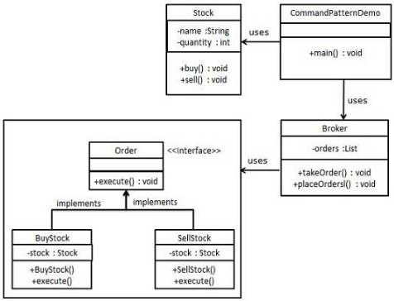
16.1 Command Pattern Implementation
Introduction
https://www.tutorialspoint.com/design_pattern/command_pattern.htm
Command Pattern Implementation Diagram:
Java Design Pattern - CS596

Slide 7
16.2 Step 1: Command Interface

Slide 8
16.2 Step 1: Command Interface
Introduction
https://www.tutorialspoint.com/design_pattern/command_pattern.htm
Command Interface:
public interface Order {
void execute();
}
Java Design Pattern - CS596

Slide 9
16.3 Step 2: Request Class

Slide 10
16.3 Step 2: Request Class
Introduction
https://www.tutorialspoint.com/design_pattern/command_pattern.htm
Create a request class.
Stock.java
public class Stock {
private String name = "ABC";
private int quantity = 10;
public void buy(){
System.out.println("Stock [ Name: " + name
+ ", Quantity: " + quantity + " ] bought");
}
public void sell(){
System.out.println("Stock [ Name: " + name
+ ", Quantity: " + quantity + " ] sold");
}
}
Java Design Pattern - CS596

Slide 11
16.4 Step 3: Concrete Order Interface

Slide 12
16.4 Step 3: Concrete Order Interface
Introduction
https://www.tutorialspoint.com/design_pattern/command_pattern.htm
Create concrete classes implementing the Order interface.
BuyStock.java
public class BuyStock implements Order {
private Stock abcStock;
public BuyStock(Stock abcStock){
this.abcStock = abcStock;
}
public void execute() {
abcStock.buy();
}
}
Java Design Pattern - CS596

Slide 13
16.4 Step 3: Concrete Order Interface
Introduction
https://www.tutorialspoint.com/design_pattern/command_pattern.htm
SellStock.java
public class SellStock implements Order {
private Stock abcStock;
public SellStock(Stock abcStock){
this.abcStock = abcStock;
}
public void execute() {
abcStock.sell();
}
}
Java Design Pattern - CS596

Slide 14
16.5 Step 4: Command Invoker

Slide 15
16.5 Step 4: Command Invoker
Introduction
https://www.tutorialspoint.com/design_pattern/command_pattern.htm
Create command invoker class.
Broker.java
import java.util.ArrayList;
import java.util.List;
public class Broker {
private List<Order> orderList = new ArrayList<Order>();
public void takeOrder(Order order){
orderList.add(order);
}
public void placeOrders(){
for (Order order : orderList) {
order.execute();
}
orderList.clear();
}
}
Java Design Pattern - CS596

Slide 16
16.6 Step 5: Command Pattern Demo

Slide 17
16.6 Step 5: Command Pattern Demo
Introduction
https://www.tutorialspoint.com/design_pattern/command_pattern.htm
Use the Broker class to take and execute commands.
CommandPatternDemo.java
public class CommandPatternDemo {
public static void main(String[] args) {
Stock abcStock = new Stock();
BuyStock buyStockOrder = new BuyStock(abcStock);
SellStock sellStockOrder = new SellStock(abcStock);
Broker broker = new Broker();
broker.takeOrder(buyStockOrder);
broker.takeOrder(sellStockOrder);
broker.placeOrders();
}
}
Java Design Pattern - CS596

Slide 18
16.7 Step 7: Run Command Pattern Demo

Slide 19
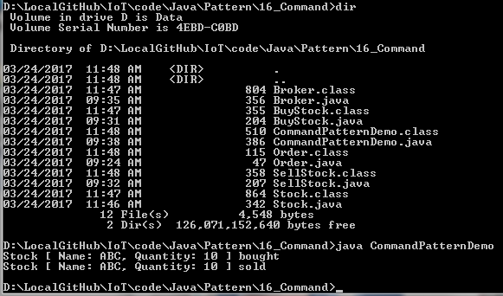
16.7 Step 6: Run Command Pattern Demo
Introduction
https://www.tutorialspoint.com/design_pattern/command_pattern.htm
Run CommandPatternDemo.java
Java Design Pattern - CS596

Slide 20

END of CHAPTER 16

