Slide 1


Java Design Pattern Chapter 17: Interpreter Pattern
Peter H. Chen, PhDEE/EMBA

Slide 2

17 Interpreter Pattern

Slide 3

17 Interpreter Pattern
Introduction
https://www.tutorialspoint.com/design_pattern/interpreter_pattern.htm
Interpreter pattern provides a way to evaluate language grammar or expression.
This type of pattern comes under behavioral pattern.
This pattern involves implementing an expression interface which tells to interpret a particular context.
This pattern is used in SQL parsing, symbol processing engine etc.
Java Design Pattern - CS596

Slide 4
17.1 Interpreter Pattern Implementation

Slide 5
17.1 Interpreter Pattern Implementation
Introduction
https://www.tutorialspoint.com/design_pattern/interpreter_pattern.htm
We are going to create an interface Expression and concrete classes implementing the Expression interface.
A class TerminalExpression is defined which acts as a main interpreter of context in question.
Other classes OrExpression, AndExpression are used to create combinational expressions.
InterpreterPatternDemo will use Expression class to create rules and demonstrate parsing of expressions.
Java Design Pattern - CS596

Slide 6
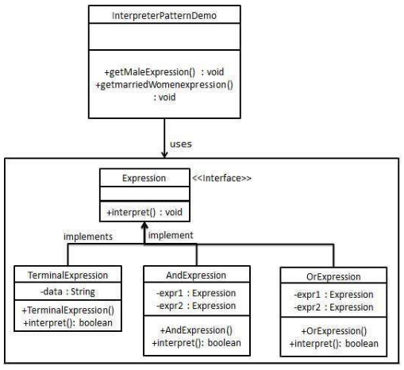
17.1 Interpreter Pattern Implementation
Introduction
https://www.tutorialspoint.com/design_pattern/interpreter_pattern.htm
Interpreter Pattern Implementation Diagram:
Java Design Pattern - CS596

Slide 7
17.2 Step 1: Expression Interface

Slide 8
17.2 Step 1: Expression Interface
Introduction
https://www.tutorialspoint.com/design_pattern/interpreter_pattern.htm
Create an expression interface.
Expression.java
public interface Expression {
public boolean interpret(String context);
}
Java Design Pattern - CS596

Slide 9
17.3 Step 2: Concrete Interface

Slide 10
17.2 Step 2: Concrete Interface
Introduction
https://www.tutorialspoint.com/design_pattern/interpreter_pattern.htm
Create concrete classes implementing the above interface.
TerminalExpression.java
public class TerminalExpression implements Expression {
private String data;
public TerminalExpression(String data){
this.data = data;
}
@Override
public boolean interpret(String context) {
if(context.contains(data)){
return true;
}
return false;
}
}
Java Design Pattern - CS596

Slide 11
17.2 Step 2: Concrete Interface
Introduction
https://www.tutorialspoint.com/design_pattern/interpreter_pattern.htm
OrExpression.java
public class OrExpression implements Expression {
private Expression expr1 = null;
private Expression expr2 = null;
public OrExpression(Expression expr1, Expression expr2) {
this.expr1 = expr1;
this.expr2 = expr2;
}
@Override
public boolean interpret(String context) {
return expr1.interpret(context) || expr2.interpret(context);
}
}
Java Design Pattern - CS596

Slide 12
17.2 Step 2: Concrete Interface
Introduction
https://www.tutorialspoint.com/design_pattern/interpreter_pattern.htm
AndExpression.java
public class AndExpression implements Expression {
private Expression expr1 = null;
private Expression expr2 = null;
public AndExpression(Expression expr1, Expression expr2) {
this.expr1 = expr1;
this.expr2 = expr2;
}
@Override
public boolean interpret(String context) {
return expr1.interpret(context) && expr2.interpret(context);
}
}
Java Design Pattern - CS596

Slide 13
17.4 Step 3: Interpreter Pattern Demo

Slide 14
17.4 Step 3: Interpreter Pattern Demo
Introduction
https://www.tutorialspoint.com/design_pattern/interpreter_pattern.htm
InterpreterPatternDemo uses Expression class to create rules and then parse them.
InterpreterPatternDemo.java
public class InterpreterPatternDemo {
//Rule: Robert and John are male
public static Expression getMaleExpression(){
Expression robert = new TerminalExpression("Robert");
Expression john = new TerminalExpression("John");
return new OrExpression(robert, john);
}
//Rule: Julie is a married women
public static Expression getMarriedWomanExpression(){
Expression julie = new TerminalExpression("Julie");
Expression married = new TerminalExpression("Married");
return new AndExpression(julie, married);
}
public static void main(String[] args) {
Expression isMale = getMaleExpression();
Expression isMarriedWoman = getMarriedWomanExpression();
System.out.println("John is male? " + isMale.interpret("John"));
System.out.println("Julie is a married women? " + isMarriedWoman.interpret("Married Julie"));
}
}}/
Java Design Pattern - CS596

Slide 15
17.5 Step 4: Run Interpreter Pattern Demo

Slide 16
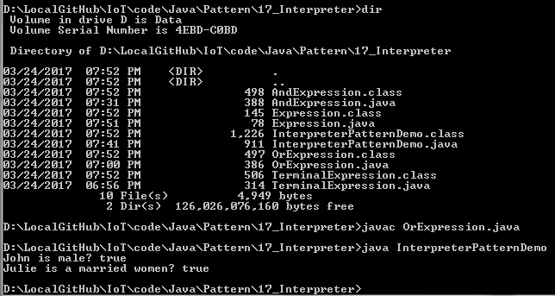
17.5 Step 4: Run Interpreter Pattern Demo
Introduction
https://www.tutorialspoint.com/design_pattern/interpreter_pattern.htm
Run InterpreterPatternDemo.java
Java Design Pattern - CS596

Slide 17

END of CHAPTER 17

