Slide 1


Java Design Pattern Chapter 18: Iterator Pattern
Peter H. Chen, PhDEE/EMBA

Slide 2

18 Iterator Pattern

Slide 3

18 Iterator Pattern
Introduction
https://www.tutorialspoint.com/design_pattern/iterator_pattern.htm
Iterator pattern is very commonly used design pattern in Java and .Net programming environment.
This pattern is used to get a way to access the elements of a collection object in sequential manner without any need to know its underlying representation.
Iterator pattern falls under behavioral pattern category.
Java Design Pattern - CS596

Slide 4
18.1 Iterator Pattern Implementation

Slide 5
18.1 Iterator Pattern Implementations
Introduction
https://www.tutorialspoint.com/design_pattern/iterator_pattern.htm
We are going to create a Iterator interface which narrates navigation method and a Container interface which returns the iterator.
Concrete classes implementing the Container interface will be responsible to implement Iterator interface and use it
IteratorPatternDemo, our demo class will use NamesRepository, a concrete class implementation to print a Names stored as a collection in NamesRepository.
Java Design Pattern - CS596

Slide 6
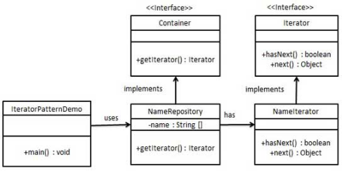
18.1 Iterator Pattern Implementations
Introduction
https://www.tutorialspoint.com/design_pattern/iterator_pattern.htm
Iterator Pattern Implementation Diagram:
Java Design Pattern - CS596

Slide 7
18.2 Step 1: Iterator Interface

Slide 8
18.2 Step 1: Iterator Interface
Introduction
https://www.tutorialspoint.com/design_pattern/iterator_pattern.htm
Create interfaces.
Iterator.java
public interface Iterator {
public boolean hasNext();
public Object next();
}
Container.java
public interface Container {
public Iterator getIterator();
}
Java Design Pattern - CS596

Slide 9
18.3 Step 2: Concrete Interface

Slide 10
18.3 Step 2: Concrete Interface
Introduction
https://www.tutorialspoint.com/design_pattern/iterator_pattern.htm
Create concrete class implementing the Container interface.
This class has inner class NameIterator implementing the Iterator interface.
NameRepository.java
private class NameIterator implements Iterator {
int index;
@Override
public boolean hasNext() {
if(index < names.length){
return true;
}
return false;
}
@Override
public Object next() {
if(this.hasNext()){
return names[index++];
}
return null;
}
}
}
public class NameRepository implements
Container {
public String names[]
= {"Robert" , "John" ,"Julie" , "Lora"};
@Override
public Iterator getIterator() {
return new NameIterator();
}
Java Design Pattern - CS596

Slide 11
18.4 Step 3: Iterator Pattern Demo

Slide 12
18.4 Step 3: Iterator Pattern Demo
Introduction
https://www.tutorialspoint.com/design_pattern/iterator_pattern.htm
Use the NameRepository to get iterator and print names.
IteratorPatternDemo.java
public class IteratorPatternDemo {
public static void main(String[] args) {
NameRepository namesRepository = new NameRepository();
for(Iterator iter = namesRepository.getIterator(); iter.hasNext();){
String name = (String)iter.next();
System.out.println("Name : " + name);
}
}
}
Java Design Pattern - CS596

Slide 13
18.5 Step 4: Run Iterator Pattern Demo

Slide 14
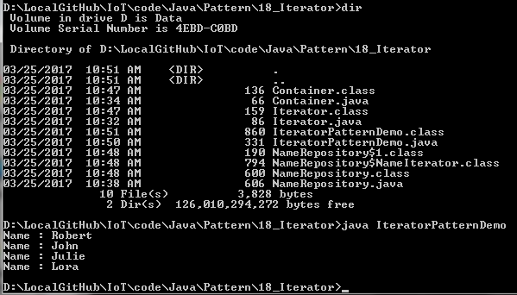
18.5 Step 4: Run Iterator Pattern Demo
Introduction
https://www.tutorialspoint.com/design_pattern/iterator_pattern.htm
Run IteratorPatternDemo.java
Java Design Pattern - CS596

Slide 15

END of CHAPTER 18

