Slide 1


Java Design Pattern Chapter 19: Mediator Pattern
Peter H. Chen, PhDEE/EMBA

Slide 2

19 Mediator Pattern

Slide 3

19 Mediator Pattern
Introduction
https://www.tutorialspoint.com/design_pattern/mediator_pattern.htm
Mediator pattern is used to reduce communication complexity between multiple objects or classes.
This pattern provides a mediator class which normally handles all the communications between different classes and supports easy maintenance of the code by loose coupling.
Mediator pattern falls under behavioral pattern category.
Java Design Pattern - CS596

Slide 4
19.1 Mediator Pattern Implementation

Slide 5
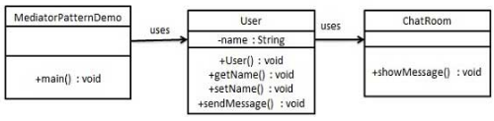
19.1 Mediator Pattern Implementation
Introduction
https://www.tutorialspoint.com/design_pattern/mediator_pattern.htm
We are demonstrating mediator pattern by example of a chat room where multiple users can send message to chat room and it is the responsibility of chat room to show the messages to all users.
We have created two classes ChatRoom and User.
User objects will use ChatRoom method to share their messages.
MediatorPatternDemo, our demo class, will use User objects to show communication between them.
Java Design Pattern - CS596

Slide 6
19.2 Step 1: Mediator Class

Slide 7
19.2 Step 1: Mediator Class
Introduction
https://www.tutorialspoint.com/design_pattern/mediator_pattern.htm
Create mediator class.
ChatRoom.java
import java.util.Date;
public class ChatRoom {
public static void showMessage(User user, String message){
System.out.println(new Date().toString() + " [" + user.getName()
+ "] : " + message);
}
}
Java Design Pattern - CS596

Slide 8
19.3 Step 2: User Class

Slide 9
19.3 Step 2: User Class
Introduction
https://www.tutorialspoint.com/design_pattern/mediator_pattern.htm
Create user class
User.java
public class User {
private String name;
public String getName() {
return name;
}
public void setName(String name) {
this.name = name;
}
public User(String name){
this.name = name;
}
public void sendMessage(String message){
ChatRoom.showMessage(this,message);
}
}
Java Design Pattern - CS596

Slide 10
19.4 Step 3: Mediator Pattern Demo

Slide 11
19.4 Step 3: Mediator Pattern Demo
Introduction
https://www.tutorialspoint.com/design_pattern/mediator_pattern.htm
Use the User object to show communications between them.
MediatorPatternDemo.java
public class MediatorPatternDemo {
public static void main(String[] args) {
User robert = new User("Robert");
User john = new User("John");
robert.sendMessage("Hi! John!");
john.sendMessage("Hello! Robert!");
}
}
Java Design Pattern - CS596

Slide 12
19.5 Step 4: Run Mediator Pattern Demo

Slide 13
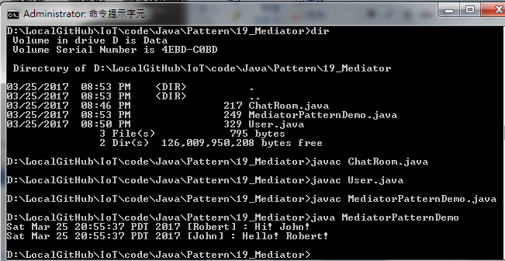
19.5 Step 4: Run Mediator Pattern Demo
Introduction
https://www.tutorialspoint.com/design_pattern/mediator_pattern.htm
Run MediatorPatternDemo.java
Java Design Pattern - CS596

Slide 14

END of CHAPTER 19

