Slide 1


Java Design Pattern Chapter 20: Memento Pattern
Peter H. Chen, PhDEE/EMBA

Slide 2

20 Memento Pattern

Slide 3

20 Memento Pattern
Introduction
https://www.tutorialspoint.com/design_pattern/memento_pattern.htm
Memento pattern is used to restore state of an object to a previous state.
Memento pattern falls under behavioral pattern category.
Java Design Pattern - CS596

Slide 4
20.1 Memento Pattern Implementation

Slide 5
20.1 Memento Pattern Implementation
Introduction
https://www.tutorialspoint.com/design_pattern/memento_pattern.htm
Memento pattern uses three actor classes.
Memento contains state of an object to be restored.
Originator creates and stores states in Memento objects and Caretaker object is responsible to restore object state from Memento.
We have created classes Memento, Originator and CareTaker.
MementoPatternDemo, our demo class, will use CareTaker and Originator objects to show restoration of object states.
Java Design Pattern - CS596

Slide 6
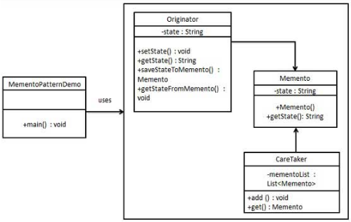
20.1 Memento Pattern Implementation
Introduction
https://www.tutorialspoint.com/design_pattern/memento_pattern.htm
Memento Pattern Implementation Diagram:
Java Design Pattern - CS596

Slide 7
20.2 Step 1: Memento Class

Slide 8
20.2 Step 1: Memento Class
Introduction
https://www.tutorialspoint.com/design_pattern/memento_pattern.htm
Create Memento class.
Memento.java
public class Memento {
private String state;
public Memento(String state){
this.state = state;
}
public String getState(){
return state;
}
}
Java Design Pattern - CS596

Slide 9
20.3 Step 2: Originator Class

Slide 10
20.3 Step 2: Originator Class
Introduction
https://www.tutorialspoint.com/design_pattern/memento_pattern.htm
Create Originator class
Originator.java
public class Originator {
private String state;
public void setState(String state){
this.state = state;
}
public String getState(){
return state;
}
public Memento saveStateToMemento(){
return new Memento(state);
}
public void getStateFromMemento (Memento memento){
state = memento.getState();
}
}
Java Design Pattern - CS596

Slide 11
20.4 Step 3: CareTaker Class

Slide 12
20.4 Step 3: CareTaker Class
Introduction
https://www.tutorialspoint.com/design_pattern/memento_pattern.htm
Create CareTaker class
CareTaker.java
import java.util.ArrayList;
import java.util.List;
public class CareTaker {
private List<Memento> mementoList = new ArrayList<Memento>();
public void add(Memento state){
mementoList.add(state);
}
public Memento get(int index){
return mementoList.get(index);
}
}
Java Design Pattern - CS596

Slide 13
20.5 Step 4: Memento Pattern Demo

Slide 14
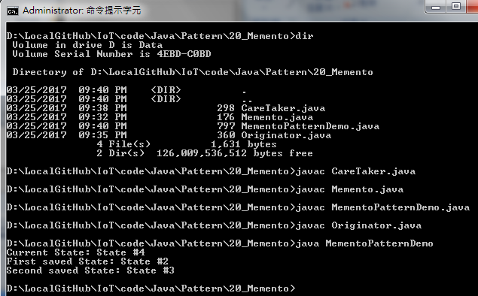
20.6 Step 5: Run Memento Pattern Demo
Introduction
https://www.tutorialspoint.com/design_pattern/memento_pattern.htm
Run MementoPatternDemo.java
Java Design Pattern - CS596

Slide 15
20.6 Step 5: Run Memento Pattern

Slide 16
20.5 Step 4: Memento Pattern Demo
Introduction
https://www.tutorialspoint.com/design_pattern/memento_pattern.htm
Use CareTaker and Originator objects.
MementoPatternDemo.java
public class MementoPatternDemo {
public static void main(String[] args) {
Originator originator = new Originator();
CareTaker careTaker = new CareTaker();
originator.setState("State #1");
originator.setState("State #2");
careTaker.add(originator.saveStateToMemento());
originator.setState("State #3");
careTaker.add(originator.saveStateToMemento());
originator.setState("State #4");
System.out.println("Current State: " + originator.getState());
originator.getStateFromMemento(careTaker.get(0));
System.out.println("First saved State: " + originator.getState());
originator.getStateFromMemento(careTaker.get(1));
System.out.println("Second saved State: " + originator.getState());
}
}
Java Design Pattern - CS596

Slide 17

END of CHAPTER 20

