Slide 1


Java Design Pattern Chapter 21: Observer Pattern
Peter H. Chen, PhDEE/EMBA

Slide 2

21 Observer Pattern

Slide 3

21 Observer Pattern
Introduction
https://www.tutorialspoint.com/design_pattern/observer_pattern.htm
Observer pattern is used when there is one-to-many relationship between objects such as if one object is modified, its dependent objects are to be notified automatically.
Observer pattern falls under behavioral pattern category.
Java Design Pattern - CS596

Slide 4
21.1 Observer Pattern Implementation

Slide 5
21.1 Observer Pattern Implementation
Introduction
https://www.tutorialspoint.com/design_pattern/observer_pattern.htm
Observer pattern uses three actor classes.
Subject, Observer and Client.
Subject is an object having methods to attach and detach observers to a client object.
We have created an abstract class Observer and a concrete class Subject that is extending class Observer.
ObserverPatternDemo, our demo class, will use Subject and concrete class object to show observer pattern in action.
Java Design Pattern - CS596

Slide 6
21.2 Step 1: Create Subject Class

Slide 7
21.2 Step 1: Create Subject Class
Introduction
https://www.tutorialspoint.com/design_pattern/observer_pattern.htm
Create Subject class.
Subject.java
import java.util.ArrayList;
import java.util.List;
public class Subject {
private List<Observer> observers = new ArrayList<Observer>();
private int state;
public int getState() {
return state;
}
public void setState(int state) {
this.state = state;
notifyAllObservers();
}
public void attach(Observer observer){
observers.add(observer);
}
public void notifyAllObservers(){
for (Observer observer : observers) {
observer.update();
}
}
}
Java Design Pattern - CS596

Slide 8
21.3 Step 2: Create Observer Class

Slide 9
21.3 Step 2: Create Observer Class
Introduction
https://www.tutorialspoint.com/design_pattern/observer_pattern.htm
Create Observer class.
Observer.java
public abstract class Observer {
protected Subject subject;
public abstract void update();
}
Java Design Pattern - CS596

Slide 10
21.4 Step 3: Concrete Observer Class

Slide 11
21.4 Step 3: Concrete Observer Class
Introduction
https://www.tutorialspoint.com/design_pattern/observer_pattern.htm
Create concrete observer classes
BinaryObserver.java
public class BinaryObserver extends Observer{
public BinaryObserver(Subject subject){
this.subject = subject;
this.subject.attach(this);
}
@Override
public void update() {
System.out.println( "Binary String: "
+ Integer.toBinaryString( subject.getState() ) );
}
}
Java Design Pattern - CS596

Slide 12
21.4 Step 3: Concrete Observer Class
Introduction
https://www.tutorialspoint.com/design_pattern/observer_pattern.htm
OctalObserver.java
public class OctalObserver extends Observer{
public OctalObserver(Subject subject){
this.subject = subject;
this.subject.attach(this);
}
@Override
public void update() {
System.out.println( "Octal String: "
+ Integer.toOctalString( subject.getState() ) );
}
}
Java Design Pattern - CS596

Slide 13
21.4 Step 3: Concrete Observer Class
Introduction
https://www.tutorialspoint.com/design_pattern/observer_pattern.htm
HexaObserver.java
public class HexaObserver extends Observer{
public HexaObserver(Subject subject){
this.subject = subject;
this.subject.attach(this);
}
@Override
public void update() {
System.out.println( "Hex String: "
+ Integer.toHexString( subject.getState() ).toUpperCase() );
}
}
Java Design Pattern - CS596

Slide 14
21.5 Step 4: Observer Pattern Demo

Slide 15
21.5 Step 4: Observer Pattern Demo
Introduction
https://www.tutorialspoint.com/design_pattern/observer_pattern.htm
Use Subject and concrete observer objects.
ObserverPatternDemo.java
public class ObserverPatternDemo {
public static void main(String[] args) {
Subject subject = new Subject();
new HexaObserver(subject);
new OctalObserver(subject);
new BinaryObserver(subject);
System.out.println("First state change: 15");
subject.setState(15);
System.out.println("Second state change: 10");
subject.setState(10);
}
}
Java Design Pattern - CS596

Slide 16
21.6 Step 5: Run Observer Pattern Demo

Slide 17
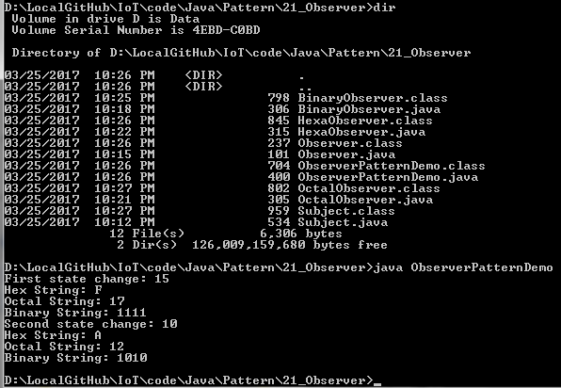
21.6 Step 5: Run Observer Pattern Demo
Introduction
https://www.tutorialspoint.com/design_pattern/observer_pattern.htm
Run ObserverPatternDemo.java
Java Design Pattern - CS596

Slide 18

END of CHAPTER 21

