Slide 1


Java Design Pattern Chapter 22: State Pattern
Peter H. Chen, PhDEE/EMBA

Slide 2

22 State Pattern

Slide 3

22 State Pattern
Introduction
https://www.tutorialspoint.com/design_pattern/state_pattern.htm
In State pattern a class behavior changes based on its state. This type of design pattern comes under behavior pattern.
In State pattern, we create objects which represent various states and a context object whose behavior varies as its state object changes.
Java Design Pattern - CS596

Slide 4
22.1 State Pattern Implementation

Slide 5
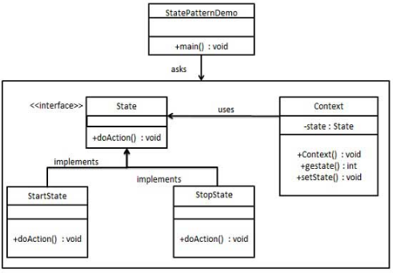
22.1 State Pattern Implementation
Introduction
https://www.tutorialspoint.com/design_pattern/state_pattern.htm
We are going to create a State interface defining an action and concrete state classes implementing the State interface.
Context is a class which carries a State.
StatePatternDemo, our demo class, will use Context and state objects to demonstrate change in Context behavior based on type of state it is in.
Java Design Pattern - CS596

Slide 6
22.2 Step 1: Create Interface

Slide 7
22.2 Step 1: Create Interface
Introduction
https://www.tutorialspoint.com/design_pattern/state_pattern.htm
Create an interface.
State.java
public interface State {
public void doAction(Context context);
}
Java Design Pattern - CS596

Slide 8
22.3 Step 2: Concrete Class

Slide 9
22.3 Step 2: Concrete Class
Introduction
https://www.tutorialspoint.com/design_pattern/state_pattern.htm
Create concrete classes implementing the same interface.
StartState.java
public class StartState implements State {
public void doAction(Context context) {
System.out.println("Player is in start state");
context.setState(this);
}
public String toString(){
return "Start State";
}
}
Java Design Pattern - CS596

Slide 10
22.3 Step 2: Concrete Class
Introduction
https://www.tutorialspoint.com/design_pattern/state_pattern.htm
StopState.java
public class StopState implements State {
public void doAction(Context context) {
System.out.println("Player is in stop state");
context.setState(this);
}
public String toString(){
return "Stop State";
}
}
Java Design Pattern - CS596

Slide 11
22.4 Step 3: Context Class

Slide 12
22.4 Step 3: Context Class
Introduction
https://www.tutorialspoint.com/design_pattern/state_pattern.htm
Create Context Class.
Context.java
public class Context {
private State state;
public Context(){
state = null;
}
public void setState(State state){
this.state = state;
}
public State getState(){
return state;
}
}
Java Design Pattern - CS596

Slide 13
22.5 Step 4: State Pattern Demo

Slide 14
22.5 Step 4: State Pattern Demo
Introduction
https://www.tutorialspoint.com/design_pattern/state_pattern.htm
Use the Context to see change in behaviour when State changes.
StatePatternDemo.java
public class StatePatternDemo {
public static void main(String[] args) {
Context context = new Context();
StartState startState = new StartState();
startState.doAction(context);
System.out.println(context.getState().toString());
StopState stopState = new StopState();
stopState.doAction(context);
System.out.println(context.getState().toString());
}
}
Java Design Pattern - CS596

Slide 15
22.6 Step 5: Run State Pattern Demo

Slide 16
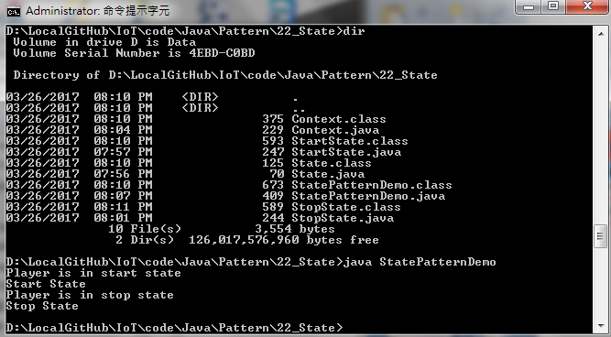
22.6 Step 5: Run State Pattern Demo
Introduction
https://www.tutorialspoint.com/design_pattern/state_pattern.htm
Run StatePatternDemo.java
Java Design Pattern - CS596

Slide 17

END of CHAPTER 22

