Slide 1


Java Design Pattern Chapter 23: Null Object Pattern
Peter H. Chen, PhDEE/EMBA

Slide 2

23 Null Object Pattern

Slide 3

23 Null Object Pattern
Introduction
https://www.tutorialspoint.com/design_pattern/null_object_pattern.htm
In Null Object pattern, a null object replaces check of NULL object instance. Instead of putting if check for a null value, Null Object reflects a do nothing relationship.
Such Null object can also be used to provide default behavior in case data is not available.
In Null Object pattern, we create an abstract class specifying various operations to be done, concrete classes extending this class and a null object class providing do nothing implementation of this class and will be used seamlessly where we need to check null value.
Java Design Pattern - CS596

Slide 4
23.1 Null Object Pattern Implementation

Slide 5
23.1 Null Object Pattern Implementation
Introduction
https://www.tutorialspoint.com/design_pattern/null_object_pattern.htm
We are going to create a AbstractCustomer abstract class defining operations.
Here the name of the customer and concrete classes extending the AbstractCustomer class.
A factory class CustomerFactory is created to return either RealCustomer or NullCustomer objects based on the name of customer passed to it.
NullPatternDemo, our demo class, will use CustomerFactory to demonstrate the use of Null Object pattern.
Java Design Pattern - CS596

Slide 6
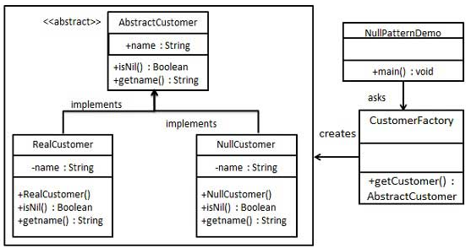
23.1 Null Object Pattern Implementation
Introduction
https://www.tutorialspoint.com/design_pattern/null_object_pattern.htm
Null Object Pattern Diagram:
Java Design Pattern - CS596

Slide 7
23.2 Step 1: Abstract Class

Slide 8
23.2 Step 1: Abstract Class
Introduction
https://www.tutorialspoint.com/design_pattern/null_object_pattern.htm
Create an abstract class.
AbstractCustomer.java
public abstract class AbstractCustomer {
protected String name;
public abstract boolean isNil();
public abstract String getName();
}
Java Design Pattern - CS596

Slide 9
23.3 Step 2: Concrete Class

Slide 10
23.3 Step 2: Concrete Class
Introduction
https://www.tutorialspoint.com/design_pattern/null_object_pattern.htm
Create concrete classes extending the above class.
RealCustomer.java
public class RealCustomer extends AbstractCustomer {
public RealCustomer(String name) {
this.name = name;
}
@Override
public String getName() {
return name;
}
@Override
public boolean isNil() {
return false;
}
}
Java Design Pattern - CS596

Slide 11
23.3 Step 2: Concrete Class
Introduction
https://www.tutorialspoint.com/design_pattern/null_object_pattern.htm
NullCustomer.java
public class NullCustomer extends AbstractCustomer {
@Override
public String getName() {
return "Not Available in Customer Database";
}
@Override
public boolean isNil() {
return true;
}
}
Java Design Pattern - CS596

Slide 12
23.4 Step 3: Factory Class

Slide 13
23.4 Step 3: Factory Class
Introduction
https://www.tutorialspoint.com/design_pattern/null_object_pattern.htm
Create CustomerFactory Class.
CustomerFactory.java
public class CustomerFactory {
public static final String[] names = {"Rob", "Joe", "Julie"};
public static AbstractCustomer getCustomer(String name){
for (int i = 0; i < names.length; i++) {
if (names[i].equalsIgnoreCase(name)){
return new RealCustomer(name);
}
}
return new NullCustomer();
}
}
Java Design Pattern - CS596

Slide 14
23.5 Step 4: Null Pattern Demo

Slide 15
23.5 Step 4: Null Pattern Demo
Introduction
https://www.tutorialspoint.com/design_pattern/null_object_pattern.htm
Use the CustomerFactory to get either RealCustomer or NullCustomer objects based on the name of customer passed to it.
NullPatternDemo.java
public class NullPatternDemo {
public static void main(String[] args) {
AbstractCustomer customer1 = CustomerFactory.getCustomer("Rob");
AbstractCustomer customer2 = CustomerFactory.getCustomer("Bob");
AbstractCustomer customer3 = CustomerFactory.getCustomer("Julie");
AbstractCustomer customer4 = CustomerFactory.getCustomer("Laura");
System.out.println("Customers");
System.out.println(customer1.getName());
System.out.println(customer2.getName());
System.out.println(customer3.getName());
System.out.println(customer4.getName());
}
}
Java Design Pattern - CS596

Slide 16
23.6 Step 5: Run Null Pattern Demo

Slide 17
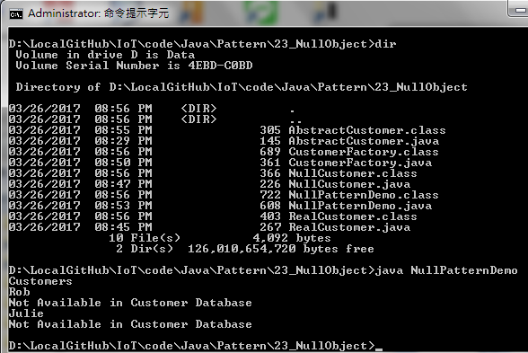
23.6 Step 5: Run Null Pattern Demo
Introduction
https://www.tutorialspoint.com/design_pattern/null_object_pattern.htm
Run NullPatternDemo.java
Java Design Pattern - CS596

Slide 18

END of CHAPTER 23

