Slide 1


Java Design Pattern Chapter 24: Strategy Pattern
Peter H. Chen, PhDEE/EMBA

Slide 2

24 Strategy Pattern

Slide 3

24 Strategy Pattern
Introduction
https://www.tutorialspoint.com/design_pattern/strategy_pattern.htm
In Strategy pattern, a class behavior or its algorithm can be changed at run time. This type of design pattern comes under behavior pattern.
In Strategy pattern, we create objects which represent various strategies and a context object whose behavior varies as per its strategy object.
The strategy object changes the executing algorithm of the context object.
Java Design Pattern - CS596

Slide 4
24.1 Strategy Pattern Implementation

Slide 5
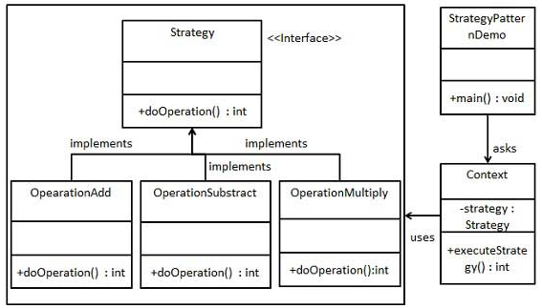
24.1 Strategy Pattern Implementation
Introduction
https://www.tutorialspoint.com/design_pattern/strategy_pattern.htm
We are going to create a Strategy interface defining an action and concrete strategy classes implementing the Strategy interface.
Context is a class which uses a Strategy.
StrategyPatternDemo, our demo class, will use Context and strategy objects to demonstrate change in Context behavior based on strategy it deploys or uses.
Java Design Pattern - CS596

Slide 6
24.2 Step 1: Strategy Interface

Slide 7
24.2 Strategy Interface
Introduction
https://www.tutorialspoint.com/design_pattern/strategy_pattern.htm
Create an interface.
Strategy.java
public interface Strategy {
public int doOperation(int num1, int num2);
}
Java Design Pattern - CS596

Slide 8
24.3 Step 2: Concrete Class

Slide 9
24.3 Step 2: Concrete Class
Introduction
https://www.tutorialspoint.com/design_pattern/strategy_pattern.htm
Create concrete classes implementing the same interface.
OperationAdd.java
public class OperationAdd implements Strategy{
@Override
public int doOperation(int num1, int num2) {
return num1 + num2;
}
}
Java Design Pattern - CS596

Slide 10
24.3 Step 2: Concrete Class
Introduction
https://www.tutorialspoint.com/design_pattern/strategy_pattern.htm
OperationSubstract.java
public class OperationSubstract implements Strategy{
@Override
public int doOperation(int num1, int num2) {
return num1 - num2;
}
}
Java Design Pattern - CS596

Slide 11
24.3 Step 2: Concrete Class
Introduction
https://www.tutorialspoint.com/design_pattern/strategy_pattern.htm
OperationMultiply.java
public class OperationMultiply implements Strategy{
@Override
public int doOperation(int num1, int num2) {
return num1 * num2;
}
}
Java Design Pattern - CS596

Slide 12
24.4 Step 3: Context Class

Slide 13
24.4 Step 3: Context Class
Introduction
https://www.tutorialspoint.com/design_pattern/strategy_pattern.htm
Create Context Class.
Context.java
public class Context {
private Strategy strategy;
public Context(Strategy strategy){
this.strategy = strategy;
}
public int executeStrategy(int num1, int num2){
return strategy.doOperation(num1, num2);
}
}
Java Design Pattern - CS596

Slide 14
24.5 Step 4: Strategy Pattern Demo

Slide 15
24.5 Step 4: Strategy Pattern Demo
Introduction
https://www.tutorialspoint.com/design_pattern/strategy_pattern.htm
Use the Context to see change in behavior when it changes its Strategy.
StrategyPatternDemo.java
public class StrategyPatternDemo {
public static void main(String[] args) {
Context context = new Context(new OperationAdd());
System.out.println("10 + 5 = " + context.executeStrategy(10, 5));
context = new Context(new OperationSubstract());
System.out.println("10 - 5 = " + context.executeStrategy(10, 5));
context = new Context(new OperationMultiply());
System.out.println("10 * 5 = " + context.executeStrategy(10, 5));
}
}
Java Design Pattern - CS596

Slide 16
24.6 Step 5: Run Strategy Pattern Demo

Slide 17
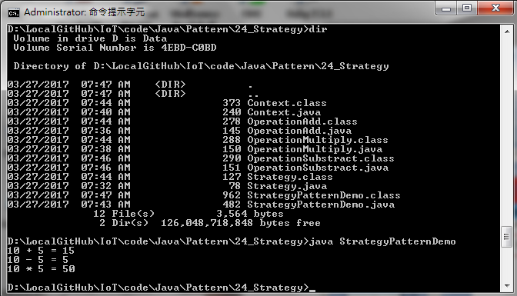
24.6 Step 5: Run Strategy Pattern Demo
Introduction
https://www.tutorialspoint.com/design_pattern/strategy_pattern.htm
Run StrategyPatternDemo.java
Java Design Pattern - CS596

Slide 18

END of CHAPTER 24

