Slide 1


Java Design Pattern Chapter 25: Template Pattern
Peter H. Chen, PhDEE/EMBA

Slide 2

25 Template Pattern

Slide 3

25 Template Pattern
Introduction
https://www.tutorialspoint.com/design_pattern/template_pattern.htm
In Template pattern, an abstract class exposes defined way(s)/template(s) to execute its methods.
Its subclasses can override the method implementation as per need but the invocation is to be in the same way as defined by an abstract class.
This pattern comes under behavior pattern category.
Java Design Pattern - CS596

Slide 4
25.1 Template Pattern Implementation

Slide 5
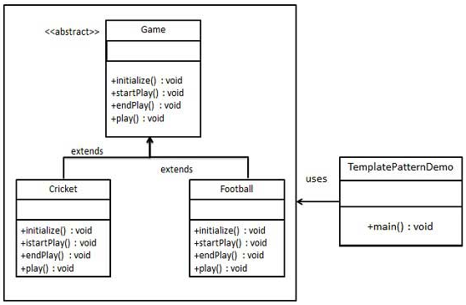
25.1 Template Pattern Implementation
Introduction
https://www.tutorialspoint.com/design_pattern/template_pattern.htm
We are going to create a Game abstract class defining operations with a template method set to be final so that it cannot be overridden.
Cricket and Football are concrete classes that extend Game and override its methods.
TemplatePatternDemo, our demo class, will use Game to demonstrate use of template pattern.
Java Design Pattern - CS596

Slide 6
25.2 Step 1: Abstract Class

Slide 7
25.2 Step 1: Abstract Class
Introduction
https://www.tutorialspoint.com/design_pattern/template_pattern.htm
Create an abstract class with a template method being final.
Game.java
public abstract class Game {
abstract void initialize();
abstract void startPlay();
abstract void endPlay();
//template method
public final void play(){
//initialize the game
initialize();
//start game
startPlay();
//end game
endPlay();
}
}
Java Design Pattern - CS596

Slide 8
25.3 Step 2: Concrete Class

Slide 9
25.3 Step 2: Concrete Class
Introduction
https://www.tutorialspoint.com/design_pattern/template_pattern.htm
Create concrete classes extending the above class.
Cricket.java
public class Cricket extends Game {
@Override
void endPlay() {
System.out.println("Cricket Game Finished!");
}
@Override
void initialize() {
System.out.println("Cricket Game Initialized! Start playing.");
}
@Override
void startPlay() {
System.out.println("Cricket Game Started. Enjoy the game!");
}
}
Java Design Pattern - CS596

Slide 10
25.3 Step 2: Concrete Class
Introduction
https://www.tutorialspoint.com/design_pattern/template_pattern.htm
Football.java
public class Football extends Game {
@Override
void endPlay() {
System.out.println("Football Game Finished!");
}
@Override
void initialize() {
System.out.println("Football Game Initialized! Start playing.");
}
@Override
void startPlay() {
System.out.println("Football Game Started. Enjoy the game!");
}
}
Java Design Pattern - CS596

Slide 11
25.4 Step 3: Template Pattern Demo

Slide 12
25.4 Step 3: Template Pattern Demo
Introduction
https://www.tutorialspoint.com/design_pattern/template_pattern.htm
Use the Game's template method play() to demonstrate a defined way of playing game.
TemplatePatternDemo.java
public class TemplatePatternDemo {
public static void main(String[] args) {
Game game = new Cricket();
game.play();
System.out.println();
game = new Football();
game.play();
}
}
Java Design Pattern - CS596

Slide 13
25.5 Step 4: Run Template Pattern Demo

Slide 14
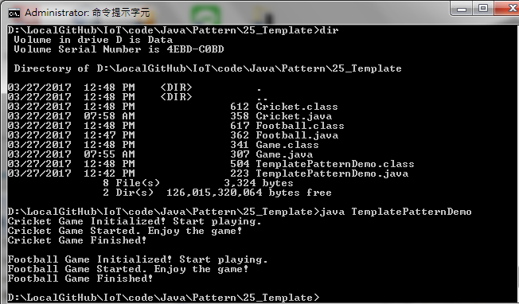
25.5 Step 4: Run Template Pattern Demo
Introduction
https://www.tutorialspoint.com/design_pattern/template_pattern.htm
Run TemplatePatternDemo.java
Java Design Pattern - CS596

Slide 15

END of CHAPTER 25

