Slide 1
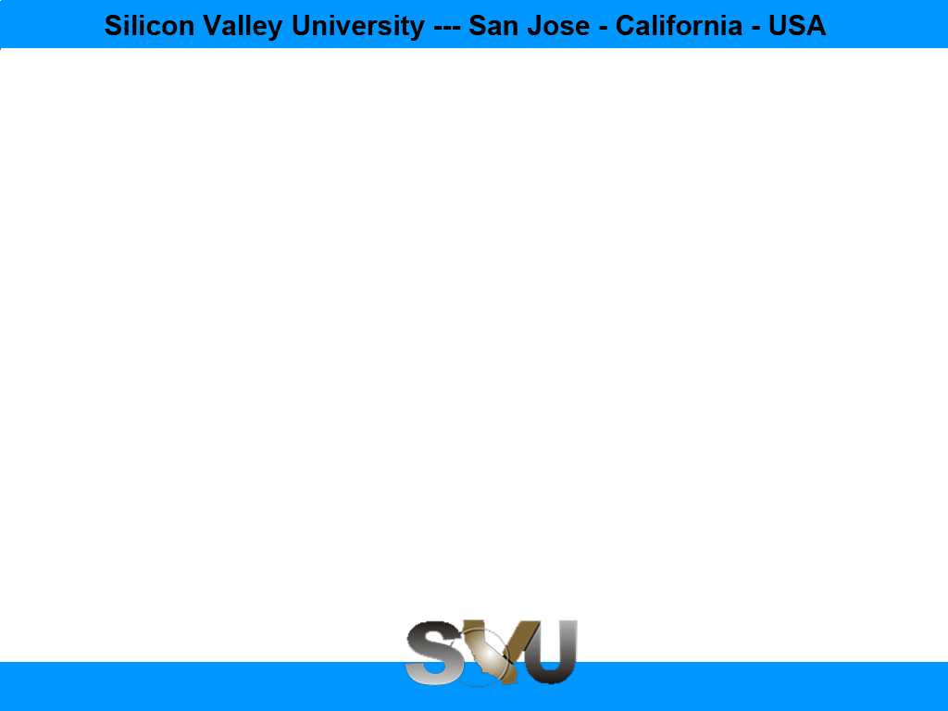

Java Design Pattern Chapter 26: Visitor Pattern
Peter H. Chen, PhDEE/EMBA

Slide 2

26 Visitor Pattern

Slide 3

26 Visitor Pattern
Introduction
https://www.tutorialspoint.com/design_pattern/visitor_pattern.htm
In Template pattern, an abstract class exposes defined way(s)/template(s) to execute its methods.
Its subclasses can override the method implementation as per need but the invocation is to be in the same way as defined by an abstract class.
This pattern comes under behavior pattern category.
Java Design Pattern - CS596

Slide 4
26.1 Visitor Pattern Implementation

Slide 5
26.1 Visitor Pattern Implementation
Introduction
https://www.tutorialspoint.com/design_pattern/visitor_pattern.htm
We are going to create a ComputerPart interface defining accept operation.
Keyboard, Mouse, Monitor and Computer are concrete classes implementing ComputerPart interface.
We will define another interface ComputerPartVisitor which will define a visitor class operations.
Computer uses concrete visitor to do corresponding action.
VisitorPatternDemo, our demo class, will use Computer and ComputerPartVisitor classes to demonstrate use of visitor pattern.
Java Design Pattern - CS596

Slide 6
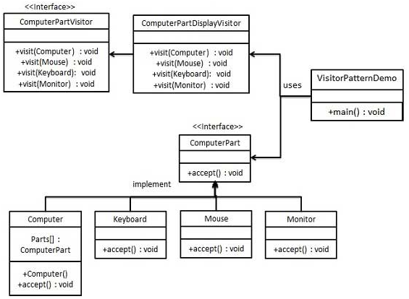
26.1 Visitor Pattern Implementation
Introduction
https://www.tutorialspoint.com/design_pattern/visitor_pattern.htm
Visitor Pattern Implementation Diagram:
Java Design Pattern - CS596

Slide 7
26.2 Step 1: Interface Class

Slide 8
26.2 Step 1: Interface Class
Introduction
https://www.tutorialspoint.com/design_pattern/visitor_pattern.htm
Define an interface to represent element.
ComputerPart.java
public interface ComputerPart {
public void accept(ComputerPartVisitor computerPartVisitor);
}
Java Design Pattern - CS596

Slide 9
26.3 Step 2: Concrete Class

Slide 10
26.3 Step 2: Concrete Class
Introduction
https://www.tutorialspoint.com/design_pattern/visitor_pattern.htm
Create concrete classes extending the above class.
Keyboard.jav
public class Keyboard implements ComputerPart {
@Override
public void accept(ComputerPartVisitor computerPartVisitor) {
computerPartVisitor.visit(this);
}
}
Java Design Pattern - CS596

Slide 11
26.3 Step 2: Concrete Class
Introduction
https://www.tutorialspoint.com/design_pattern/visitor_pattern.htm
Monitor.java
public class Monitor implements ComputerPart {
@Override
public void accept(ComputerPartVisitor computerPartVisitor) {
computerPartVisitor.visit(this);
}
}
Java Design Pattern - CS596

Slide 12
26.3 Step 2: Concrete Class
Introduction
https://www.tutorialspoint.com/design_pattern/visitor_pattern.htm
Mouse.java
public class Mouse implements ComputerPart {
@Override
public void accept(ComputerPartVisitor computerPartVisitor) {
computerPartVisitor.visit(this);
}
}
Java Design Pattern - CS596

Slide 13
26.3 Step 2: Concrete Class
Introduction
https://www.tutorialspoint.com/design_pattern/visitor_pattern.htm
Computer.java
public class Computer implements ComputerPart {
ComputerPart[] parts;
public Computer(){
parts = new ComputerPart[] {new Mouse(), new Keyboard(), new Monitor()};
}
@Override
public void accept(ComputerPartVisitor computerPartVisitor) {
for (int i = 0; i < parts.length; i++) {
parts[i].accept(computerPartVisitor);
}
computerPartVisitor.visit(this);
}
}
Java Design Pattern - CS596

Slide 14
26.4 Step 3: Visitor Interface

Slide 15
26.4 Step 3: Visitor Interface
Introduction
https://www.tutorialspoint.com/design_pattern/visitor_pattern.htm
Define an interface to represent visitor.
ComputerPartVisitor.java
public interface ComputerPartVisitor {
public void visit(Computer computer);
public void visit(Mouse mouse);
public void visit(Keyboard keyboard);
public void visit(Monitor monitor);
}
Java Design Pattern - CS596

Slide 16
26.5 Step 4: Concrete Visitor

Slide 17
26.5 Step 4: Concrete Visitor
Introduction
https://www.tutorialspoint.com/design_pattern/visitor_pattern.htm
Create concrete visitor implementing the above class.
ComputerPartDisplayVisitor.java
public class ComputerPartDisplayVisitor implements ComputerPartVisitor {
@Override
public void visit(Computer computer) {
System.out.println("Displaying Computer.");
}
@Override
public void visit(Mouse mouse) {
System.out.println("Displaying Mouse.");
}
@Override
public void visit(Keyboard keyboard) {
System.out.println("Displaying Keyboard.");
}
@Override
public void visit(Monitor monitor) {
System.out.println("Displaying Monitor.");
}
}
Java Design Pattern - CS596

Slide 18
26.6 Step 5: Visitor Pattern Demo

Slide 19
26.6 Step 5: Visitor Pattern Demo
Introduction
https://www.tutorialspoint.com/design_pattern/visitor_pattern.htm
Use the ComputerPartDisplayVisitor to display parts of Computer.
VisitorPatternDemo.java
public class VisitorPatternDemo {
public static void main(String[] args) {
ComputerPart computer = new Computer();
computer.accept(new ComputerPartDisplayVisitor());
}
}
Java Design Pattern - CS596

Slide 20
26.7 Step 6: Run Visitor Pattern

Slide 21
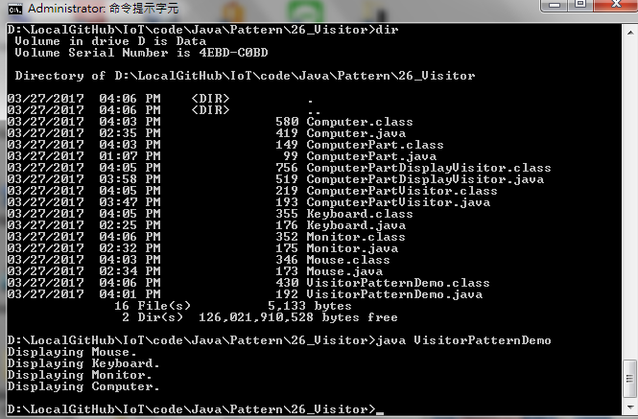
26.7 Step 6: Run Visitor Pattern
Introduction
https://www.tutorialspoint.com/design_pattern/visitor_pattern.htm
Run VisitorPatternDemo.java
Java Design Pattern - CS596

Slide 22

END of CHAPTER 26

