Slide 1
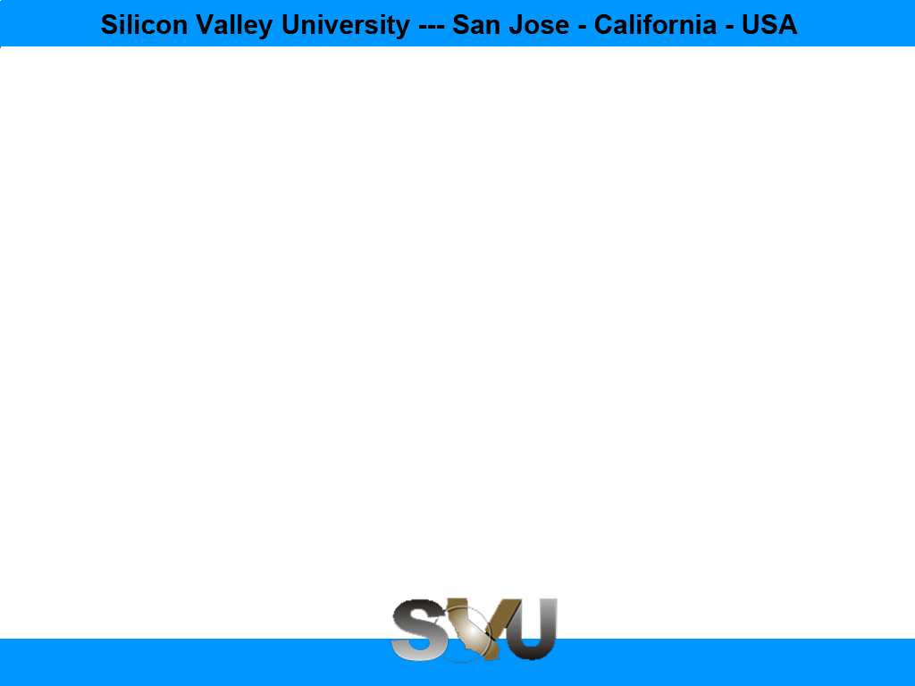

Java Design Pattern Chapter 27: MVC Pattern
Peter H. Chen, PhDEE/EMBA

Slide 2

27 MVC Pattern

Slide 3

27 MVC Pattern
Introduction
https://www.tutorialspoint.com/design_pattern/mvc_pattern.htm
MVC Pattern stands for Model-View-Controller Pattern.
This pattern is used to separate application's concerns.
Model - Model represents an object or JAVA POJO carrying data. It can also have logic to update controller if its data changes.
View - View represents the visualization of the data that model contains.
Controller - Controller acts on both model and view. It controls the data flow into model object and updates the view whenever data changes. It keeps view and model separate.
Java Design Pattern - CS596

Slide 4
27.1 MVC Pattern Implementation

Slide 5
27.1 MVC Pattern Implementation
Introduction
https://www.tutorialspoint.com/design_pattern/mvc_pattern.htm
MVC (Model-View-Controller) Pattern is used to separate application's concerns.
Model - Model represents an object or JAVA POJO carrying data. It can also have logic to update controller if its data changes.
View - View represents the visualization of the data that model contains.
Controller - Controller acts on both model and view. It controls the data flow into model object and updates the view whenever data changes. It keeps view and model separate.
Java Design Pattern - CS596

Slide 6
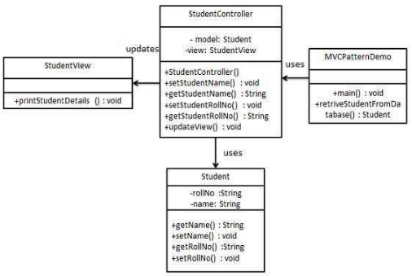
27.1 MVC Pattern Implementation
Introduction
https://www.tutorialspoint.com/design_pattern/mvc_pattern.htm
MVC Pattern Diagram:
Java Design Pattern - CS596

Slide 7
27.2 Step 1: Model

Slide 8
27.2 Step 1: Model
Introduction
https://www.tutorialspoint.com/design_pattern/mvc_pattern.htm
Create Model.
Student.java
public class Student {
private String rollNo;
private String name;
public String getRollNo() {
return rollNo;
}
public void setRollNo(String rollNo) {
this.rollNo = rollNo;
}
public String getName() {
return name;
}
public void setName(String name) {
this.name = name;
}
}
Java Design Pattern - CS596

Slide 9
27.3 Step 2: View

Slide 10
27.3 Step 2: View
Introduction
https://www.tutorialspoint.com/design_pattern/mvc_pattern.htm
Create View.
StudentView.java
public class StudentView {
public void printStudentDetails(String studentName, String studentRollNo){
System.out.println("Student: ");
System.out.println("Name: " + studentName);
System.out.println("Roll No: " + studentRollNo);
}
}
Java Design Pattern - CS596

Slide 11
27.4 Step 3: Controller

Slide 12
27.4 Step 3: Controller
Introduction
https://www.tutorialspoint.com/design_pattern/mvc_pattern.htm
Create Controller.
StudentController.java
public class StudentController {
private Student model;
private StudentView view;
public StudentController(Student model, StudentView view){
this.model = model;
this.view = view;
}
public void setStudentName(String name){
model.setName(name);
}
public String getStudentName(){
return model.getName();
}
public void setStudentRollNo(String rollNo){
model.setRollNo(rollNo);
}
public String getStudentRollNo(){
return model.getRollNo();
}
public void updateView(){
view.printStudentDetails(model.getName(), model.getRollNo());
}
}
Java Design Pattern - CS596

Slide 13
27.5 Step 4: MVC Pattern Demo

Slide 14
27.5 Step 4: MVC Pattern Demo
Introduction
https://www.tutorialspoint.com/design_pattern/mvc_pattern.htm
Use the StudentController methods to demonstrate MVC design pattern usage.
MVCPatternDemo.java
public class MVCPatternDemo {
public static void main(String[] args) {
//fetch student record based on his roll no from the database
Student model = retriveStudentFromDatabase();
//Create a view : to write student details on console
StudentView view = new StudentView();
StudentController controller = new StudentController(model, view);
controller.updateView();
//update model data
controller.setStudentName("John");
controller.updateView();
}
private static Student retriveStudentFromDatabase(){
Student student = new Student();
student.setName("Robert");
student.setRollNo("10");
return student;
}
}
Java Design Pattern - CS596

Slide 15
27.6 Step 5: Run MVC Pattern

Slide 16
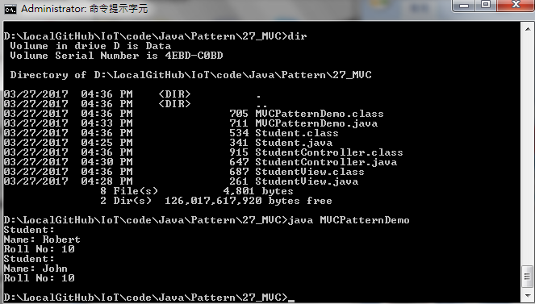
27.6 Step 5: Run MVC Pattern
Introduction
https://www.tutorialspoint.com/design_pattern/mvc_pattern.htm
Run MVCPatternDemo.java
Java Design Pattern - CS596

Slide 17

END of CHAPTER 27

