Slide 1


Java Design Pattern Chapter 28: Business Delegate Pattern
Peter H. Chen, PhDEE/EMBA

Slide 2

28 Business Delegate Pattern

Slide 3

28 Business Delegate Pattern
Introduction
https://www.tutorialspoint.com/design_pattern/business_delegate_pattern.htm
Business Delegate Pattern is used to decouple presentation tier and business tier.
It is basically use to reduce communication or remote lookup functionality to business tier code in presentation tier code. In business tier we have following entities.
Client - Presentation tier code may be JSP, servlet or UI java code.
Business Delegate - A single entry point class for client entities to provide access to Business Service methods.
LookUp Service - Lookup service object is responsible to get relative business implementation and provide business object access to business delegate object.
Business Service - Business Service interface. Concrete classes implement this business service to provide actual business implementation logic.
Java Design Pattern - CS596

Slide 4
28.1 Business Delegate Pattern Implementation

Slide 5
28.1 Business Delegate Pattern Implementation
Introduction
https://www.tutorialspoint.com/design_pattern/business_delegate_pattern.htm
We are going to create a Client, BusinessDelegate, BusinessService, LookUpService, JMSService, and EJBService representing various entities of Business Delegate patterns.
BusinessDelegatePatternDemo, our demo class, will use BusinessDelegate and Client to demonstrate use of Business Delegate pattern.
Java Design Pattern - CS596

Slide 6
28.2 Step 1: Business Service Interface

Slide 7
28.2 Step1: Business Service Interface
Introduction
https://www.tutorialspoint.com/design_pattern/business_delegate_pattern.htm
Create BusinessService Interface.
BusinessService.java
public interface BusinessService {
public void doProcessing();
}
Java Design Pattern - CS596

Slide 8
28.3 Step 2: Concrete Service Class

Slide 9
28.3 Step 2: Concrete Service Class
Introduction
https://www.tutorialspoint.com/design_pattern/business_delegate_pattern.htm
Create concrete Service classes.
EJBService.java
public class EJBService implements BusinessService {
@Override
public void doProcessing() {
System.out.println("Processing task by invoking EJB Service");
}
}
Java Design Pattern - CS596

Slide 10
28.3 Step 2: Concrete Service Class
Introduction
https://www.tutorialspoint.com/design_pattern/business_delegate_pattern.htm
JMSService.java
public class JMSService implements BusinessService {
@Override
public void doProcessing() {
System.out.println("Processing task by invoking JMS Service");
}
}
Java Design Pattern - CS596

Slide 11
28.4 Step 3: Business Lookup Service

Slide 12
28.4 Step 3: Business Lookup Service
Introduction
https://www.tutorialspoint.com/design_pattern/business_delegate_pattern.htm
Create Business Lookup Service.
BusinessLookUp.java
public class BusinessLookUp {
public BusinessService getBusinessService(String serviceType){
if(serviceType.equalsIgnoreCase("EJB")){
return new EJBService();
}
else {
return new JMSService();
}
}
}
Java Design Pattern - CS596

Slide 13
27.5 Step 4: Business Delegate

Slide 14
28.5 Step 4: Business Delegate
Introduction
https://www.tutorialspoint.com/design_pattern/business_delegate_pattern.htm
Create Business Delegate.
BusinessDelegate.java
public class BusinessDelegate {
private BusinessLookUp lookupService = new BusinessLookUp();
private BusinessService businessService;
private String serviceType;
public void setServiceType(String serviceType){
this.serviceType = serviceType;
}
public void doTask(){
businessService = lookupService.getBusinessService(serviceType);
businessService.doProcessing();
}
}
Java Design Pattern - CS596

Slide 15
28.6 Step 5: Client

Slide 16
28.6 Step 5: Client
Introduction
https://www.tutorialspoint.com/design_pattern/business_delegate_pattern.htm
Create Client.
Client.java
public class Client {
BusinessDelegate businessService;
public Client(BusinessDelegate businessService){
this.businessService = businessService;
}
public void doTask(){
businessService.doTask();
}
}
Java Design Pattern - CS596

Slide 17
27.7 Step 6: Business Delete Pattern

Slide 18
28.7 Step 6: Business Delegate Pattern
Introduction
https://www.tutorialspoint.com/design_pattern/business_delegate_pattern.htm
Use BusinessDelegate and Client classes to demonstrate Business Delegate pattern.
BusinessDelegatePatternDemo.java
public class BusinessDelegatePatternDemo {
public static void main(String[] args) {
BusinessDelegate businessDelegate = new BusinessDelegate();
businessDelegate.setServiceType("EJB");
Client client = new Client(businessDelegate);
client.doTask();
businessDelegate.setServiceType("JMS");
client.doTask();
}
}
Java Design Pattern - CS596

Slide 19
28.8 Step 7: Run Business Delete Pattern

Slide 20
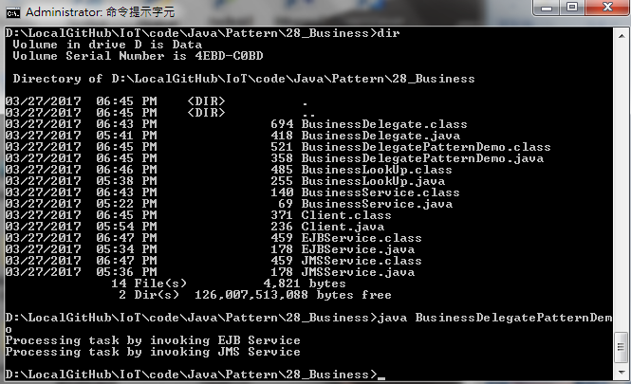
28.8 Step 7: Run Business Delegate Pattern
Introduction
https://www.tutorialspoint.com/design_pattern/business_delegate_pattern.htm
Run BusinessDelegatePatternDemo.java
Java Design Pattern - CS596

Slide 21

END of CHAPTER 28

