Slide 1


Java Design Pattern Chapter 29: Composite Entity Pattern
Peter H. Chen, PhDEE/EMBA

Slide 2

29 Composite Entity Pattern

Slide 3

29 Composite Entity Pattern
Introduction
https://www.tutorialspoint.com/design_pattern/composite_entity_pattern.htm
Composite Entity pattern is used in EJB persistence mechanism.
A Composite entity is an EJB entity bean which represents a graph of objects.
When a composite entity is updated, internally dependent objects beans get updated automatically as being managed by EJB entity bean.
Following are the participants in Composite Entity Bean.
Composite Entity - It is primary entity bean. It can be coarse grained or can contain a coarse grained object to be used for persistence purpose.
Coarse-Grained Object - This object contains dependent objects. It has its own life cycle and also manages life cycle of dependent objects.
Dependent Object - Dependent object is an object which depends on coarse grained object for its persistence lifecycle.
Strategies - Strategies represents how to implement a Composite Entity.
Java Design Pattern - CS596

Slide 4
29.1 Composite Entity Pattern Implementation

Slide 5
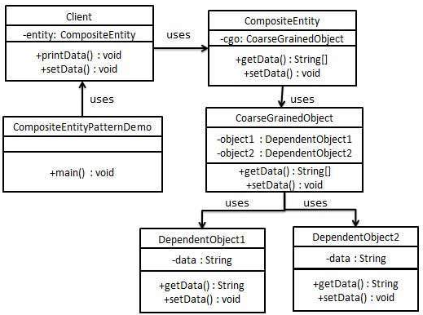
29.1 Composite Entity Pattern Implementation
Introduction
https://www.tutorialspoint.com/design_pattern/composite_entity_pattern.htm
We are going to create CompositeEntity object acting as CompositeEntity.
CoarseGrainedObject will be a class which contains dependent objects.
CompositeEntityPatternDemo, our demo class will use Client class to demonstrate use of Composite Entity pattern.
Java Design Pattern - CS596

Slide 6
29.2 Step 1: Dependent Object

Slide 7
29.2 Step 1: Dependent Object
Introduction
https://www.tutorialspoint.com/design_pattern/composite_entity_pattern.htm
Create Dependent Objects.
DependentObject1.java
public class DependentObject1 {
private String data;
public void setData(String data){
this.data = data;
}
public String getData(){
return data;
}
}
Java Design Pattern - CS596

Slide 8
29.2 Step 1: Dependent Object
Introduction
https://www.tutorialspoint.com/design_pattern/composite_entity_pattern.htm
DependentObject2.java
public class DependentObject2 {
private String data;
public void setData(String data){
this.data = data;
}
public String getData(){
return data;
}
}
Java Design Pattern - CS596

Slide 9
29.3 Step 2: Coarse Grained Object

Slide 10
29.3 Step 2: Coarse Grained Object
Introduction
https://www.tutorialspoint.com/design_pattern/composite_entity_pattern.htm
Create Coarse Grained Object.
CoarseGrainedObject.java
public class CoarseGrainedObject {
DependentObject1 do1 = new DependentObject1();
DependentObject2 do2 = new DependentObject2();
public void setData(String data1, String data2){
do1.setData(data1);
do2.setData(data2);
}
public String[] getData(){
return new String[] {do1.getData(),do2.getData()};
}
}
Java Design Pattern - CS596

Slide 11
29.4 Step 3: Create Composite Entity

Slide 12
29.4 Step 3: Create Composite Entity
Introduction
https://www.tutorialspoint.com/design_pattern/composite_entity_pattern.htm
Create Composite Entity.
CompositeEntity.java
public class CompositeEntity {
private CoarseGrainedObject cgo = new CoarseGrainedObject();
public void setData(String data1, String data2){
cgo.setData(data1, data2);
}
public String[] getData(){
return cgo.getData();
}
}
Java Design Pattern - CS596

Slide 13
29.5 Step 4: Create Client Class

Slide 14
29.5 Step 4: Create Client Class
Introduction
https://www.tutorialspoint.com/design_pattern/composite_entity_pattern.htm
Create Client class to use Composite Entity.
Client.java
public class Client {
private CompositeEntity compositeEntity = new CompositeEntity();
public void printData(){
for (int i = 0; i < compositeEntity.getData().length; i++) {
System.out.println("Data: " + compositeEntity.getData()[i]);
}
}
public void setData(String data1, String data2){
compositeEntity.setData(data1, data2);
}
}
Java Design Pattern - CS596

Slide 15
29.6 Step 5: Composite Entity Pattern Demo

Slide 16
29.5 Step 4: Composite Entity Pattern Demo
Introduction
https://www.tutorialspoint.com/design_pattern/composite_entity_pattern.htm
Use the Client to demonstrate Composite Entity design pattern usage.
CompositeEntityPatternDemo.java
public class CompositeEntityPatternDemo {
public static void main(String[] args) {
Client client = new Client();
client.setData("Test", "Data");
client.printData();
client.setData("Second Test", "Data1");
client.printData();
}
}
Java Design Pattern - CS596

Slide 17
29.7 Step 6: Run Composite Entity Pattern

Slide 18
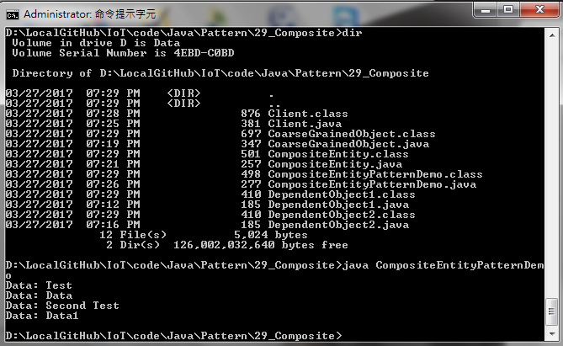
29.6 Step 5: Run Composite Entity Pattern
Introduction
https://www.tutorialspoint.com/design_pattern/composite_entity_pattern.htm
Run CompositeEntityPatternDemo.java
Java Design Pattern - CS596

Slide 19

END of CHAPTER 29

