Slide 1


Java Design Pattern Chapter 30: Data Access Object Pattern
Peter H. Chen, PhDEE/EMBA

Slide 2

30 Data Access Object Pattern

Slide 3

30 Data Access Object Pattern
Introduction
https://www.tutorialspoint.com/design_pattern/data_access_object_pattern.htm
DAO (Data Access Object Pattern) pattern is used to separate low level data accessing API or operations from high level business services.
Following are the participants in Data Access Object Pattern.
Data Access Object Interface - This interface defines the standard operations to be performed on a model object(s).
Data Access Object concrete class - This class implements above interface. This class is responsible to get data from a data source which can be database / xml or any other storage mechanism.
Model Object or Value Object - This object is simple POJO (Plain Old Java Object) containing get/set methods to store data retrieved using DAO (Data Access Object) class.
Java Design Pattern - CS596

Slide 4
30.1 DAO Pattern Implementation

Slide 5
30.1 DAO Pattern Implementation
Introduction
https://www.tutorialspoint.com/design_pattern/data_access_object_pattern.htm
We are going to create a Student object acting as a Model or Value Object.
StudentDao is Data Access Object Interface.
StudentDaoImpl is concrete class implementing Data Access Object Interface.
DaoPatternDemo, our demo class, will use StudentDao to demonstrate the use of Data Access Object pattern.
Java Design Pattern - CS596

Slide 6
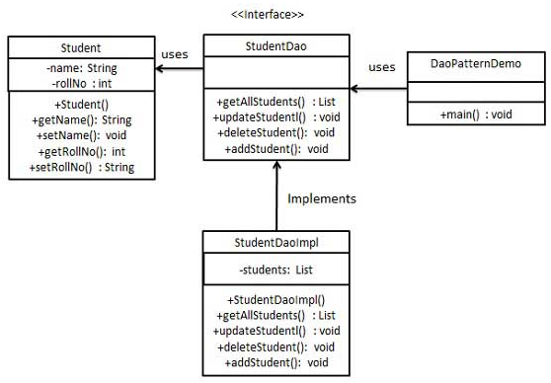
30.1 DAO Pattern Implementation
Introduction
https://www.tutorialspoint.com/design_pattern/data_access_object_pattern.htm
DAO Pattern Implementation.
Java Design Pattern - CS596

Slide 7
30.2 Step 1: Create Value Object

Slide 8
30.2 Step 1: Create Value Object
Introduction
https://www.tutorialspoint.com/design_pattern/data_access_object_pattern.htm
Create Value Object.
Student.java
public class Student {
private String name;
private int rollNo;
Student(String name, int rollNo){
this.name = name;
this.rollNo = rollNo;
}
public String getName() {
return name;
}
public void setName(String name) {
this.name = name;
}
public int getRollNo() {
return rollNo;
}
public void setRollNo(int rollNo) {
this.rollNo = rollNo;
}
}
Java Design Pattern - CS596

Slide 9
30.3 Step 2: DAO Interface

Slide 10
30.3 Step 2: DAO Interface
Introduction
https://www.tutorialspoint.com/design_pattern/data_access_object_pattern.htm
Create Data Access Object Interface.
StudentDao.java
import java.util.List;
public interface StudentDao {
public List<Student> getAllStudents();
public Student getStudent(int rollNo);
public void updateStudent(Student student);
public void deleteStudent(Student student);
}
Java Design Pattern - CS596

Slide 11
30.4 Step 3: Concrete Class

Slide 12
30.4 Step 3: Concrete Class
Introduction
https://www.tutorialspoint.com/design_pattern/data_access_object_pattern.htm
Create concrete class implementing above interface.
StudentDaoImpl.java (1)
import java.util.ArrayList;
import java.util.List;
public class StudentDaoImpl implements StudentDao {
//list is working as a database
List<Student> students;
public StudentDaoImpl(){
students = new ArrayList<Student>();
Student student1 = new Student("Robert",0);
Student student2 = new Student("John",1);
students.add(student1);
students.add(student2);
}
Java Design Pattern - CS596

Slide 13
30.4 Step 3: Concrete Class
Introduction
https://www.tutorialspoint.com/design_pattern/data_access_object_pattern.htm
StudentDaoImpl.java (2)
@Override
public void deleteStudent(Student student) {
students.remove(student.getRollNo());
System.out.println("Student: Roll No " + student.getRollNo() + ",
deleted from database");
}
//retrive list of students from the database
@Override
public List<Student> getAllStudents() {
return students;
}
Java Design Pattern - CS596

Slide 14
30.4 Step 3: Concrete Class
Introduction
https://www.tutorialspoint.com/design_pattern/data_access_object_pattern.htm
StudentDaoImpl.java (3)
@Override
public Student getStudent(int rollNo) {
return students.get(rollNo);
}
@Override
public void updateStudent(Student student) {
students.get(student.getRollNo()).setName(student.getName());
System.out.println("Student: Roll No " + student.getRollNo() + ",
updated in the database");
}
}
Java Design Pattern - CS596

Slide 15
30.5 Step 4: Dao Pattern Demo

Slide 16
30.5 Step 4: Dao Pattern Demo
Introduction
https://www.tutorialspoint.com/design_pattern/data_access_object_pattern.htm
Use the StudentDao to demonstrate Data Access Object pattern usage.
DaoPatternDemo.java
public class DaoPatternDemo {
public static void main(String[] args) {
StudentDao studentDao = new StudentDaoImpl();
//print all students
for (Student student : studentDao.getAllStudents()) {
System.out.println("Student: [RollNo : " + student.getRollNo() + ", Name : “
+ student.getName() + " ]");
}
//update student
Student student =studentDao.getAllStudents().get(0);
student.setName("Michael");
studentDao.updateStudent(student);
//get the student
studentDao.getStudent(0);
System.out.println("Student: [RollNo : " + student.getRollNo() + ", Name : "
+ student.getName() + " ]");
}
}
Java Design Pattern - CS596

Slide 17
30.6 Step 5: Run Dao Pattern Demo

Slide 18
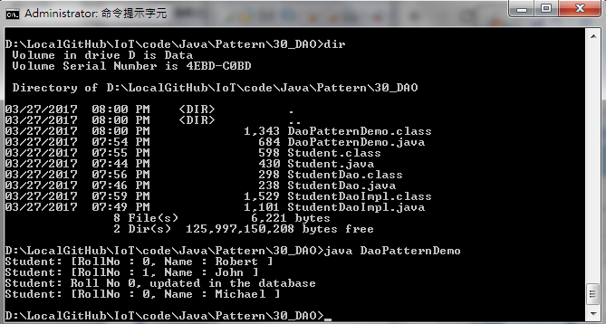
30.6 Step 5: Run Dao Pattern Demo
Introduction
https://www.tutorialspoint.com/design_pattern/data_access_object_pattern.htm
Run DaoPatternDemo.java
Java Design Pattern - CS596

Slide 19

END of CHAPTER 30

