Slide 1


Java Design Pattern Chapter 31: Front Controller Pattern
Peter H. Chen, PhDEE/EMBA

Slide 2

31 Front Controller Pattern

Slide 3

31 Front Controller Pattern
Introduction
https://www.tutorialspoint.com/design_pattern/front_controller_pattern.htm
The front controller design pattern is used to provide a centralized request handling mechanism so that all requests will be handled by a single handler.
This handler can do the authentication/ authorization/ logging or tracking of request and then pass the requests to corresponding handlers.
Following are the entities of this type of design pattern.
Front Controller - Single handler for all kinds of requests coming to the application (either web based/ desktop based).
Dispatcher - Front Controller may use a dispatcher object which can dispatch the request to corresponding specific handler.
View - Views are the object for which the requests are made.
Java Design Pattern - CS596

Slide 4
31.1 Front Controller Pattern Implementation

Slide 5
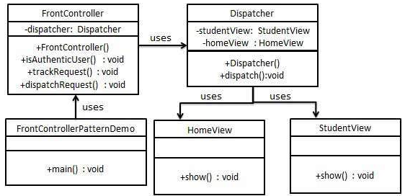
31.1 Front Controller Pattern Implementation
Introduction
https://www.tutorialspoint.com/design_pattern/front_controller_pattern.htm
We are going to create a FrontController and Dispatcher to act as Front Controller and Dispatcher correspondingly.
HomeView and StudentView represent various views for which requests can come to front controller.
FrontControllerPatternDemo, our demo class, will use FrontController to demonstrate Front Controller Design Pattern.
Java Design Pattern - CS596

Slide 6
31.2 Step 1: Create View

Slide 7
31.2 Step 1: Create View
Introduction
https://www.tutorialspoint.com/design_pattern/front_controller_pattern.htm
Create Views.
HomeView.java
public class HomeView {
public void show(){
System.out.println("Displaying Home Page");
}
}
Java Design Pattern - CS596

Slide 8
31.2 Step 1: Create View
Introduction
https://www.tutorialspoint.com/design_pattern/front_controller_pattern.htm
StudentView.java
public class HomeView {
public void show(){
System.out.println("Displaying Home Page");
}
}
Java Design Pattern - CS596

Slide 9
31.3 Step 2: Dispatcher

Slide 10
31.3 Step 2: Dispatcher
Introduction
https://www.tutorialspoint.com/design_pattern/front_controller_pattern.htm
Create Dispatcher.
Dispatcher.java
public class Dispatcher {
private StudentView studentView;
private HomeView homeView;
public Dispatcher(){
studentView = new StudentView();
homeView = new HomeView();
}
public void dispatch(String request){
if(request.equalsIgnoreCase("STUDENT")){
studentView.show();
}
else{
homeView.show();
}
}
}
Java Design Pattern - CS596

Slide 11
31.4 Step 3: Front Controller

Slide 12
31.4 Step 3: Front Controller
Introduction
https://www.tutorialspoint.com/design_pattern/front_controller_pattern.htm
Create FrontController
FrontController.java
public class FrontController {
private Dispatcher dispatcher;
public FrontController(){
dispatcher = new Dispatcher();
}
private boolean isAuthenticUser(){
System.out.println("User is authenticated successfully.");
return true;
}
private void trackRequest(String request){
System.out.println("Page requested: " + request);
}
public void dispatchRequest(String request){
//log each request
trackRequest(request);
//authenticate the user
if(isAuthenticUser()){
dispatcher.dispatch(request);
}
}
}
Java Design Pattern - CS596

Slide 13
31.5 Step 4: Front Controller Demo

Slide 14
31.5 Step 4: Front Controller Demo
Introduction
https://www.tutorialspoint.com/design_pattern/front_controller_pattern.htm
Use the FrontController to demonstrate Front Controller Design Pattern.
FrontControllerPatternDemo.java
public class FrontControllerPatternDemo {
public static void main(String[] args) {
FrontController frontController = new FrontController();
frontController.dispatchRequest("HOME");
frontController.dispatchRequest("STUDENT");
}
}
Java Design Pattern - CS596

Slide 15
31.6 Step 5: Run Front Controller

Slide 16
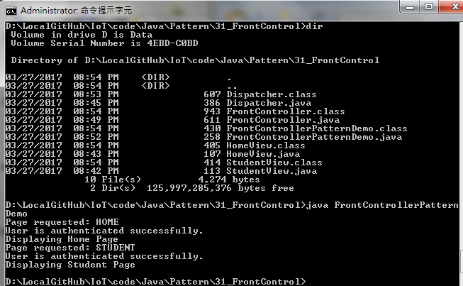
31.6 Step 5: Run Front Controller
Introduction
https://www.tutorialspoint.com/design_pattern/front_controller_pattern.htm
Run FrontControllerPatternDemo.java
Java Design Pattern - CS596

Slide 17

END of CHAPTER 31

