Slide 1


Java Design Pattern Chapter 32: Intercept Filter Pattern
Peter H. Chen, PhDEE/EMBA

Slide 2

32 Intercept Filter Pattern

Slide 3

32 Intercept Filter Pattern
Introduction
https://www.tutorialspoint.com/design_pattern/intercepting_filter_pattern.htm
The intercepting filter design pattern is used when we want to do some pre-processing / post-processing with request or response of the application.
Filters are defined and applied on the request before passing the request to actual target application. Filters can do the authentication/ authorization/ logging or tracking of request and then pass the requests to corresponding handlers.
Following are the entities of this type of design pattern.
Filter - Filter which will performs certain task prior or after execution of request by request handler.
Filter Chain - Filter Chain carries multiple filters and help to execute them in defined order on target.
Target - Target object is the request handler
Filter Manager - Filter Manager manages the filters and Filter Chain.
Client - Client is the object who sends request to the Target object.
Java Design Pattern - CS596

Slide 4
32.1 Intercept Filter Pattern Implementation

Slide 5
32.1 Intercept Filter Pattern Implementation
Introduction
https://www.tutorialspoint.com/design_pattern/intercepting_filter_pattern.htm
We are going to create a FilterChain, FilterManager, Target, and Client as various objects representing our entities.
AuthenticationFilter and DebugFilter represent concrete filters.
InterceptingFilterDemo, our demo class, will use Client to demonstrate Intercepting Filter Design Pattern
Java Design Pattern - CS596

Slide 6
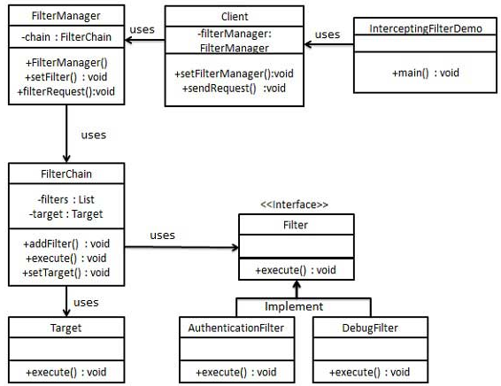
32.1 Intercept Filter Pattern Implementation
Introduction
https://www.tutorialspoint.com/design_pattern/intercepting_filter_pattern.htm
Intercept Filter Pattern Diagram:
Java Design Pattern - CS596

Slide 7
32.2 Step 1: Filter Interface

Slide 8
32.2 Step 1: Filter Interface
Introduction
https://www.tutorialspoint.com/design_pattern/intercepting_filter_pattern.htm
Create Filter interface.
Filter.java
public interface Filter {
public void execute(String request);
}
Java Design Pattern - CS596

Slide 9
32.3 Step 2: Concrete Filter

Slide 10
32.3 Step 2: Concrete Filter
Introduction
https://www.tutorialspoint.com/design_pattern/intercepting_filter_pattern.htm
Create concrete filters.
AuthenticationFilter.java
public class AuthenticationFilter implements Filter {
public void execute(String request){
System.out.println("Authenticating request: " + request);
}
}
Java Design Pattern - CS596

Slide 11
32.3 Step 2: Concrete Filter
Introduction
https://www.tutorialspoint.com/design_pattern/intercepting_filter_pattern.htm
DebugFilter.java
public class DebugFilter implements Filter {
public void execute(String request){
System.out.println("request log: " + request);
}
}
Java Design Pattern - CS596

Slide 12
32.4 Step 3: Target

Slide 13
32.4 Step 3: Target
Introduction
https://www.tutorialspoint.com/design_pattern/intercepting_filter_pattern.htm
Create Target
Target.java
public class Target {
public void execute(String request){
System.out.println("Executing request: " + request);
}
}
Java Design Pattern - CS596

Slide 14
32.5 Step 4: Target Chain

Slide 15
32.5 Step 4: Target Chain
Introduction
https://www.tutorialspoint.com/design_pattern/intercepting_filter_pattern.htm
Create Filter Chain
FilterChain.java
import java.util.ArrayList;
import java.util.List;
public class FilterChain {
private List<Filter> filters = new ArrayList<Filter>();
private Target target;
public void addFilter(Filter filter){
filters.add(filter);
}
public void execute(String request){
for (Filter filter : filters) {
filter.execute(request);
}
target.execute(request);
}
public void setTarget(Target target){
this.target = target;
}
}
Java Design Pattern - CS596

Slide 16
32.6 Step 5: Filter Manager

Slide 17
32.6 Step 5: Filter Manager
Introduction
https://www.tutorialspoint.com/design_pattern/intercepting_filter_pattern.htm
Create Filter Manager
FilterManager.java
public class FilterManager {
FilterChain filterChain;
public FilterManager(Target target){
filterChain = new FilterChain();
filterChain.setTarget(target);
}
public void setFilter(Filter filter){
filterChain.addFilter(filter);
}
public void filterRequest(String request){
filterChain.execute(request);
}
}
Java Design Pattern - CS596

Slide 18
32.7 Step 6: Client

Slide 19
32.7 Step 6: Client
Introduction
https://www.tutorialspoint.com/design_pattern/intercepting_filter_pattern.htm
Create Client
Client.java
public class Client {
FilterManager filterManager;
public void setFilterManager(FilterManager filterManager){
this.filterManager = filterManager;
}
public void sendRequest(String request){
filterManager.filterRequest(request);
}
}
Java Design Pattern - CS596

Slide 20
32.8 Step 7: Intercept Filter Demo

Slide 21
32.8 Step 7: Intercept Filter Demo
Introduction
https://www.tutorialspoint.com/design_pattern/intercepting_filter_pattern.htm
Use the Client to demonstrate Intercepting Filter Design Pattern.
InterceptingFilterDemo.java
public class InterceptingFilterDemo {
public static void main(String[] args) {
FilterManager filterManager = new FilterManager(new Target());
filterManager.setFilter(new AuthenticationFilter());
filterManager.setFilter(new DebugFilter());
Client client = new Client();
client.setFilterManager(filterManager);
client.sendRequest("HOME");
}
}}
Java Design Pattern - CS596

Slide 22
32.9 Step 8: Run Intercept Filter Demo

Slide 23
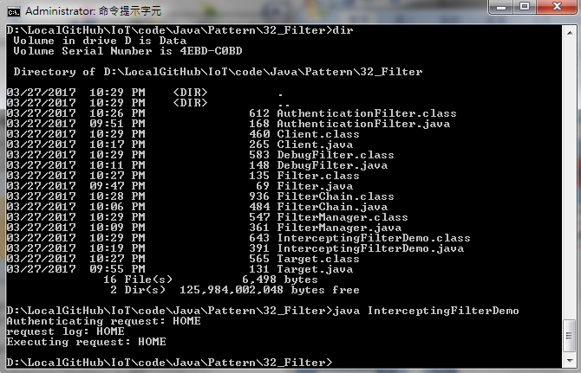
32.9 Step 8: Run Intercept Filter Demo
Introduction
https://www.tutorialspoint.com/design_pattern/intercepting_filter_pattern.htm
Run InterceptingFilterDemo.java
Java Design Pattern - CS596

Slide 24

END of CHAPTER 32

