Slide 1


Java Design Pattern Chapter 33: Service Locator Pattern
Peter H. Chen, PhDEE/EMBA

Slide 2

33 Service Locator Pattern

Slide 3

33 Service Locator Pattern
Introduction
https://www.tutorialspoint.com/design_pattern/service_locator_pattern.htm
The service locator design pattern is used when we want to locate various services using JNDI lookup.
Considering high cost of looking up JNDI for a service, Service Locator pattern makes use of caching technique. For the first time a service is required, Service Locator looks up in JNDI and caches the service object.
Further lookup or same service via Service Locator is done in its cache which improves the performance of application to great extent.
Following are the entities of this type of design pattern.
Service - Actual Service which will process the request. Reference of such service is to be looked upon in JNDI server.
Context / Initial Context - JNDI Context carries the reference to service used for lookup purpose.
Service Locator - Service Locator is a single point of contact to get services by JNDI lookup caching the services.
Cache - Cache to store references of services to reuse them
Client - Client is the object that invokes the services via ServiceLocator.
Java Design Pattern - CS596

Slide 4
33.1 Service Locator Pattern Implementation

Slide 5
33.1 Service Locator Pattern Implementation
Introduction
https://www.tutorialspoint.com/design_pattern/service_locator_pattern.htm
We are going to create a ServiceLocator, InitialContext, Cache, and Service as various objects representing our entities.
Service1 and Service2 represent concrete services.
ServiceLocatorPatternDemo, our demo class, is acting as a client here and will use ServiceLocator to demonstrate Service Locator Design Pattern.
Java Design Pattern - CS596

Slide 6
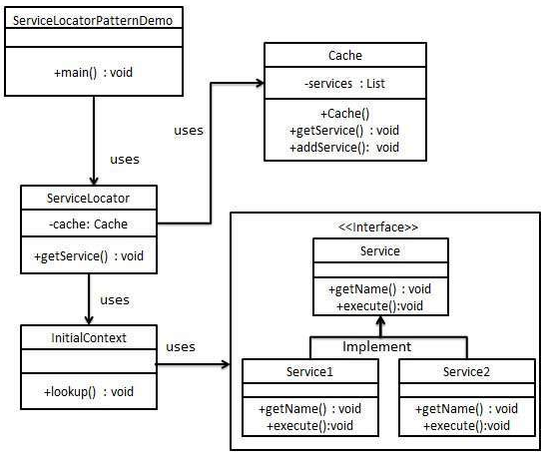
33.1 Service Locator Pattern Implementation
Introduction
https://www.tutorialspoint.com/design_pattern/service_locator_pattern.htm
Service Locator Pattern Diagram:
Java Design Pattern - CS596

Slide 7
33.2 Step 1: Service Interface

Slide 8
33.2 Step 1: Service Interface
Introduction
https://www.tutorialspoint.com/design_pattern/service_locator_pattern.htm
Service Interface
Service.java
public interface Service {
public String getName();
public void execute();
}
Java Design Pattern - CS596

Slide 9
33.3 Step 2: Concrete Service

Slide 10
33.3 Step 2: Concrete Service
Introduction
https://www.tutorialspoint.com/design_pattern/service_locator_pattern.htm
Create concrete services.
Service1.java
public class Service1 implements Service {
public void execute(){
System.out.println("Executing Service1");
}
@Override
public String getName() {
return "Service1";
}
}
Java Design Pattern - CS596

Slide 11
33.3 Step 2: Concrete Service
Introduction
https://www.tutorialspoint.com/design_pattern/service_locator_pattern.htm
Service2.java
public class Service2 implements Service {
public void execute(){
System.out.println("Executing Service2");
}
@Override
public String getName() {
return "Service2";
}
}
Java Design Pattern - CS596

Slide 12
33.4 Step 2: JNDI Lookup

Slide 13
33.4 Step 3: JNDI Lookup
Introduction
https://www.tutorialspoint.com/design_pattern/service_locator_pattern.htm
Create InitialContext for JNDI (Java Naming and Directory Interface) lookup
InitialContext.java
public class InitialContext {
public Object lookup(String jndiName){
if(jndiName.equalsIgnoreCase("SERVICE1")){
System.out.println("Looking up and creating a new Service1 object");
return new Service1();
}
else if (jndiName.equalsIgnoreCase("SERVICE2")){
System.out.println("Looking up and creating a new Service2 object");
return new Service2();
}
return null;
}
}
Java Design Pattern - CS596

Slide 14
33.5 Step 4: Cache

Slide 15
33.5 Step 4: Cache
Introduction
https://www.tutorialspoint.com/design_pattern/service_locator_pattern.htm
Create Cache
Cache.java (1)
import java.util.ArrayList;
import java.util.List;
public class Cache {
private List<Service> services;
public Cache(){
services = new ArrayList<Service>();
}
Java Design Pattern - CS596

Slide 16
33.5 Step 4: Cache
Introduction
https://www.tutorialspoint.com/design_pattern/service_locator_pattern.htm
Cache.java (2)
public Service getService(String serviceName){
for (Service service : services) {
if(service.getName().equalsIgnoreCase(serviceName)){
System.out.println("Returning cached " + serviceName
+ " object");
return service;
}
}
return null;
}
Java Design Pattern - CS596

Slide 17
33.5 Step 4: Cache
Introduction
https://www.tutorialspoint.com/design_pattern/service_locator_pattern.htm
Cache.java (3)
public void addService(Service newService){
boolean exists = false;
for (Service service : services) {
if(service.getName().equalsIgnoreCase(newService.getName())){
exists = true;
}
}
if(!exists){
services.add(newService);
}
}
}
Java Design Pattern - CS596

Slide 18
33.6 Step 5: Service Locator

Slide 19
33.6 Step 5: Service Locator
Introduction
https://www.tutorialspoint.com/design_pattern/service_locator_pattern.htm
Create Service Locator
ServiceLocator.java
public class ServiceLocator {
private static Cache cache;
static {
cache = new Cache();
}
public static Service getService(String jndiName){
Service service = cache.getService(jndiName);
if(service != null){
return service;
}
InitialContext context = new InitialContext();
Service service1 = (Service)context.lookup(jndiName);
cache.addService(service1);
return service1;
}
}
Java Design Pattern - CS596

Slide 20
33.7 Step 6: Service Locator Pattern

Slide 21
33.7 Step 6: Service Locator Pattern
Introduction
https://www.tutorialspoint.com/design_pattern/service_locator_pattern.htm
Use the ServiceLocator to demonstrate Service Locator Design Pattern.
ServiceLocatorPatternDemo.java
public class ServiceLocatorPatternDemo {
public static void main(String[] args) {
Service service = ServiceLocator.getService("Service1");
service.execute();
service = ServiceLocator.getService("Service2");
service.execute();
service = ServiceLocator.getService("Service1");
service.execute();
service = ServiceLocator.getService("Service2");
service.execute();
}
}
Java Design Pattern - CS596

Slide 22
33.8 Step 7: Run Service Locator Pattern

Slide 23
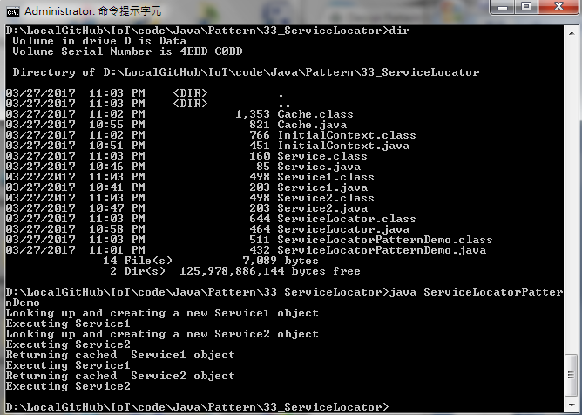
33.8 Step 7: Run Service Locator Pattern
Introduction
https://www.tutorialspoint.com/design_pattern/service_locator_pattern.htm
Run ServiceLocatorPatternDemo.java
Java Design Pattern - CS596

Slide 24

END of CHAPTER 33

