Slide 1


Spring Framework Chapter 1: Introduction to Spring
Peter H. Chen, PhDEE/EMBA

Slide 2

1 Introduction to Spring

Slide 3

1 Introduction to SPring
Introduction
https://www.tutorialspoint.com/spring/index.htm
The Spring framework is an open source Java platform that provides comprehensive infrastructure support for developing robust Java applications very easily and very rapidly.
Spring is the most popular application development framework for enterprise Java. Millions of developers around the world use Spring Framework to create high performing, easily testable, reusable code.
Spring framework was initially written by Rod Johnson and was first released under the Apache 2.0 license in June 2003.
Spring - CS596

Slide 4
1 Introduction to SPring
Introduction
https://www.tutorialspoint.com/spring/index.htm
Spring is the most popular application development framework for enterprise Java. Millions of developers around the world use Spring Framework to create high performing, easily testable, reusable code.
Spring framework is an open source Java platform and it was initially written by Rod Johnson and was first released under the Apache 2.0 license in June 2003.
Spring is lightweight when it comes to size and transparency. The basic version of spring framework is around 2MB.
The core features of the Spring Framework can be used in developing any Java application, but there are extensions for building web applications on top of the Java EE platform.
Spring framework targets to make J2EE development easier to use and promote good programming practice by enabling a POJO (Plain Old Java Object)-based programming model.
Spring - CS596

Slide 5
1 Introduction to SPring
Introduction
https://www.tutorialspoint.com/spring/index.htm
Note:
POJO (Plain Old Java Object) is used to describe the same things as a "Normal Class" whereas a JavaBean follows a set of rules.
Most commonly Beans use getters and setters to protect their member variables, which are typically set to private and have a no-argument constructor.
Spring - CS596

Slide 6
1.1 Benefit of Spring Framework

Slide 7
1.1 Benefit of Spring Framework
Introduction
https://www.tutorialspoint.com/spring/spring_overview.htm
Following is the list of few of the great benefits of Spring Framework (1):
Spring enables developers to develop enterprise-class applications using POJOs. The benefit of using only POJOs is that you do not need an EJB container product such as an application server but you have the option of using only a robust servlet container such as Tomcat or some commercial product.
Spring is organized in a modular fashion. Even though the number of packages and classes are substantial, you have to worry only about ones you need and ignore the rest.
Spring does not reinvent the wheel instead, it truly makes use of some of the existing technologies like several ORM frameworks, logging frameworks, JEE, Quartz and JDK timers, other view technologies.
Testing an application written with Spring is simple because environment-dependent code is moved into this framework. Furthermore, by using JavaBean-style POJOs, it becomes easier to use dependency injection for injecting test data.
Spring - CS596

Slide 8
1.1 Benefit of Spring Framework
Introduction
https://www.tutorialspoint.com/spring/spring_overview.htm
Following is the list of few of the great benefits of Spring Framework (2):
Spring's web framework is a well-designed web MVC framework, which provides a great alternative to web frameworks such as Struts or other over engineered or less popular web frameworks.
Spring provides a convenient API to translate technology-specific exceptions (thrown by JDBC, Hibernate, or JDO (Java Data Object), for example) into consistent, unchecked exceptions.
Lightweight IoC (Inversion of Control) containers tend to be lightweight, especially when compared to EJB containers, for example. This is beneficial for developing and deploying applications on computers with limited memory and CPU resources.
Spring provides a consistent transaction management interface that can scale down to a local transaction (using a single database, for example) and scale up to global transactions (using JTA, for example).
Spring - CS596

Slide 9
1.2 DI (Dependency Injection)

Slide 10
1.2 DI (Dependency Injection)
Introduction
https://www.tutorialspoint.com/spring/spring_overview.htm
The technology that Spring is most identified with is the Dependency Injection (DI) flavor of IoC (Inversion of Control). The IoC is a general concept, and it can be expressed in many different ways and Dependency Injection is merely one concrete example of Inversion of Control.
When writing a complex Java application, application classes should be as independent as possible of other Java classes to increase the possibility to reuse these classes and to test them independently of other classes while doing unit testing. Dependency Injection helps in gluing these classes together and same time keeping them independent.
What is dependency injection exactly? Let's look at these two words separately. Here the dependency part translates into an association between two classes. For example, class A is dependent on class B. Now, let's look at the second part, injection. All this means is that class B will get injected into class A by the IoC.
Spring - CS596

Slide 11
1.2 DI (Dependency Injection)
Introduction
https://www.tutorialspoint.com/spring/spring_overview.htm
Dependency injection can happen in the way of passing parameters to the constructor or by post-construction using setter methods. As Dependency Injection is the heart of Spring Framework, so I will explain this concept in a separate chapter with a nice example.
Spring - CS596

Slide 12
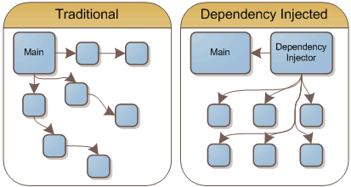
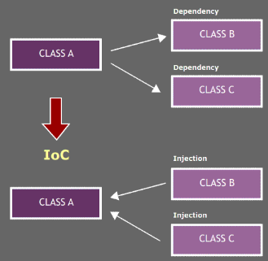
1.2 DI (Dependency Injection)
Introduction
https://www.tutorialspoint.com/spring/spring_overview.htm
The Spring IoT (Inversion of Control) container will create the objects, wire them together, configure them, and manage their complete lifecycle from creation till destruction.
The Spring IoT container uses Dependency Injection (DI) to manage and configure the components that make up an application by XML, Java annotations, and Java program.
Spring - CS596

Slide 13
1.3 AOP (Aspect Oriented Programming)

Slide 14
1.3 AOP (Aspect Oriented Programming)
Introduction
https://www.tutorialspoint.com/spring/spring_overview.htm
One of the key components of Spring is the Aspect oriented programming (AOP) framework. The functions that span multiple points of an application are called cross-cutting concerns and these cross-cutting concerns are conceptually separate from the application's business logic. There are various common good examples of aspects including logging, declarative transactions, security, and caching etc.
The key unit of modularity in OOP is the class, whereas in AOP the unit of modularity is the aspect. Whereas DI helps you decouple your application objects from each other, AOP helps you decouple cross-cutting concerns from the objects that they affect.
The AOP module of Spring Framework provides aspect-oriented programming implementation allowing you to define method-interceptors and point-cuts to cleanly decouple code that implements functionality that should be separated. I will discuss more about Spring AOP concepts in a separate chapter.
Spring - CS596

Slide 15
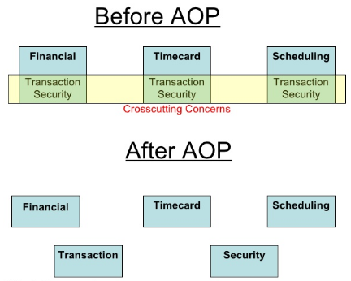
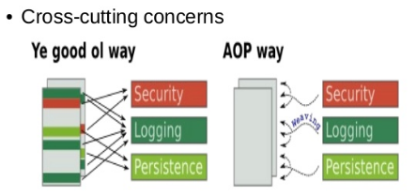
1.3 AOP (Aspect Oriented Programming)
Introduction
https://en.wikipedia.org/wiki/Inversion_of_control
In OOP (Object Oriented Programming), modularity of application is achieved by Classes.
In AOP (Aspect Oriented Programming), application modularity is achieved by Aspects (View Point) and they are configured to cross-cutting into different classes.
Old OOP Way
Spring - CS596

Slide 16

END of CHAPTER 1

