Slide 1


Spring Framework Chapter 3: Setup Spring
Peter H. Chen, PhDEE/EMBA

Slide 2

2 Setup Spring

Slide 3

2 Setup Spring
Introduction
https://www.tutorialspoint.com/spring/spring_environment_setup.htm
This document shows how to prepare a development environment to start your work with Spring Framework.
This document shows how to setup JDK, Tomcat, and Eclipse on your machine before you setup Spring Framework
Spring - CS596

Slide 4
3.1 Verify JDK

Slide 5
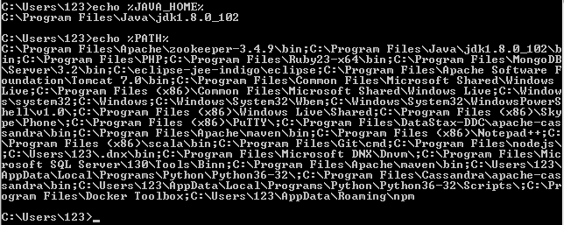
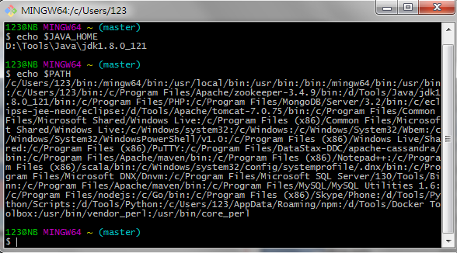
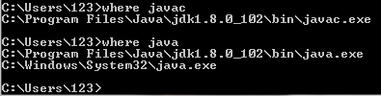
3.1 Verify JDK
Introduction
https://www.tutorialspoint.com/spring/spring_environment_setup.htm
Check %JAVA_HOME% and %PATH%.
Check $JAVA_HOME and $PATH.
$ echo %JAVA_HOME%
$ echo %PATH%
$ echo $JAVA_HOME
$ echo $PATH
Spring - CS596

Slide 6
3.2 Verify Tomcat

Slide 7
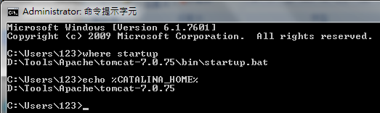
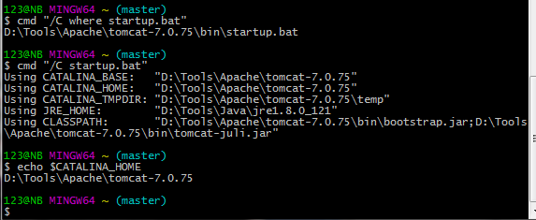
3.2 Install Tomcat
Introduction
https://www.tutorialspoint.com/spring/spring_environment_setup.htm
Go to www.apache.org
Download and Install Tomcat.
Setup %CATALINA_HOME% and startup.bat
$ echo $CTALALINA_HOME
$ cmd “/C where startup.bat”
$ cmd “/C startup.bat”
$ echo %CTALALINA_HOME%
$ where startup
Spring - CS596

Slide 8
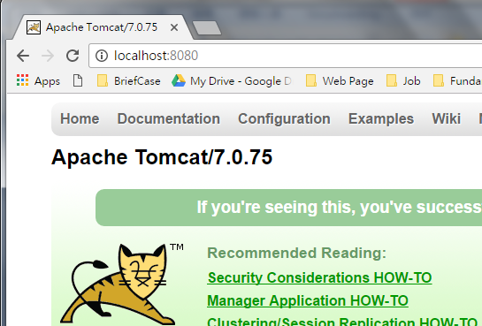

3.2 Install Tomcat
Introduction
https://www.tutorialspoint.com/spring/spring_environment_setup.htm
Start the tomcat7 Server and Verify
Window Prompt:
$ startup
$ localhost:8080
If port “8080” is occupied by other server.
$ netstat -ano | findStr :8080
$ tomcat7 stop
$ taskKill /F /PID 2228
If you cannot find port number, use “shutdown” and then “startup”
$ shutdown
$ startup
Spring - CS596

Slide 9
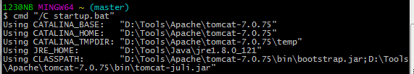
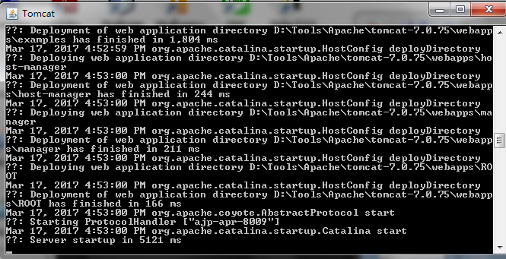
3.2 Install Tomcat
Introduction
https://www.tutorialspoint.com/spring/spring_environment_setup.htm
Start the tomcat7 Server and Verify
Git Bash:
$ cmd “/C startup.bat”
Spring - CS596

Slide 10
3.3 Apache Loggings

Slide 11
3.3 Apache Loggings
Introduction
https://www.tutorialspoint.com/spring/spring_environment_setup.htm
JCL (Apache Commons Logging or Jakarta Commons Logging) is a Java-based logging utility and a programming model for logging and for other toolkits. It provides APIs, log implementations, and wrapper implementations over some other tools.
Jakarta: City of Victory. Jar = Victory, Karta = City.
Spring - CS596

Slide 12
3.3 Apache Loggings
Introduction
https://en.wikipedia.org/wiki/Apache_Commons_Logging
While logging-implementation independence is not as important for applications as it is for libraries, using commons-logging does allow the application to change to a different logging implementation without recompiling code.
Note that commons-logging does not attempt to initialize or terminate the underlying logging implementation that is used at runtime; that is the responsibility of the application.
However many popular logging implementations do automatically initialize themselves; in this case an application may be able to avoid containing any code that is specific to the logging implementation used.
Spring - CS596

Slide 13
3.3 Apache Loggings
Introduction
https://en.wikipedia.org/wiki/Apache_Commons_Logging
JCL Log Level:
Level | Description
fatal | Severe errors that cause premature termination. Expect these to be immediately visible on a status console.
error | Other runtime errors or unexpected conditions. Expect these to be immediately visible on a status console.
warn | Use of deprecated APIs, poor use of API, 'almost' errors, other runtime situations that are undesirable or unexpected, but not necessarily "wrong". Expect these to be immediately visible on a status console.
info | Interesting runtime events (startup/shutdown). Expect these to be immediately visible on a console, so be conservative and keep to a minimum.
debug | Detailed information on the flow through the system. Expect these to be written to logs only.
trace | Most detailed information. Expect these to be written to logs only.
Spring - CS596

Slide 14
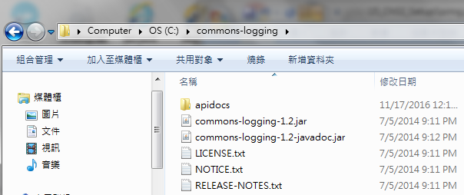
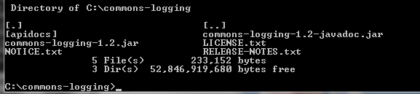
3.3 Apache Loggings
Introduction
https://www.tutorialspoint.com/spring/spring_environment_setup.htm
The commons logging is located “C:\commons-logging”.
This directory will have following jar files and other supporting documents and etc.
Spring - CS596

Slide 15
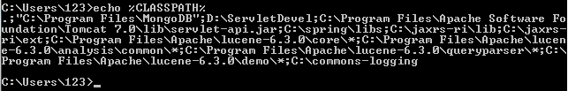
3.3 Apache Loggings
Introduction
https://www.tutorialspoint.com/spring/spring_environment_setup.htm
Make sure you set your CLASSPATH variable on this directory properly otherwise you will face problem while running your application.
$ echo %CLASSPATH%
The CLASSPATH variable should contains “C:\commons-logging”.
Spring - CS596

Slide 16
3.4 Setup Eclipse IDE

Slide 17
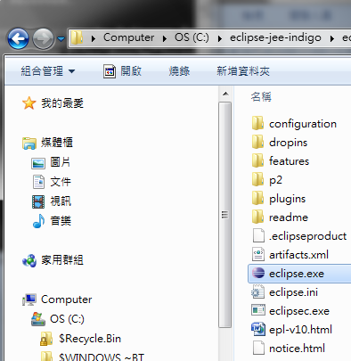

3.4 Install Eclipse IDE
Introduction
https://www.tutorialspoint.com/spring/spring_environment_setup.htm
Download “eclipse-java-indigo”.
Unzip into “C:\eclipse-java-indigo” directory.
In “C:\eclipse-java-indigo\eclipse” directory, click “eclipse.exe” to start.
$ where eclipse
Spring - CS596

Slide 18
3.5 Setup Spring Framework Libraries

Slide 19
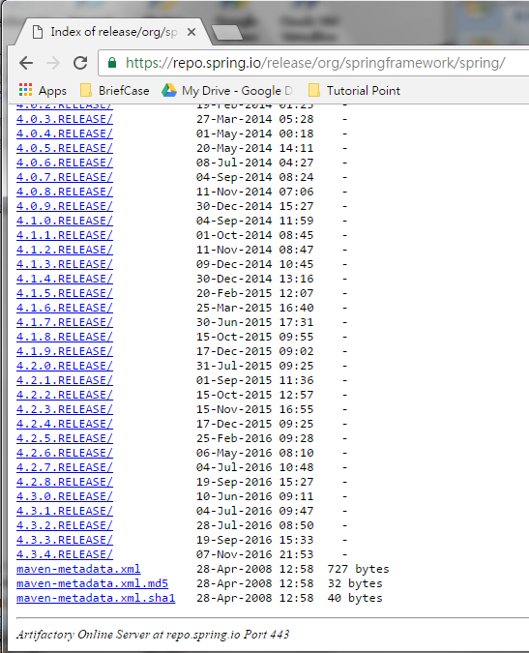
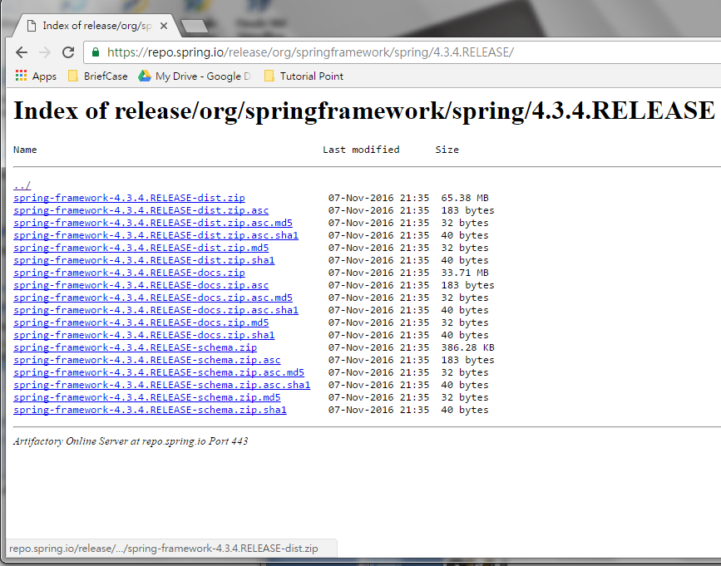
3.5 Install Spring Framework Libraries
Introduction
https://www.tutorialspoint.com/spring/spring_environment_setup.htm
Go to https://repo.spring.io/release/org/springframework/spring/
Download spring-framework-.x.x.RELEASE-disk.zip
Spring - CS596

Slide 20
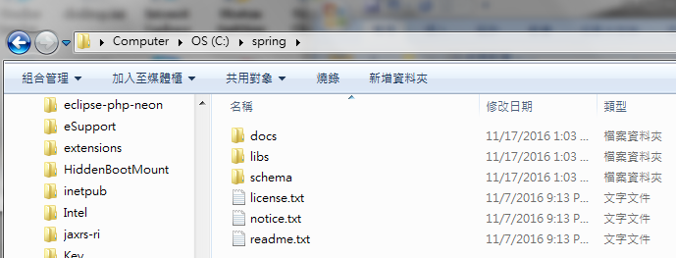
3.5 Install Spring Framework Libraries
Introduction
https://www.tutorialspoint.com/spring/spring_environment_setup.htm
Unzip “spring-framework-RELEASE-x.x.x.zip” under ”C:\spring” as follow:
Spring - CS596

Slide 21
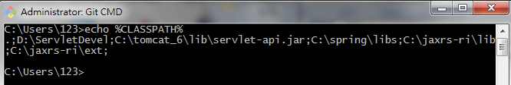
3.5 Install Spring Framework Libraries
Introduction
https://www.tutorialspoint.com/spring/spring_environment_setup.htm
You will find all the Spring libraries in the directory ”C:\spring\libs”.
Make sure you set your CLASSPATH variable on this directory properly otherwise you will face problem while running your application.
If you are using Eclipse then it is not required to set CLASSPATH because all the setting will be done through Eclipse.
Once you are done with this last step, you are ready to proceed for your first Spring Example which you will see in the next docuement.
Spring - CS596

Slide 22

END of CHAPTER 3

