Slide 1


Spring Framework Chapter 4: Hello World
Peter H. Chen, PhDEE/EMBA

Slide 2

4 Hello World

Slide 3

3 Hello World
Introduction
https://www.tutorialspoint.com/spring/spring_hello_world_example.htm
Let us start actual programming with Spring Framework.
Before you start writing your first example using Spring framework, you have to make sure that you have setup your Spring environment properly as explained in Spring - Environment Setup tutorial.
You need to have knowledge with Eclipse IDE.
So let us proceed to write a simple Spring Application which will print "Hello World!" or any other message based on the configuration done in Spring Beans Configuration file.
Spring - CS596

Slide 4
4.1 Create Java Project

Slide 5
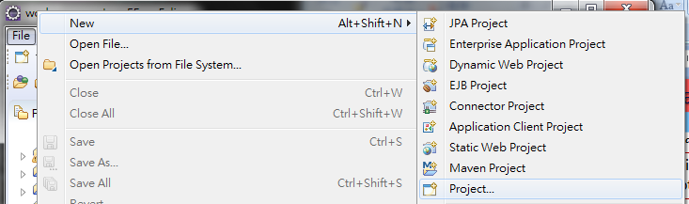
4.2 Create Java Project
Introduction
https://www.tutorialspoint.com/spring/spring_hello_world_example.htm
The first step is to create a simple Java Project using Eclipse IDE.
Follow the option File -> New -> Project
Spring - CS596

Slide 6
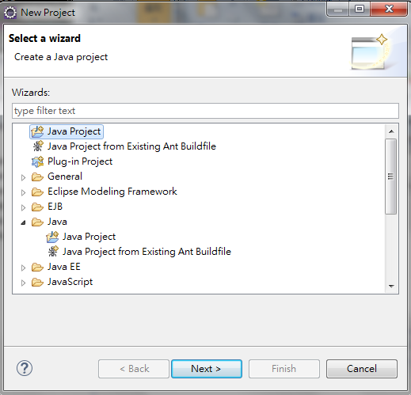
4.2 Create Java Project
Introduction
https://www.tutorialspoint.com/spring/spring_hello_world_example.htm
In New Project Windows, select Java Project wizard from the wizard list.
Spring - CS596

Slide 7
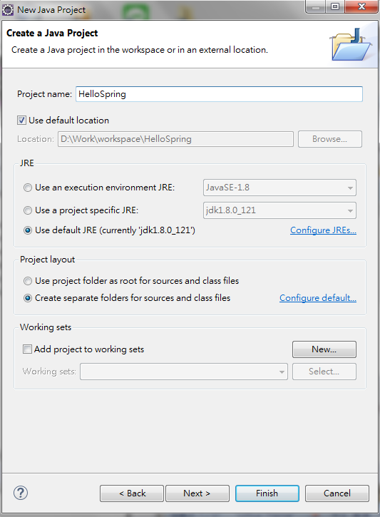
4.2 Create Java Project
Introduction
https://www.tutorialspoint.com/spring/spring_hello_world_example.htm
Project Name: HelloSpring.
Use JRE: JavaSE-1.8
Use Project JRE: jdk1.8.0_121
Use default JRE: jdk1.8.0_121
Select “Create separate folders for sources and class files.
Click Finish Button.
Spring - CS596

Slide 8
4.3 Display Navigator

Slide 9
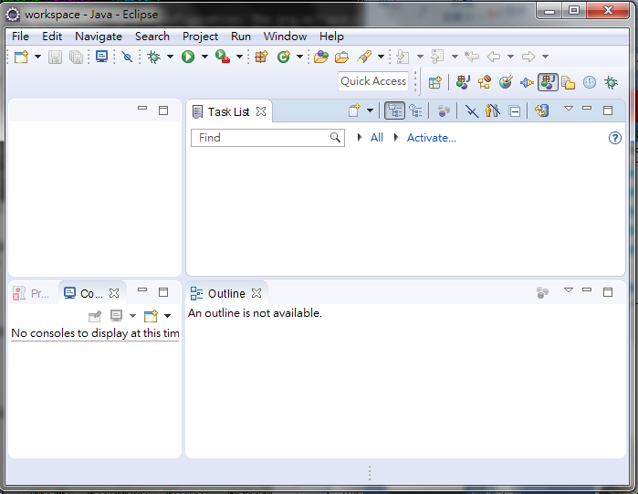
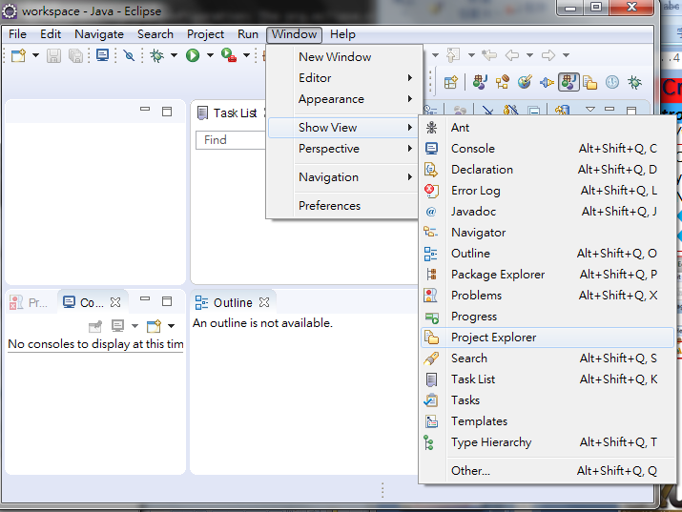
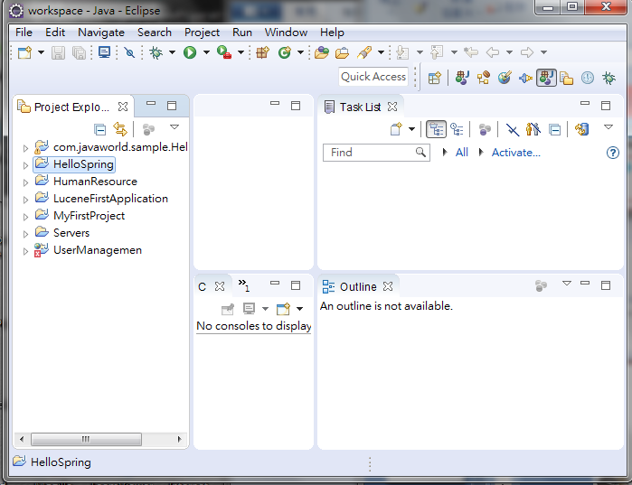
4.3 Display Navigator
Introduction
https://www.tutorialspoint.com/spring/spring_hello_world_example.htm
If you cannot see the Project Navigator, use Windows > Show View > Project Explorer to display the Project Navigator.
Spring - CS596

Slide 10
4.4 Display JRE System Library

Slide 11
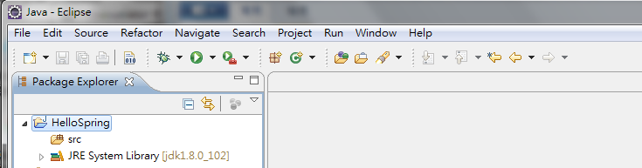
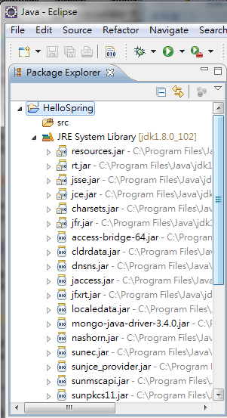
4.4 Display JRE System Library
Introduction
https://www.tutorialspoint.com/spring/spring_hello_world_example.htm
Once your project is created successfully, you will have following content in your Project Explorer:
Expand JRE Folder
Spring - CS596

Slide 12
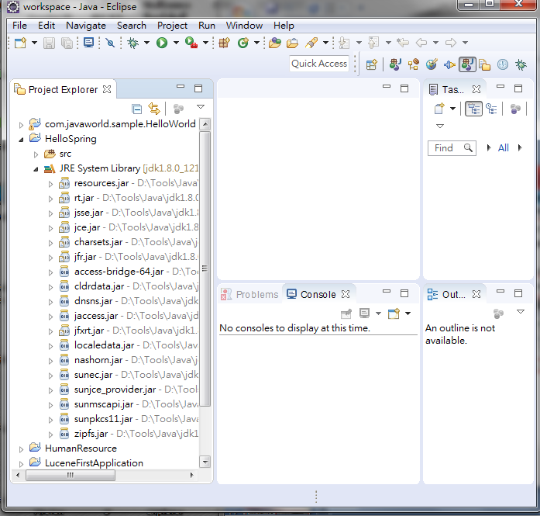
4.4 Display JRE System Library
Introduction
https://www.tutorialspoint.com/spring/spring_hello_world_example.htm
Expand the JRE folder will see all JARs files.
Expand JRE Folder
Spring - CS596

Slide 13
4.5 Added Required Libraries

Slide 14
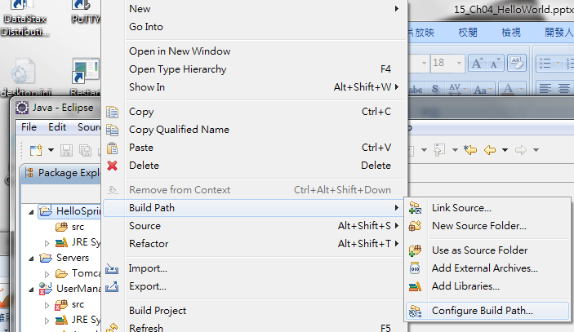
4.5 Add Required Libraries
Introduction
https://www.tutorialspoint.com/spring/spring_hello_world_example.htm
As a second step let us add Spring Framework and common logging API libraries in our project.
To do this, Right-Mouse Click on your project name HelloSpring and then follow the following option available in context menu: Build Path -> Configure Build Path to display the Java Build Path window as follows:
Right-Mouse Click
Spring - CS596

Slide 15
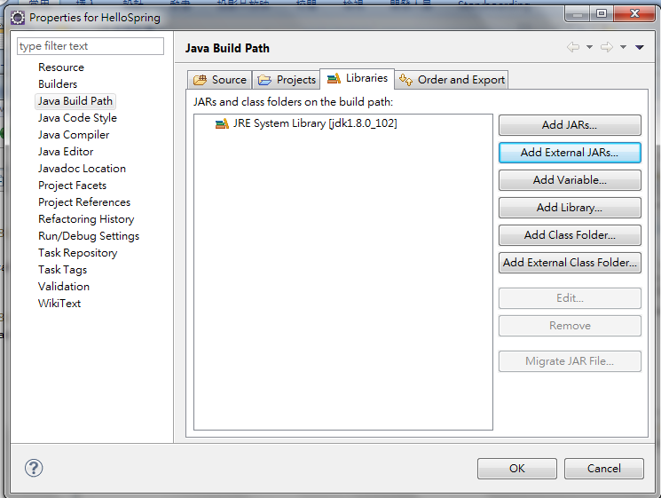
4.5 Add Required Libraries
Introduction
https://www.tutorialspoint.com/spring/spring_hello_world_example.htm
Click Libraries Tab.
Click Add External JARs button.
Spring - CS596

Slide 16
4.5 Add Required Libraries
Introduction
https://www.tutorialspoint.com/spring/spring_hello_world_example.htm
Browse add the following core JARs from the following installation directories.
Spring Framework
Common Logging
Spring - CS596

Slide 17
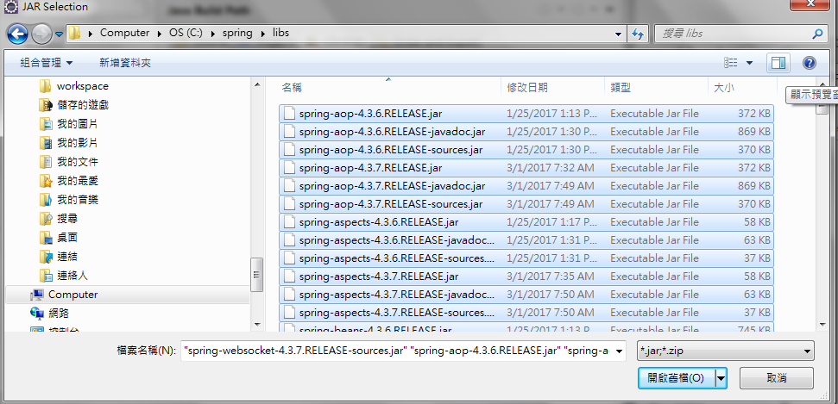
4.5 Add Required Libraries: Add Spring Framework
Introduction
https://www.tutorialspoint.com/spring/spring_hello_world_example.htm
The Spring Framework libraries are as follow:
C:\spring
spring-aop-4.1.6.RELEASE
spring-aspects-4.1.6.RELEASE
spring-beans-4.1.6.RELEASE
spring-context-4.1.6.RELEASE
spring-context-support-4.1.6.RELEASE
spring-core-4.1.6.RELEASE
spring-expression-4.1.6.RELEASE
spring-instrument-4.1.6.RELEASE
spring-instrument-tomcat-4.1.6.RELEASE
spring-jdbc-4.1.6.RELEASE
spring-jms-4.1.6.RELEASE
spring-messaging-4.1.6.RELEASE
spring-orm-4.1.6.RELEASE
spring-oxm-4.1.6.RELEASE
spring-test-4.1.6.RELEASE
spring-tx-4.1.6.RELEASE
spring-web-4.1.6.RELEASE
spring-webmvc-4.1.6.RELEASE
spring-webmvc-portlet-4.1.6.RELEASE
spring-websocket-4.1.6.RELEASE
Spring - CS596

Slide 18
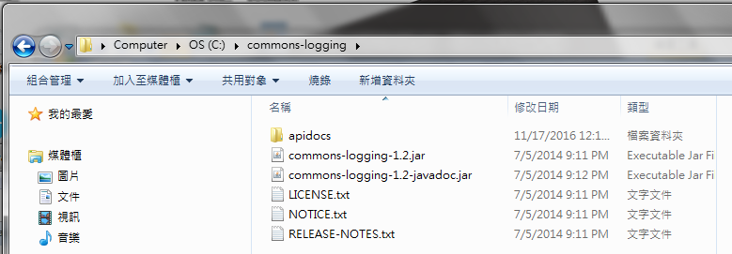
4.5 Add Required Libraries: Add Commons-Logging
Introduction
https://www.tutorialspoint.com/spring/spring_hello_world_example.htm
The commons-logging libraries area a follow:
C:\Common-logging:
Commons-logging-1.2.jar
Commons-logging-1.2-javadoc.jar
Spring - CS596

Slide 19
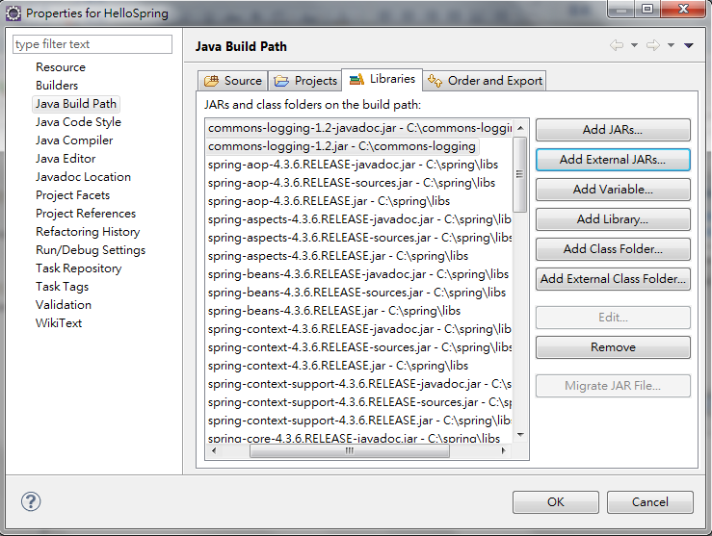
4.5 Add Required Libraries
Introduction
https://www.tutorialspoint.com/spring/spring_hello_world_example.htm
After commons-logging libraries and spring libraries are added.
Spring - CS596

Slide 20
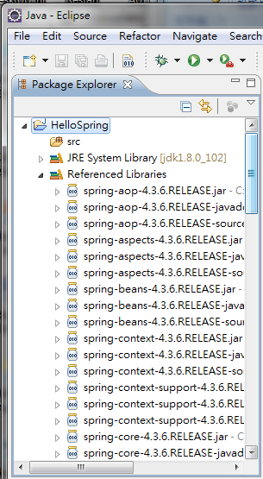
4.5 Add Required Libraries
Introduction
https://www.tutorialspoint.com/spring/spring_hello_world_example.htm
After “Add the External Libraries”, the Java Project “HelloSpring” will include all the external libraries
spring libraries
commons-logging libraries
Spring - CS596

Slide 21
4.6 Create Source Files

Slide 22
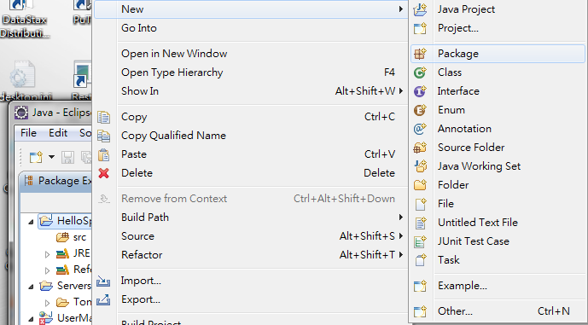
4.6 Create Source Files
Introduction
https://www.tutorialspoint.com/spring/spring_hello_world_example.htm
Now let us create actual source files under the HelloSpring project.
We have two source files: MainApp.java and HelloWorld.java
First we need to create a package called com.tutorialspoint.
To do this, right click on src in package explorer section and follow the option : New -> Package.
Right-Mouse Click
Spring - CS596

Slide 23
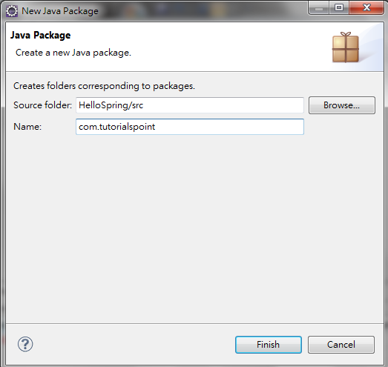
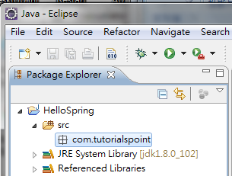
4.6 Create Source Files
Introduction
https://www.tutorialspoint.com/spring/spring_hello_world_example.htm
Next we will create HelloWorld.java and MainApp.java files under the com.tutorialspoint package.
Spring - CS596

Slide 24
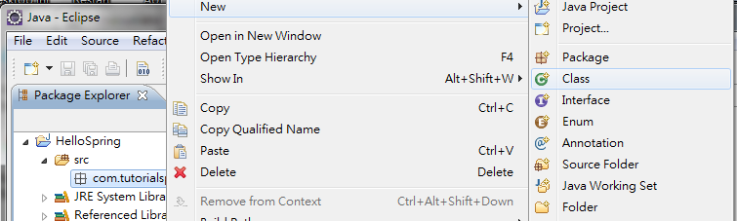
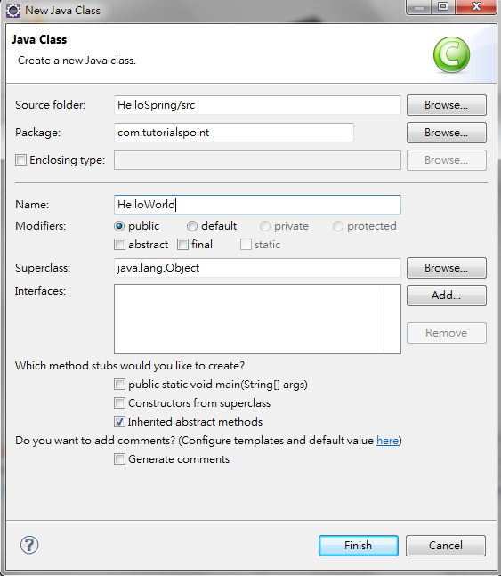
4.6 Create Source Files
Introduction
https://www.tutorialspoint.com/spring/spring_hello_world_example.htm
Next we will create class HelloWorld for HelloWorld.java.
The passing parameter message will be passed from external beans.xml.
Right-mouse click on package com.turorialspoint
Right-Mouse Click
Spring - CS596

Slide 25
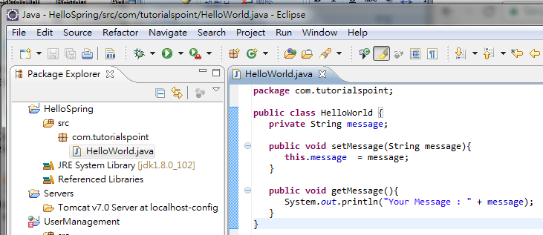
4.6 Create Source Files
Introduction
https://www.tutorialspoint.com/spring/spring_hello_world_example.htm
Type in HelloWorld.java
Spring - CS596

Slide 26
4.6 Create Source Files
Introduction
https://www.tutorialspoint.com/spring/spring_hello_world_example.htm
Here is the content of HelloWorld.java file:
package com.tutorialspoint;
public class HelloWorld {
private String message;
public void setMessage(String message){
this.message = message;
}
public void getMessage(){
System.out.println("Your Message : " + message);
}
}
Spring - CS596

Slide 27
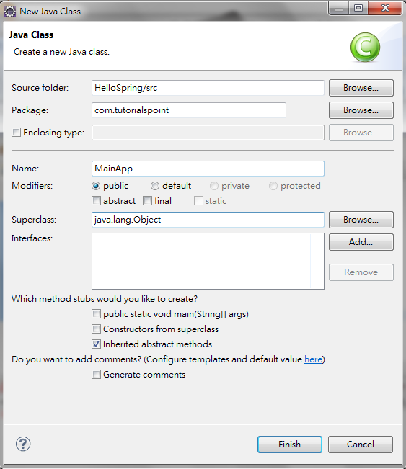
4.6 Create Source Files
Introduction
https://www.tutorialspoint.com/spring/spring_hello_world_example.htm
Next we will create class MainApp for MainApp.java.
Right-mouse click on package com.turorialspoint
Right-Mouse Click
Spring - CS596

Slide 28
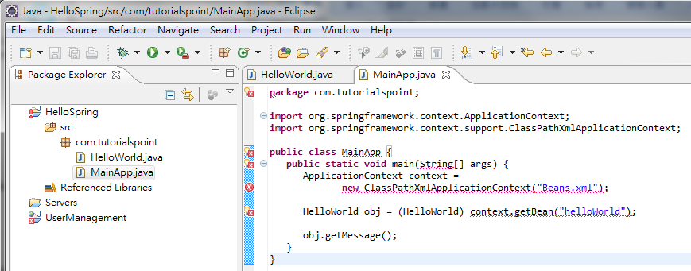
4.6 Create Source Files
Introduction
https://www.tutorialspoint.com/spring/spring_hello_world_example.htm
Type in MainApp.java asf ollow.
Spring - CS596

Slide 29
4.6 Create Source Files
Introduction
https://www.tutorialspoint.com/spring/spring_hello_world_example.htm
Following is the content of the second file MainApp.java:
package com.tutorialspoint;
import org.springframework.context.ApplicationContext;
import org.springframework.context.support.ClassPathXmlApplicationContext;
public class MainApp {
public static void main(String[] args) {
ApplicationContext context = new ClassPathXmlApplicationContext("Beans.xml");
HelloWorld obj = (HelloWorld) context.getBean("helloWorld");
obj.getMessage();
}
}
Spring - CS596

Slide 30
4.6 Create Source Files
Introduction
https://www.tutorialspoint.com/spring/spring_hello_world_example.htm
There are following two important points to note about the main program:
First step is to create application context where we used framework API ClassPathXmlApplicationContext(). This API loads beans configuration file and eventually based on the provided API, it takes care of creating and initializing all the objects, i.e., beans mentioned in the configuration file.
Second step is used to get required bean using getBean() method of the created context. This method uses bean ID to return a generic object which finally can be casted to actual object. Once you have object, you can use this object to call any class method.
Spring - CS596

Slide 31
4.7 Create Bean Configuration

Slide 32
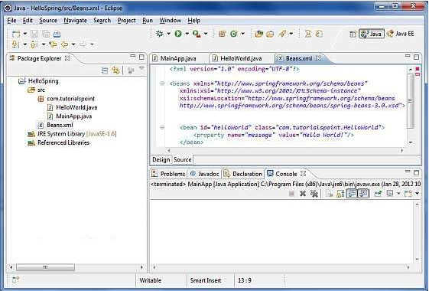
4.7 Create Bean Configuration
Introduction
https://www.tutorialspoint.com/spring/spring_hello_world_example.htm
You need to create a Bean Configuration file which is an XML file and acts as cement that glues the beans, i.e., classes together.
This file needs to be created under the src directory as shown below:
Spring - CS596

Slide 33
4.7 Create Bean Configuration
Introduction
https://www.tutorialspoint.com/spring/spring_hello_world_example.htm
Usually developers keep this file name as Beans.xml, but you are independent to choose any name you like.
You have to make sure that this file is available in CLASSPATH and use the same name in main application while creating application context as shown in MainApp.java file.
The Beans.xml is used to assign unique IDs to different beans and to control the creation of objects with different values without impacting any of the Spring source files.
For example, using below file you can pass any value for "message" variable and so you can print different values of message without impacting HelloWorld.java and MainApp.java files.
Spring - CS596

Slide 34
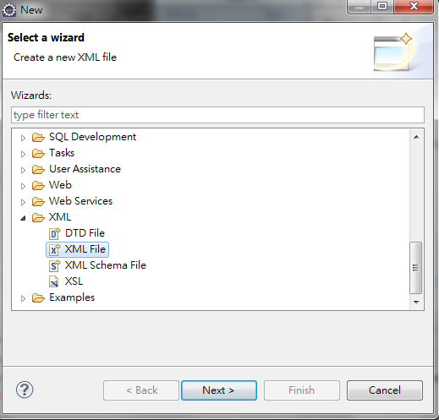
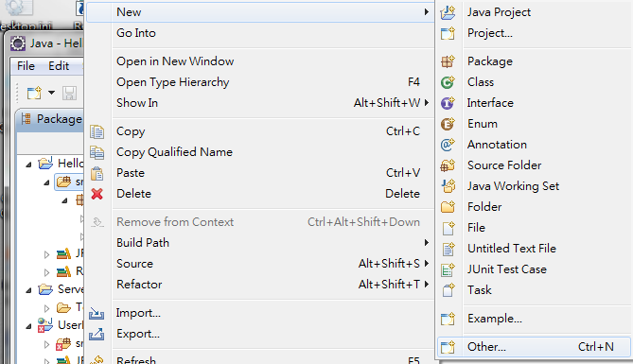
4.7 Create Bean Configuration
Introduction
https://www.tutorialspoint.com/spring/spring_hello_world_example.htm
To create XML file, right-mouse click src and New -> Other…
On New Dialog, Select XML -> XML File as below.
Right-Mouse Click
Spring - CS596

Slide 35
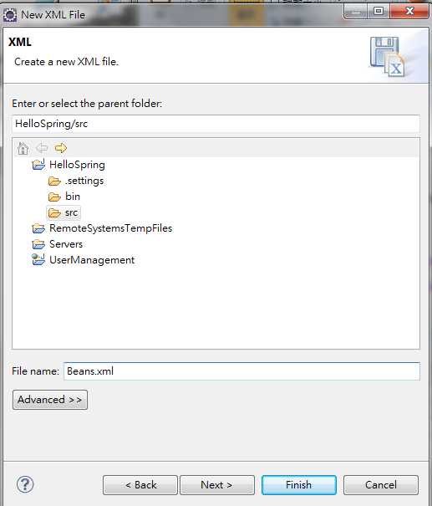
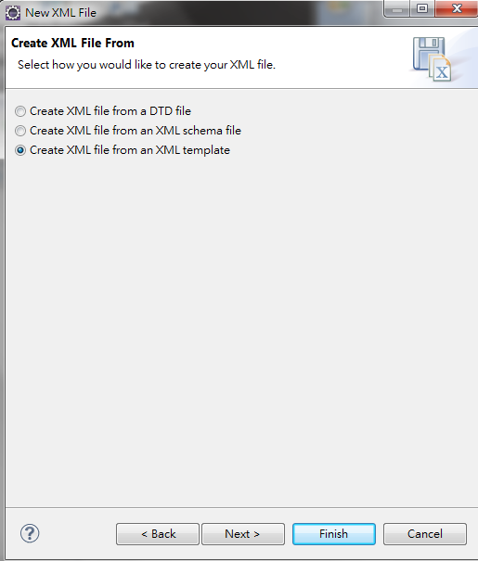
4.7 Create Bean Configuration
Introduction
https://www.tutorialspoint.com/spring/spring_hello_world_example.htm
On “New XML File” Dialog, type “Beans.xml”
Spring - CS596

Slide 36
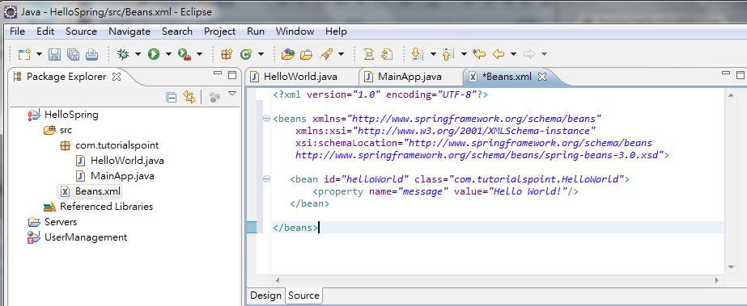
4.7 Create Bean Configuration
Introduction
https://www.tutorialspoint.com/spring/spring_hello_world_example.htm
Type bean configuration for “Beans.xml” as below.
Spring - CS596

Slide 37
4.7 Create Bean Configuration
Introduction
https://www.tutorialspoint.com/spring/spring_hello_world_example.htm
Let us see how it works:
<?xml version="1.0" encoding="UTF-8"?>
<beans xmlns="http://www.springframework.org/schema/beans"
xmlns:xsi="http://www.w4.org/3001/XMLSchema-instance"
xsi:schemaLocation="http://www.springframework.org/schema/beans
http://www.springframework.org/schema/beans/spring-beans-4.0.xsd">
<bean id="helloWorld" class="com.tutorialspoint.HelloWorld">
<property name="message" value="Hello World!"/>
</bean>
</beans>
When Spring application gets loaded into the memory, Framework makes use of the above configuration file to create all the beans defined and assign them a unique ID as defined in <bean> tag.
You can use <property> tag to pass the values of different variables used at the time of object creation.
Spring - CS596

Slide 38
4.8 Run the program

Slide 39
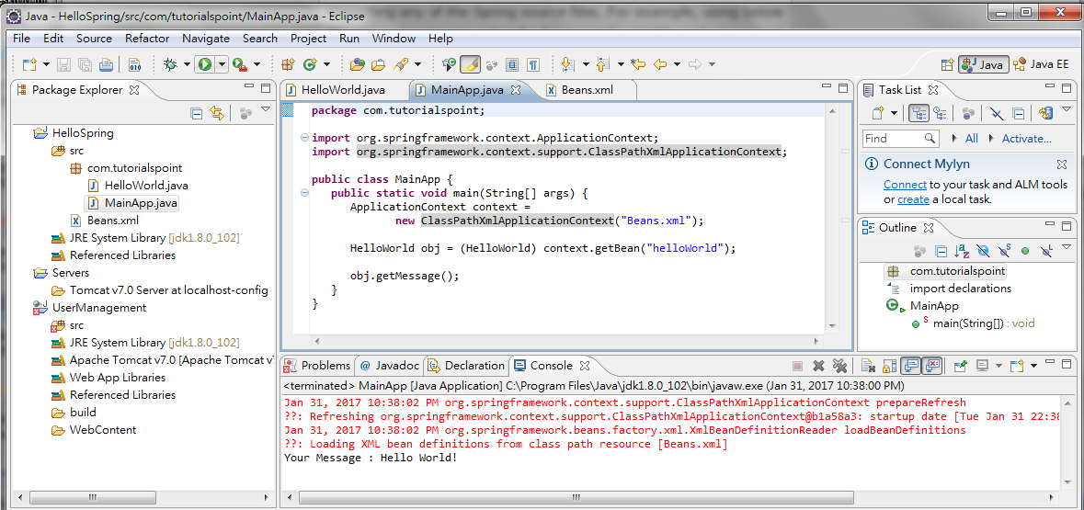
4.8 Run the Program
Introduction
https://www.tutorialspoint.com/spring/spring_hello_world_example.htm
Once you are done with creating source and beans configuration files, you are ready for this step which is compiling and running your program.
To do this, Keep MainApp.Java file tab active
Use either Run option available in the Eclipse IDE or use Ctrl + F11 to compile and run your MainApp application.
2
Click “Run”
1
Click MainApp.java
3
Display “Hello World”
Spring - CS596

Slide 40
4.8 Run the Program
Introduction
https://www.tutorialspoint.com/spring/spring_hello_world_example.htm
If everything is fine with your application, this will print the following message in Eclipse IDE's console:
Your Message : Hello World!
Spring - CS596

Slide 41

END of CHAPTER 4

