Slide 1


Spring Framework Chapter 7: Bean Scope
Peter H. Chen, PhDEE/EMBA

Slide 2

7 Bean Scope

Slide 3

7 Bean Scope
Introduction
https://www.tutorialspoint.com/spring/spring_bean_scopes.htm
When defining a <bean> in Spring, you have the option of declaring a scope for that bean.
For example, To force Spring to produce a new bean instance each time one is needed, you should declare the bean's scope attribute to be prototype.
Similar way if you want Spring to return the same bean instance each time one is needed, you should declare the bean's scope attribute to be singleton.
Spring - CS596

Slide 4
7 Bean Scope
Introduction
https://www.tutorialspoint.com/spring/spring_bean_scopes.htm
The Spring Framework supports following five scopes, three of which are available only if you use a web-aware ApplicationContext.
Scope | Description
singleton | This scopes the bean definition to a single instance per Spring IoC container (default).
prototype | This scopes a single bean definition to have any number of object instances.
request | This scopes a bean definition to an HTTP request. Only valid in the context of a web-aware Spring ApplicationContext.
session | This scopes a bean definition to an HTTP session. Only valid in the context of a web-aware Spring ApplicationContext.
global-session | This scopes a bean definition to a global HTTP session. Only valid in the context of a web-aware Spring ApplicationContext.
Spring - CS596

Slide 5
7 Bean Scope
Introduction
https://www.tutorialspoint.com/spring/spring_bean_scopes.htm
This chapter will discuss about first two scopes and remaining three will be discussed when we will discuss about web-aware Spring ApplicationContext.
Spring - CS596

Slide 6
7.1 Singleton Scope

Slide 7
7.1 Singleton Scope
Introduction
https://www.tutorialspoint.com/spring/spring_bean_scopes.htm
If scope is set to singleton, the Spring IoC container creates exactly one instance of the object defined by that bean definition. This single instance is stored in a cache of such singleton beans, and all subsequent requests and references for that named bean return the cached object.
The default scope is always singleton however, when you need one and only one instance of a bean, you can set the scope property to singleton in the bean configuration file, as shown below:
<!-- A bean definition with singleton scope -->
<bean id="..." class="..." scope="singleton">
<!-- collaborators and configuration for this bean go here -->
</bean>
Spring - CS596

Slide 8
7.1 Singleton Scope
Introduction
https://www.tutorialspoint.com/spring/spring_bean_scopes.htm
Example:
Let us have working Eclipse IDE in place and follow the following steps to create a Spring application:
Step | Description
1 | Create a project with a name SpringExample and create a package com.tutorialspoint under the src folder in the created project.
2 | Add required Spring libraries using Add External JARs option as explained in the Spring Hello World Example chapter.
3 | Create Java classes HelloWorld and MainApp under the com.tutorialspoint package.
4 | Create Beans configuration file Beans.xml under the src folder.
5 | The final step is to create the content of all the Java files and Bean Configuration file and run the application as explained below.
Spring - CS596

Slide 9
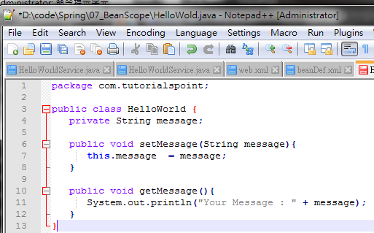
7.1 Singleton Scope
Introduction
https://www.tutorialspoint.com/spring/spring_bean_scopes.htm
Here is the content of HelloWorld.java file:
package com.tutorialspoint;
public class HelloWorld {
private String message;
public void setMessage(String message){
this.message = message;
}
public void getMessage(){
System.out.println("Your Message : " + message);
}
}
Spring - CS596

Slide 10
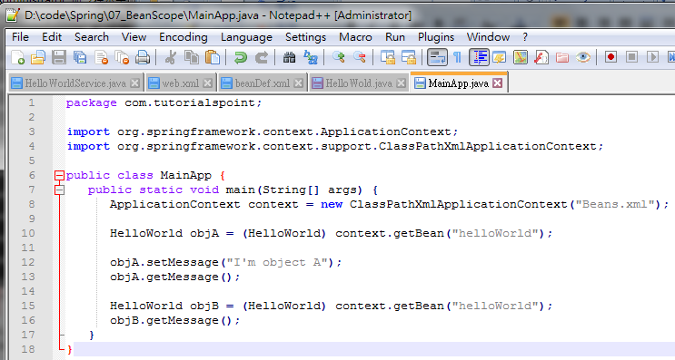
7.1 Singleton Scope
Introduction
https://www.tutorialspoint.com/spring/spring_bean_scopes.htm
Following is the content of the MainApp.java file
package com.tutorialspoint;
import org.springframework.context.ApplicationContext;
import org.springframework.context.support.ClassPathXmlApplicationContext;
public class MainApp {
public static void main(String[] args) {
ApplicationContext context = new ClassPathXmlApplicationContext("Beans.xml");
HelloWorld objA = (HelloWorld) context.getBean("helloWorld");
objA.setMessage("I'm object A");
objA.getMessage();
HelloWorld objB = (HelloWorld) context.getBean("helloWorld");
objB.getMessage();
}
}
Spring - CS596

Slide 11
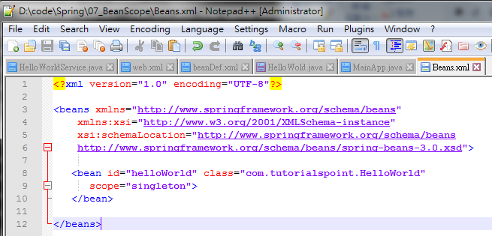
7.1 Singleton Scope
Introduction
https://www.tutorialspoint.com/spring/spring_bean_scopes.htm
Following is the configuration file Beans.xml required for singleton scope:
<?xml version="1.0" encoding="UTF-8"?>
<beans xmlns="http://www.springframework.org/schema/beans"
xmlns:xsi="http://www.w3.org/2001/XMLSchema-instance"
xsi:schemaLocation="http://www.springframework.org/schema/beans
http://www.springframework.org/schema/beans/spring-beans-3.0.xsd">
<bean id="helloWorld" class="com.tutorialspoint.HelloWorld"
scope="singleton">
</bean>
</beans>
Spring - CS596

Slide 12
7.1 Singleton Scope
Introduction
https://www.tutorialspoint.com/spring/spring_bean_scopes.htm
Once you are done with creating source and bean configuration files, let us run the application.
If everything is fine with your application, this will print the following message:
Your Message : I'm object A
Your Message : I'm object A
Spring - CS596

Slide 13
7.2 Prototype Scope

Slide 14
7.2 Prototype Scope
Introduction
https://www.tutorialspoint.com/spring/spring_bean_scopes.htm
If scope is set to prototype, the Spring IoC container creates new bean instance of the object every time a request for that specific bean is made.
As a rule, use the prototype scope for all state-full beans and the singleton scope for stateless beans.
To define a prototype scope, you can set the scope property toprototype in the bean configuration file, as shown below:
<!-- A bean definition with singleton scope -->
<bean id="..." class="..." scope="prototype">
<!-- collaborators and configuration for this bean go here -->
</bean>
Spring - CS596

Slide 15
7.1 Singleton Scope
Introduction
https://www.tutorialspoint.com/spring/spring_bean_scopes.htm
Example:
Let us have working Eclipse IDE in place and follow the following steps to create a Spring application:
Step | Description
1 | Create a project with a name SpringExample and create a package com.tutorialspoint under the src folder in the created project.
2 | Add required Spring libraries using Add External JARs option as explained in the Spring Hello World Example chapter.
3 | Create Java classes HelloWorld and MainApp under the com.tutorialspoint package.
4 | Create Beans configuration file Beans.xml under the src folder.
5 | The final step is to create the content of all the Java files and Bean Configuration file and run the application as explained below.
Spring - CS596

Slide 16
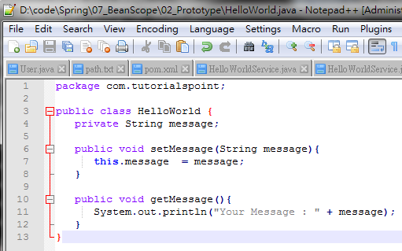
7.2 Prototype Scope
Introduction
https://www.tutorialspoint.com/spring/spring_bean_scopes.htm
Here is the content of HelloWorld.java file:
package com.tutorialspoint;
public class HelloWorld {
private String message;
public void setMessage(String message){
this.message = message;
}
public void getMessage(){
System.out.println("Your Message : " + message);
}
}
Spring - CS596

Slide 17
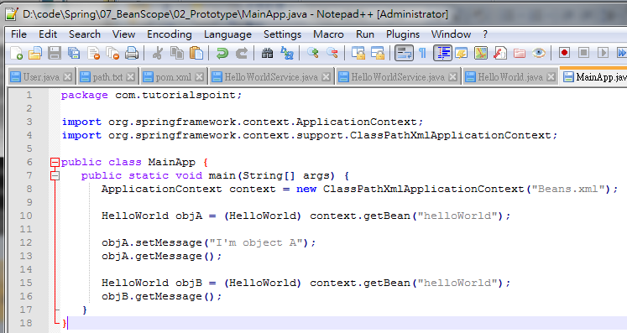
7.2 Prototype Scope
Introduction
https://www.tutorialspoint.com/spring/spring_bean_scopes.htm
Following is the content of the MainApp.java file:
package com.tutorialspoint;
import org.springframework.context.ApplicationContext;
import org.springframework.context.support.ClassPathXmlApplicationContext;
public class MainApp {
public static void main(String[] args) {
ApplicationContext context = new ClassPathXmlApplicationContext("Beans.xml");
HelloWorld objA = (HelloWorld) context.getBean("helloWorld");
objA.setMessage("I'm object A");
objA.getMessage();
HelloWorld objB = (HelloWorld) context.getBean("helloWorld");
objB.getMessage();
}
}
Spring - CS596

Slide 18
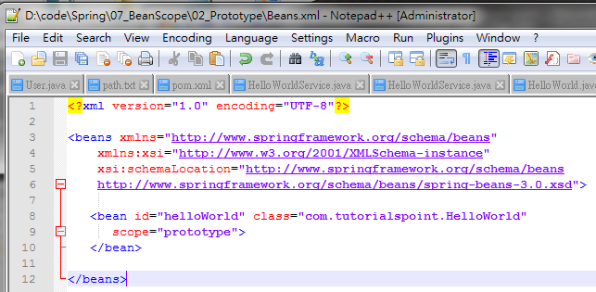
7.2 Prototype Scope
Introduction
https://www.tutorialspoint.com/spring/spring_bean_scopes.htm
Following is the configuration file Beans.xml required for prototype scope:
<?xml version="1.0" encoding="UTF-8"?>
<beans xmlns="http://www.springframework.org/schema/beans"
xmlns:xsi="http://www.w3.org/2001/XMLSchema-instance"
xsi:schemaLocation="http://www.springframework.org/schema/beans
http://www.springframework.org/schema/beans/spring-beans-3.0.xsd">
<bean id="helloWorld" class="com.tutorialspoint.HelloWorld"
scope="prototype">
</bean>
</beans>
Spring - CS596

Slide 19
7.2 Prototype Scope
Introduction
https://www.tutorialspoint.com/spring/spring_bean_scopes.htm
Once you are done with creating source and bean configuration files, let us run the application.
If everything is fine with your application, this will print the following message:
Your Message : I'm object A
Your Message : null
Spring - CS596

Slide 20

END of CHAPTER 7

