Slide 1
Shallow Blue
x x x x
Jomar Dizon, Zachariah Dohogne, Stephen Gilbert, Kevin Quintero, and Brent Williams

Slide 2
Requirements x x x x

Slide 3

Interview - Technical Details
Attendees: Kevin Quintero, Jomar Dizon, Professor Yuan (client)
Q. Do you want each user to be stored in a server database or a text file?
The information can be stored in either a database or text file. The following information must be stored per player User ID, Wins, Loses, Ties.
Q. Can you explain the retrieval of win/loss records?
History should be accessible only in the main menu by searching the player’s user name.
Q. How easy, medium, hard do you want it to be?
Easy – random number generator is acceptable
Medium- Should be competitive.
Hard – Must win majority of the time.

Slide 4
Non-functional Requirements
Cost Constraints
The coding will be performed in free, open source IDE’s such as Aptana or simple text editors already available on the team’s machines. The execution environment will be the common web browsers such as Safari, Chrome, and Firefox that are readily available for downloading. The team also has access to a web server, should the application make use of MySQL and be deployed on the World Wide Web.
Thus, Shallow Blue does not anticipate incurring any monetary cost for the project.
Reliability
The client wishes for application to have an immediate start up time in the event of a system failure. Restarting the application can be accomplished with a refresh in the browser or navigating to the directory housing the files. If a text file is chosen as the storage format for the match data, then there will be no risk of server downtime.
Time Constraints
The client has decided that this is intended to be a one-semester project. The client has specified the following non-negotiable project milestone deadlines:

Slide 5

Use Case 1: Starting the Tic-Tac-Toe Application
Goals of actor | Actor: Any human user of the application. The objective for this use case is to launch the application in the actor’s browser.
Tasks | 1) Actor navigates to the folder housing the files related to the application on his desktop. 2) Actor clicks on the index.html file storing the home page for the application. 3) Actor’s default browser opens the home screen to the Tic-Tac-Toe application.
Preconditions | To successfully launch the application: 1) The actor must have a web browser installed on his desktop. 2) The index.html and all related .js and .css files must be located in the same directory. 3) Actor’s browser must have JavaScript enabled.
Exceptions | 1) JavaScipt not enabled in the browser. Should this be the case, actor must consult the Options tab for his preferred browser. Failure to do so will prevent certain features from rendering correctly. 2) Relevant files not found during application execution. As mentioned, if any .html, .js, .css, or .txt files are removed from the parent directory, then there could be a loss of aesthetics or functionality. It is advised that the actor make back up copies on a USB or other storage device upon delivery.
Variation of action interactions | The actor need not use the default browser stored on his system. It is often possible to open a preferred browser (i.e. Safari, Chrome, Firefox) and drag the desired file into the browser window so that it displays. In addition, the actor, having previously opened the application in a certain browser, may be able to take advantage of using the browser’s “History” or “Bookmarks” options.

Slide 6
Use Case 1: Starting the Tic-Tac-Toe Application
Goals of actor | Actor: For this use case, the actor could be one (1) or two (2) human users of the application. The overall objective is to set up the following conditions for the next tic-tac-toe match that takes place: 1) The number of human players 2) The ID of said players 3) The difficulty level (if the option for a computer opponent is chosen)
Tasks | 1) Actor navigates to the home page (index.html) for the application as mentioned in Use Case 1. 2) Actor chooses from a dropdown box whether they wish to play a match that is “Player vs. Player” or “Player vs. Computer.” [default: Player vs. Player] 3) Actor chooses to either check a checkbox with the label “Play as Guest” or uses a textbox in which he can enter a new name or select a previously-defined account name. [Selecting an existing username value causes a label below to show the player’s current win-loss-tie record] 4) Other actor, if applicable, repeats step 3 with a second checkbox/text box group that appears to the right. 5) With both input groups filled in, one of the actors can now click the “Start Match” button that has become enabled.
Preconditions | To display existing user options and the related win-loss-tie records: 1) There must be records previously stored in the data storage mechanism (i.e. text file or database). In other words, this assumes that user accounts were created in the past during previous executions of the application. 2) A successful connection with the user data must be established.
Exceptions | 1) Cannot connect to database. If a MySQL database is where the data is housed, then proper PHP error handling mechanisms will need to be put into place such as a “try, catch, finally” block. 2) File not found exception. If a text file houses the data, then it needs to exist in the directory that stores the application’s .html and .js files. Consider writing a function that creates the file if it does not already exist. 3) Both players choose the same username. The application needs to disable the “Start Match” button and provide a message that discourages this.
Variation of action interactions | The tasks list above assumed a selection of “Player vs. Player,” but “Player vs. Computer” is an alternative choice. Should the “Player vs. Computer” option be selected in the dropdown, then the checkbox/textbox group on the right needs to change to a dropdown box labeled as “Difficulty.” The actor then selects either Easy, Medium, or Hard.

Slide 7
Use Case 3: Choosing a Game Piece
Goals of actor | Actors: The two players in the match that is beginning. The second player can be human or the computer. Each player is to have a unique marker that it places on the board to designate squares that it has selected throughout the match. The goal of this use case is for each player to select from a pre-defined list of images the marker that will serve as his game piece.
Tasks | 1) The onclick() event of the “Start Match” button fires an event where the Select Options menu disappears and a menu with different images to choose from appears. The new menu reads “Player 1 Choose Piece” and the actor is shown a choice of images with a radio button underneath each one. 2) Actor clicks the radio button for the desired game piece. 3) Actor clicks button that says “OK”. 4) The other game piece is automatically selected for Player 2. 5) The game piece selection menu disappears and the game board appears on the web page.1) Actor navigates to the folder housing the files related to the application on his desktop. 2) Actor clicks on the index.html file storing the home page for the application. 3) Actor’s default browser opens the home screen to the Tic-Tac-Toe application.
Preconditions | This use case assumed that the actor(s) have successfully filled out the game settings options from Use Case 2.
Exceptions | 1) Browser cannot locate images. If the browser is unable to find the images in the specified directory, it will not be able to render images in any of the menu <img> tags. The <img> elements should display alternate text if such an error occurs. As previously stated, the client should save backup copies of the product files upon delivery.
Variation of action interactions | As stated, the second actor need not be a human player. If the “Player vs. Computer” option has been chosen, then the “Player 2 Choose Piece” menu should not display. The computer should automatically select an image without any input from the human actor.

Slide 8
Use Case 4: Selecting a Square on the Game Board
Goals of actor | Actor: One of the game players. Throughout a tic-tac-toe match, the two players alternate selecting squares on the game board to designate their strategic selections. The goal of this use case is for the actor to mark a square as his newest selection.
Tasks | 1) Text label towards top of the display reads “[Player Name] turn” where [Player Name] is the name of the registered user whose turn it is to make a selection. If the actor has opted to play as a guest, or the actor is the computer, then the label will simply read “Player 1 turn” or “Player 2 turn.” 2) Actor mouses over the square he chooses to select. Whenever the mouse hovers over a square, there should be some visual feedback implemented with JavaScript or .css such as adding a small highlighted border over the active square. 3) Actor clicks the square of his choice. 4) The chosen square will now display with the image of the actor’s game piece to designate his choice. 5) The game board tests to see if there is a player with four adjacent squares in a horizontal, diagonal, or vertical fashion OR if there are no remaining squares that are unoccupied. 6) If there is not yet a winner, the label is updated to reflect that it is the other actor’s turn to make a selection.
Preconditions | This use case can only execute if the previous turn did not result in a winner. That is, it cannot be the case that a user already has four adjacent squares in a horizontal, diagonal, or vertical fashion.
Exceptions | 1) Actor clicks on square already claimed. Once a square has been selected, it cannot be chosen a second time. Thus, any input from the mouse must be ignored when the actor clicks on a square that already displays the game piece for a player.
Variation of action interactions | It is possible for the actor making a selection to be a computer player. In this instance, there is going to be no clicking of the mouse. An algorithm, based on the difficulty selected prior to the match, will make the selection rather than an actor using mouse input. While a computer player is making a selection, the human actor cannot provide input. The board must be temporarily disabled.

Slide 9
Use Case 5: Testing for a Winner or a Tie
Goals of actor | Actor: the game board object. After each selection of a square by a player (see Use Case 4), the game board needs to check to see if there is a winner or if all the squares on the board have been selected. The goal of this use case if for the game board to check the status of the match to see if any further instances of Use Case 4 are required (or even possible).Actor: One of the game players. Throughout a tic-tac-toe match, the two players alternate selecting squares on the game board to designate their strategic selections. The goal of this use case is for the actor to mark a square as his newest selection.
Tasks | 1) Actor examines all of its rows to see if any player has claimed four horizontally adjacent squares. If so, the results are recorded and the display reports who the winner is. 2) Actor examines all of its columns to see if any player has claimed four vertically adjacent squares. If so, the results are recorded and the display reports who the winner is. 3) Actor examines all of its diagonals to see if any player has claimed four diagonals adjacent squares. If so, the results are recorded and the display reports who the winner is. 4) If none of the previous steps resulted in a winner being discovered, actor checks to see if any of its squares have not been claimed. If there are no vacancies, a tie is reported on the display. Otherwise, Use Case 4 repeats.
Preconditions | This use case cannot execute until Use Case 4 has occurred at least once.
Exceptions | 1) The state of a square is altered during the steps for this use case. While the four step algorithm above is running, no player should be able to select a square. That is, the actor needs its squares to be disabled from selection while it checks for a winner or a tie.
Variation of action interactions | Not applicable for this use case.

Slide 10
Use Case 6: Replaying with the Current Options
Goals of actor | Actor: a human player using the application. Upon completion of a match, the actor can opt to play another match. The goal of this use case to initiate a new match with the same parameters as the one that was just played.
Tasks | 1) After the game board has determined that there has been a winner or a tie and the results are recorded by the same, a dialog box reading “Play again?” appears on the screen. 2) Actor clicks “Yes.” 3) Second dialog appears that asks “Use same settings as last match?” 4) Actor click “Yes.” 5) Game board is cleared so that once again none of the squares are marked by game pieces. 6) Label above the game board prompts Player 1 for a selection (Use Case 4).
Preconditions | This use case can only execute after a prior match has reached completion either through a player winning, the match ending in a tie, or a player opting to quit mid-match.
Exceptions | 1) Actor has disabled further dialogs on the webpage. If multiple dialog boxes have appeared on a webpage, many browsers will display a check box where the user can disable any further dialog boxes for the duration of the time that they remain on the page. A “readme” file should probably be included in the directory.
Variation of action interactions | If the actor chooses “No” in any of the dialog boxes mentioned in steps 1 and 3, then the display should revert back to the original options selection menu where the actor originally chose between “Player vs. Player” and “Player vs. Computer.”

Slide 11
Use Case 7: Quitting Mid-match
Goals of actor | Actor: a human player using the application. If, for whatever reason, a player wants to end a match prior to its proper completion, forfeiture will be an option. The goal of this use case is for the actor to indicate a desire to terminate the current match.
Tasks | 1) Actor is prompted to make a selection with “[Player Name] turn” at the top of the game board. 2) Actor mouses down to button below the game board that reads “Quit.” 3) Actor clicks this button and a dialog box pops up that reads “Are you sure you want to quit? This will result in a loss being recorded for [Player Name].” 4) Actor clicks “OK.” 5) Use Case 6, the choice to replay, is presented on the screen.
Preconditions | In order to quit a match, it must be the actor’s turn. Player 1 cannot forfeit during Player 2’s turn, or vice versa.
Exceptions | 1) Actor has disabled further dialogs on the page. This is the same concern as delineated in Use Case 6.
Variation of action interactions | Upon reading the dialog, the actor can opt to select “Cancel.” In this instance, the match will resume as usual. It will still be the actor’s turn and he is free to select a square.

Slide 12
Use Case 8: Recording the Results of a Match
Goals of actor | Actor: An object representing a match. There needs to be a way for the system to receive information about the results of each match. The objective of this use case is for a match to record its results so they can be retrieved later.
Tasks | 1) Actor notes the two players of the match. Each player can be represented by a unique ID number that is stored in a hidden textbox field. 2) Actor notes if it has tie result or if there is a winner and loser. 3) Actor writes the details pertaining to itself: winner, loser, a Boolean to indicate whether or not it is a tie, and a timestamp, to a text file or database storing the system data. 4) Screen asks if there is to be another match (Use Case 6).
Preconditions | A match being played needs to have just ended. This can occur in one of two ways: 1) The actor’s game board has determined that there is a winner or a tie. 2) A player has opted to quit mid-match.
Exceptions | Depending on data storage mechanism chosen: 1) Cannot connect to database 2) File not found exception These possibilities are discussed in Use Case 2.
Variation of action interactions | Not applicable for this case.

Slide 13
Non-functional Requirements
Cost Constraints
The tic-tac-toe application will likely use software that is already readily available to both Shallow Blue and the client. The coding will be performed in free, open source IDE’s such as Aptana or simple text editors already available on the team’s machines. The execution environment will be the common web browsers such as Safari, Chrome, and Firefox that are readily available for downloading. The team also has access to a web server, should the application make use of MySQL and be deployed on the World Wide Web. Thus, Shallow Blue does not anticipate incurring any monetary cost for the project.
Reliability
The client wishes for application to have an immediate start up time in the event of a system failure. Restarting the application can be accomplished with a refresh in the browser or navigating to the directory housing the files. If a text file is chosen as the storage format for the match data, then there will be no risk of server downtime.
Time Constraints
The client has decided that this is intended to be a one-semester project. The client has specified the following non-negotiable project milestone deadlines:

Slide 14
Class Diagram x x x x

Slide 15
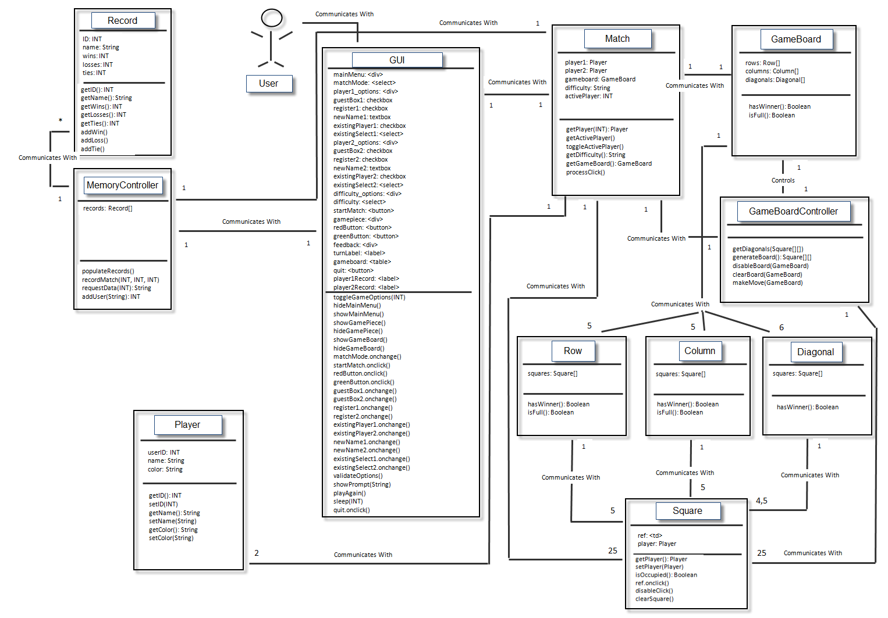

Slide 16
Dynamic Modeling

Slide 17
Software Project Management Plan x x x x

Slide 18
Team Organization
Team Lead Jomar Dizon
Secretary Kevin Quintero
SQA Stephen Gilbert
SQA Zachariah Dohogne
SQA Brent Williams

Slide 19
Estimation Progress
Major Deliverable | Planned Delivery Date | Author | Delivery Mechanism
Team Formation | 08-29-2016 | Jomar | Blackboard
Preliminary Requirements | 10-02-2016 | Shallow Blue | Blackboard
Preliminary Product Specification | 10-02-2016 | Shallow Blue | Blackboard
Preliminary Software Project Management Plan | 10-02-2016 | Shallow Blue | Blackboard
Complete Requirements | 11-06-2016 | Shallow Blue | Blackboard
Complete Product Specification | 11-06-2016 | Shallow Blue | Blackboard
Complete Software Project Management Plan | 11-06-2016 | Shallow Blue | Blackboard
Preliminary Detail Design | 11-06-2016 | Shallow Blue | Blackboard
Preliminary Test Plan | 11-06-2016 | Shallow Blue | Blackboard
Tic Tac Toe Prototype | 11-01-2016 | Shallow Blue | In Class
Product Demo Presentation | 11-01-2016 | Shallow Blue | In Class
Complete Detail Design | 12-04-2016 | Shallow Blue | Blackboard
Complete Test Plan | 12-04-2016 | Shallow Blue | Blackboard
Tic Tac Toe Source Code | 12-04-2016 | Shallow Blue | Blackboard
Testing Records | 12-04-2016 | Shallow Blue | Blackboard
Complete Product Presentation | 11-29-2016 | Shallow Blue | In Class
Tic Tac Toe Competition | 12-06-2016 | Shallow Blue | In Class

Slide 20
Milestones
Tuesday, Nov. 1
Complete requirement
complete Product Specifications
Complete Project Management Plan
Preliminary Detail Design
Preliminary Test Plan
Presentation slides.
Sunday, Oct. 2
Preliminary Requirements with uses cases and non-functional requirements
Preliminary Product Specifications with scenarios, class diagrams, and sequence diagrams,
Preliminary Project Management Plan.
Tuesday, Oct. 9
Prototype

Slide 21
Risk Management
Risk Management Activity | Performed By Whom | Comments
Member Leaves | Team Lead | Duties are divided among capable team members
Data & Documents Loss | Everyone | Is preventable with Cloud management. (Google Docs & Github)
Failed Customer Requirements | Team Lead | Assures consistent scheduling with customer to assure accuracy and coordination with team afterwards.
Team Member Abandons Duties | Everyone | Duties are divided among capable. Team Lead Coordination -> Lead SQA Team Lead Documentation -> Secretary Secretary -> All Duties fall to Team Lead or is divided with Lead SQA SQAs -> All responsible duties are covered with other SQAs and other duties are rearranged appropriately.
Failure in Meeting Attendance | Everyone | Communication is suffice through GroupMe but if consistent absence occurs then further action is required.
Programming Language Expertise | Everyone | If not familiar with programming language used, review material to learn it. Ex: Codecademy, Stack Overflow.
Understanding OOP | Everyone | OOP is essential to the product. Not understanding the fundamentals of OOP could set the team back. Reviewing Absolute Java 5th Ed. by Walter Savitch or any equivalent Java book would help alleviate this problem.

Slide 22
Configuration

Slide 23
Operational Control

Slide 24
Preliminary x x x x

Slide 25
Algo*

Slide 26
Data format

Slide 27
Pseudo Code
Load Application
Player Setup and Difficulty
Start Game
Player 1 and Player 2/Computer make moves
After every move, check possible win conditions
If the no winning combination is found, game continues till winner is found
Game ends when a winner is found
Game ends when tie or all spaces are populated and no win condition
Display game result
Save results to database
Return back to main menu or reset game with same settings

Slide 28
Test Plan x x x x

Slide 29
Test Plan

Slide 30
Demo x x x x

Slide 31
Thank You x x x x

