Slide 1
Case Simple Grocery App for local store
Arturo Mendoza Rendón

Slide 2
Project overview
The product:
Insert a few sentences about the app, website, or other product that you designed and the target users
Preview of selected polished designs.
Project duration:
June 2022 – November 2022

Slide 3
Project overview
The problem:
User´s doesn’t have enough time to shop at their local grocery store due work schedule or daily activities.
The goal:
Let users purchase from their local grocery store and be able choose a curve–pickup or have it delivered after regular business hours.

Slide 4
Project overview
My role:
UX researcher
UX designer
UI development
Responsibilities:
User research
Competitive audit
Wireframing
Conduct a Test research
Prototyping
App development

Slide 5
User research
Personas
Problem statements
User journey maps
Understanding
the user

Slide 6
User research: summary
I start with foundational research trying to figure out what the user needs and how to define those needs in the app. The research focus on three main questions: 1) What are the user´s problems?, 2) How can I solve those problems?, and 3) What should I build?
At the beginning of the project, I assume that only single professionals have troubles doing their groceries, but as the research advance and conduct interviews and surveys where applied, I found out that also none professionals and couples have the same issue.

Slide 7
User research: pain points
1
2
3
4
Go inside the store
No delivery
Work Late
Pick-up service
The only way to get your products is by getting inside the store.
The local store don't have delivery of goods.
The store business hours align with most work schedules.
Don´t like to share their address, some prefer picking up their goods.

Slide 8
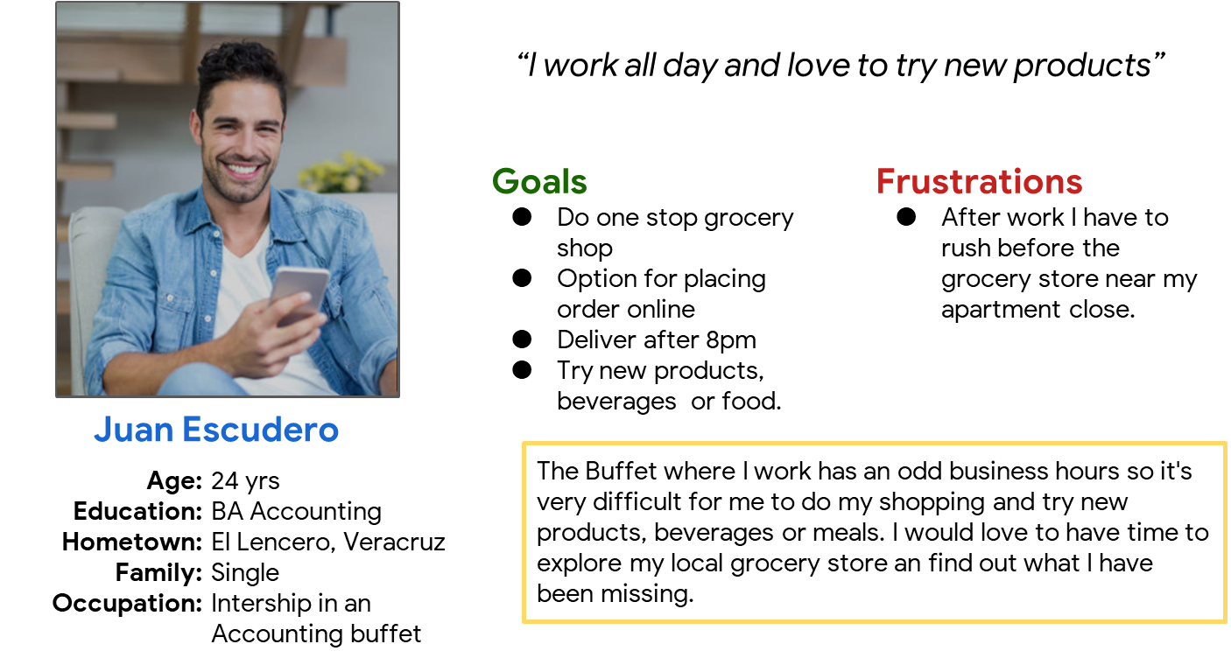
Persona: Juan Escudero
Problem statement:
Juan is a young professional that has an odd working schedule
who needs to choose a delivery that meets his schedule because his goods need to be delivered after the regular store business hours .

Slide 9
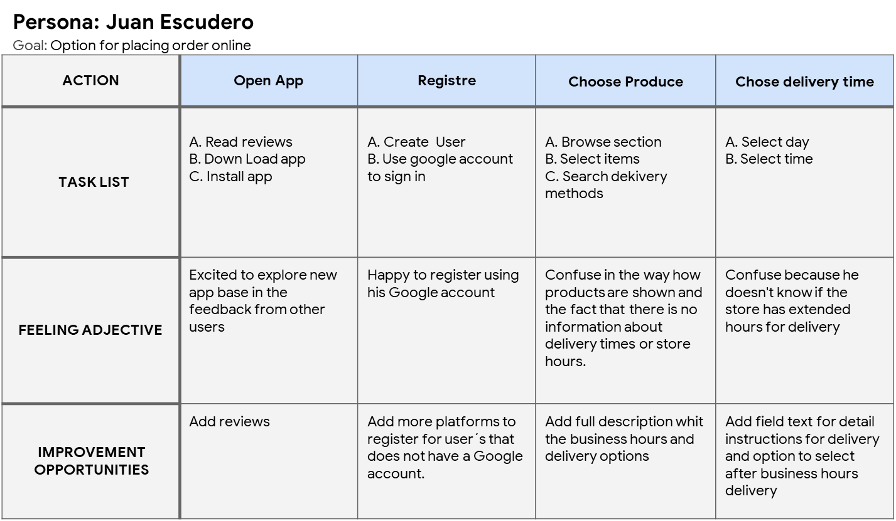
User journey map
The participant was enthusiast, I am trying a new app that might solve his pain points due the incompatibility of schedules whit his local grocery store.
Seems confuse on how to select of where to choose the delivery method.
Image of user journey map

Slide 10
Paper wireframes
Digital wireframes
Low-fidelity prototype
Usability studies
Starting
the design

Slide 11
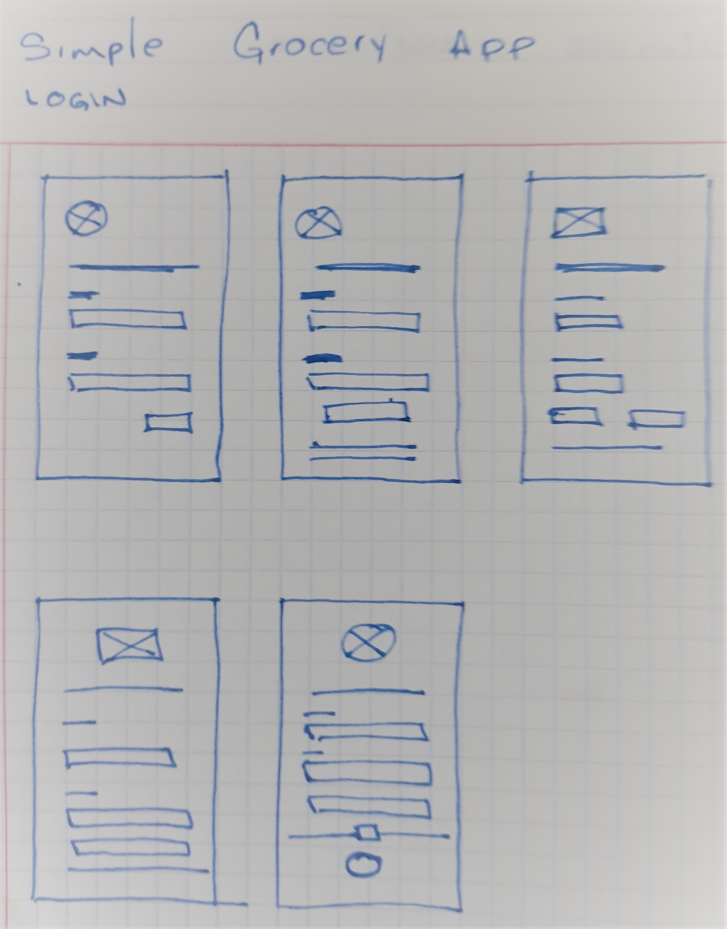
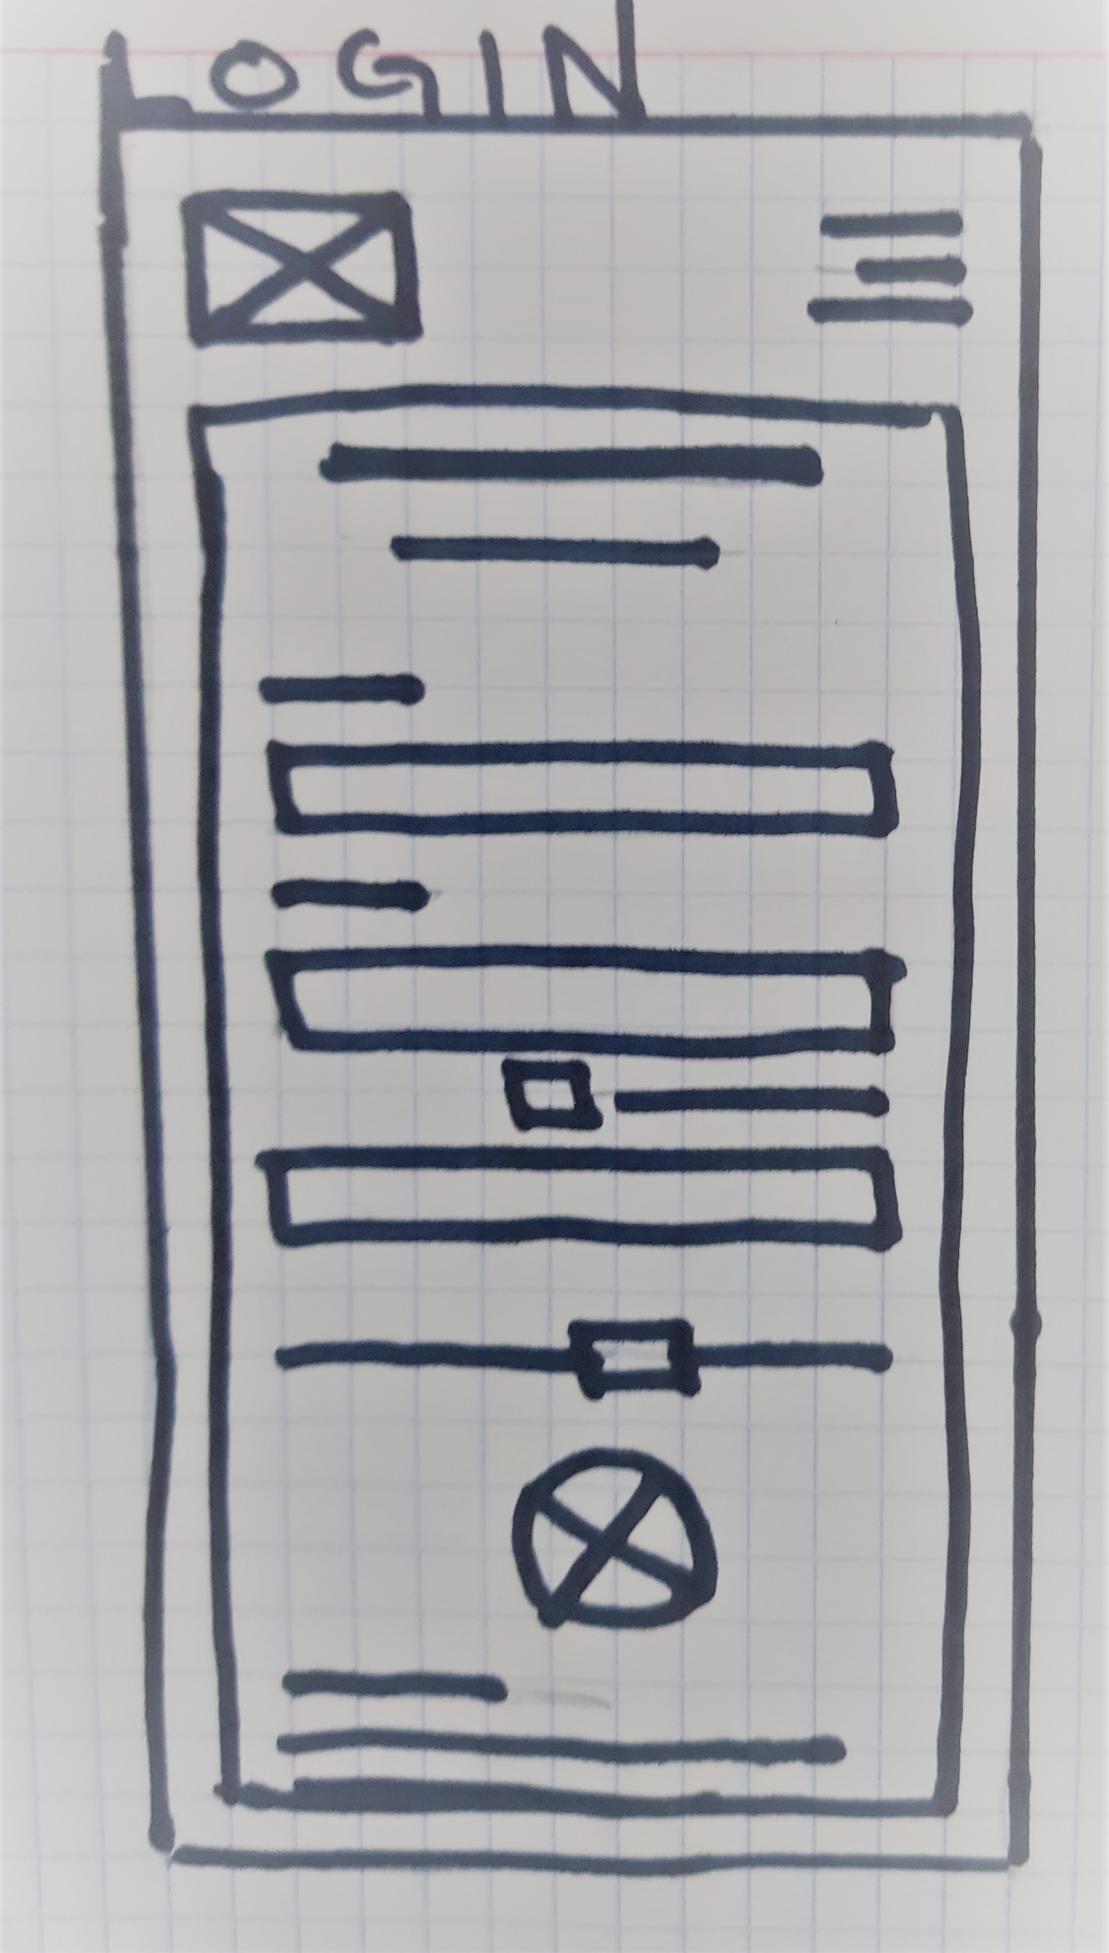
Paper wireframes
In this process I tend to create 4-5 wireframes with my first thoughts and then I pick or discard ideas for the final wireframe for that page in particular.

Slide 12
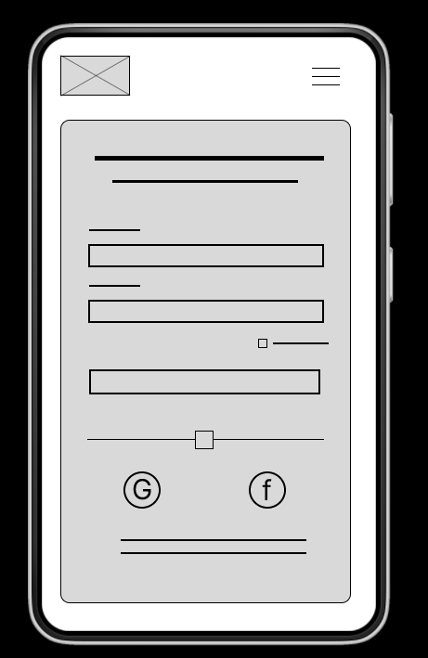
Digital wireframes
From the user journey maps I include an extra option for a mayor social network the sign in button is big to facilitate the action.
Option to be remembered for further logins.
Option to login with an existing account from gmail or Facebook.

Slide 13
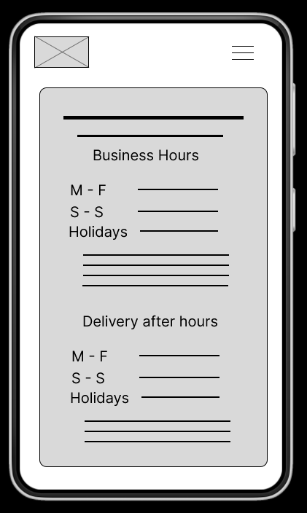
Digital wireframes
Attending Juan´s journey map, I create a detail page for business ours and delivery schedules.
Details for store business hours
Delivery schedules for after regular busines hours

Slide 14
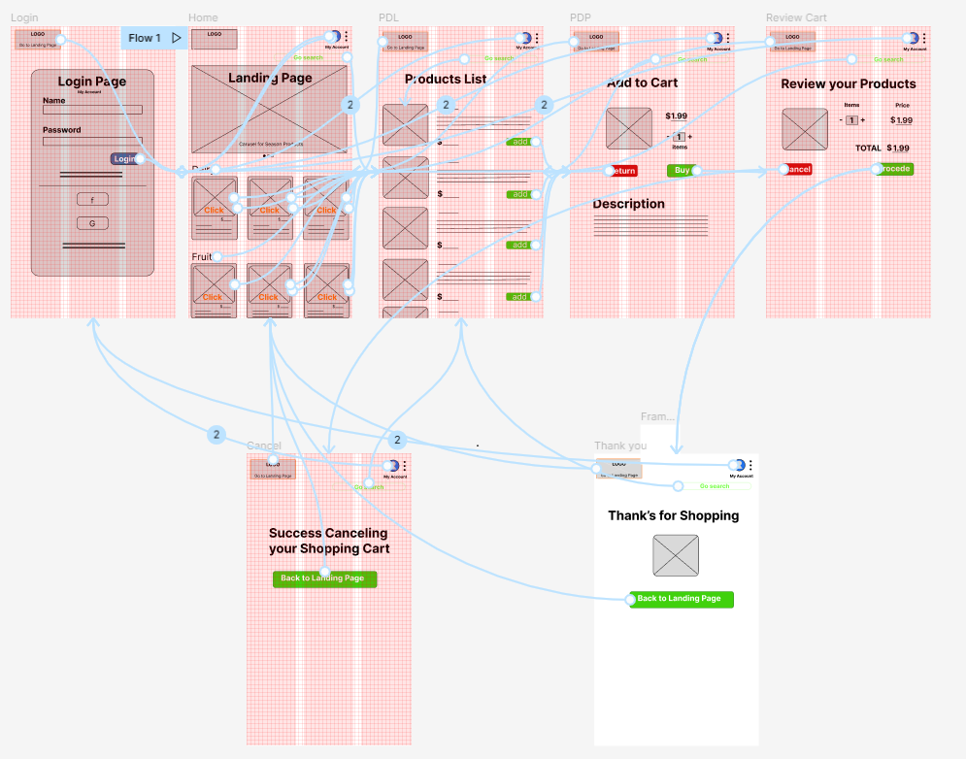
Low-fidelity prototype
Simple app for a local grocery store
Link: https://www.figma.com/proto/l3pK5mguvkgDNtfK0zjHjl/Grocery?node-id=1%3A31&scaling=scale-down&page-id=0%3A1&starting-point-node-id=1%3A31
Screenshot of prototype with connections or prototype GIF

Slide 15
Usability study: findings
The methodology I used was Unmoderated test for a maximum length of 15min. Was a prototype shown to 5 participants between the ages of 23-60 who reside in town. Who do their groceries at least once a week. All of them with different professional or none professional background.
Round 1 findings
Round 2 findings
1
Users’ need a way to review their order.
1
Senior users needs biger fonts.
Users’ need a cues when they cancel a product.
Color schema was to light at direct sun light.
2
2
3
Users´need to add more than one item at the time.
3
Not all users´ had Credit or debit card.

Slide 16
Refining
the design
Mockups
High-fidelity prototype
Accessibility

Slide 17
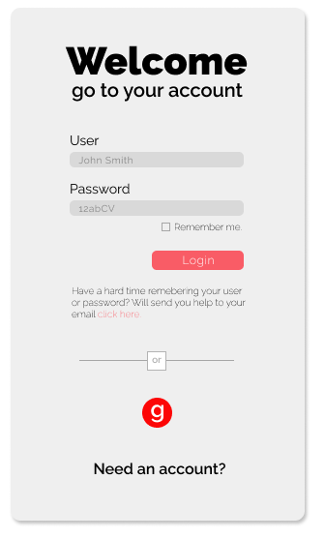
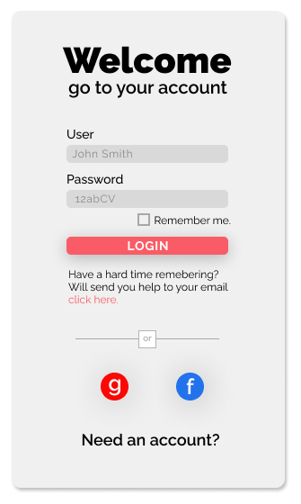
Mockups
Before usability study
After usability study
For senior user, the small font was too hard to read so I apply the Material Design for Android principles to typography and shadows. Also shortened text for readability

Slide 18
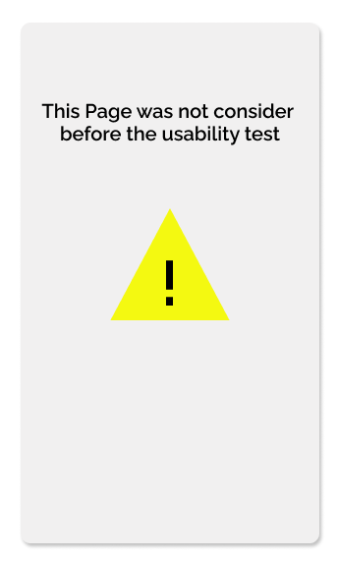
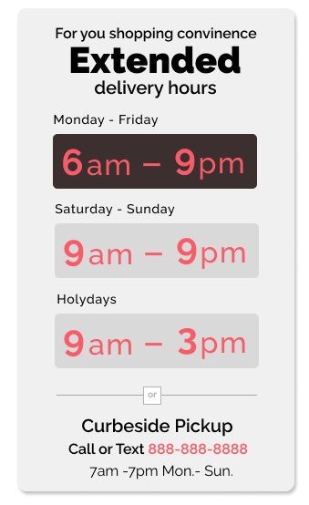
Mockups
Before usability study
After usability study
The initial wireframe and prototype didn´t consider this page as result from the usability test, I find this pain point to resolve.
Image of selected screen after usability study

Slide 19
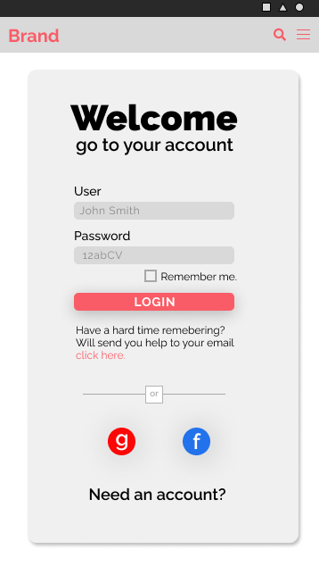
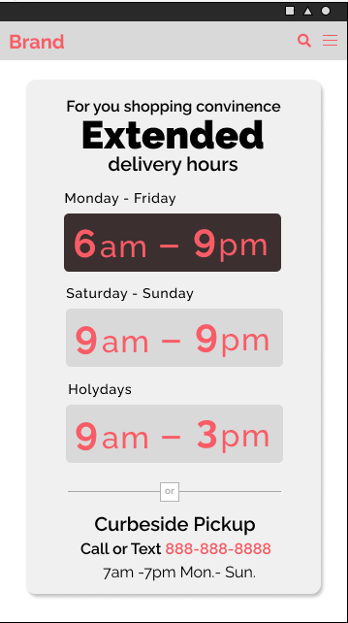
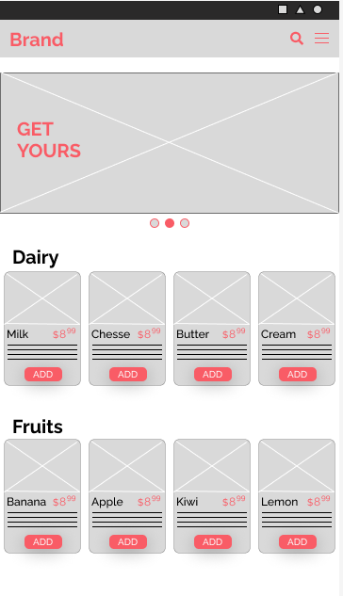
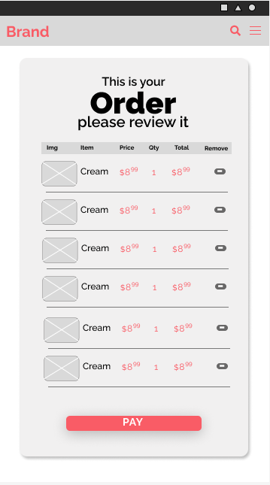
Mockups
Main mockup screen for display
Main mockup screen for display
Main mockup screen for display

Slide 20
High-fidelity
prototype
[Link to high-fidelity prototype]
Screenshot of prototype with connections or prototype GIF

Slide 21
Accessibility considerations
1
2
3
Use Icons and text to draw users´ attention
Luminosity contrast at least of 4.5:1 to improve the readability
Infrement font size and letter spacing to improve readability.

Slide 22
Going forward
Takeaways
Next steps

Slide 23
Takeaways
Impact:
I create an app that can open and explore the online grocery shopping for my small town, improve revenues, and increase customer satisfaction and loyalty.
What I learned:
UX design involves more steps than just Create pleasant graphics It's a whole process that ends in a high-fidelity prototype before going to die UI stage. Always keeping the user front and center.

Slide 24
Next steps
1
2
3
Start coding the mobile app.
Design the UX desktop site.
Develop the desktop site and deploy both.

Slide 25
Insert a few sentences summarizing the next steps you would take with this project and why. Feel free to organize next steps in a bullet point list.
Let’s connect!
Thank you for the time you took to read my project, hope that gives you an overview of how a UX/UI design is developed.
Contact information.
mail. arturomendozarendon@gmail.com
phone number 2288378109.

Slide 26
Thank you!

