Slide 1
Glean
8–10%
of global greenhouse
gas emissions from food waste
Less waste. More good.
$1T+
lost to food waste
every year worldwide
Campus Food Waste Tracker
& Smart Redistribution Platform
40%
of institutional food
never reaches a plate
Suleiman Mejd, Donavon Burton

Slide 2
The Problem
22,000,000+ pounds of food is wasted at college campuses every year, according to the National Resource Defense Council.
Universities recognize the waste but lack clear ways to reduce it, as current tracking methods are manual and complicated.
There is no communication between campuses who have a surplus of food and the people who need it

Slide 3
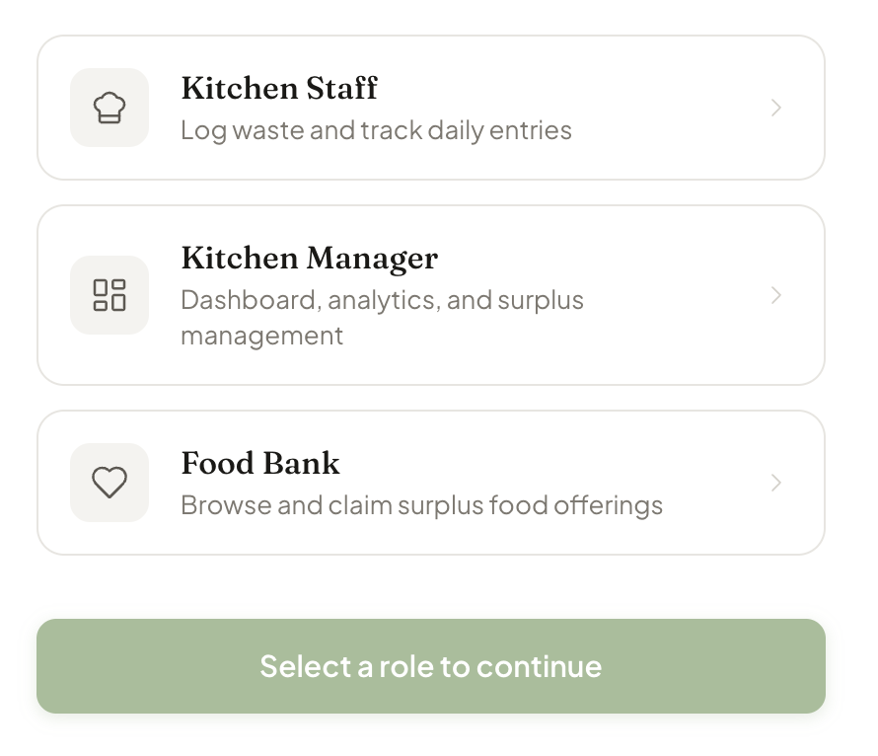
The Solution: Glean
Glean is a simple, three-part system designed to fit into the existing workflow of a busy campus kitchen.
Staff
Managers
Use a simple mobile UI to log food waste at the end of the day
Tags food by type and estimated weight
E.g (Protein, Veg, Grain)
Immediately notifies manager of available food
View live analytics and cost-leak patterns via ‘ReCharts’ library
Receive automated suggestions from OpenAI to reduce overall waste
Approve and push food to local food banks
Food Banks
Browse a real time feed of available surplus food
Sorts by dietary needs and distance with one click

Slide 4
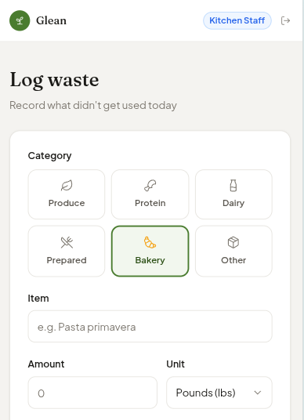
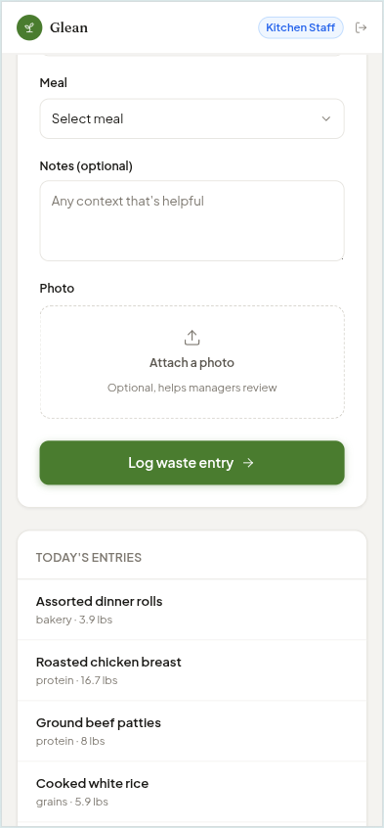
Kitchen Staff Logging
Glean’s fast mobile UI makes logging food for kitchen staff hassle free
Supports multiple entry types to ensure data accuracy regardless of how the kitchen preps its food.
(e.g., "5 lbs" or "20 Portions")
Add photos to document food quality and amount.
Use pre-defined inventory tags to accelerate entry and ensure high data accuracy for better sorting.
(e.g. “Protein”, “Dairy”, “Baked Goods")

Slide 5
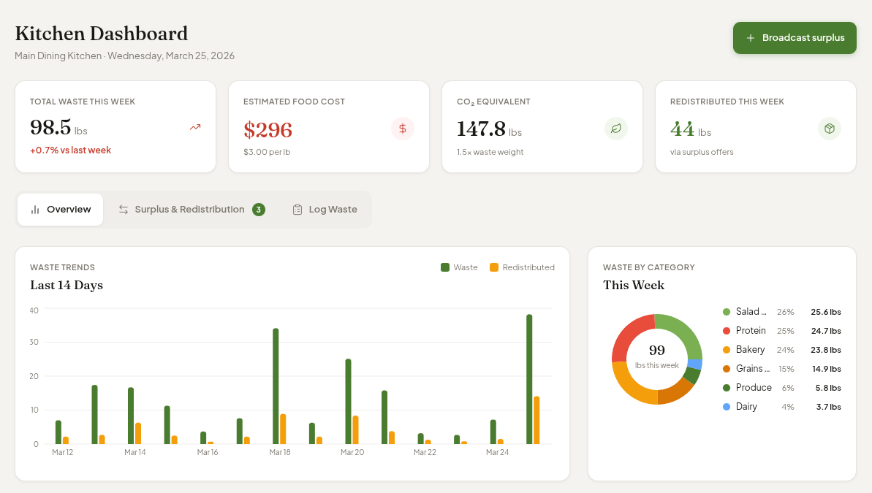
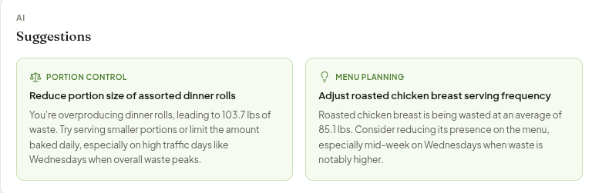
The Manager Dashboard
Convert wasted food into real-time financial data to pinpoint budget leaks instantly.
Uses OpenAI to analyze waste patterns and suggest precise production cuts for the next cycle.
Instantly review and verify kitchen logs before they are broadcast to food banks in the local area.

Slide 6
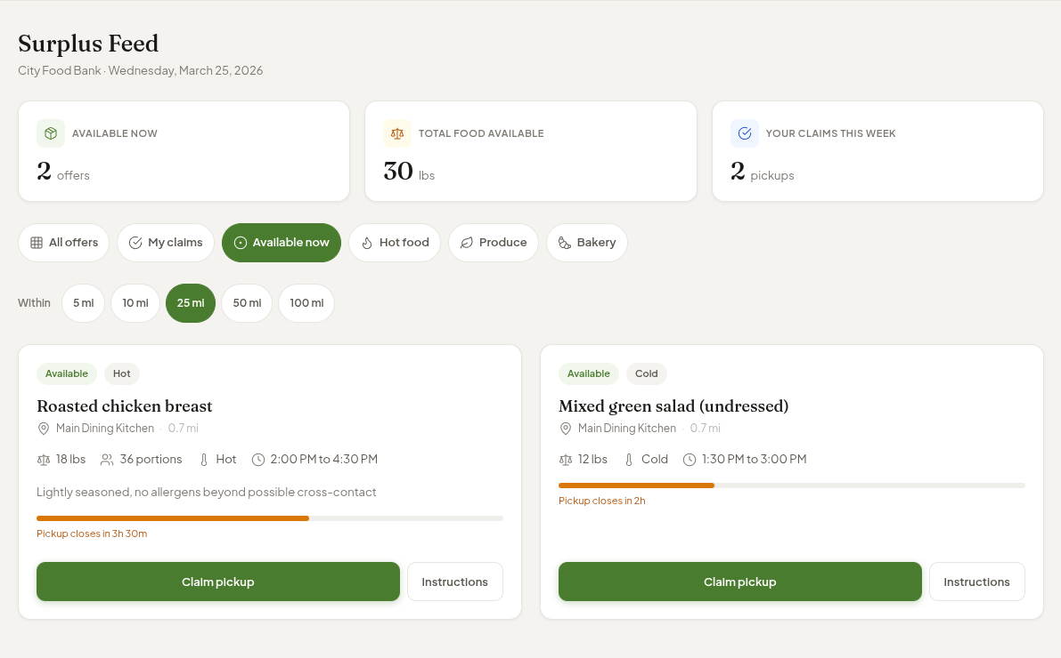
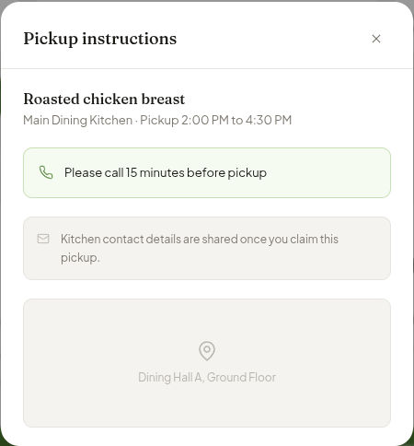
Food Bank Distribution
The Food Bank Dashboard provides food banks with efficient, real-time access to surplus food from university kitchens.
Access a live dashboard of available food, categorized by weight and ingredient type.
Reserve specific food batches instantly to ensure a coordinated pickup.
Track all active claims of food collected each week for easy reporting.

Slide 7
The App Flow
Kitchen Staff
Managers
Food Banks
Records the surplus at the source by logging weights and snapping photos, instantly pushing real-time data to the management layer.
Analyzes the data with the help of OpenAI to identify consistent waste patterns and provides clear instructions for food banks to pick up safe, high-quality batches.
Completes the cycle by browsing the filtered marketplace to claim available food, manage incoming donations, and coordinate seamless pickups for their community.
Glean’s design transforms raw kitchen data into actionable instructions that bridge the gap between surplus and community need.

Slide 8
The Tech Stack
Core Infrastructure
AI
Next.js 14
TypeScript
React 18
OpenAI SDK v4
Model: gpt‑4o
UI & Styling
Recharts
Lucide
Zustand v4
Tailwind CSS v3

Slide 9
Plans for the Future
Glean is built as a production-ready foundation, engineered to scale seamlessly from a single kitchen to a high-impact, multi-campus recovery network.
Production-Ready Changes:
Replacing Zustand mock data with a live PostgreSQL database (via Supabase) to ensure every surplus entry is saved and searchable.
Implementing real authentication and Role-Based Sessions for Kitchen Staff, Managers, and Food Banks to ensure secure, private account access using auth.js.
Scaling for Growth:
Updating the database schema to enable multi-campus support, allowing a single manager to oversee multiple dining halls across an entire university system.
Exploring Expo as a potential framework to port mobile-first web code into a native app for kitchen tablets.

Slide 10
Thank You!
Demo Presentation
Questions or Comments?

